Slide 1
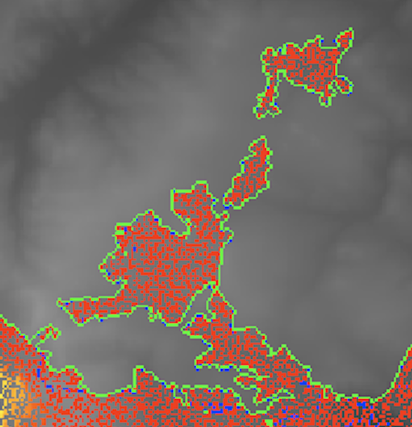
A
B
C

Slide 2
