Slide 1


Review 5 M2 ERTS PROJECT
Validation of EDF
&
Implementation of ED-H on Xenomai
Debus Alexy
Rayella Niranjan
25/01/2022

Slide 2


Our team
C
Debus Alexy
Rayella Niranjan
C dev.
C dev.

Slide 3
Table of contents
1 Context
2 Key question
3 Approach
4 Objectives
5 Planning
6 Progress
7 Project evolutions
8 Presentation of sprint 4

Slide 4
1. Context
Meeting with the professor (M.Queudet) on october the 15th :
The interest here is to put into applications a dynamic-priority energy aware scheduling strategie ED-H through the use of a Real-time kernel.
We will use Xenomai, I mean a dual kernel configurations : a Linux kernel (using Ubuntu distributions) supplementing by a RT co-kernel (Cobalt)
A Master student recently integrated EDF into Xenomai…

Slide 5


2. Key question
​
​
We need to have ED-H working without affecting integrity of other scheduling policies (fixed priority, EDF).
​
How could we manage to integrate/validate ED-H on Xenomai ?
Et si je n’ai pas
de robot réel ?
Et si je n’ai pas
de robot réel ?

Slide 6
3. Approach
Learn about Xenomai
Validate/Assert EDF implementation on Xenomai
Understand EDF implementation
Learn about ED-H
Implement ED-H In Xenomai
Validate/Assert ED-H implementation on Xenomai
The project will be split into sprints (1 sprint = 2 weeks)

Slide 7
4. Primary objectives
1) Installation of modified Xenomai and validation for EDF integration
Metric : report for modifications added to have a functional installation + tests to validate xenomai-EDF (report + source code)
Estimated time : 10h
2) Development of a linux module to grab battery information and transfer to Cobalt
Metric : guideline for the creation/usee of the linux module + source code for the linux module
Estimated time : 25h
3) ED-H implementation and validation on Xenomai
Metric : guideline for the creation/use of the linux module + source code for the linux module + source code for ED-H implementation + source code for fake battery module
Estimated time : 50h
Remaining time : 15h (Redaction of the final report, PWP presentation, handle git repo.)
Primary objectives are established at the beginning of the project

Slide 8
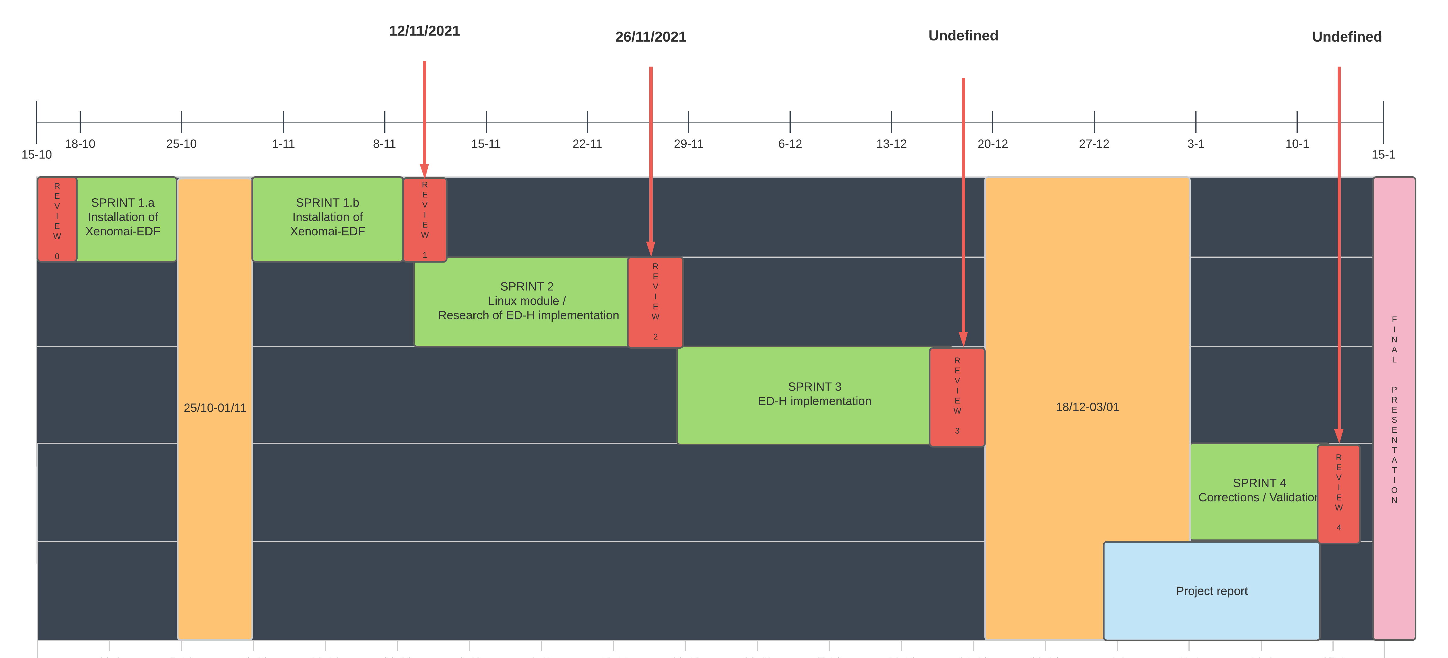
5. Planning
Provisional planning:

Slide 9
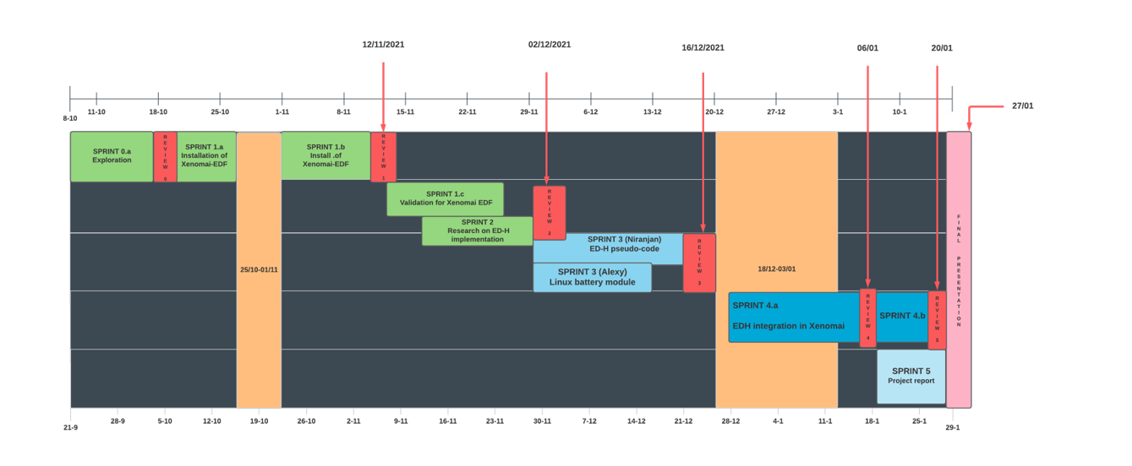
5. Planning
Effective planning:

Slide 10

6. Progress
0) Development of linux module to grab battery information
Results: Start implementation of a simple linux module (using kernel header file linux/power_supply)
2 weeks (08/10 - 17/10)
- In charge : Debus Alexy
1) Installation of Xenomai EDF
Results: Successfully installed Xenomai and validate EDF for no-premption test cases
3 weeks (18/10 - 11/11)
In charge : Debus Alexy & Rayella Niranjan
2) Validation of Xenomai EDF
Results: Validate EDF for premption test cases
3 weeks (13/11 - 26/11)
- In charge : Debus Alexy
3) Linux battery module
Results: Working linux module to receive battery information
2 weeks (29/11 - 13/12)
- In charge : Debus Alexy

Slide 11
6. Progress
4) ED-H source code integration in Xenomai + battery module deployment
Results: source code for ED-H on Xenomai
(+ communication with battery module and/or fake battery module)
2 weeks ++ (17/12 - …)
- In charge : Debus Alexy & Rayella Niranjan

Slide 12
7. Project evolution
Actual : (17/12 – 06/01) ED-H understanding
1. Calculating the scheduling of the task (like E0, Emax, Emin, gw e.tc.).
2. Output of the Scheduling ED-H
WAITING state: Executing the next ready task from runqueue for execution (Checked for each time interval)
CHECK_ENERGY state: Checking the energy level of reservoir before task is executed and predicting
the residual energy after the execution of task
EXECUTE_JOB state: Authorizing to execute task
CHECK_SLACK_ENERGY state: Calculating SE
CHECK_SLACK_TIME state: Calculating ST
EXECUTE_CYCLE_BY_CYCLE state: Authorizing to execute job, only in the case of preemption
Future (07/01 – 20/01) :
Help Alexy to develop/validate source code for ED-H integration (eg. Compute slack time, slack energy...)
Redaction of project documentation (using LateX)

Slide 13
7. Project evolution
Actual : (17/12 – 06/01)
Add source code for ED-H integration in Xenomai source code
Add FakeBatteryModule to github repo.
Future (07/01 – 20/01) :
Finish ED-H source code + compilation of the source code
Documentation

Slide 14
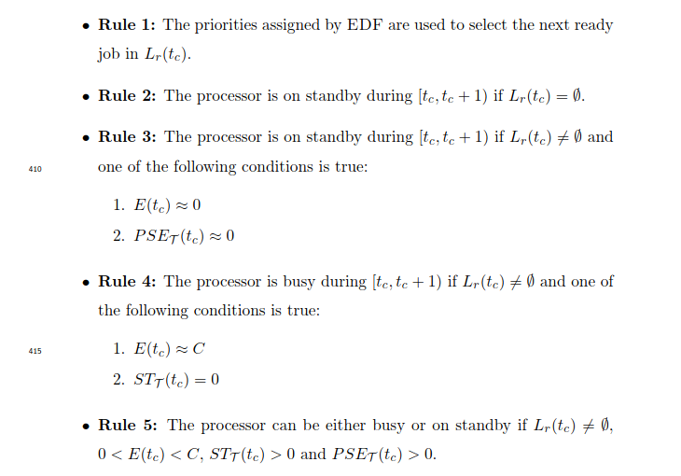
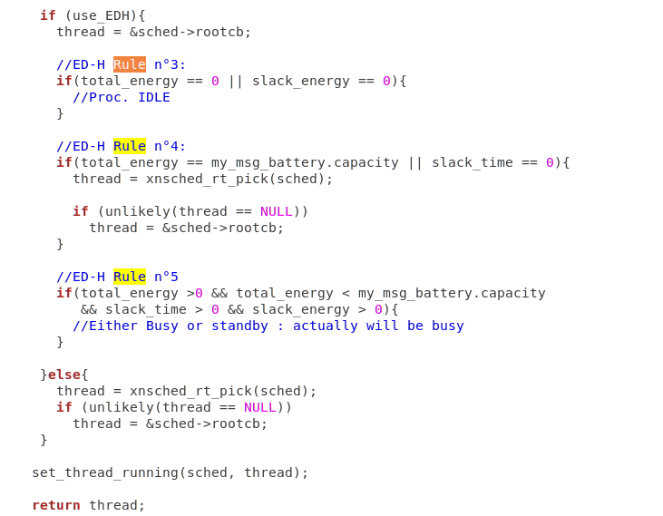
8. Presentation of sprint 4

Slide 15
9. Future
0) Cheddar tool enable ED-H simulations
1) FakeBattery module to handle battery change over time

Slide 16
Thanks for your attention.
Do you have any questions ?​

Slide 17
EDF files
Main files to check for modifications :
kernel/cobalt/sched-dyna.c
kernel/cobalt/sched.c
kernel/cobalt/posix/thread.c
kernel/cobalt/thread.c
lib/alchemy/task.c
include/cobalt/kernel/sched-dyna.h
include/cobalt/kernel/sched.h
include/cobalt/kernel/thread.h
include/alchemy/task.h
Minor files to check for modifications :​
​
include/mercury/boilerplate/sched.h​
kernel/cobalt/posix/sched.c​ ​
include/cobalt/uapi/sched.h​
include/cobalt/kernel/schedparam.h​
​
include/cobalt/kernel/list.h​
include/cobalt/kernel/schedqueue.h​ ​
lib/copperplate/internal.c​
lib/copperplate/threadobj.c​

Slide 18
Deliverables

