Slide 1


Review 5 M2 ERTS PROJECT
Validation of EDF
&
Implementation of ED-H on Xenomai
Debus Alexy
Rayella Niranjan
25/01/2022

Slide 2


Our team
C
Debus Alexy
Rayella Niranjan
C dev.
C dev.

Slide 3
Table of contents
1 Context
2 Key question
3 Approach
4 Objectives
5 Planning
6 Progress
7 Project evolutions
8 Presentation of sprint 4

Slide 4
1. Context
Meeting with the professor (M.Queudet) on october the 15th :
The interest here is to put into applications a dynamic-priority energy aware scheduling strategie ED-H through the use of a Real-time kernel.
We will use Xenomai, I mean a dual kernel configurations : a Linux kernel (using Ubuntu distributions) supplementing by a RT co-kernel (Cobalt)
A Master student recently integrated EDF into Xenomai…

Slide 5


2. Key question
​
​
We need to have ED-H working without affecting integrity of other scheduling policies (fixed priority, EDF).
​
How could we manage to integrate/validate ED-H on Xenomai ?
Et si je n’ai pas
de robot réel ?
Et si je n’ai pas
de robot réel ?

Slide 6
3. Approach
Learn about Xenomai
Validate/Assert EDF implementation on Xenomai
Understand EDF implementation
Learn about ED-H
Implement ED-H In Xenomai
Validate/Assert ED-H implementation on Xenomai
The project will be split into sprints (1 sprint = 2 weeks)

Slide 7
4. Primary objectives
1) Installation of modified Xenomai and validation for EDF integration
Metric : report for modifications added to have a functional installation + tests to validate xenomai-EDF (report + source code)
Estimated time : 10h
2) Development of a linux module to grab battery information and transfer to Cobalt
Metric : guideline for the creation/usee of the linux module + source code for the linux module
Estimated time : 25h
3) ED-H implementation and validation on Xenomai
Metric : guideline for the creation/use of the linux module + source code for the linux module + source code for ED-H implementation + source code for fake battery module
Estimated time : 50h
Remaining time : 15h (Redaction of the final report, PWP presentation, handle git repo.)
Primary objectives are established at the beginning of the project

Slide 8
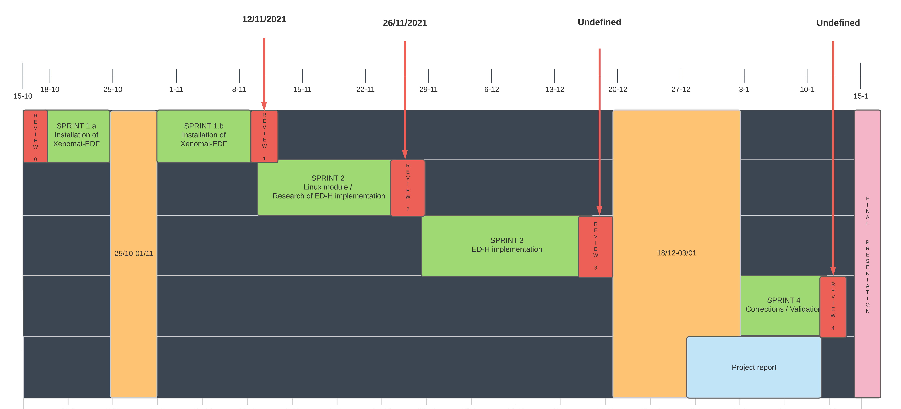
5. Planning
Provisional planning:

Slide 9
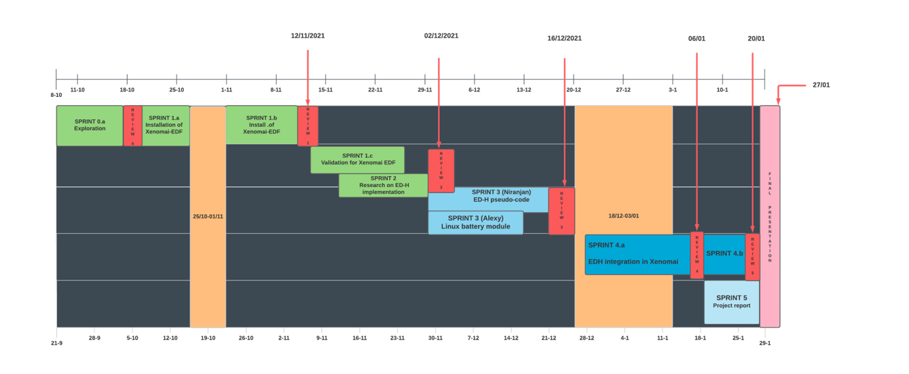
5. Planning
Effective planning:

Slide 10

6. Progress
0) Development of linux module to grab battery information
Results: Start implementation of a simple linux module (using kernel header file linux/power_supply)
2 weeks (08/10 - 17/10)
- In charge : Debus Alexy
1) Installation of Xenomai EDF
Results: Successfully installed Xenomai and validate EDF for no-premption test cases
3 weeks (18/10 - 11/11)
In charge : Debus Alexy & Rayella Niranjan
2) Validation of Xenomai EDF
Results: Validate EDF for premption test cases
3 weeks (13/11 - 26/11)
- In charge : Debus Alexy
3) Linux battery module
Results: Working linux module to receive battery information
2 weeks (29/11 - 13/12)
- In charge : Debus Alexy

Slide 11
6. Progress
4) ED-H source code integration in Xenomai + battery module deployment
Results: source code for ED-H on Xenomai
(+ communication with battery module and/or fake battery module)
4 weeks ++ (17/12 - 25/01)
- In charge : Debus Alexy

Slide 12
7. Project evolution
Actual : (06/01 - 25/01) ED-H understanding
1. ED-H logic part.
2. End of project report
Future (25/01 – ...) :
End report redaction / Add all files/documentations in Github repo.

Slide 13
7. Project evolution
Actual : (06/01 - 25/01)
Modification for Alchemy API
Correction of batt.c source file for XDDP communication
Compilation (Kernel linux / Xenomai source code)
Report redaction
Add patch for EDF / ED-H
Future (25/01 – ...) :
Test XDDP comm. + end project documentation

Slide 14
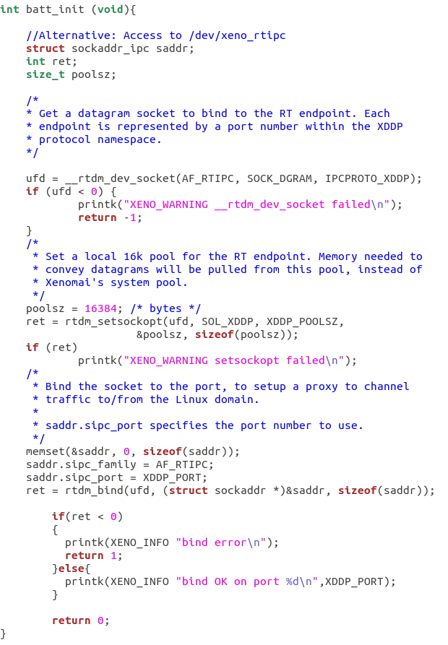
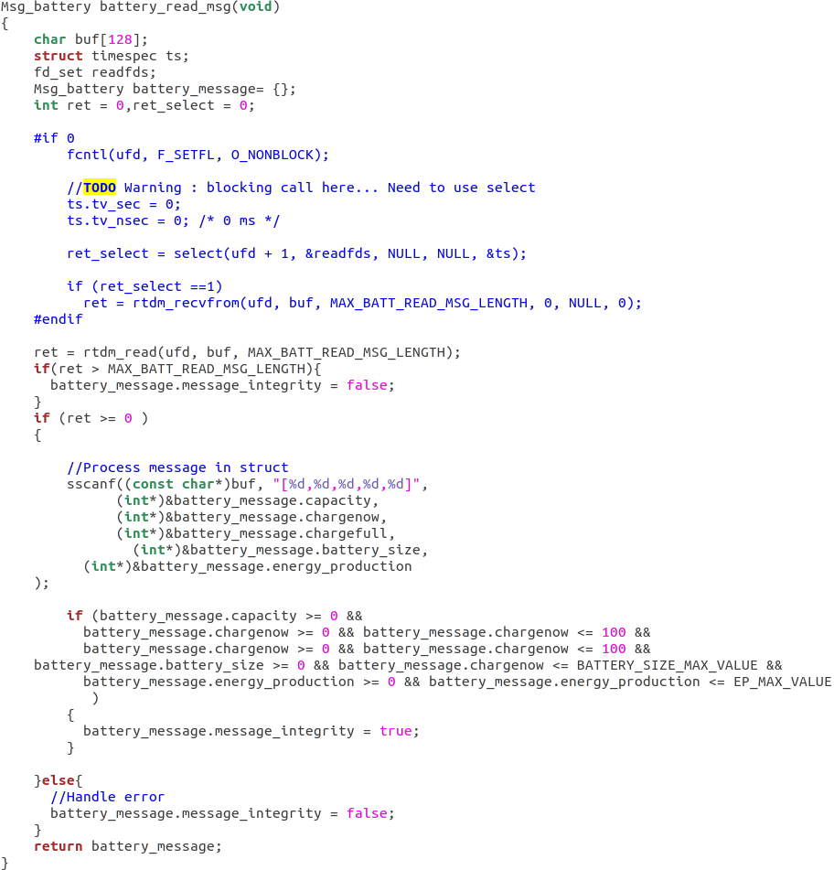
8. Presentation of sprint 4.b
Modification for battery source file

Slide 15
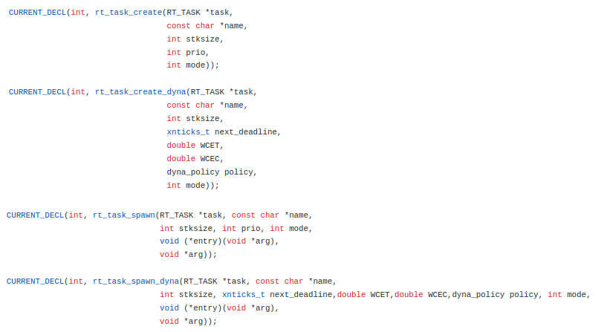
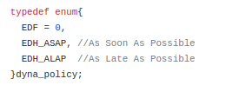
8. Presentation of sprint 4.b
Modification for Alchemy API
RTIME

Slide 16
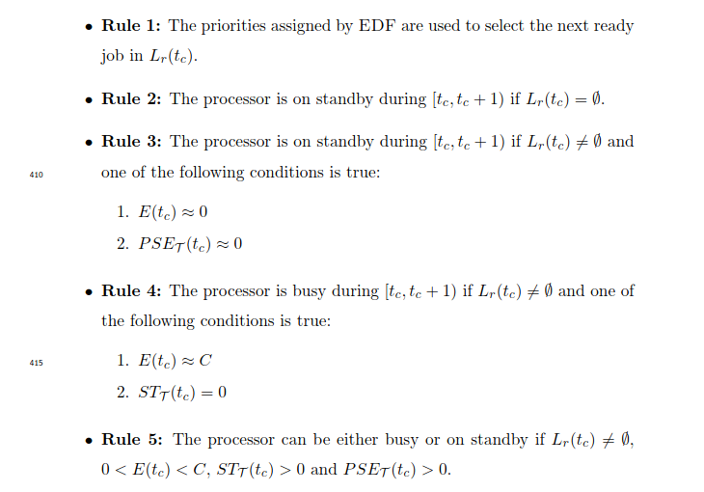
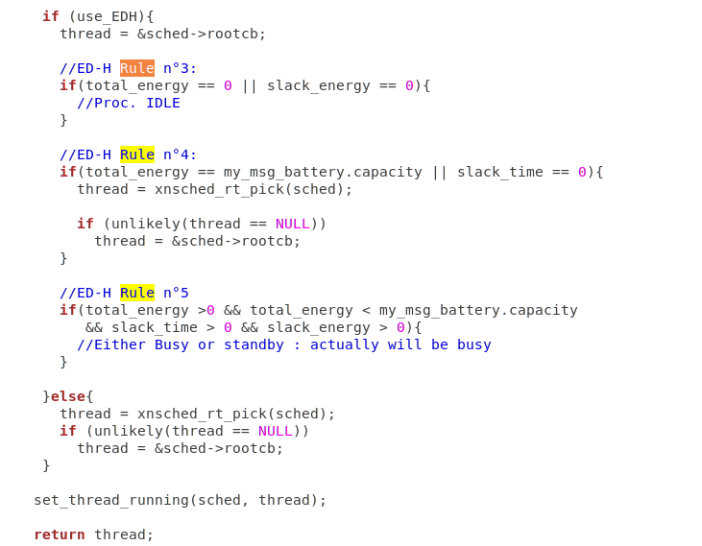
8. Presentation of sprint 4.b
Function xnsched_pick_next in kernel/cobalt/sched.c

Slide 17
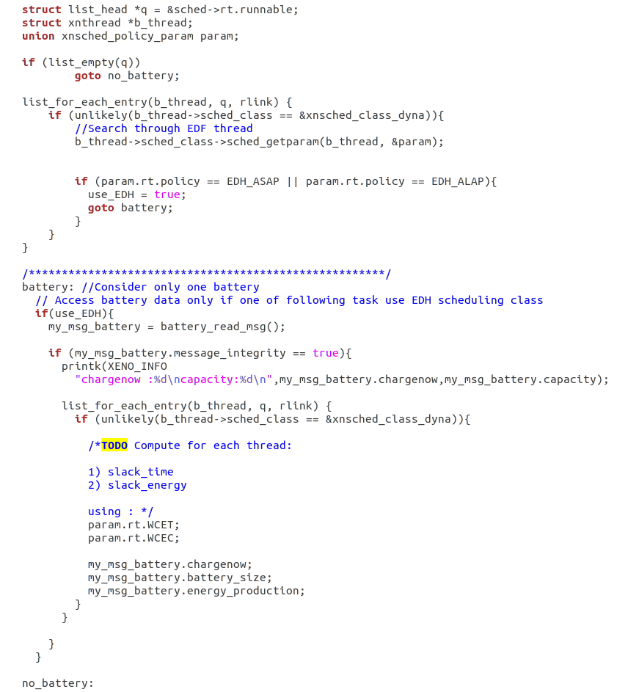
9. Future
Function xnsched_pick_next in kernel/cobalt/sched.c
Compute slack_time & slack_energy for each task

Slide 18
Thanks for your attention.
Do you have any questions ?​

Slide 19
EDF files
Main files to check for modifications :
kernel/cobalt/sched-dyna.c
kernel/cobalt/sched.c
kernel/cobalt/posix/thread.c
kernel/cobalt/thread.c
lib/alchemy/task.c
include/cobalt/kernel/sched-dyna.h
include/cobalt/kernel/sched.h
include/cobalt/kernel/thread.h
include/alchemy/task.h
Minor files to check for modifications :​
​
include/mercury/boilerplate/sched.h​
kernel/cobalt/posix/sched.c​ ​
include/cobalt/uapi/sched.h​
include/cobalt/kernel/schedparam.h​
​
include/cobalt/kernel/list.h​
include/cobalt/kernel/schedqueue.h​ ​
lib/copperplate/internal.c​
lib/copperplate/threadobj.c​

Slide 20
Deliverables

