Slide 1


MERE PROJECT : Implementation of ED-H on Xenomai
Debus Alexy
Rayella Niranjan
12/11/2021

Slide 2


Our team
C
Debus Alexy
Rayella Niranjan
C dev.
C dev.

Slide 3
Table of contents
1 Context
2 Key question
3 Approach
4 Objectives
5 Planning
6 Progress
7 Project evolutions
8 Presentation of sprint 1

Slide 4
1. Context
Meeting with the professor (M.Queudet) on october the 15th :
The interest here is to put into applications a dynamic-priority energy aware scheduling strategie ED-H through the use of a Real-time kernel.
We will use Xenomai, I mean a dual kernel configurations : a Linux kernel (using Ubuntu distributions) supplementing by a RT co-kernel (Cobalt)
A Master student recently integrated EDF into Xenomai…

Slide 5


2. Key question
​
​
We need to have ED-H working without affecting integrity of other scheduling policies (fixed priority, EDF).
​
How could we manage to integrate/validate ED-H on Xenomai ?
Et si je n’ai pas
de robot réel ?
Et si je n’ai pas
de robot réel ?

Slide 6
3. Approach
Learn about Xenomai
Validate/Assert EDF implementation on Xenomai
Understand EDF implementation
Learn about ED-H
Implement ED-H In Xenomai
Validate/Assert ED-H implementation on Xenomai
The project will be split into sprints (1 sprint = 3-4 weeks)

Slide 7
4. Primary objectives
1) Installation of modified Xenomai and validation for EDF integration
Metric : report for modifications added to have a functional installation + tests to validate xenomai-EDF (report + source code)
Estimated time : 10h
2) Development of a linux module to grab battery information and transfer to Cobalt
Metric : guideline for the creation/usee of the linux module + source code for the linux module
Estimated time : 25h
3) ED-H implementation and validation on Xenomai
Metric : guideline for the creation/usee of the linux module + source code for the linux module
Estimated time : 50h
Remaining time : 15h (Redaction of the final report, PWP presentation, handle git repo.)
Primary objectives are established at the beginning of the project

Slide 8
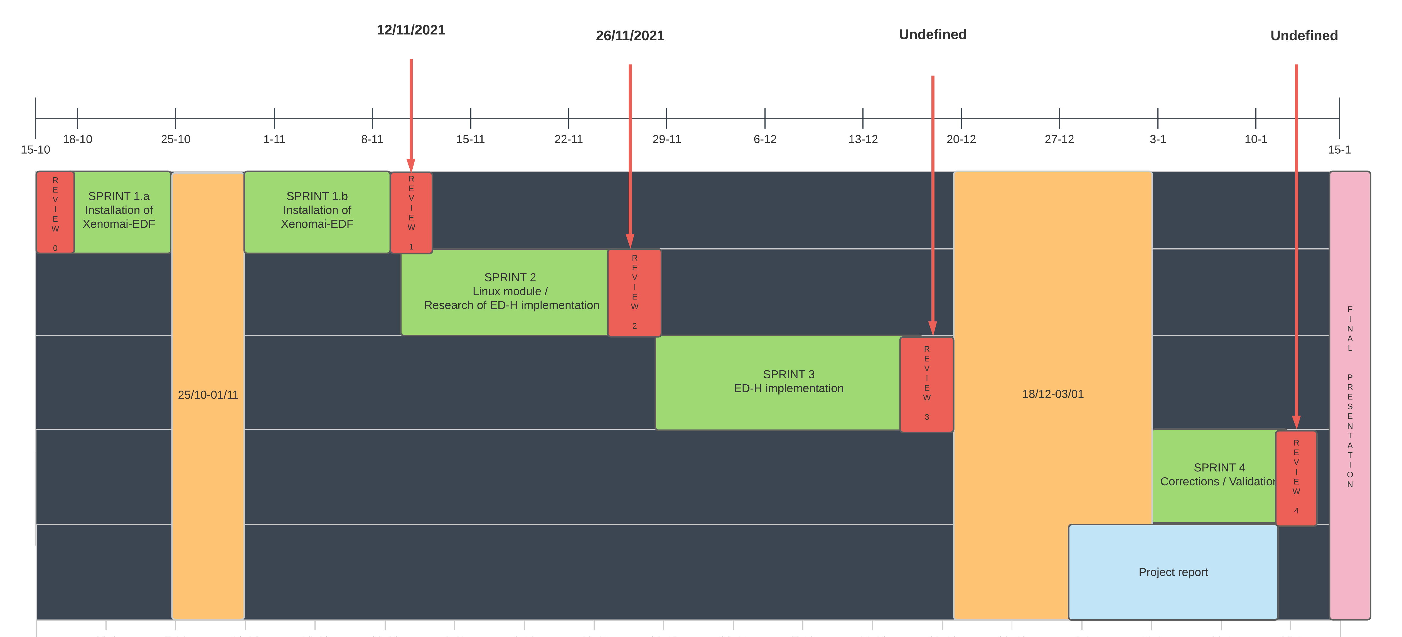
5. Planning
Provisional planning:

Slide 9
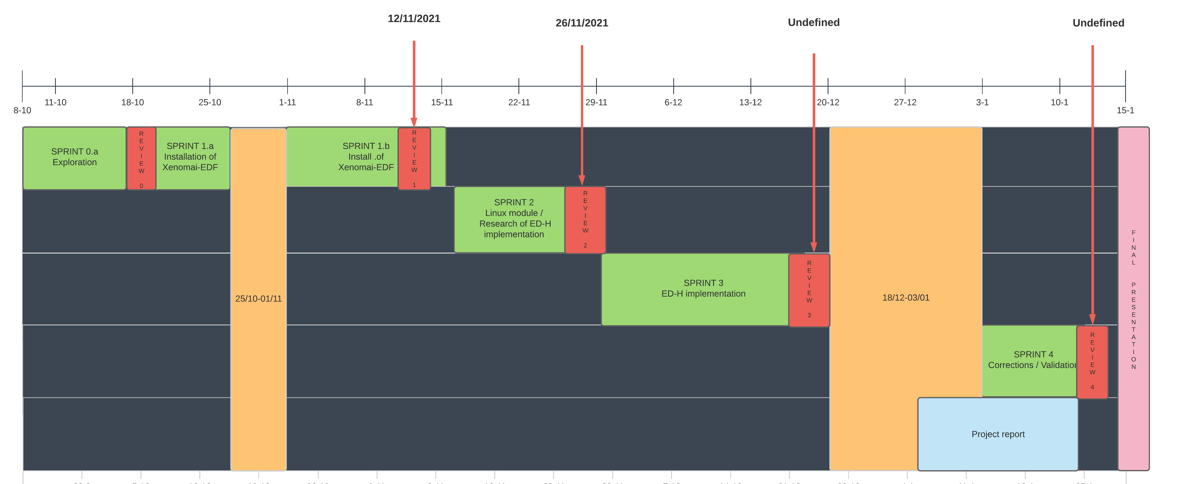
5. Planning
Effective planning :

Slide 10

6. Progress
0) Development of linux module to grab battery information
Results: Start implementation of a simple linux module (using kernel header file linux/power_supply)
2 weeks (08/10 - 17/10)
- In charge : Debus Alexy
1) Installation of Xenomai EDF and validation of EDF alg.
Results: Successfully installed Xenomai and validate EDF for no-premption test cases
3 weeks (18/10 - 11/11
- In charge : Debus Alexy & Rayella Niranjan

Slide 11
7. Project evolution
Actual :
Working on linux module - 8h
Installation of Standard Xenomai - 2h
Resolved problems for install. of EDF-Xenomai -20h
Source code to validate EDF implementation -6h
Future (11/11 - 26/11) : Linux module + Read EDF source files

Slide 12
7. Project evolution
Actual : installation of xenomai and EDF-Xenomai.
1. Installation of Linux Kernel - 8h
2. Installation of Xenomai - 4h
3. Installation of Xenomai-EDF Installation,
meeting with Alexy (compilation problems) - 18h
Future (11/11 - 26/11) : ED-H Implementation

Slide 13
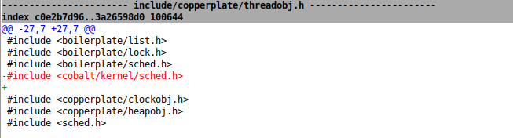
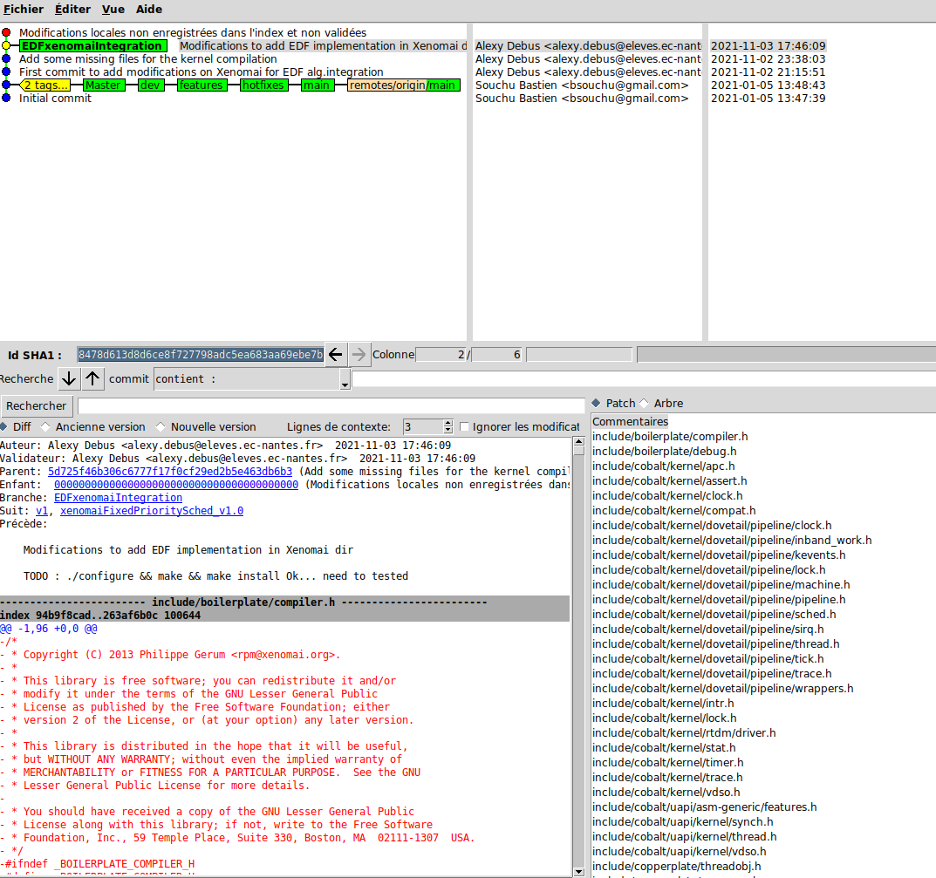
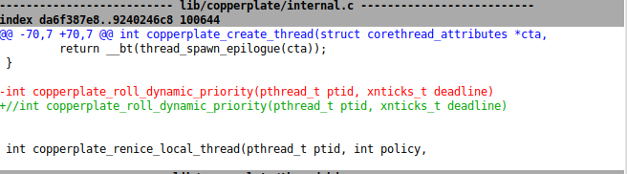
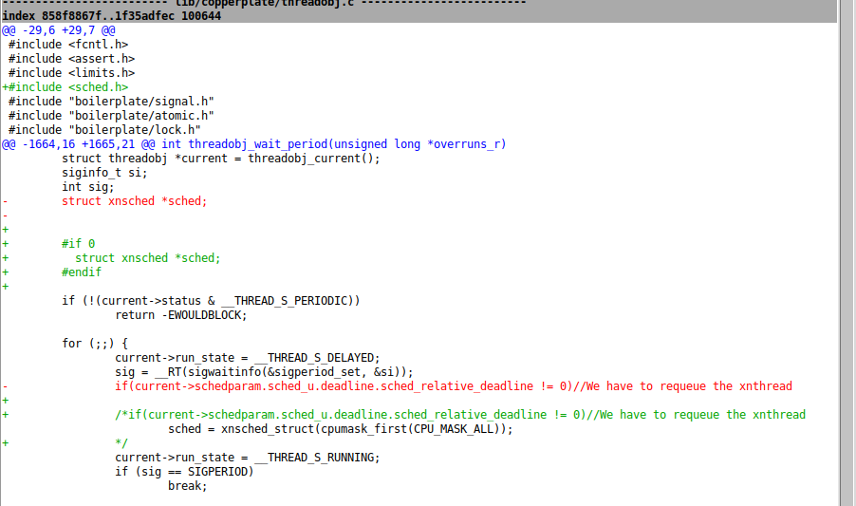
8. Presentation of sprint 1

Slide 14
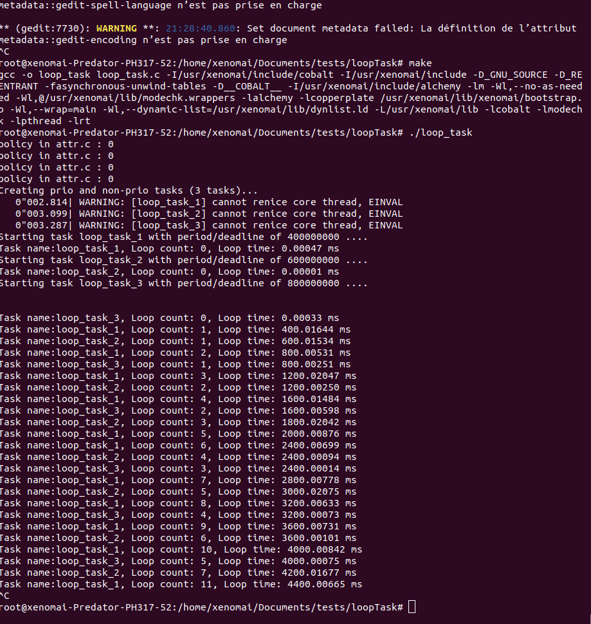
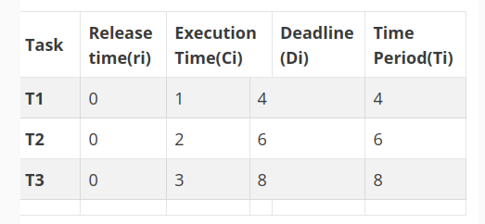
8. Presentation of sprint 1
Simple example without preemption

Slide 15
8. Presentation of sprint 1
Example with preemption
Demonstration

Slide 16
Thanks for your attention.
Do you have any questions ?​

Slide 17
Deliverables

