Slide 1


M2 ERTS PROJECT : Implementation of ED-H on Xenomai
Debus Alexy
Rayella Niranjan
02/12/2021

Slide 2


Our team
C
Debus Alexy
Rayella Niranjan
C dev.
C dev.

Slide 3
Table of contents
1 Context
2 Key question
3 Approach
4 Objectives
5 Planning
6 Progress
7 Project evolutions
8 Presentation of sprint 1

Slide 4
1. Context
Meeting with the professor (M.Queudet) on october the 15th :
The interest here is to put into applications a dynamic-priority energy aware scheduling strategie ED-H through the use of a Real-time kernel.
We will use Xenomai, I mean a dual kernel configurations : a Linux kernel (using Ubuntu distributions) supplementing by a RT co-kernel (Cobalt)
A Master student recently integrated EDF into Xenomai…

Slide 5


2. Key question
​
​
We need to have ED-H working without affecting integrity of other scheduling policies (fixed priority, EDF).
​
How could we manage to integrate/validate ED-H on Xenomai ?
Et si je n’ai pas
de robot réel ?
Et si je n’ai pas
de robot réel ?

Slide 6
3. Approach
Learn about Xenomai
Validate/Assert EDF implementation on Xenomai
Understand EDF implementation
Learn about ED-H
Implement ED-H In Xenomai
Validate/Assert ED-H implementation on Xenomai
The project will be split into sprints (1 sprint = 3-4 weeks)

Slide 7
4. Primary objectives
1) Installation of modified Xenomai and validation for EDF integration
Metric : report for modifications added to have a functional installation + tests to validate xenomai-EDF (report + source code)
Estimated time : 10h
2) Development of a linux module to grab battery information and transfer to Cobalt
Metric : guideline for the creation/usee of the linux module + source code for the linux module
Estimated time : 25h
3) ED-H implementation and validation on Xenomai
Metric : guideline for the creation/use of the linux module + source code for the linux module
Estimated time : 50h
Remaining time : 15h (Redaction of the final report, PWP presentation, handle git repo.)
Primary objectives are established at the beginning of the project

Slide 8
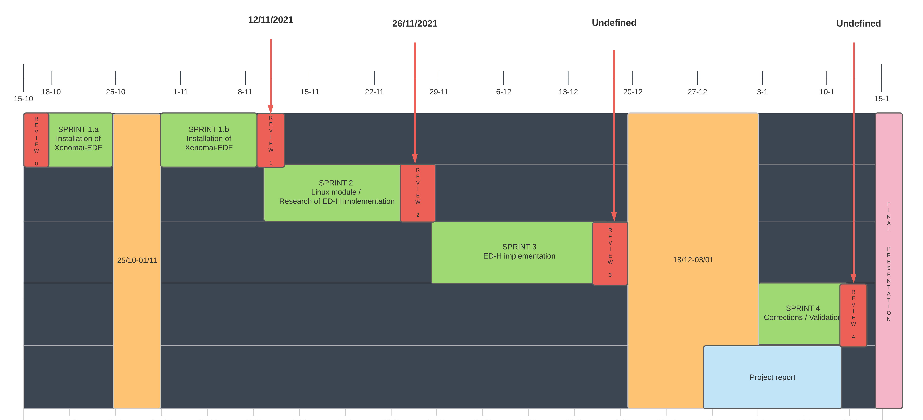
5. Planning
Provisional planning:

Slide 9
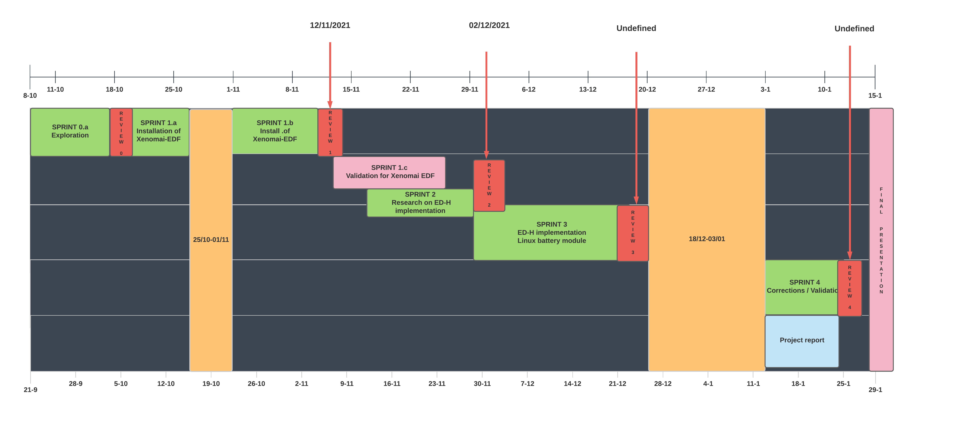
5. Planning
Effective planning :

Slide 10

6. Progress
0) Development of linux module to grab battery information
Results: Start implementation of a simple linux module (using kernel header file linux/power_supply)
2 weeks (08/10 - 17/10)
- In charge : Debus Alexy
1) Installation of Xenomai EDF
Results: Successfully installed Xenomai and validate EDF for no-premption test cases
3 weeks (18/10 - 11/11
In charge : Debus Alexy & Rayella Niranjan
2) Validation of Xenomai EDF
Results: Validate EDF for premption test cases
3 weeks (13/11 - 26/11
- In charge : Debus Alexy

Slide 11
7. Project evolution
Actual : (13/11 – 01/12)
Study of EDH (Theory for EDH)
Future (02/12 - 17/12) :
Read EDF source code / EDH implementation

Slide 12
7. Presentation of EDH
Energy Harvesting : Energy sources from environment , which can be harvested and converted them in to electric sources . It can be used to power wireless systems .
EDH Scheduling Algorithm : Objective of EDH scheduling algorithm Authorize job execution as long as there occurs no starvation in future.
Static Analysis : Energy, Deadline constraints.
Dynamic Analysis : Dynamic Slack energy with respect to current time .

Slide 13
7. Presentation of EDH in C simulator
Input to the task set.
Check Feasibility based on EDH Algorithm.
Schedule the task based on input.
Simulator Packages :
1.EDH.c file -→ Feasibility of the schedule task
2.Task.c file → Parameters from the user are received for each task.
3. schedule_trace.c file → Display the Gantt chart.

Slide 14
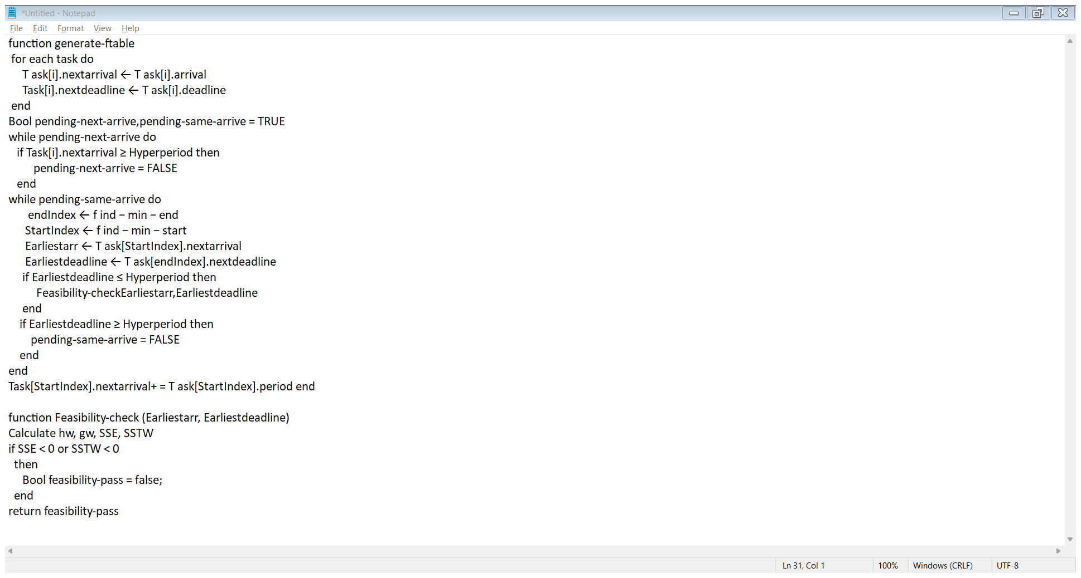
7. Presentation of EDH Simulator Functions
Feasibility check :

Slide 15
7. Project evolution
Actual : (13/11 – 01/12)
Validation for Xenomai EDF (Preemption for 2/3/4 tasks)
Research for XDDP-based communication
Read/Understand EDF source code
Future (02/12 - 17/12) :
Source code for EDH (including Battery linux module)

Slide 16
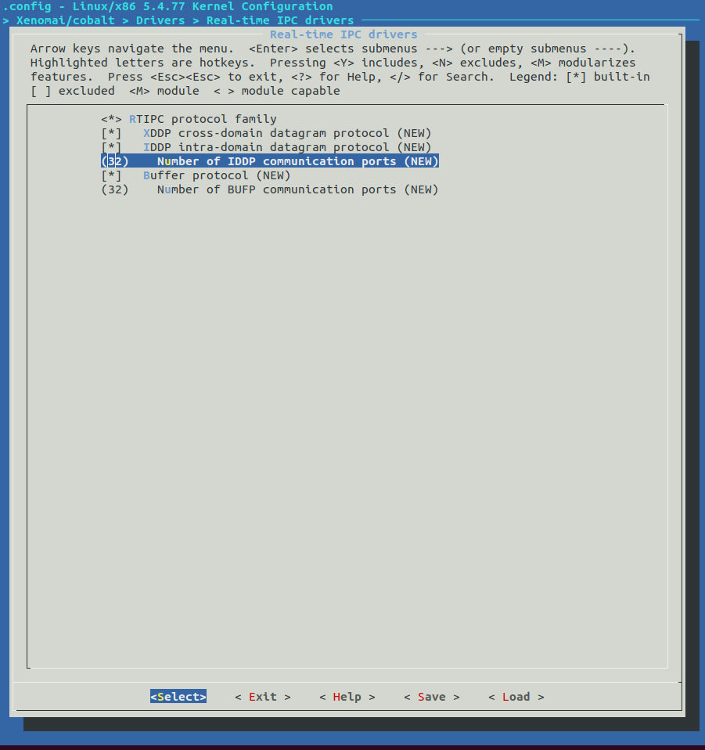
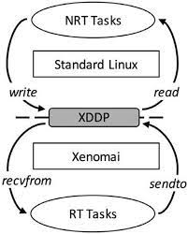
8. Presentation of sprint 2
Need to compilate linux kernel
With XDDP protocol enabled
On Xenomai kernel space :
RW on port /dev/rtp0
On standard linux kernel space :
RW on port /proc/xenomai/registry/rtipe/xddp/0

Slide 17
8. Presentation of sprint 2
Added lines in .config for linux kernel compilation
# # Real-time IPC drivers # CONFIG_XENO_DRIVERS_RTIPC=y CONFIG_XENO_DRIVERS_RTIPC_XDDP=y CONFIG_XENO_DRIVERS_RTIPC_IDDP=y CONFIG_XENO_OPT_IDDP_NRPORT=32 CONFIG_XENO_DRIVERS_RTIPC_BUFP=y CONFIG_XENO_OPT_BUFP_NRPORT=32 # end of Real-time IPC drivers

Slide 18
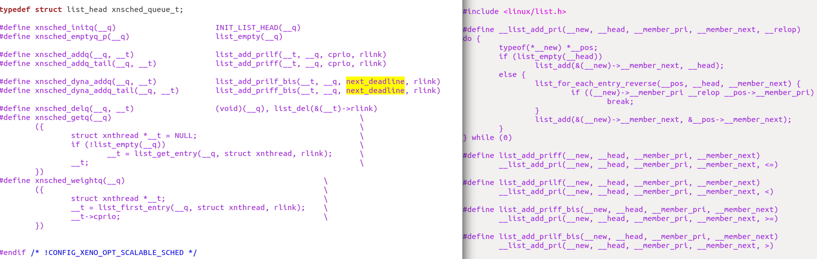
8. Presentation of sprint 2
File Schedqueue.h
File list.h

Slide 19
Thanks for your attention.
Do you have any questions ?​

Slide 20
Deliverables

