Slide 1


Modeling Demand Curve for Non-Traditional Patterns
IE-685 M.Sc Project 1
Under the supervision of prof. Saurabh Jain
Name- Aakash Verma
Roll No.- 23N0453
Notes:
sjkdbdnsds

Slide 2
Contents:
Introduction
Problem Description
Features
Dataset
Method and Approaches
Demand curve and Elasticity
Experiment
Results
Conclusion
Future Work
References

Slide 3
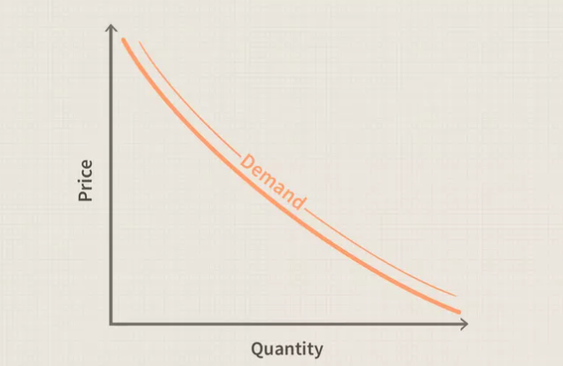
Introduction
Traditional Economic Theory The law of demand explains that higher prices reduce demand, resulting in a downward-sloping demand curve.
Significance:
Price-setting strategies
Supply chain optimization
Production planning
Promotional Strategy
Future Predictions
Value of Your Product

Slide 4
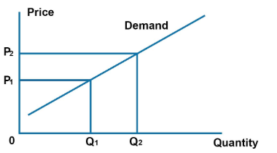
Challenges in Modern Markets
New Products: Priced low initially to attract buyers, with demand often less sensitive to price.
Established Brands: Keep high prices with steady demand due to strong trust and loyalty.
Luxury Goods: Higher prices can increase demand due to their exclusivity.
Smaller Brands: Price increases can disrupt demand due to weaker loyalty and value perception

Slide 5
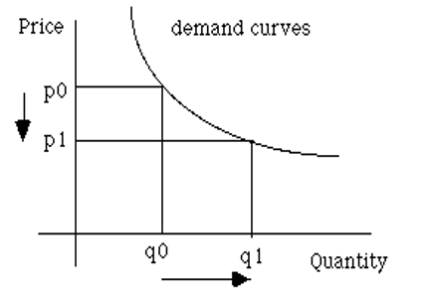
Proposed Solution
Develop a non-linear regression model that incorporates:
Weighted variables for price and non-price factors.
Behavioral indicators such as brand strength and exclusivity perception.
Constraints to align with traditional economic principles (e.g., negative slope for primary price variables).
Key Insights:
Captures real-world deviations in consumer behavior.
Offers insights for How market behaves ??

Slide 6
Problem Description
Traditional models assume an inverse price-demand relationship, often oversimplifying market dynamics and not always fit as they are actually ….
Modern challenges:
Non-linear demand patterns (e.g., luxury goods, stable brands, new launches).
Behavioral factors like brand loyalty and Competition impact.
Linear approaches fail to predict demand accurately in complex, dynamic markets as of reasons it sometimes give positive relationship of price.
Key Requirement:
A flexible model integrating price, non-price factors, and non-linear behaviors.

Slide 7
Features
1. Price (PPL)
Price per Liter (PPL) is a key factor in measuring brand or pack performance.
Higher prices typically lead to lower volume, reflecting price sensitivity.
Models the non-linear relationship between price and volume.
2. Competitive Pricing
Cannibalization Price: Examines how the price of one product affects the volume of another within the same Pack/Brand/Variant.
Direct Competition Price: Measures the impact of competitor prices on demand in same channel .
Indirect Competition Price: Analyzes the effect of prices from competitors in different channels/markets.

Slide 8
Features
3. Seasonality, Trend, and Category Volume
Seasonality: Captures demand fluctuations over specific periods (e.g., yearly, monthly) over markets/channels.
Trend: Represents long-term changes in demand.
Category Volume: Represents the total demand in a category over time particularly weekly for all packs in channel
4. Distribution
Cannibalization Distribution: Measures the overlap in sales within the same brand.
Direct Competition Distribution: Assesses the availability of competing brands in the market.
Indirect Competition Distribution: Evaluates market overlap across different categories.

Slide 9
Features
5. Up-Down Index & Category Price Index
Up-Down Index (UDI): Tracks shifts in consumer preferences towards higher or lower-priced products.
Category Price Index (CPI): Monitors the price levels in a category over time.
6. Brand Value and Interaction Terms
Brand Value: Identifies brand-specific effects using binary variables.
Interaction Terms: Captures the unique impact of price on different brands.

Slide 10
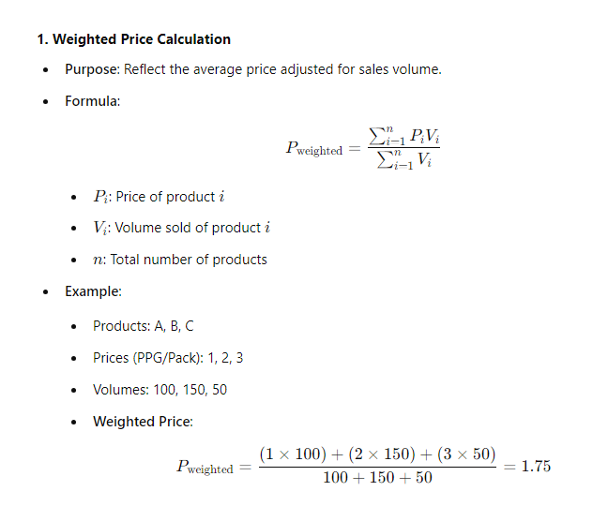
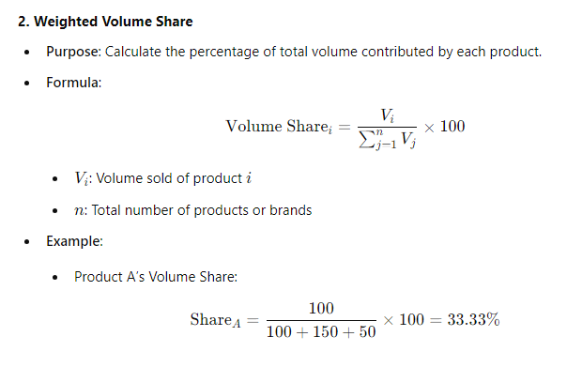
Weighted Metrics

Slide 11
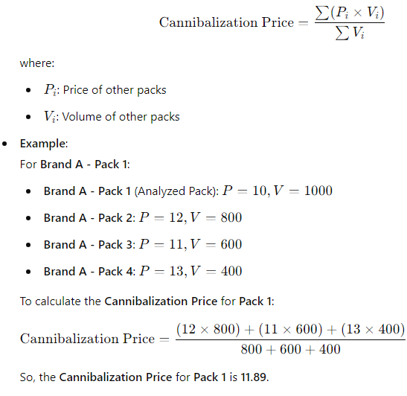
Competitive Features
Cannibalization:
Measures the impact of one product's price on the volume of other products within the same brand. It shows how the price of one pack within a brand affects the sales volume of other packs of the same brand.

Slide 12
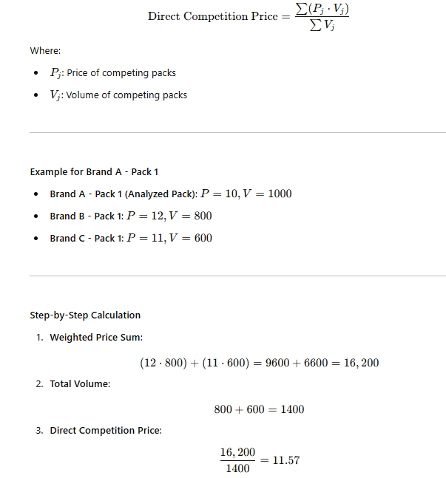
Competitive Features
Direct Competition:
Quantifies the effect of prices from similar products (competing packs) in the same category. This is the impact of competing products within the same category on the analyzed pack’s volume.

Slide 13
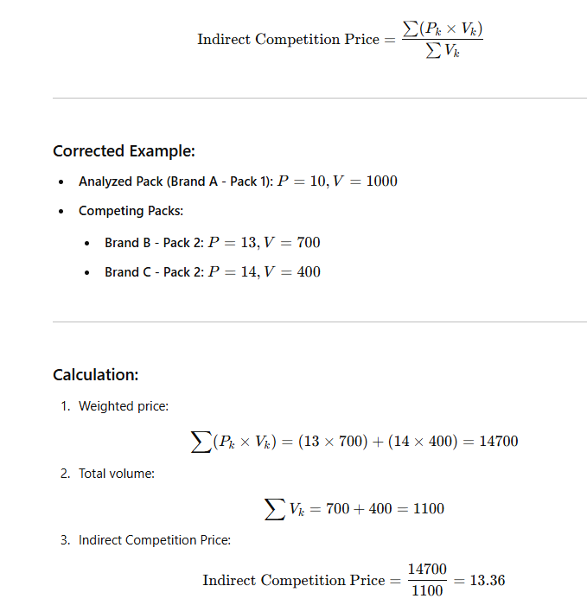
Competitive Features
Indirect Competition:
Measures the effect of prices from products in different categories that fulfill similar consumer needs. This shows the price influence of products that are not direct competitors but may still influence the analyzed pack’s demand.

Slide 14
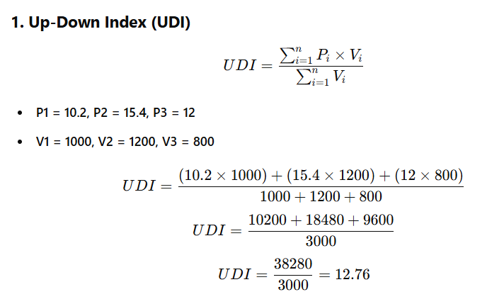
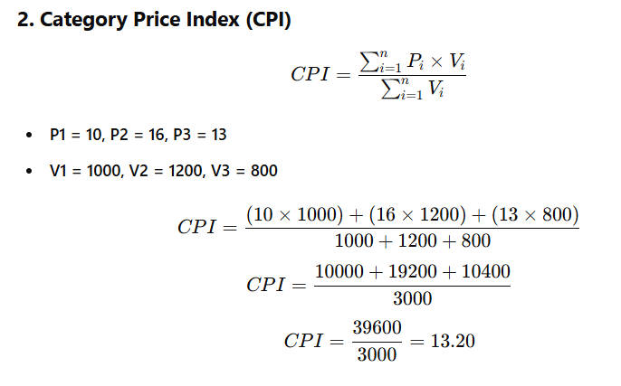
Features
The Up down Index monitors average price levels in a category over time, weighted by volume. However, in this calculation, price remains constant, and it primarily captures volume variability across time periods which gives idea how consumers move.
The Category Price Index (CPI) tracks shifts in consumer behavior towards higher or lower-priced products by incorporating both price and volume effects. It calculates the weighted average price, considering how the volume of each product influences the overall index.

Slide 15
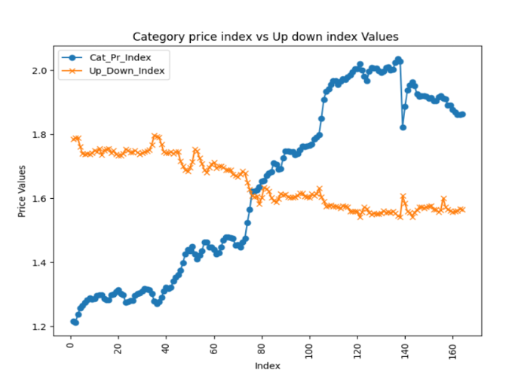
Up Down Index
This curve is for a specific combination of PPG and Brand , here it shows that over the time people are moving towards the cheaper prices and originally over the time price is increases which we see as category price index

Slide 16
Data Set
It contains numeric columns such as sales value, price, and volume, alongside categorical columns like channel, market, PPG/pack type/variant, and brand.
The data includes entries for 3 or more brands and multiple pack types, representing a comprehensive view of market performance.
The dataset spans over three years, with weekly data providing more than 150 entries per combination, and monthly data offering more than 36 entries per combination.
The dataset is anonymized for privacy protection, originating from the UK ,India, China market but not directly usable due to confidentiality concerns.

Slide 17
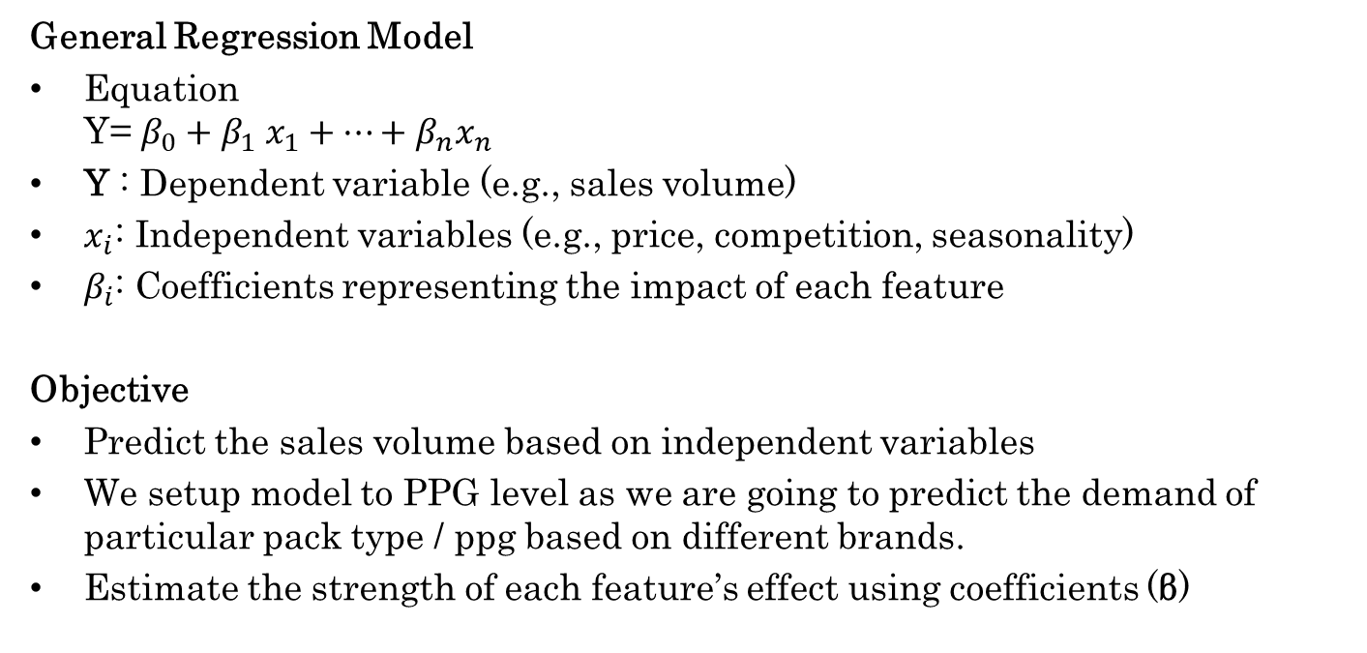
Methods and Approach
General Regression Model
Equation Y= $β_{0}+β_{1} x_{1}+⋯+β_{n}x_{n}$
Y : Dependent variable (e.g., sales volume)
$x_{i}$: Independent variables (e.g., price, competition, seasonality)
$β_{i}$: Coefficients representing the impact of each feature
Objective
Predict the sales volume based on independent variables
We setup model to PPG level as we are going to predict the demand of particular pack type / ppg based on different brands.
Estimate the strength of each feature’s effect using coefficients (β)

Slide 18
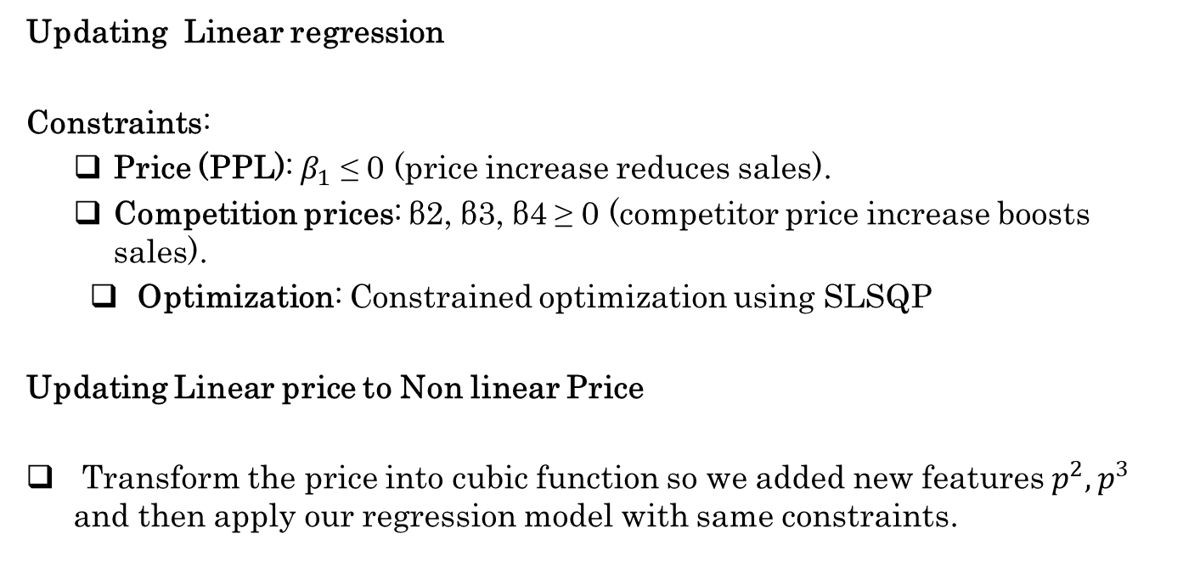
Approaches
Updating Linear regression
Constraints:
Price (PPL): $β_{1}$ ≤ 0 (price increase reduces sales).
Competition prices: β2, β3, β4 ≥ 0 (competitor price increase boosts sales).
Optimization: Constrained optimization using SLSQP
Updating Linear price to Non linear Price
Transform the price into cubic function so we added new features $p^{2},p^{3}$ and then apply our regression model with same constraints.

Slide 19
Approach: Ridge regression
Price Variable Transformation (PPL):
Applied various transformations (reciprocal, exponential, and linear) to enhance flexibility and capture non-linear relationships.
The transformation yielding the lowest Mean Absolute Percentage Error (MAPE) is selected.
Constraints & Regularization:
Implemented L2 regularization (Ridge) to prevent overfitting and improve model stability.
Introduced constraints on feature weights to enhance model robustness and preserving economic behavior

Slide 20
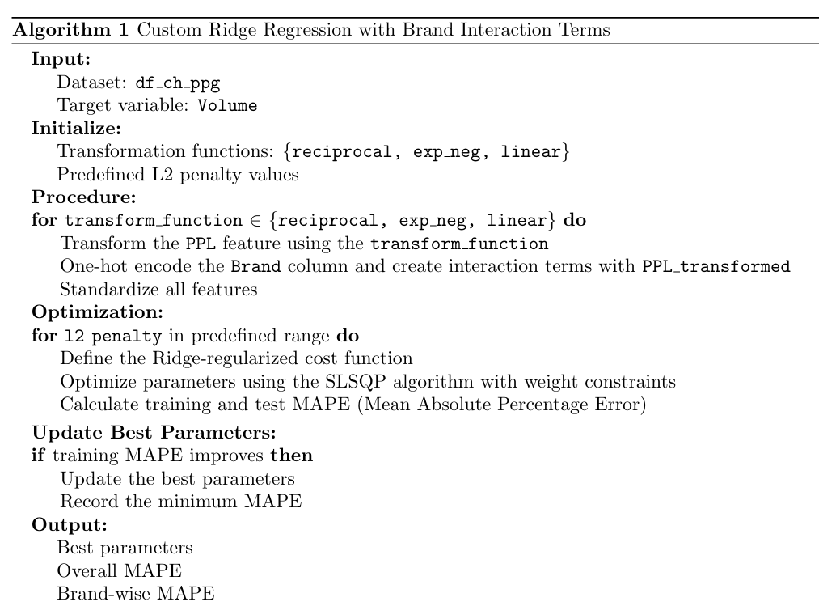
Workflow
We used the results of this approach to find the final results and after that we use the result to determine the demand curve for various transformations.

Slide 21
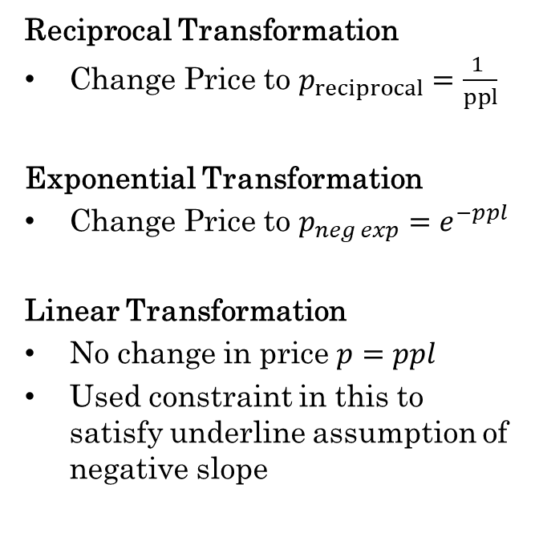
Transformations
Reciprocal Transformation
Change Price to $p_{reciprocal}=\frac{1 }{ppl}$
Exponential Transformation
Change Price to ${p_{neg exp}=e}^{−ppl}$
Linear Transformation
No change in price $p=ppl$
Used constraint in this to satisfy underline assumption of negative slope

Slide 22
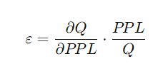
Price Elasticity
Elasticity Formula:
Elastic vs. Inelastic Demand:
Elastic (|ε| > 1): High responsiveness to price changes.
Small price changes → Larger demand changes.
Inelastic (|ε| < 1): Low responsiveness to price changes.
Price increases → Potential revenue gains.
Unit Elastic (|ε| = 1): Proportional change in price and demand.
Revenue remains unchanged.

Slide 23
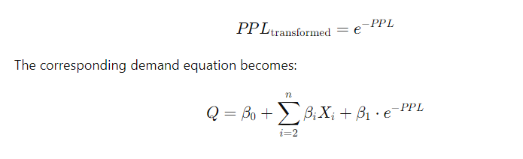
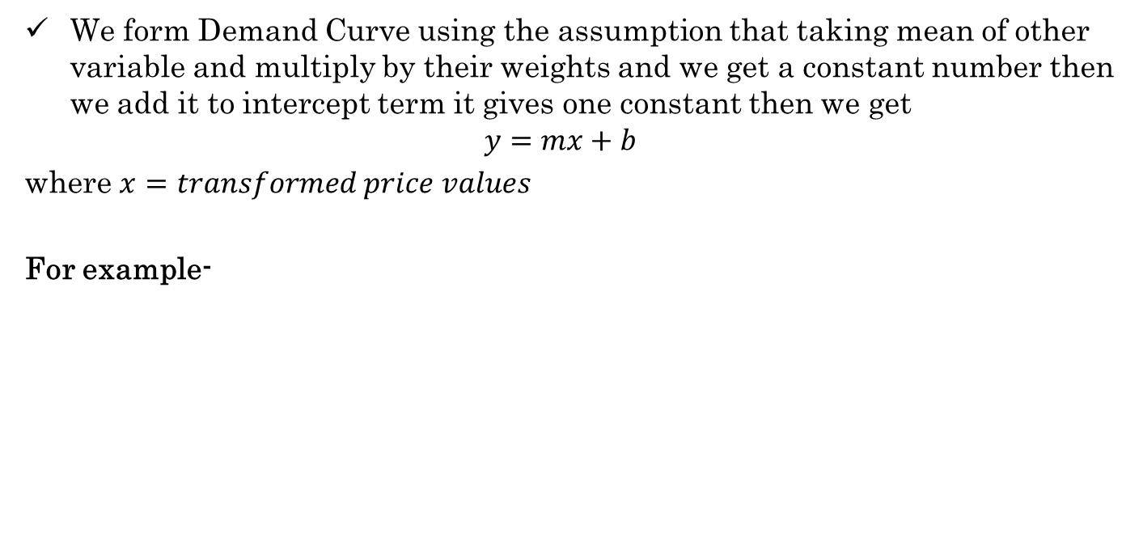
Demand Curve Formulation
We form Demand Curve using the assumption that taking mean of other variable and multiply by their weights and we get a constant number then we add it to intercept term it gives one constant then we get
$$y=mx+b$$
where $x=transformed price values$
For example-

Slide 24
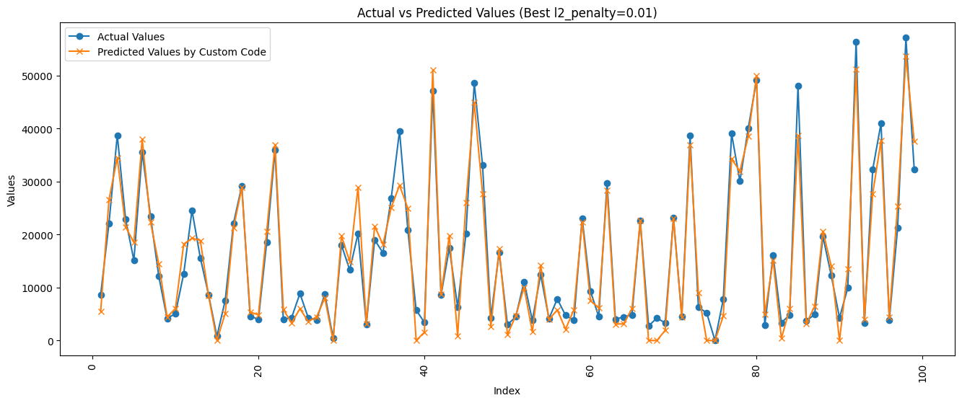
Experiments
Linear Transformation Results :
This is for one pack containing three brands, using linear we get fits which are closely good

Slide 25
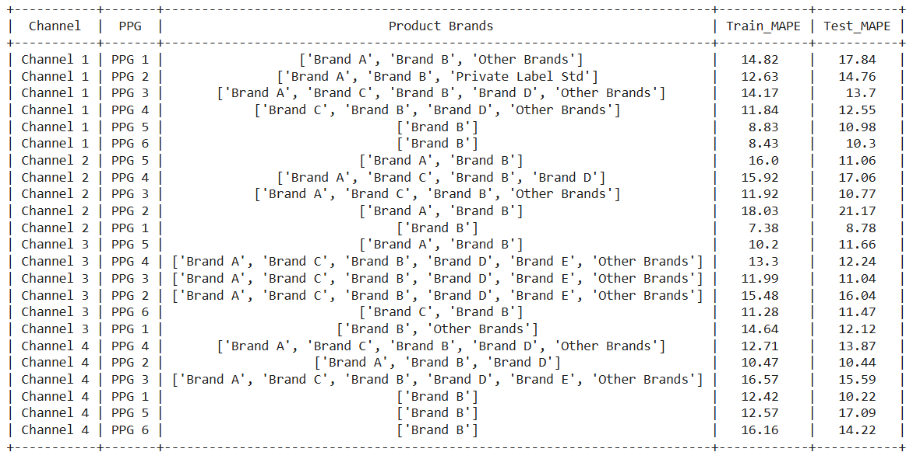
Experiments

Slide 26
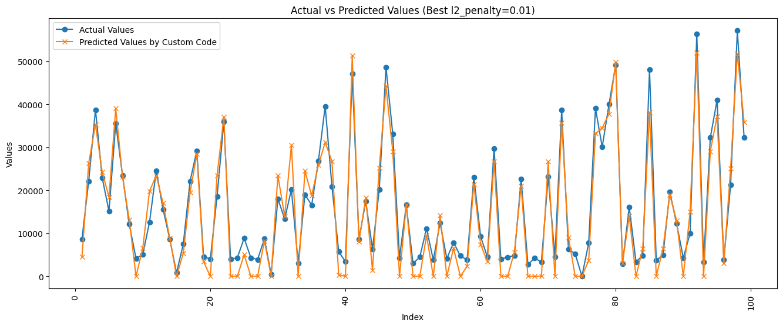
Experiments
Negative Exponential Transformation
Similar to linear we have exponential results but now problem arises which one we have to take for the final interpretation

Slide 27
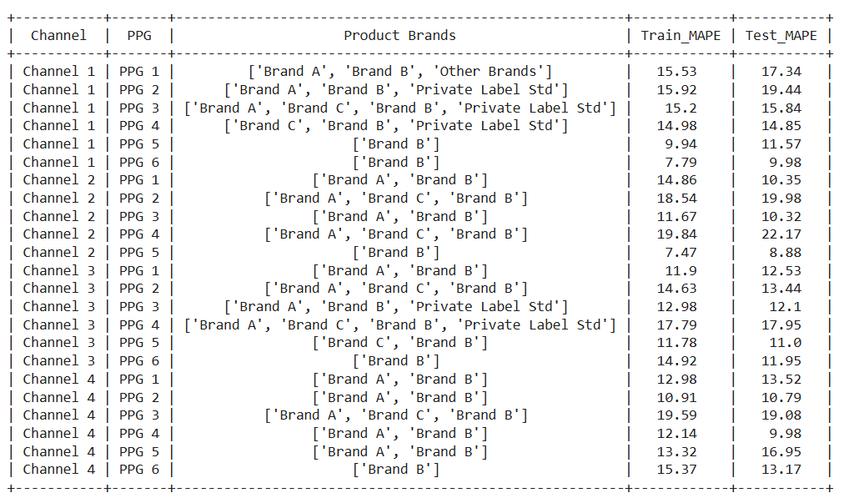
Experiments

Slide 28
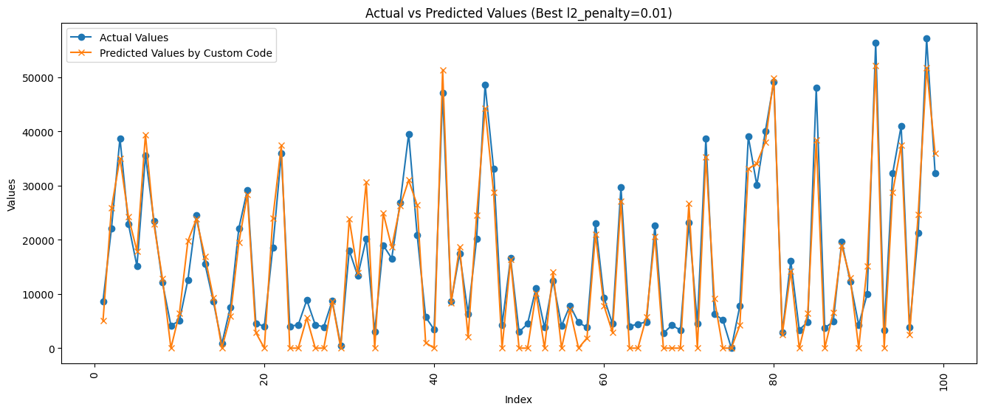
Experiments
Reciprocal Transformation
To choose one of these three we apply that model which have less train mape will be consider better, we can also go with test as well

Slide 29
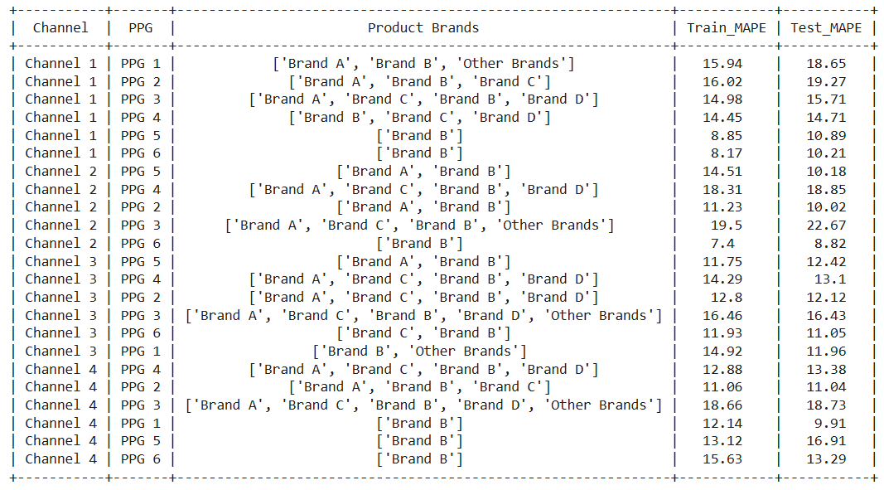
Experiments

Slide 30
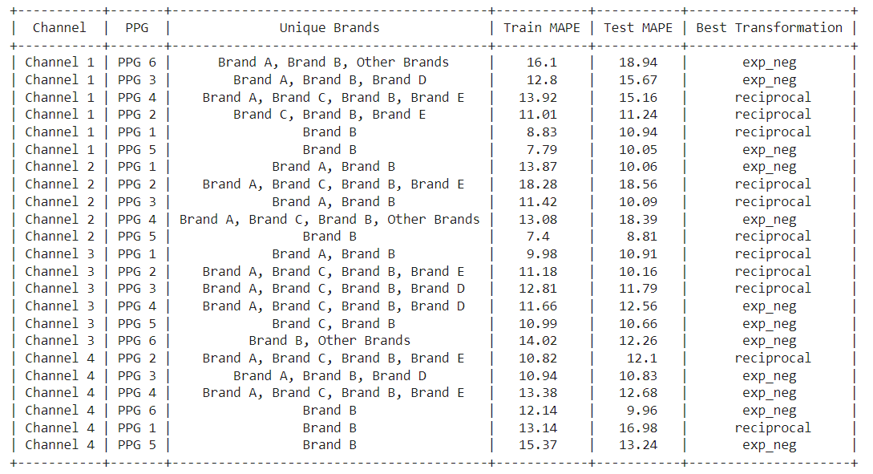
Final Interpretation

Slide 31
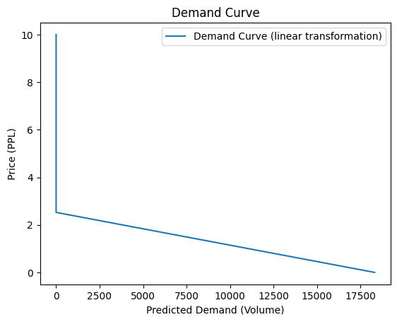
Experiments
We create the demand using our assumption of taking remaining variable as a constant, doing this we get the demand curve and we can interpret major results as in this at price 2.2 (approx.) the demand become zero, so we can check current price and check what’s the opportunity at different price and what could be happen for different scenario.

Slide 32
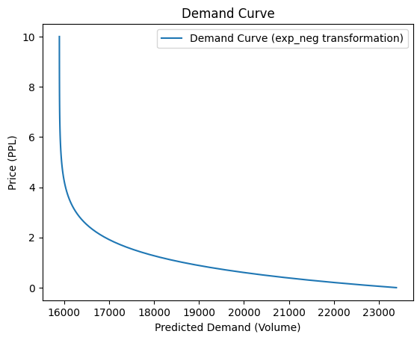
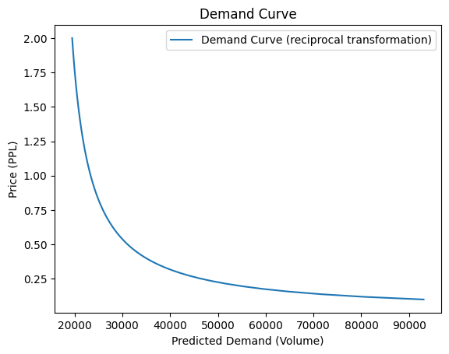
Results
From these different transformation we find best train or test mape and take that curve for our analysis of future predictions and conclusion for that particular Pack.

Slide 33
Final Interpretation
Strategic Decision-Making:
Targeted Analysis: Enables a deeper analysis of price sensitivity and revenue optimization
Demand Modeling & Elasticity Analysis: Provides a framework for strategic pricing and product positioning across markets
Predicting Future Market Behavior:
Reciprocal Transformation:
Price increases have reduced impact on demand at higher price points.
Negative Exponential Transformation:
Small price increases lead to significant drops in demand at lower price points.
Practical Application
Optimizing Pricing Strategies: Use insights from elasticity analysis to predict consumer behavior under different pricing scenarios.
Long-term Revenue & Market Forecasting: Make informed decisions about price adjustments, promotions, and market trends.

Slide 34
Why this is better than other……
Robustness Across Multiple Datasets: The approach was validated on more than five real-world datasets, demonstrating its capability to capture price-quantity relationships across various market conditions, including different Price Groups (PPGs), pack types, and brand variants.
Generalized Methodology: The methodology is not limited to a specific dataset; it is adaptable and can be applied to different PPGs, product variants, and channels, making it a versatile tool for analyzing consumer behavior across diverse market scenarios.
Optimal Demand Curve Identification: For each dataset, the approach successfully identifies the optimal demand curve transformation, ensuring that the analysis remains accurate and relevant for the specific data and market conditions.

Slide 35
Conclusion
The project aimed to identify the most accurate demand curve for different product categories, considering various pricing strategies and consumer behaviors.
By applying different transformations (linear, negative exponential, and reciprocal), we were able to capture the price-sensitivity dynamics of each product category.
The analysis provided actionable insights into pricing strategies, helping businesses optimize revenue through a better understanding of demand elasticity and consumer reactions to price changes.
Ultimately, the project demonstrates the importance of adapting demand models to real-world complexities, allowing for more informed and effective pricing decisions.

Slide 36
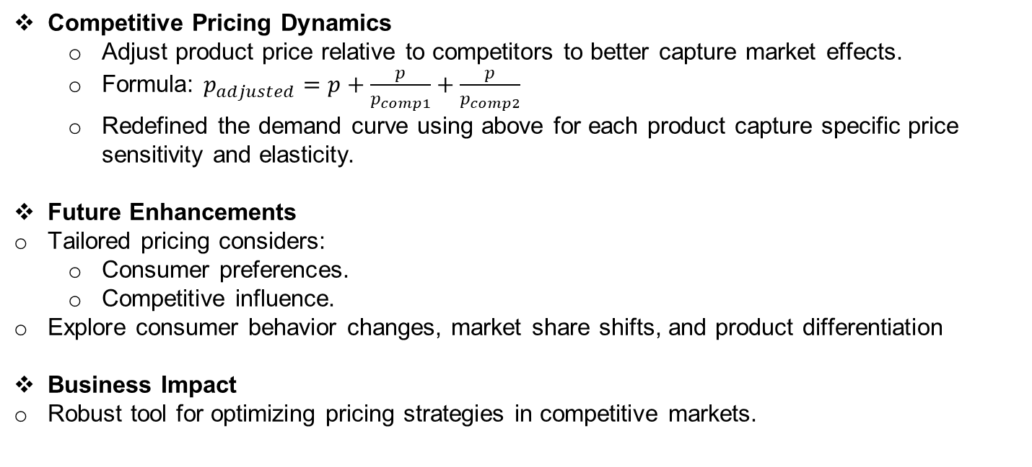
Future Work
Competitive Pricing Dynamics
Adjust product price relative to competitors to better capture market effects.
Formula: $p_{adjusted}=p+\frac{p}{p_{comp1}}+\frac{p}{p_{comp2}}$
Redefined the demand curve using above for each product capture specific price sensitivity and elasticity.
Future Enhancements
Tailored pricing considers:
Consumer preferences.
Competitive influence.
Explore consumer behavior changes, market share shifts, and product differentiation
Business Impact
Robust tool for optimizing pricing strategies in competitive markets.

Slide 37
References
[1] Choi, H. (2021). The Profitable Theory of Consumers’ and Producers’ Surplus: Positive Demand, Negative Supply?. Advisor, Chung-Hua Institution for Eco nomic Research.
[2] Hirth, L., Khanna, T., Ruhnau, O. (2022). The (very) short-term price elastic ity of German electricity demand. ZBW- Leibniz Information Centre for Eco nomics, Kiel, Hamburg. Available at: http://hdl.handle.net/10419/249570.
[3] Dooley, P. C. (1983). Consumer’s Surplus: Marshall and His Critics. The Cana dian Journal of Economics / Revue canadienne d’Economique, 16(1), 26-38. Published by Wiley on behalf of the Canadian Economics Association. Avail able at: https://www.jstor.org/stable/134973.
[4] Rosenthal-Kay, J., Traina, J., Tran, U. (2021). Seven million demand elasticities. Leibniz Information Centre for Economics

Slide 38
References
[5] Neelamegham, R., Chintagunta, P. (2003). A Bayesian Model to Forecast New Product Performance in Domestic and International Markets. INSEAD, Graduate School of Business, University of Chicago. Available at: https: //www.insead.edu.
[6] Manchanda, P., Rossi, P. E., Chintagunta, P. K. (2004). Investigating Hetero geneity in Brand Preferences in Logit Models for Panel Data, Response Model ing with Nonrandom Marketing-Mix Variables. Journal of Marketing Research, 41(4), 467-4700. 10.1509/jmkr.41.4.467.4700.
[7] Hitsch, G. J., Horta¸csu, A., Lin, X. (2019). Prices and promotions in U.S. retail markets: Evidence from big data. NBER Working Paper. Available at: https://www.nber.org/.
[8] Jensen, R. T., Miller, N. H. (2008). Giffen behavior and subsistence consump tion. American Economic Review, 98(4), 2008

