Slide 1
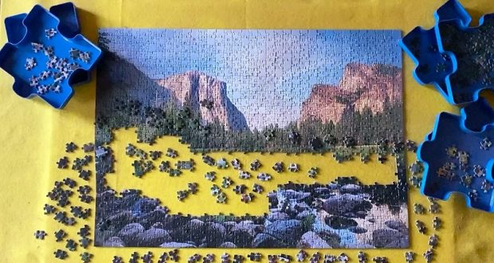
Jigsaw Puzzles
Jigsaw puzzles are a popular form of entertainment and a fascinating hobby. They consist of a picture or image that has been divided into numerous small, uniquely shaped pieces, and the objective is to reassemble these pieces to recreate the original image.

Slide 2
We try to solve a Jigsaw Image using Linear Programming.
A problem
in matching
gradients
and optimal orientation

Slide 3
Use Case
Image Cryptography: As an additional layer in image steganography.
Archaeology: solving archaeological pieces to best match the original piece

Slide 4
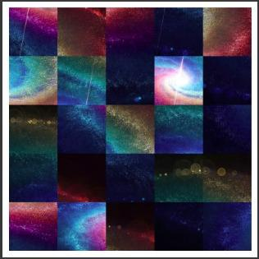
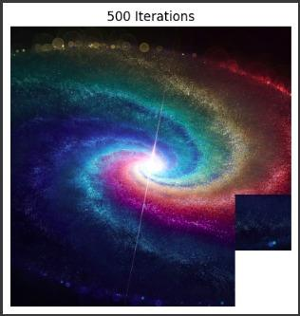

Slide 5
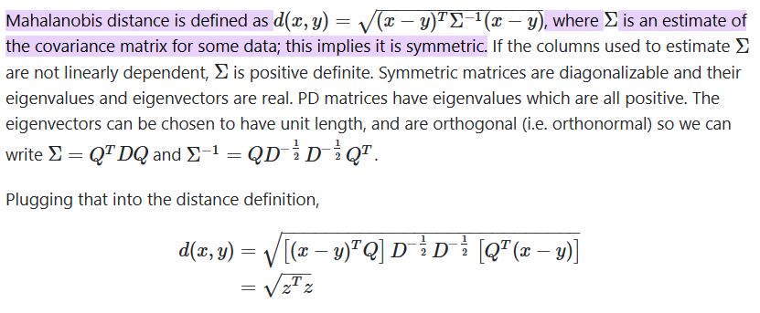
Matching Compatibility

Slide 6
Literature Survey
Initial solvers used only the shape information to solve the 9-piece puzzle
Fact: Jigsaw puzzles are NP-hard when multiple correct pieces are possible
Two main strategies:
Greedy methods: Start from initial pairwise matches and build for larger components
Global methods: Directly search for a solution to maximize a global compatibility function
Son et al. found that puzzle cycles to exploit constraints lead to a better performance than directly solving the global problem

Slide 7
Our approach
Our approach is a hybrid between global and greedy approaches.
Delayed placing of pieces until we have information that they are potentially unambiguous like greedy approaches
Each step considers placement of all pieces rather than a small set like global approaches
This prevents us from solving the puzzle incorrectly in some local region in the early steps
With these optimizations, we aim to improve the performance than existing ones

Slide 8
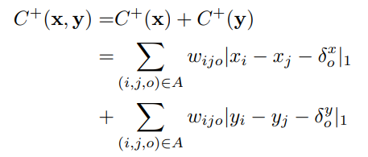

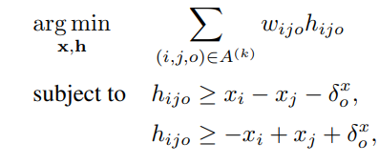
Linear Programming Formulation
Objective function

Slide 9
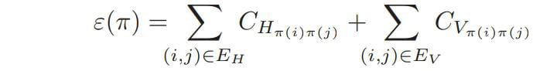
Quadratic Programming Formulation
The global compatibility function of a permutation π is
where e = (i, j) is the edge connecting the neighboring locations i and j; and π(i) corresponds to the tile permuted to location i.
The GOAL is to MAXIMIZE this function

Slide 10



Each permutation π of N elements can be represented as a permutation matrix, i.e., a binary square matrix P, with one entry 1 in each row and column:
Using this notation, we can reformulate the global compatibility function as
If the columns p1,...,pN of matrix P, which has N × N elements, are stacked up in a column-vector p of dimension N2, we have

Slide 11

We can rewrite it in the canonical quadratic form pAp, where A is a symmetric non-negative matrix of dimension N2 × N2 that represents the Hessian of ε(P). In vector form and in coordinates,
Extending the domain of ε(P) for all doubly stochastic matrices, the problem reduces to the solution of the following quadratic optimization problem:

Slide 12


The horizontal dissimilarity between two tiles ti and tj is computed as
where G_{ijLR}(k) is the gradient from the right side of ti to the left side of tj , at row k; μ_{iL} is the mean difference between the final two columns of t_{i}; and S_{iL} is a 3 × 3 covariance matrix estimated from the difference between the last column of t_{i} and the first column of t_{j} . Because dissimilarity D_{LR} is not symmetric, the final horizontal symmetric dissimilarity is

Slide 13
Horizontal compatibility between two tiles ti and tj : C_{H} depends on :
φ(i, j) : determined by the position/ranking of D_{Hij} in an increasingly ordered set of values D_{Hik} , for 1 ≤ k ≤ N, summed up with the position/ranking of D_{Hij} in an increasingly ordered set of values D_{Hkj} , for 1 ≤ k ≤ N
D_{Hij} : distance of LR MGC (Mahalanobis Gradient Compatibility) summed with RL MGC.

Slide 14


Results

Slide 15
References:
Mahalanobis Gradient Compatibility : Jigsaw puzzles with pieces of unknown orientation, 2012 IEEE Conference, A. C. Gallagher
Images Taken from Google.

Slide 16
Thank you
Team members
Neeraj Jadhav (200050086)
Nisarg Jain (23n0454)
Aakash Verma (23n0453)
Onkar Borade (200050022)

