Slide 1
Vision-Based Smart Parking Occupancy Detection System
Using Dual YOLO Architecture
Group:
Group 66011049 · 66011666 · 66011117
Members:
Kunanon Rungsomboon · Mihini Methasa Boteju · Papangkorn Wongsuwan
Advisor:
Jirayut Petchhan
Course:
01276390 CEPP | April 2026
CEIPP | 2026

Slide 2
Background — The Parking Problem
💰
⏱
📐
Expensive Sensors
17 Minutes Lost
Perspective Distortion
Per-bay magnetic loops / ultrasonic sensors: cost, wiring, and maintenance scale linearly with bay count
Average time per trip spent searching for a parking spot — causing congestion, fuel waste, and emissions
Single-model detectors fail: cars far from camera appear smaller, making fixed-distance matching unreliable
Solution: Vision-only system using Dual YOLO + Bird's Eye View occupancy matching — no per-bay hardware
2

Slide 3
Current Methods & Limitations
Manual Monitoring
Security personnel conduct physical walkthroughs — not scalable, error-prone
Per-Bay Sensors
Magnetic / ultrasonic sensors per space — high cost, difficult to maintain
Single-Model Vision
One CNN for all tasks — lower accuracy, struggles with multi-class inference
Perspective Distortion
Far objects appear smaller; naïve pixel-distance matching fails
Manual Spot Annotation
Parking bay coordinates must be hand-labelled — labour intensive, brittle
3

Slide 4
Key Insights
Four ideas that define our approach
01
02
One Camera, Many Slots
Separate the Detection Tasks
A single overhead camera can monitor an entire parking zone, eliminating per-bay sensor hardware.
Spot detection and car detection are different problems using dedicated models for each yield's higher accuracy.
03
04
BEV Fixes Perspective
Recalibration Reduces Maintenance
Bird's Eye View projection normalises distance distortion, making proximity matching reliable across the entire lot.
Automated 2 AM spot re-scan self-heals after camera drift, eliminating the need for human re-annotation.
4

Slide 5
Training Hardware
All training and inference benchmarking performed on a single laptop with CUDA acceleration
💻
🎮
MACHINE
GPU
Lenovo Laptop
NVIDIA GeForce RTX 4060
Model 83DG · Windows 11 Home 64-bit
Laptop GPU · 8 GB VRAM · CUDA-enabled
⚡
🧠
🔧
CPU
RAM
FRAMEWORK
Intel Core i7-14650HX
16 GB
Ultralytics YOLO
24 CPUs · 2.2 GHz
System Memory
CUDA Acceleration + PyTorch
5

Slide 6
System Overview
Reference Image
→
Spot Detector (spots.pt)
→
Spot Coordinates JSON
→
BEV Transform
→
Matching Algorithm
→
Occupancy Output
↑
Live Video
→
Car Detector (best.pt) + Tracker
★ Red boxes = YOLO model inference
6

Slide 7
System Architecture
System Architecture — Vision-Based Smart Parking
Two-phase pipeline: Initialization (once at startup) + Main Processing Loop (every frame)
Video Input/Output
Spot Detection/BEV
Matching & Dashboard
NMS Filter
Config Files
INITIALIZATION PHASE
Reference
Image (.jpg)
spots.pt
Spot Detector
NMS Filter
IoU>0.4 suppressed
⟳ Auto-recalibrate at 2AM (≤2 cars)
spots_data.json
37 bay coords
MAIN PROCESSING LOOP
config.yaml
thresholds · paths
homography.json
BEV calibration
(every frame)
Spot BEV coords
CCTV / Live
Video Feed
Video Frame
per frame
best.pt
Vehicle Detector
+ Tracker
Bird's Eye
View
Perspective
Transform
Greedy BEV
Matching O(K log K)
70px threshold
Occupancy
Car ↔ Spot
Assignment
Dashboard
FREE/OCCUPIED
Overlay (OpenCV)
7

Slide 8
Implementation & Tools
Python 3.8+
Core programming language
Module Structure
src/main.py — Entry point & main loop
OpenCV 4.x
Video capture, BEV transform, visualisation
modules/detector/ — YOLOv11 car detector wrapper
Ultralytics YOLOv11
Object detection & real-time tracking
modules/parking_logic/
NumPy
/spot_manager.py — Spot detection, NMS, BEV matching
Numerical arrays & distance computation
/perspective.py — Homography / BEV transform
PyYAML
Configuration file loading (config.yaml)
src/visualization.py — OpenCV drawing utilities
JSON stdlib
Persistent spot coordinate storage
config/config.yaml — Runtime settings
config/spots_data.json— 37 persisted spot coords
Roboflow
End to end computer vision web platform
config/reference.jpg — Empty lot reference image
8

Slide 9
Core Technical Method
Dual YOLOv11 Models
Distance-Based Greedy Matching
• spots.pt — detects empty bay boundaries from a reference image
• All (car, spot) BEV distance pairs computed each frame
• best.pt — tracks vehicles frame-by-frame in live video
• Sorted ascending — closest pairs assigned first (greedy, O(K log K))
• Each model is specialized, smaller, and more accurate than a single multi-task model
• 70 px BEV threshold rejects implausible matches
Homography / Bird's Eye View
Self-Healing Recalibration
• 4 anchor points map camera view → flat top-down canvas (400 × 800 px)
• Simulated clock triggers spot re-scan at 2:00 AM
• Car's tyre contact point & spot centre both projected to BEV
• Only fires when ≤ 2 cars detected (low traffic window)
• Eliminates perspective-induced scale variation between near/far spots
• Re-saves spots_data.json — no human annotation required
9

Slide 10
Dual-Model Architecture
spots.pt — Spot Detector
best.pt — Vehicle Detector (y11s ★)
Input
Clean reference image (config/reference.jpg)
Input
Every live video frame (real-time stream)
Trigger
Once at startup; again at 2 AM self-heal
Trigger
Every frame continuously
Task
Locate empty parking bay boundaries via YOLO
Task
Detect and track vehicles with persist IDs
Output
37 bounding boxes → saved to spots_data.json
Output
BBox + confidence score + track ID per car
Two dedicated models > one unified model: each optimised for its task → higher accuracy, lower compute per frame
10

Slide 11
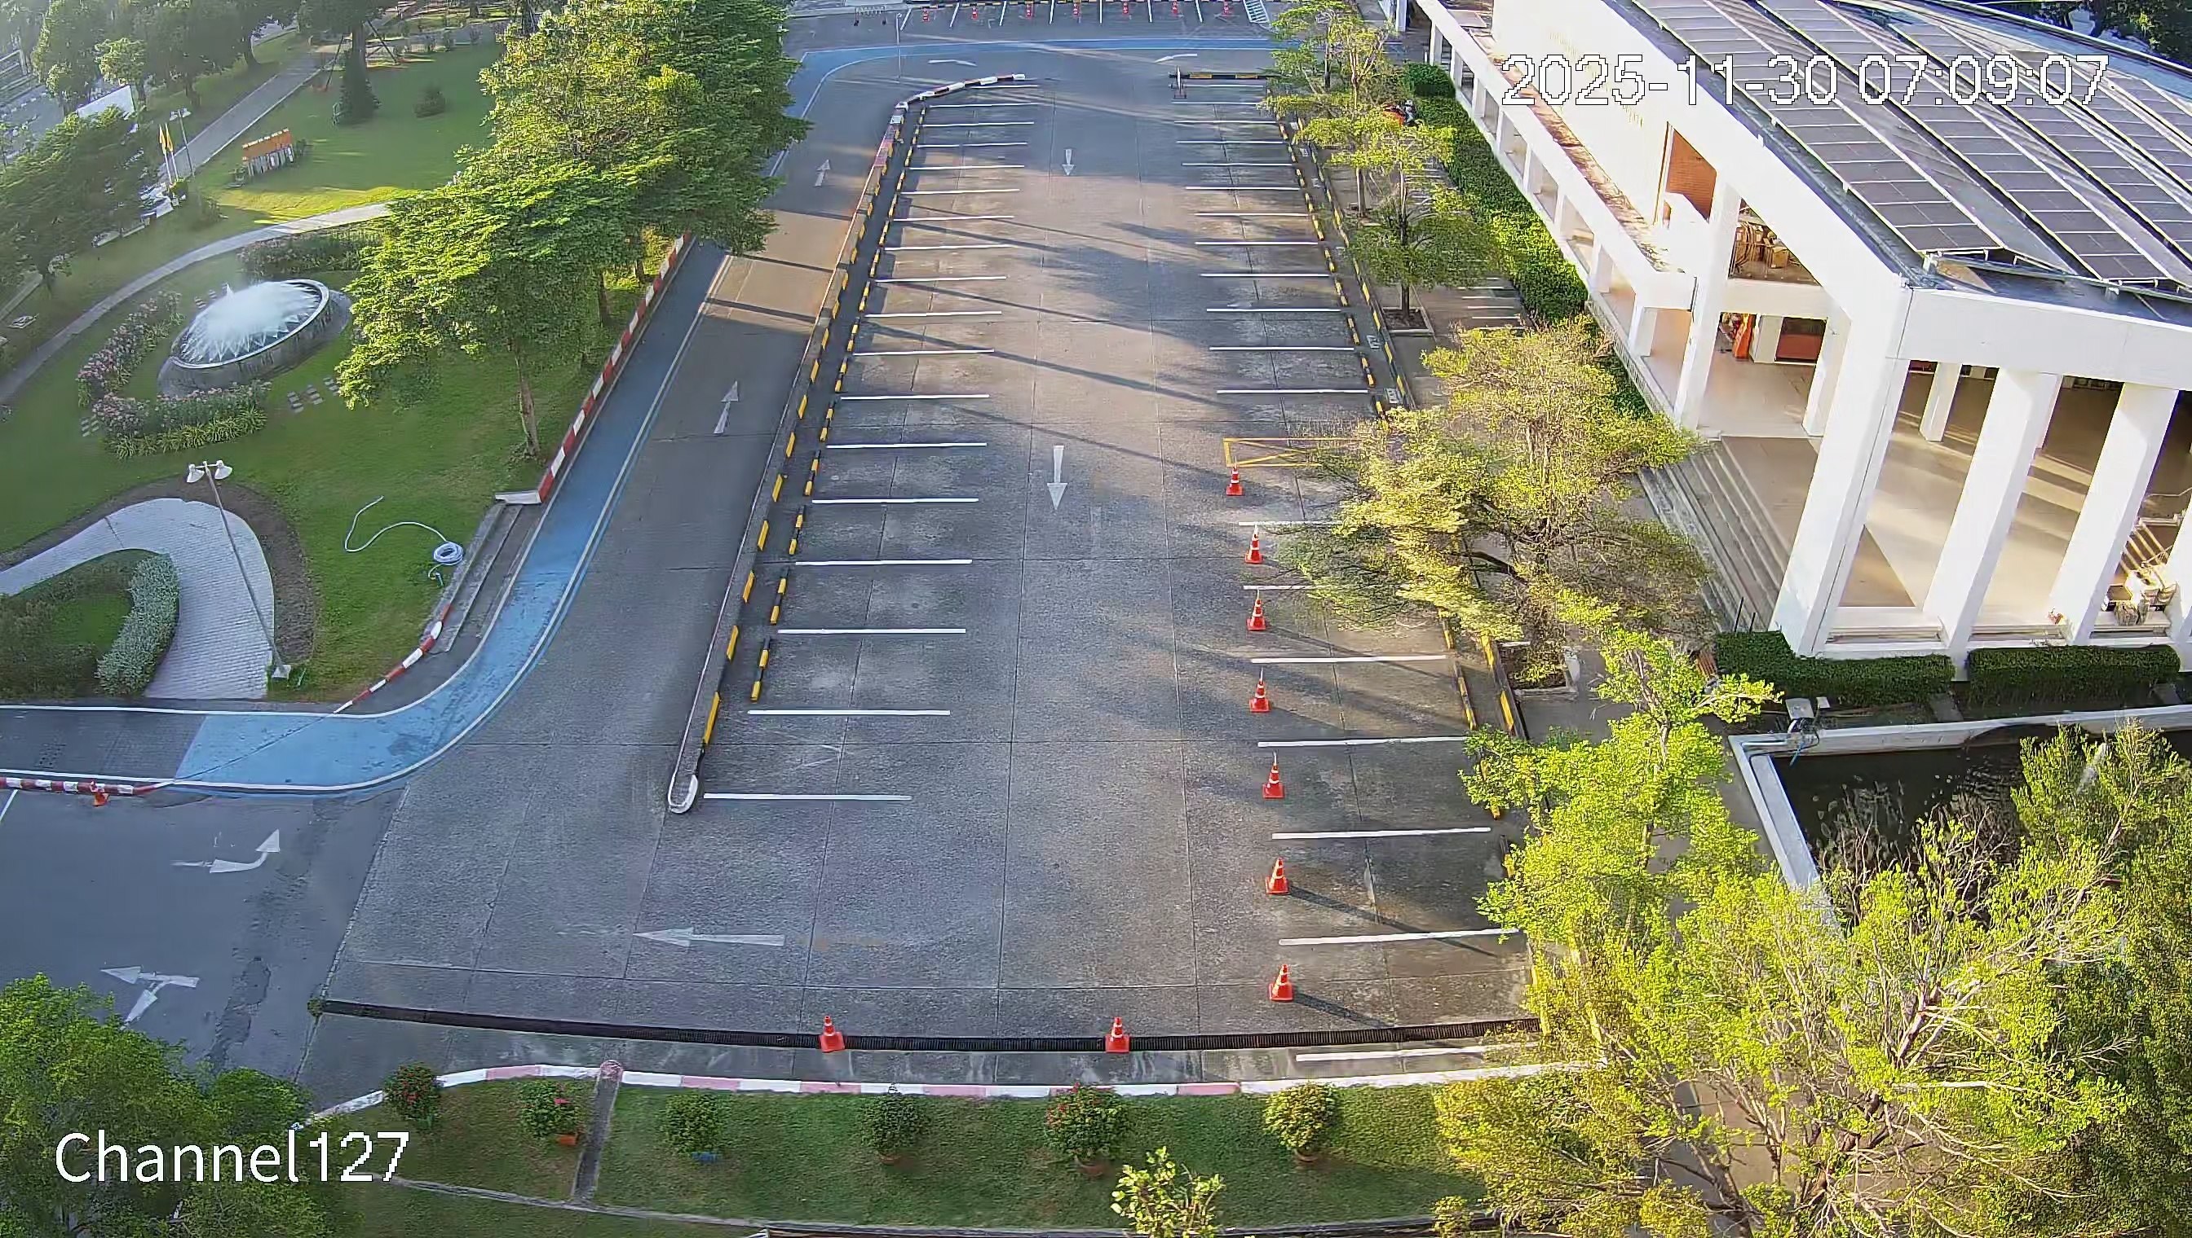
Dataset Collection & Annotation
Dataset Collection & Annotation
Video Source
KMITL CCTV (existing infrastructure)
Recording Period
12 Days
Time Windows / Day
4 (Morning · Afternoon · Evening · Night)
Frames / Window
50
Total Frames
2,400
KMITL Campus Security Camera — Parking Area
Annotation Classes
Parking Spot & Vehicle / Car
Platform
Roboflow
Time-stratified sampling → training data covers full day/night lighting range
11

Slide 12
Bird's Eye View (BEV) Occupancy Matching
Homography Calibration
1
4 ground-plane anchor points → 3×3 matrix maps trapezoidal camera region to flat 400×800 px BEV canvas
BEV Projection
2
Car bottom-center (tyre contact point) and spot centers both transformed to scale-normalized BEV coordinates
Camera view — perspective distortion visible
Greedy Matching O(K log K)
3
All (car, spot) pairs scored by Euclidean distance in BEV. 70 px threshold filters implausible matches.
One fixed 70 px threshold works correctly across the entire lot — near and far from camera
12

Slide 13
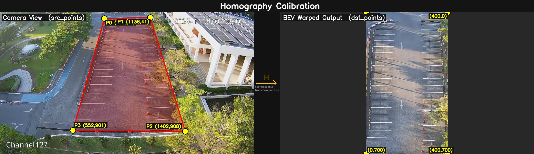
Bird's Eye View (BEV) Occupancy Matching
Homography Calibration
1
4 ground-plane anchor points → 3×3 matrix maps trapezoidal camera region to flat 400×800 px BEV canvas
13

Slide 14
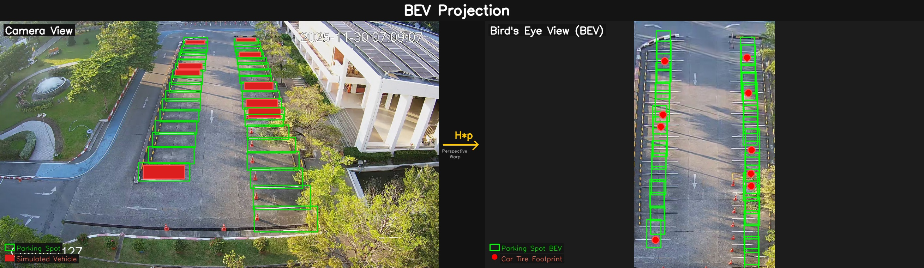
Bird's Eye View (BEV) Occupancy Matching
BEV Projection
1
Car bottom-center (tyre contact point) and spot centers both transformed to scale-normalized BEV coordinates
14

Slide 15
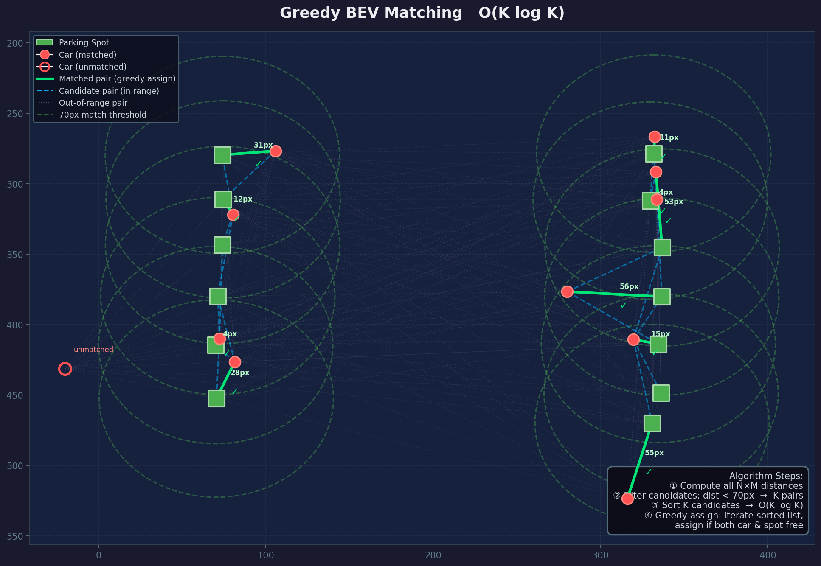
Bird's Eye View (BEV) Occupancy Matching
Greedy Matching O(K log K)
1
All (car, spot) pairs scored by Euclidean distance in BEV. 70 px threshold filters implausible matches.
15

Slide 16
Model Training
Training Configuration
Four Variants Trained
Hyperparameter
Value
Model ID
Architecture
Dataset
Notes
Epochs
50
y11n
YOLOv11 Nano
Standard dataset
Smallest / fastest
Image Size
640 × 640 px
y11s
YOLOv11 Small
Standard dataset
★ SELECTED — best accuracy
Batch Size
8
y26n
YOLOv11 Nano
26-class dataset
Tests class breadth
Optimizer
AdamW (auto)
y26s
YOLOv11 Small
26-class dataset
Comparison baseline
IoU Threshold
0.7
Pre-trained
Yes — COCO weights
Conf Threshold
0.15 (inference)
All models trained with identical hyperparameters for fair comparison.
16

Slide 17
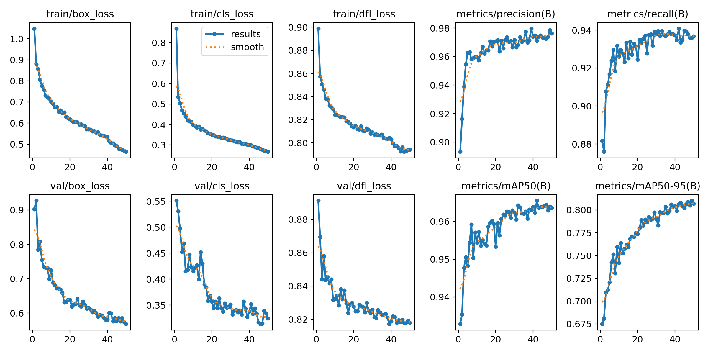
Training Convergence — y11s Model (50 Epochs)
Figure 1. Training & validation loss curves + key metrics for y11s across 50 epochs.
All loss components decrease monotonically — stable convergence, no overfitting. Validation closely tracks training.
17

Slide 18
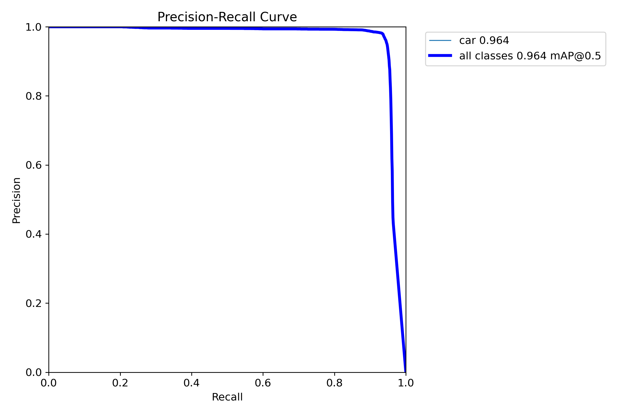
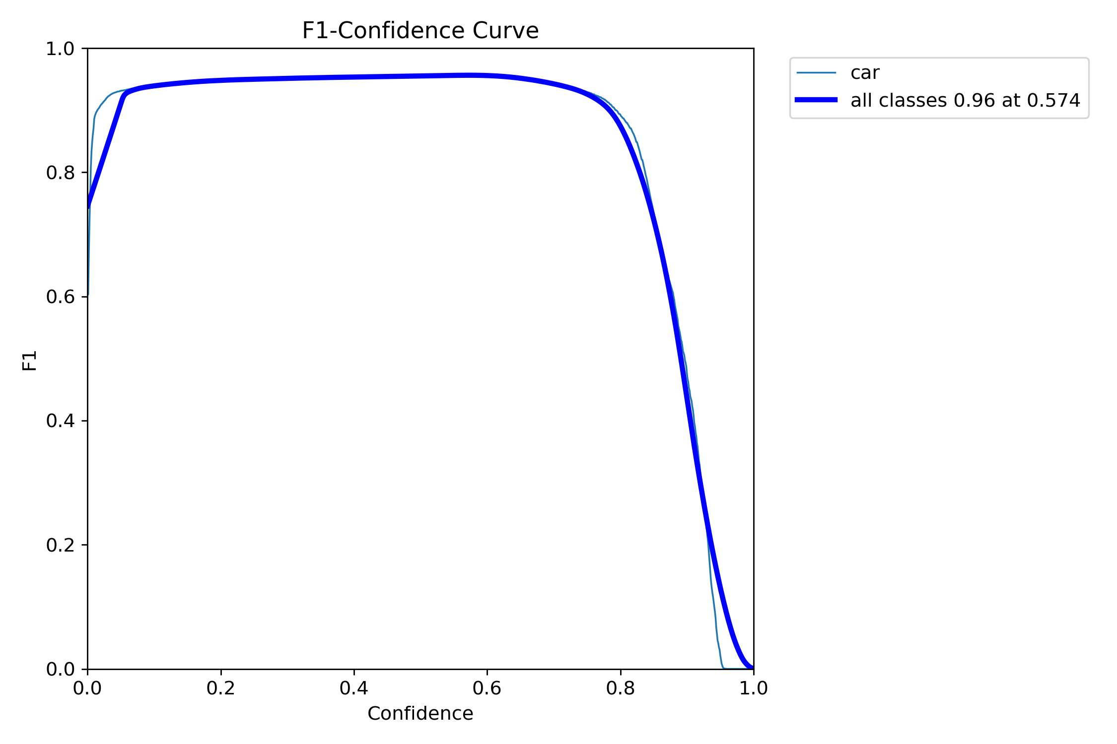
Precision-Recall & F1 Analysis — y11s
Figure 2. Precision-Recall Curve
Figure 3. F1-Confidence Curve
High area under PR curve confirms robustness across confidence thresholds · Peak F1 > 0.95 at confidence ≈ 0.4
18

Slide 19
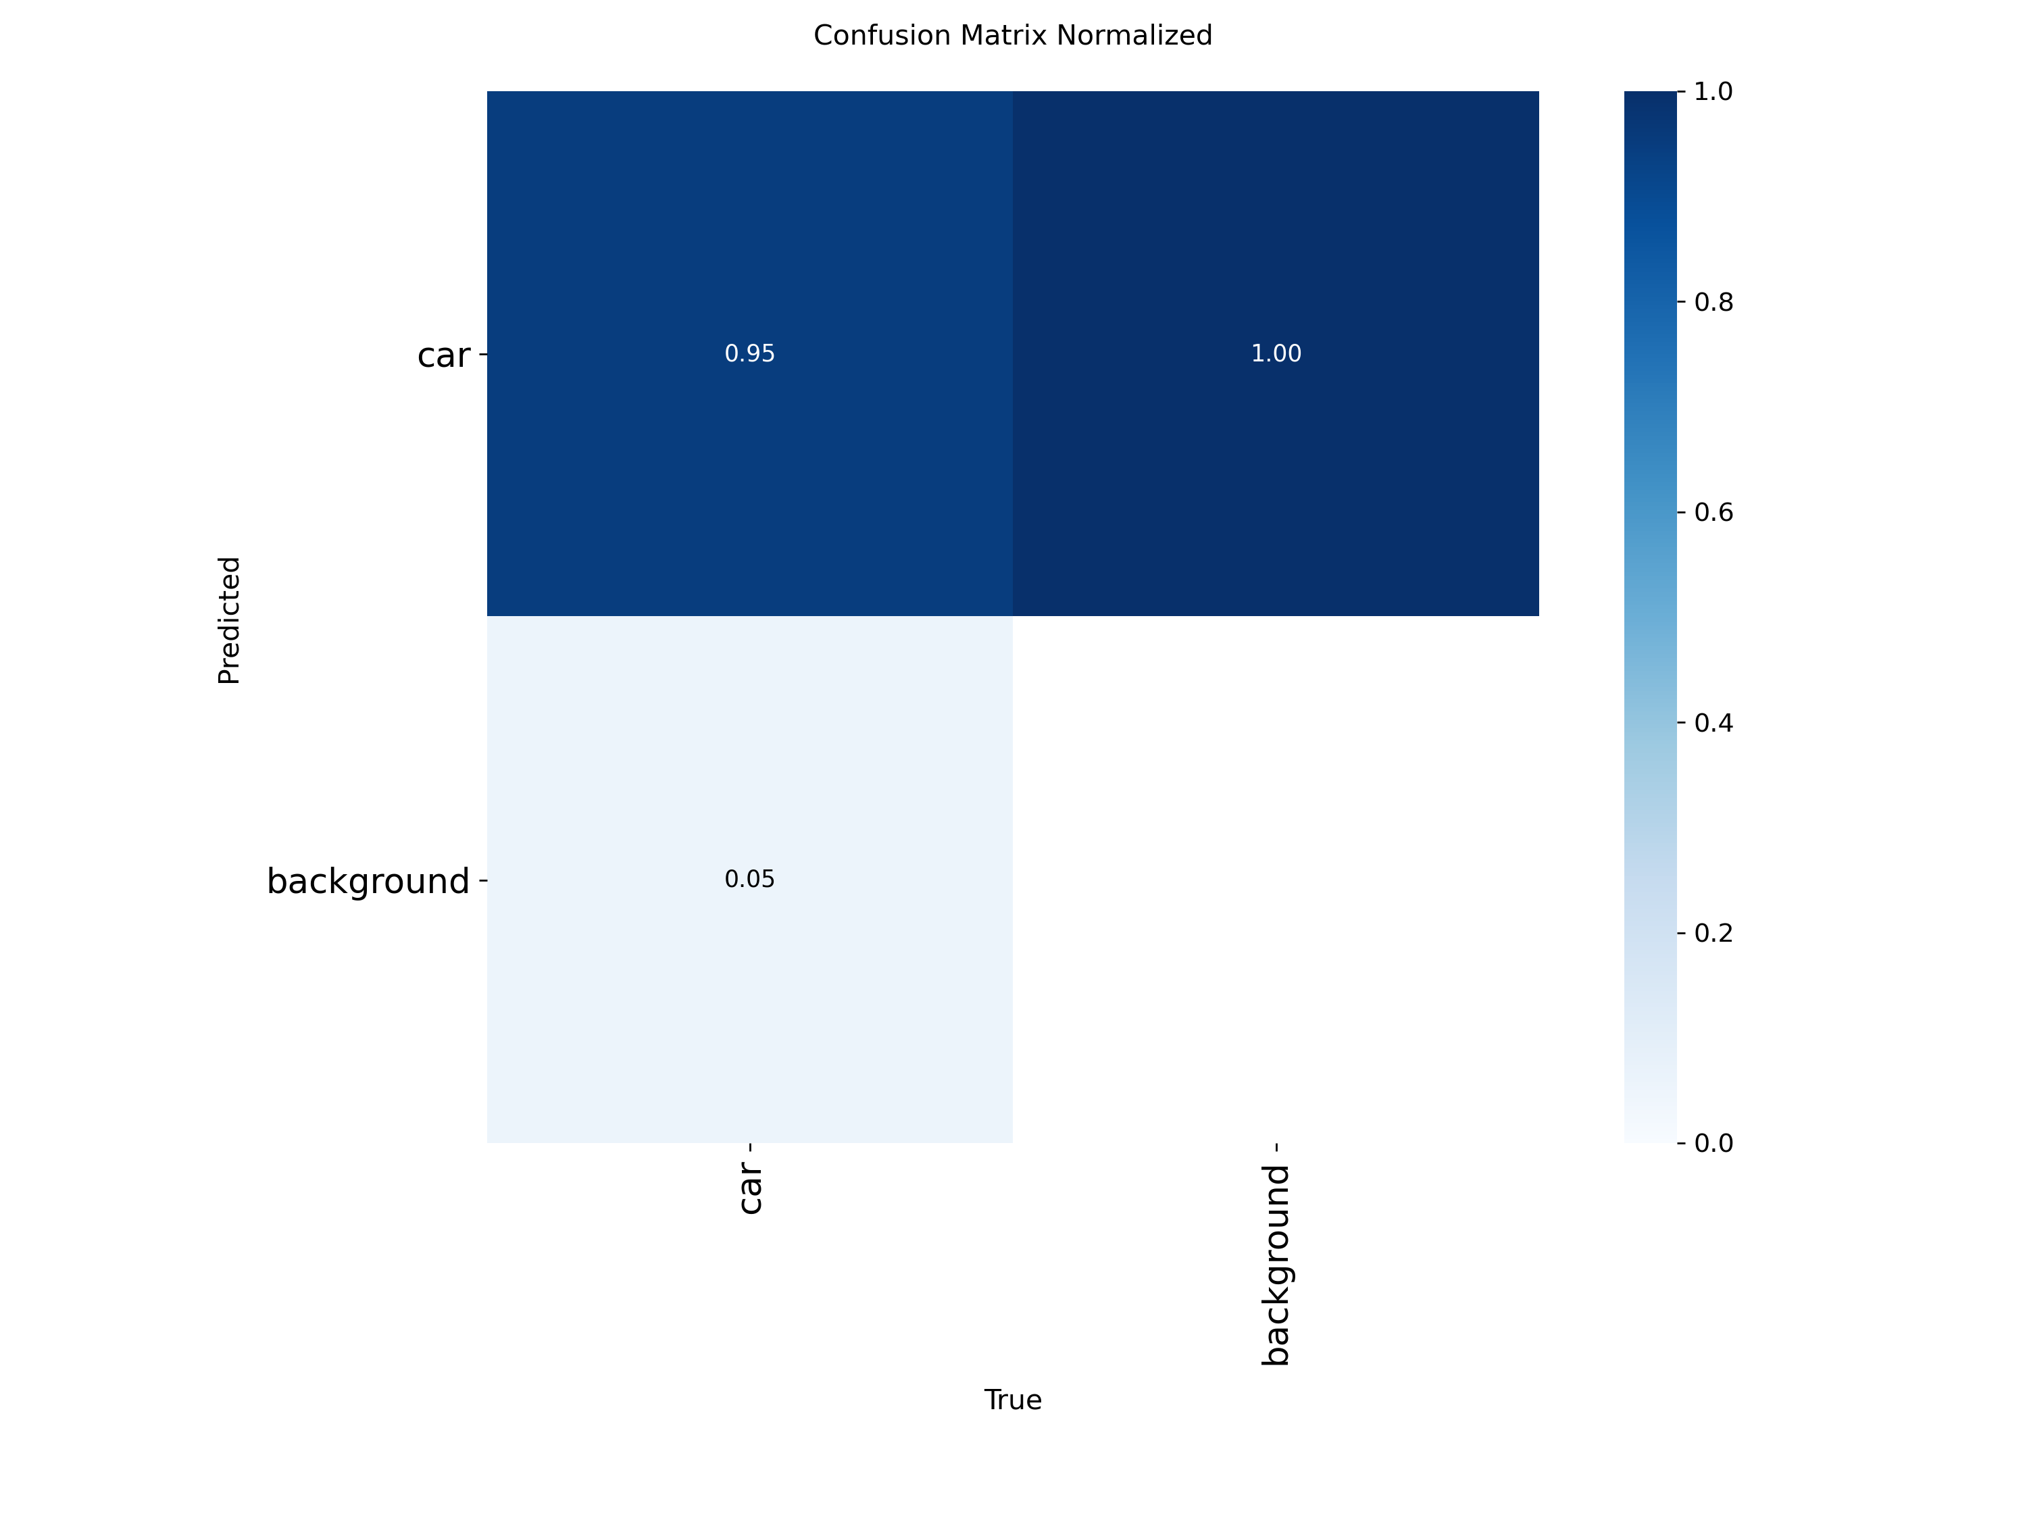
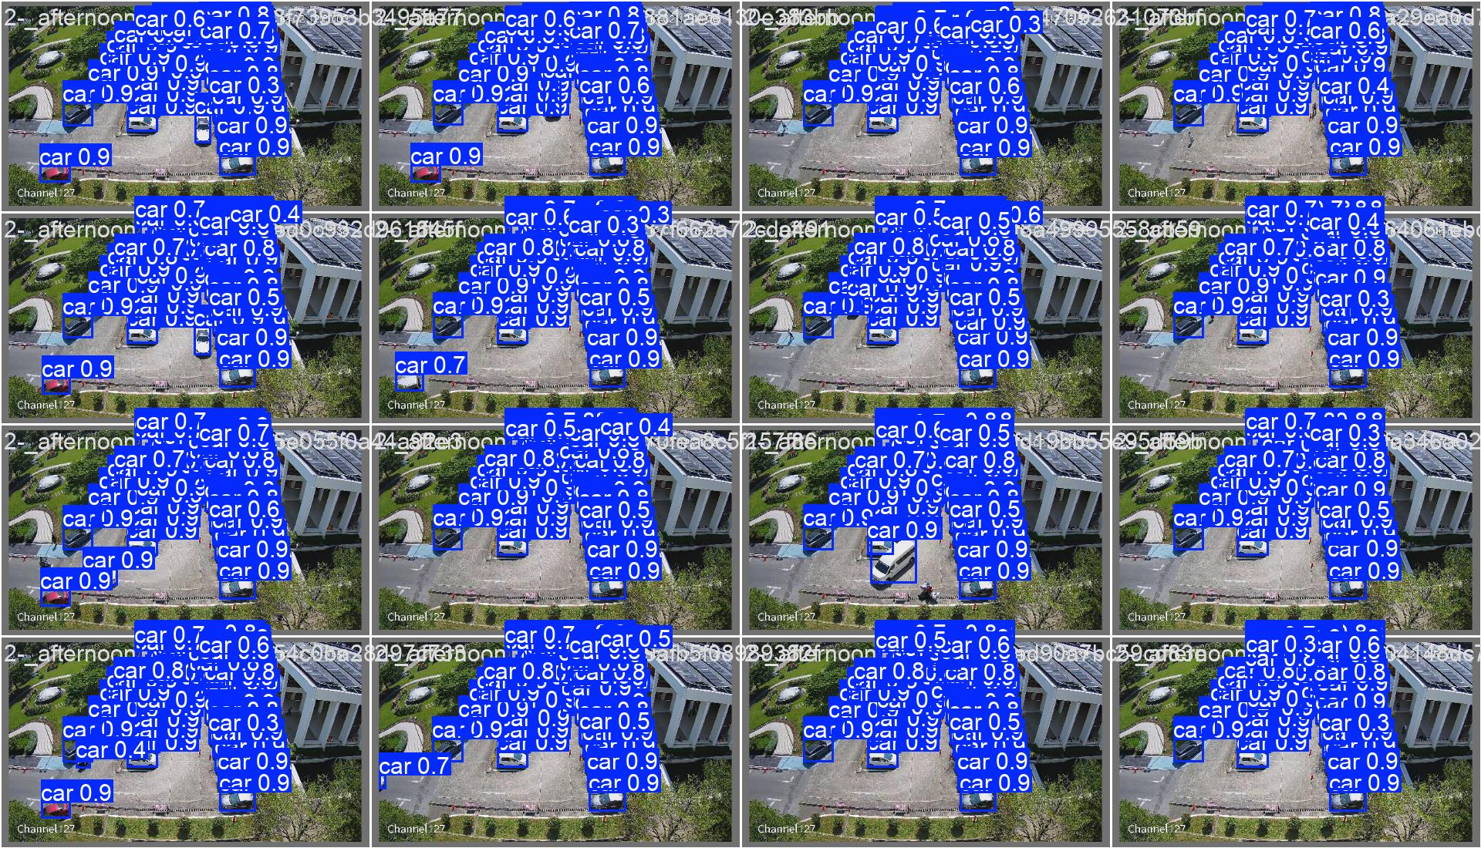
Confusion Matrix & Sample Validation Predictions
Figure 4. Normalised Confusion Matrix — y11s validation set
Figure 5. Sample validation batch predictions — y11s (high confidence, diverse scenes)
High on-diagonal values confirm reliable classification — minimal false positives and false negatives
19

Slide 20
Parking Spot Detection — Reference Image Output
37
Bays detected
2688×1520
Reference resolution
Once
Runs at startup only
2 AM
Auto-recalibration
JSON
Figure 6. config/reference.jpg — spots.pt detected 37 parking bays at 2688×1520 px. Coordinates saved to spots_data.json.
Coordinates persisted
20

Slide 21
Performance Results
Model Comparison — Epoch 50 Results
Model
Precision
Recall
mAP@50
mAP@50-95
Train Time (s)
y11n (YOLOv11n, std)
0.961
0.923
95.7%
77.4%
5,597
y11s (YOLOv11s, std) ★
0.976
0.937
96.4%
80.7%
6,729
y26n (YOLOv11n, 26-cls)
0.928
0.905
95.1%
75.2%
5,448
y26s (YOLOv11s, 26-cls)
0.965
0.930
96.2%
80.8%
5,303
96.4%
80.7%
37
y11s
mAP@50
mAP@50-95
Spots Detected
Deployed Model
★ Selected for deployment
21

Slide 22
Real-World Performance Benchmarks
ONNX Speed & Efficiency
y11s wins on all metrics
Model | CPU ONNX (ms) | GPU (ms) | Params (M) | FLOPs (B)
y11n | 30.35 | 26.89 | 2.59 | 3.22
y11s ★ | 58.13 | 10.89 | 9.43 | 10.77
y26n | 26.59 | 10.68 | 2.50 | 2.89
y26s | 54.60 | 11.16 | 9.95 | 11.25
mAP@50
96.4%
Highest accuracy
mAP@50-95
80.7%
Best generalization
Real-World Throughput (7,200 frames)
Throughput
Model | FPS | Latency (ms) | Total (s)
y11n | 97.18 | 10.29 | 74.09
y11s ★ | 102.85 | 9.72 | 70.01
y26n | 101.97 | 9.81 | 70.61
y26s | 99.04 | 10.10 | 72.70
102.85 FPS
Fastest real-world
Latency
9.72 ms
Lowest per-frame
Note: larger y11s model achieves higher FPS than y11n — better GPU kernel alignment outweighs extra parameters
22

Slide 23
System Behaviour — Demo Timeline
02:00 AM
09:30 AM
16:00 PM
18:00 PM
Low Occupancy (≤ 2 cars)
Medium Occupancy
Peak Occupancy
Variable Occupancy
Self-healing recalibration triggered. spots.pt re-scans live frame, updates spot registry & JSON.
Accurate FREE / TAKEN labels on all 37 spots. Dashboard reflects correct counts in real time.
HIGH occupancy correctly identified. Dashboard updates live as cars enter and occupy bays.
Smooth real-time transitions as vehicles enter and exit bays. Greedy matching resolves instantly.
23

Slide 24
Current Progress & Limitations
Completed
In Progress
Future Work
• YOLOv11 model training (4 variants benchmarked)
• Demo video polishing & screen capture
• Multi-camera orchestration
• Parking spot detection — spots.pt, NMS, JSON persistence
• UI refinement — label styling, color overlays
• IoT / MQTT cloud integration
• License plate recognition (ALPR)
• Bird's Eye View homography transform
• Greedy BEV distance-based occupancy matching
• Edge deployment (Jetson / Coral TPU)
• Self-healing 2 AM recalibration mechanism
• Real-time dashboard overlay (OpenCV)
24

Slide 25
Conclusion
Next Steps
What We Built
→ Multi-camera facility-wide coverage
• Dual YOLOv11 pipeline: spots.pt (bay detection) + best.pt (vehicle tracking)
→ IoT / MQTT real-time data streaming
• Bird's Eye View perspective normalization eliminates camera distortion
→ Mobile app driver notifications
• Greedy BEV matching assigns cars to spots in O(K log K) per frame
→ ALPR for permit enforcement
• Self-healing recalibration at 2 AM — zero manual re-annotation
→ Edge deployment (Jetson / Coral TPU)
• Deployed model (y11s): mAP@50 = 96.4%, mAP@50-95 = 80.7%
→ Adaptive BEV threshold learning
Why It Matters
High-accuracy real-time parking management with no per-bay hardware. Purely software-based — cost-effective, scalable, and maintainable.
Thank You | Q & A
25

