Slide 1



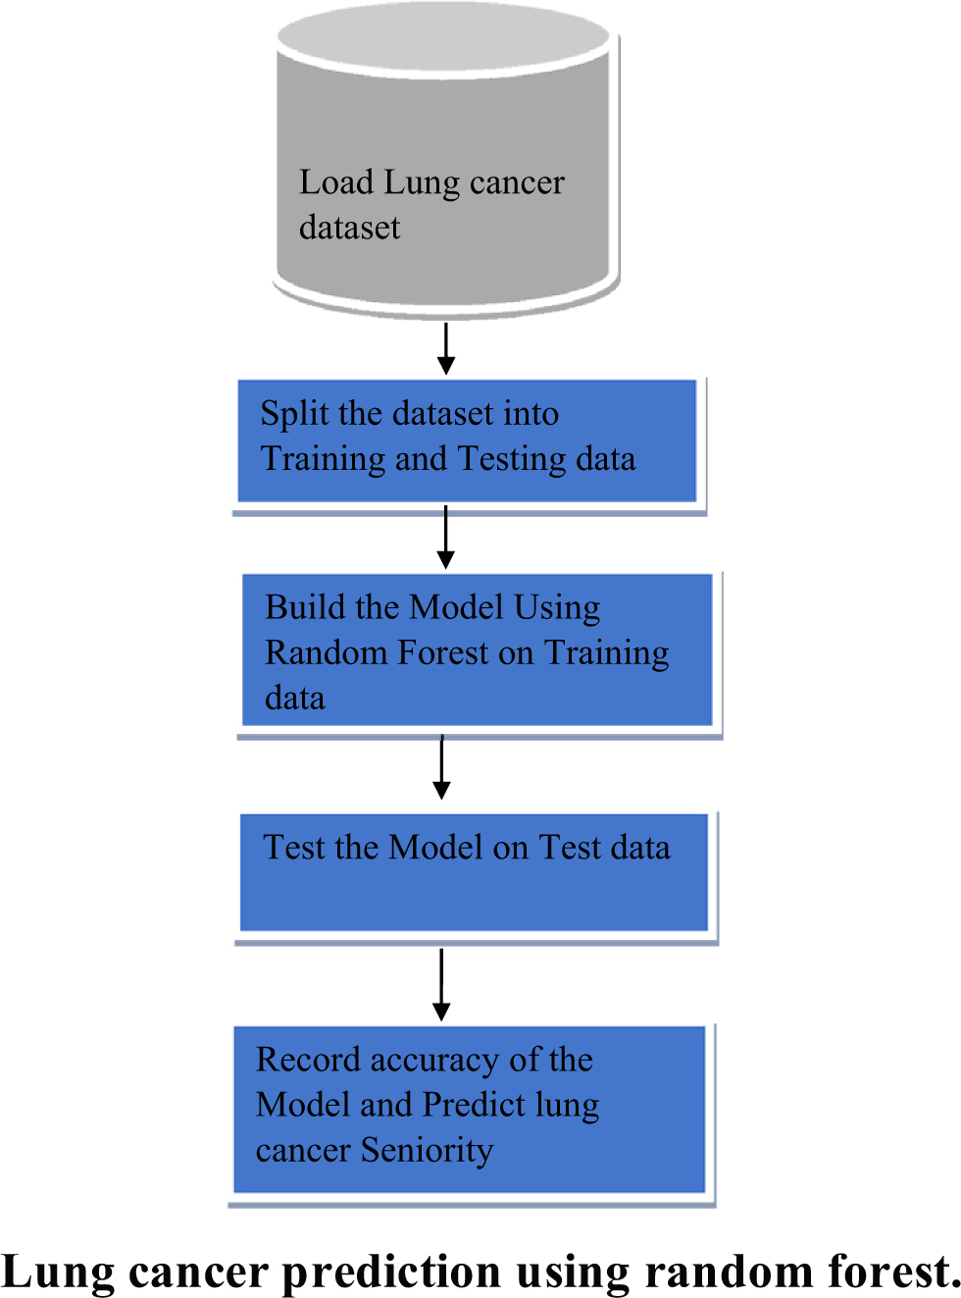
Lung Cancer Detection using Random Forest and SVM: A Diagnostic Aid for Leukemia
Student ID: 2311981436, 2311981440, 2311981413, 2311981386
Under The Supervision of : Dr. Ramamani Tripathy,
Professor, Chitkara University,
Himachal Pradesh
Add SDG Goal according to your title
(LOGO)
Abstract
Methodology
Proposed Solution
Conclusion
Dataset Collection: CT or histopathology images from publicly available databases such as LIDC-IDRI or LC25000.
Preprocessing: Resize, normalize, zero-score normalization.
Feature Extraction: ResNet50 and EfficientNetB3 for high-dimensional semantic feature extraction.
Feature Fusion: Feature vector concatenation.
Classification: Random Forest classifier to separate benign and malignant samples.
Evaluation Metrics: Accuracy, precision, recall, F1-score.
The approach starts by obtaining CT scan or histopathology images from public repositories. Images are normalized and resized to ensure consistency. Deep features are extracted with ResNet50 and EfficientNetB3, preserving fine semantic and structural details. These features are combined into one high-dimensional vector that describes the image. The vector is then classified using a Random Forest model, where multiple decision trees pool predictions to reliably differentiate benign from malignant lung tissue, ensuring interpretability and robustness.
The solution replaces the SVM classifier with a Random Forest model in order to enhance lung cancer detection. Random Forest improves interpretability by offering feature importance insight, making it easier to understand which features impact predictions. Its set of decision trees provides strong resistance against overfitting, rendering the model stronger on varied and noisy data. Random Forest also needs less parameter tuning than SVM, making the training process easier. In spite of this shift, the model performs highly in classification accuracy by using deep features derived from ResNet50 and EfficientNetB3 effectively, and as such, it is a useful and effective tool for computerized lung cancer diagnosis.
The ensemble model that integrates ResNet50, EfficientNetB3, and Random Forest shows impressive performance in classifying accurately the benign and malignant lung tissues. With the strong feature extraction capabilities of deep convolutional neural networks and classification capability of Random Forest, the model enjoys the benefits of both high-level semantic comprehension and interpretability. Random Forest's ensemble method not only improves classification results but also confers robustness to noisy data and mitigates overfitting, making it particularly useful for medical diagnosis. The combination of different features from both ResNet50 and EfficientNetB3 enables the model to detect subtle structural and textural changes in CT or histopathology images. The hybrid architecture places it as a potential clinical decision support tool, especially in resource-constrained healthcare environments. Future advancements will investigate real-time deployment in clinical settings and the integration of 3D volumetric image information to enhance diagnostic accuracy and flexibility with diverse imaging modalities and patient groups, leading to earlier lung cancer detection.
Introduction
Lung cancer is still one of the major cancer killers globally, mainly because of delayed diagnosis and mixed symptoms. For enhancing patient survival rates, early and proper detection is very important. Conventional methods of detection are greatly reliant on human review of CT scans or histopathology images, which can be time-consuming and are subject to human error. Machine learning, especially ensemble algorithms such as Random Forest, provides an optimal solution for robust and automated lung cancer diagnosis. This paper suggests deep feature extraction with a Random Forest classifier to improve accuracy and interpretability in lung cancer detection from medical images.
.

