Slide 1

The music recommendation system
By Radiants

Slide 2
Basic idea of fitopSy
Does not fit in to a specific model per se.
However, it is basically content based reinforcement learning.
No training data in the beginning. Cold start problem solved by asking the new user for his favorite genres in the first iteration and recommending the top songs which could be called the ‘typical’ songs of that genre i.e if favorite genres are Rock and Metal then in the first iteration recommend 4 songs from Led Zappelin and 4 songs from Metallica

Slide 3
Basic idea of fitopSy
In the subsequent iterations, we try to acquire taste of the user based on his actions like “Playing”,”Adding to playlist”,”disliking”,”Ignoring”, “liking” the recommended songs.
The system will be dynamic, changing according to users current taste.

Slide 4
Decision Parameters for content based filtering
Loudness
Will be higher and negative for loud songs ie rock and metal and positive for silent/peaceful acoustic songs ie folk
Tempo
Is the speed of the song in beats per minute
Timbre
Timbre is the different instruments or voices incorporated into the songs, so we’d have 12 different timbre values which could be called as different instruments like Guitar, Keyboard, Drums, vocals etc.
Genre
We have incorporated 10 different genres in our system.

Slide 5
Initial Steps
In initialization, we have average parameter values ie tempo,timbre etc for all the 10 of the genres that we have
When user selects his favorite genre, we’d recommend top x songs based on euclidean distance which are nearest to those average genre values that we have calculated.

Slide 6
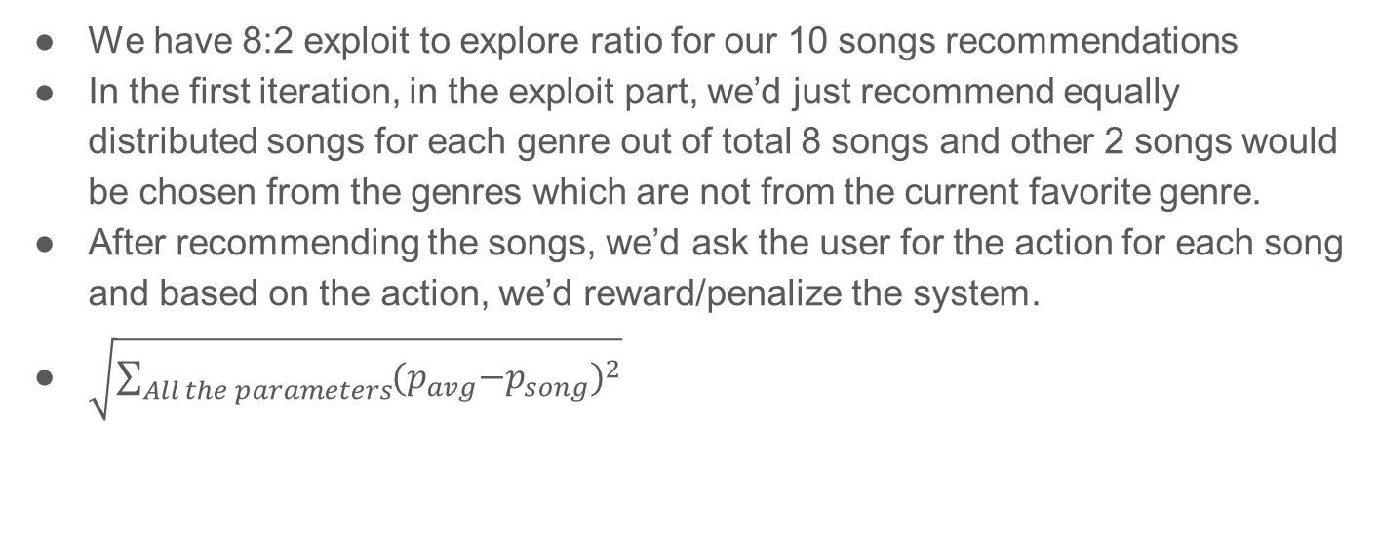
Mathematical Calculations

Slide 7
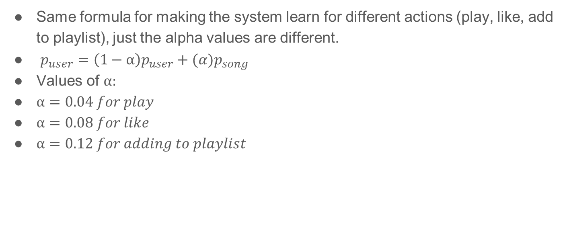
Mathematical Calculations

Slide 8
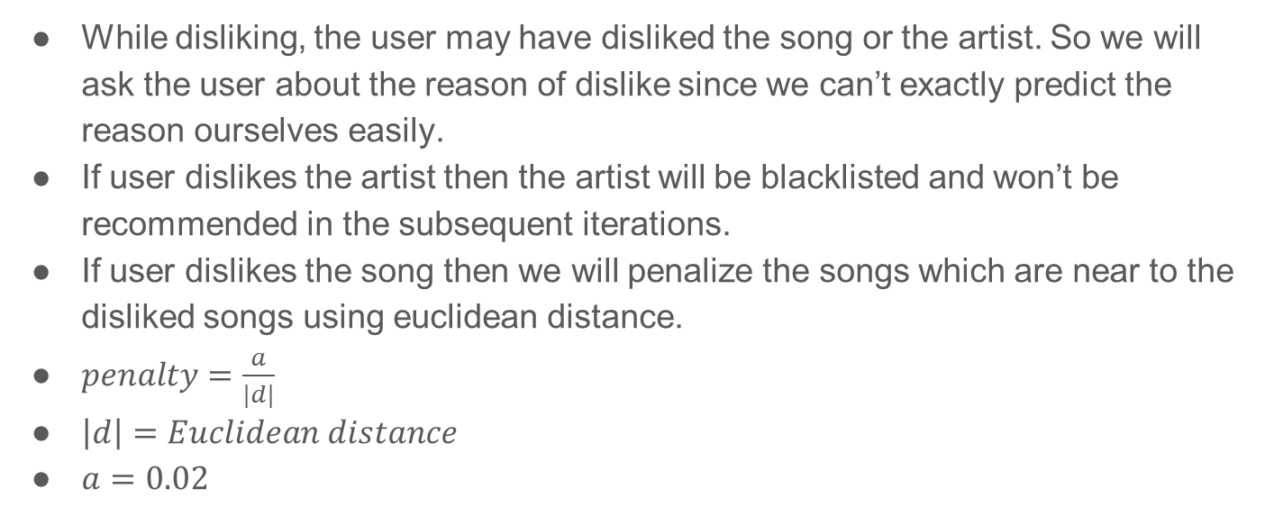
Dealing With Dislikes

Slide 9
How fitopSy Evolves?
We will keep the history of the past 20 “positive” actions of the user ie play, add to playlist and like.
Then we have given points for each action taken and accumulate all the points for each genres of the user.
The ratio for recommended songs in the next iteration will be decided from these points calculated for each genre ie if the user has liked/added to playlist/played more rock songs as compared to his other genre pop in the previous 20 recommended songs then in the next recommendation iteration, there will be more rock songs than the pop songs.
If the user has been ignoring a genre in the history again and again then we’d just stop recommending songs from that genre
If the user listens to a song from the exploration part (ie from the last 2 songs) then we’d also start recommending songs from that genre in the next iteration.

Slide 10
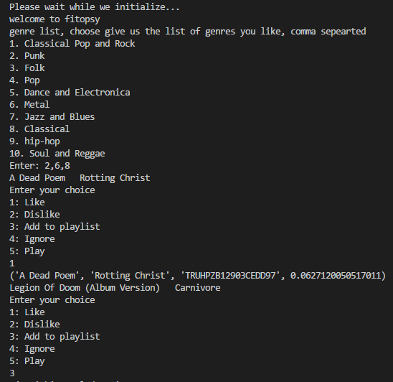
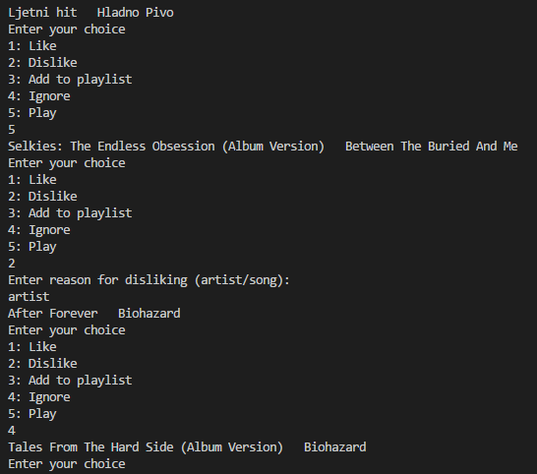

Slide 11


Thanks!
Questions?

