Slide 1

mongoDB Introduction
Peter Mo
Summer 2017

Slide 2
Outline
Introduction
Data Architecture
Data Types
Use Cases
Default Info.
User Interface
Working with Data
Databases
Collections
Document CRUD Examples
Notes:
CRUD = Create Read Update Delete

Slide 3
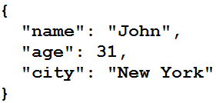
Introduction
What is MongoDB?
MongoDB is a Document Database
Documents are stored as BSON format
pronounced "bee-son" or "bee-sahn"
BSON is a Binary version of JSON
BSON supports more data types then JSON
Notes:
Example JSON with "Key": "Value"
bsonspec.org

Slide 4
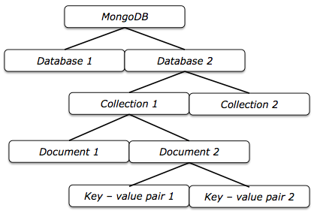
Data Architecture
Notes:
The "value" is the data

Slide 5
BSON Data Types
Double | Boolean | 32-bit integer
String | Date | Timestamp
Object | Null | 64-bit integer
Array | Regular Expression | Decimal128
Binary data | JavaScript | Min key
ObjectId | JavaScript (with scope) | Max key
Notes:
https://docs.mongodb.com/manual/reference/bson-types/

Slide 6
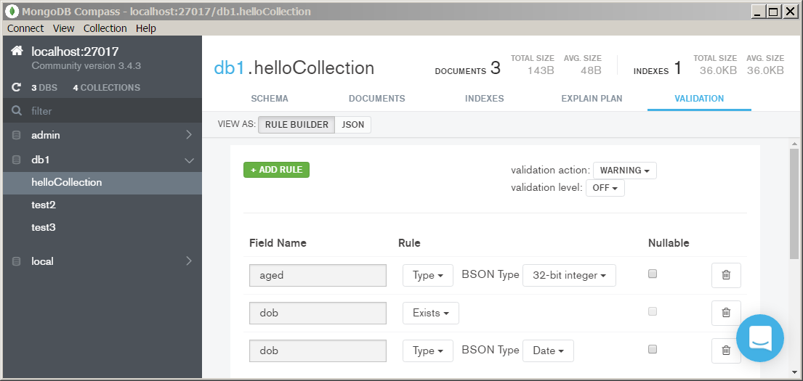
Document Schema?
There is no pre-defined structure to constrain data
Document Structures are Self-Describing
However, you can optionally implement a Collection Validator to enforce a schema.
Notes:
Validators are Per Each Collection
https://docs.mongodb.com/manual/core/document-validation
I think people realized now that we still want some structure to be enforced.

Slide 7
General Use Cases
Big Data 3Vs Compatible
High Volume (Distributed Data Storage)
High Variety (Dynamic Data Structures)
High Velocity (Parallel Processing)
Focus on Data Processing
Reporting/Analysis is NOT a primary concern

Slide 8

Typical Use Cases
External Data
Process
Data Warehouse
External Data
ETL
Process
Analyze
External Data
Process
Notes:
I think NoSQL is a complement (not a replacement) to Relational Technologies.
What do you think?

Slide 9
Primary Key
All Records/Documents are Uniquely Identified by an Automatic Field "_id"
e.g. ObjectID(591dc8e436c96b1b583960ab)
Hexadecimal Value
"_id" is of ObjectId data type
a 4-byte value representing the seconds since the Unix epoch
a 3-byte machine identifier
a 2-byte process id
a 3-byte counter, starting with a random value
Notes:
https://docs.mongodb.com/manual/reference/bson-types/#objectid
4 byte is not same as 4 characters here…
https://docs.mongodb.com/v3.2/reference/method/ObjectId/

Slide 10
Default Databases
admin
Internal management repository reserved for MongoDB
Contains DB User & Privilege Info.
Do NOT store your data here
local
Internal management DB used to support replication, startup info., etc. Data in local does not get replicated.
Do NOT store your data here
test
Default End User or Application Database Name
If you create a Collection without specifying a DB Name, it will automatically be created here!
Notes:
You should create your own databases by:
Using db.createCollection command
Insert New Document into Collection
There is NO createDatabase Command!

Slide 11
Default Users
MongoDB has a No default users!
Therefore, there is no security by default
That means anyone can do anything!
To enable Security
Create DB Users with Roles
Enable Authentication
Online References
https://docs.mongodb.com/manual/core/authentication
https://docs.mongodb.com/manual/reference/method/db.createUser
Notes:
Unlike most systems, MongoDB has no default root or sys or admin users!
https://docs.mongodb.com/manual/core/authentication
https://docs.mongodb.com/manual/reference/method/db.createUser
Fortunately, remote DB access is disabled by default.

Slide 12
Default Roles
Examples of User Roles:
read
readWrite
dbAdmin
dbOwner
userAdmin
root (Most Powerful)
Roles contain "Privilege Actions"
Online Reference:
https://docs.mongodb.com/manual/reference/built-in-roles
Notes:
https://docs.mongodb.com/manual/reference/built-in-roles
root is the most privileged system admin

Slide 13
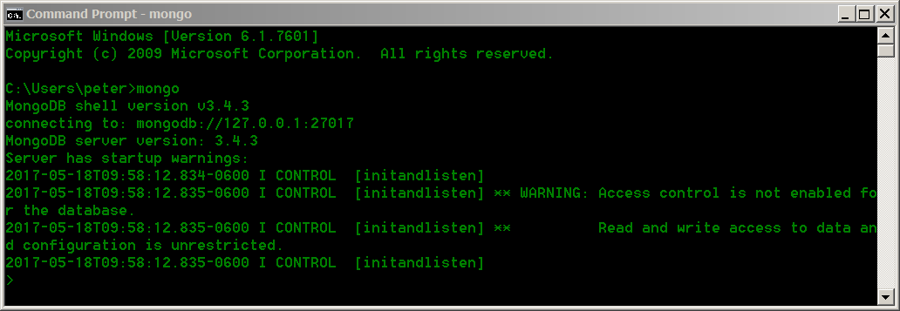
End User Interface
Mongo Command Line Shell:
Type "mongo" at command line
Notes:
Be sure to have set your PATH Environment Variable to run from your MongoDB Installation bin directory

Slide 14
Basic Mongo Shell Commands
List ALL DBs on Server:
show dbs;
show databases;
Display Currently Connected DB Name
db;
List ALL Collection in Current DB
show collections;
show tables;
List ALL Users on DB Server
show users;
List ALL User Roles on Server
show roles;
Notes:
semi-colons are optional;

Slide 15
Basic Mongo Shell Commands
Count Documents in Collection
db.myCollection.count()
Display Version of MongoDB
db.version()
Logout of Mongo Shell
exit

Slide 16
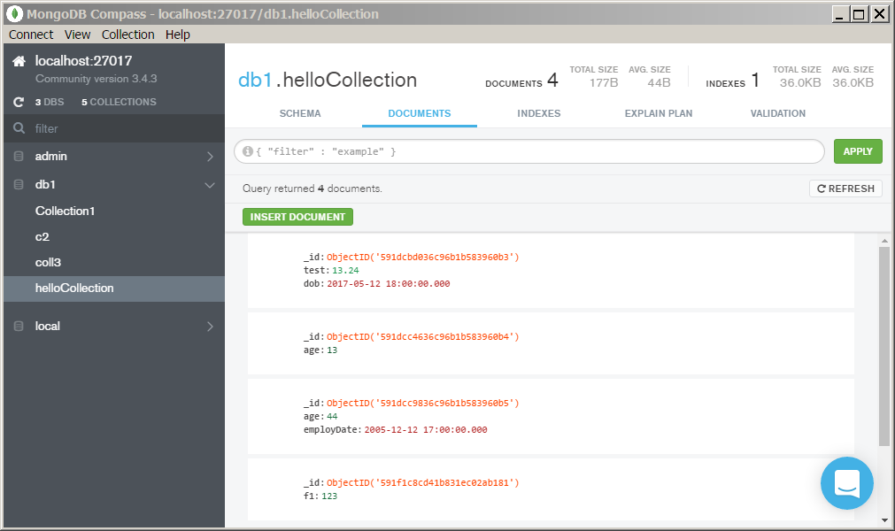
End User Interface
Mongo Compass Desktop GUI:
Notes:
Compass is an Awesome Desktop GUI Application!
Free for Development Only, Paid for Enterprise Production Customers.
https://www.mongodb.com/products/compass

Slide 17
Working with Databases
The use command
Switches to an existing Database or Switch to a new database if it does not already exist
use myDB
DB Name is Case Sensitive!
"dbName" & "DBname" are two different databases
There is NO createDatabase() command
The actual database will be created when data is inserted into the database.
Notes:
Seems like they borrowed "use" from mysql
use newDB does not actually create the DB until you create a new collection or document in newDB!

Slide 18
Working with Collections
db.createCollection("myCollection")
Or simply insert a new document to a new Collection
db.movieCollection.insert({"name":"Up"})
Creates new collection named "movieCollection"
Notes:
Creates this collection in "test" db unless you used the "use" command to specify your DB Name.

Slide 19
Drop
Drop Database
db.dropDatabase()
Removes current database & data files.
Drop Collection
db.myCollection.drop()
Removes collection & data files
All documents in collection will be deleted
Notes:
i think every collection has its own physical datafile in the Operating/File System.

Slide 20
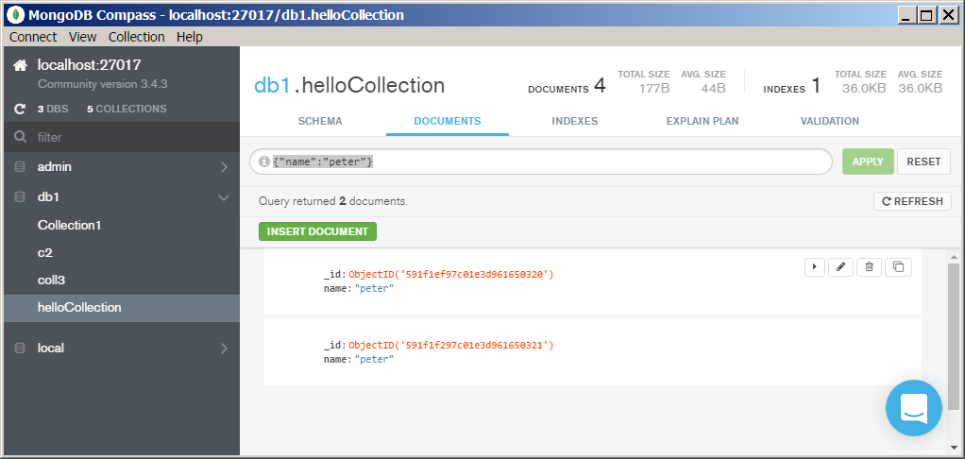
Queries/Filters
Use a json object as filter criteria
{"name":"peter"}

Slide 21
CRUD
Create
Insert document(s) to a collection, if collection does not exist, auto creates new collection
Read
Query or find document(s)
Update
Update data within document(s) or replace an entire document
Delete
Remove one or more documents
Notes:
https://docs.mongodb.com/manual/crud/
Collection Names are Case Sensitive, so be careful when inserting to Collection, since any typo would create a New Collection Automatically.

Slide 22
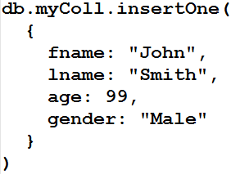
CRUD
Create One Document Syntax:
db.collection.insertOne()
Example:
Notes:
"db." is NOT the name of the database!
_id field auto created
The field names need "doubleQuotes" if NOT starting with Alpha or Underscore.
db.myColl.insertOne(
{
fname: "John",
lname: "Smith",
age: 99,
gender: "Male"
}
)

Slide 23
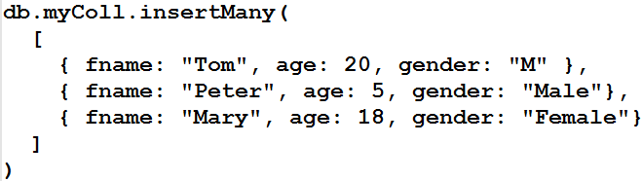
CRUD
Create Many Document Syntax:
db.collection.insertMany()
Example:
Notes:
JSON Array of Objects, One Object for each Document.
_id field auto created
db.myColl.insertMany(
[
{ fname: "Tom", age: 20, gender: "M" },
{ fname: "Peter", age: 5, gender: "Male"},
{ fname: "Mary", age: 18, gender: "Female"}
]
)

Slide 24
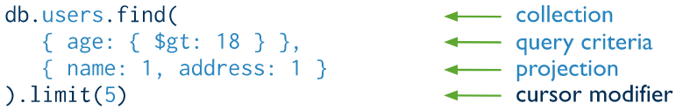
CRUD
Read or Query Documents
Compared to Relational SQL
collection = From Table Clause
query criteria = Where Clause Condition
projection = Select Clause Attributes
Notes:
Use the find() command
https://docs.mongodb.com/manual/crud/#read-operations
https://docs.mongodb.com/manual/tutorial/project-fields-from-query-results/
The 1 in the projection means Return True for that Field, 0 means do not return that Field.
So you can use {Field: 0} to exclude certain fields.
However, With the exception of the _id field, you cannot combine inclusion and exclusion statements in projection documents.
You can also just find by ObjectId:
db.myColl.find( { _id: ObjectId("5925b8747c01e3d961650322")} )

Slide 25
CRUD
Query Operator Examples:
Select all documents from collection
db.myCollection.find( {} )
db.myCollection.find()
Select using Conditional Criteria or Filter
db.myCollection.find( { gender: "M"} )
db.myCollection.find( { gender: { $eq: "M"} } )
db.myCollection.find( { gender: { $in: [ "M", "F" ] } } )
db.myCollection.find( { age: { $lt: 30 } } )
Notes:
The second $eq example is same as first example, meaning equal to "M"
The operators are documented here:
https://docs.mongodb.com/manual/reference/operator/query/#query-selectors

Slide 26
CRUD
Comparison Operators:
Operator | Meaning
$eq | Equal
$gt | Greater Than
$gte | Greater Than or Equal To
$lt | Less Than
$lte | Less Than or Equal To
$ne | Not Equal To
$in | In Any Item within List of Values
$nin | Not In Any Item within List Values
Notes:
https://docs.mongodb.com/manual/reference/operator/query/#query-selectors

Slide 27
CRUD
Logical Operators:
Operator | Meaning
$and | Both conditions must be True
$or | Either condition must be True
$not | Returns documents that do NOT match the query criteria
$nor | Both conditions must be False
Notes:
https://docs.mongodb.com/manual/reference/operator/query/#query-selectors

Slide 28
CRUD
Common Update Methods:
updateOne()
Update some data within a single document
updateMany()
Update some data within a multiple documents
replaceOne()
Replace an entire single document
https://docs.mongodb.com/manual/reference/update-methods
Notes:
https://docs.mongodb.com/manual/reference/update-methods

Slide 29
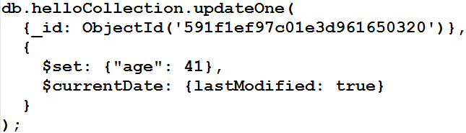
CRUD
db.collection.updateOne()
Example:
<-- Search
<-- Update
<-- lastModified
Notes:
db.helloCollection.updateOne(
{_id: ObjectId('591f1ef97c01e3d961650320')},
{
$set: {"age": 41},
$currentDate: {lastModified: true}
}
);
"_id" is the Primary Key of the Document
https://docs.mongodb.com/manual/tutorial/update-documents
https://docs.mongodb.com/manual/reference/method/db.collection.update/#examples
https://docs.mongodb.com/manual/reference/operator/update/currentDate/#up._S_currentDate

Slide 30
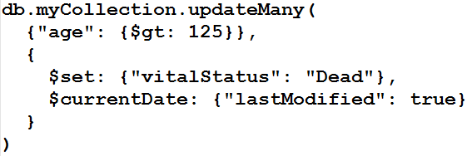
CRUD
db.collection.updateMany()
Example:
<-- Search
<-- Update
<-- lastModified
Notes:
db.inventory.updateMany(
{"age": {$gt: 125}},
{
$set: {"vitalStatus": "Dead"},
$currentDate: {lastModified: true}
}
)
https://docs.mongodb.com/manual/tutorial/update-documents
https://docs.mongodb.com/manual/reference/method/db.collection.update/#examples
https://docs.mongodb.com/manual/reference/operator/update/currentDate/#up._S_currentDate

Slide 31
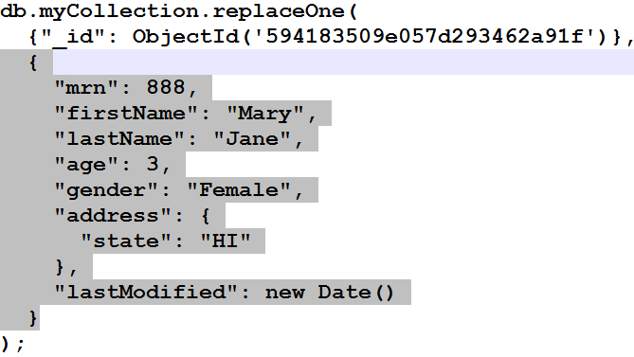
CRUD
db.collection.replaceOne()
Example:
<-- Search
<-- Document Replacement
<-- lastModified
Notes:
db.myCollection.replaceOne(
{"_id": ObjectId('594183509e057d293462a91f')},
{
"mrn": 888,
"firstName": "Mary",
"lastName": "Jane",
"age": 3,
"gender": "Female",
"address": {
"state": "HI"
},
"lastModified": new Date()
}
);
https://docs.mongodb.com/manual/reference/method/db.collection.replaceOne/#db.collection.replaceOne

Slide 32
CRUD
Common Delete Methods:
deleteOne()
Deletes FIRST Matched Single Document
deleteMany()
Deletes ALL Matched Documents
https://docs.mongodb.com/manual/reference/delete-methods
Notes:
https://docs.mongodb.com/manual/reference/delete-methods

Slide 33

CRUD
db.collection.deleteOne()
Example:
<-- Search
Notes:
https://docs.mongodb.com/manual/reference/method/db.collection.deleteOne
db.myCollection.deleteOne(
{"_id": ObjectId("594183509e057d293462a91f")}
);

Slide 34
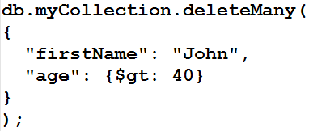
CRUD
db.collection.deleteMany()
Example:
Delete ALL Documents within a Collection
db.myCollection.deleteMany({})
<-- Search Criteria
Notes:
https://docs.mongodb.com/manual/reference/method/db.collection.deleteMany
db.myCollection.deleteMany(
{
"firstName": "John",
"age": {$gt: 40}
}
);

Slide 35



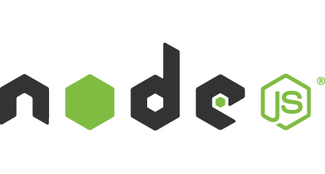



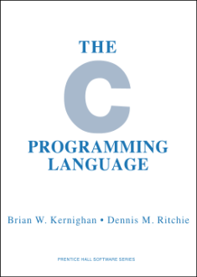



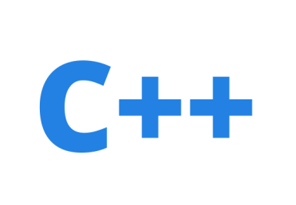



API Languages
Notes:
http://api.mongodb.com

Slide 36
Online Resources
Online Documentation
https://docs.mongodb.com
Free Online Courses
https://university.mongodb.com
Certification
https://university.mongodb.com/certification
Other Resources
https://resources.mongodb.com/getting-started-with-mongodb
Free Online DB Hosting
https://mlab.com
Notes:
Main Site: https://www.mongodb.com
https://resources.mongodb.com/getting-started-with-mongodb

Slide 37
Thank You!
Do we have time for an Exercise?
Patient Registration in an Electronic Medical Records (EMR) System.

Slide 38
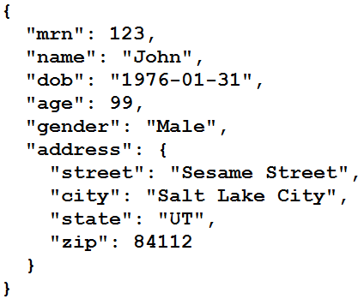
JSON Example Model
Patient Registration Example Fields:
Notes:
Very Important to understand the Data Model First!

Slide 39
Exercise (if time allows)
Create account on mlab.com
Create database named "emr"
Create collection named "patReg"
Create DB Username/Password of your choice under the "Users" Tab.
Use PyMongo to:
Insert Patient Registration Documents
Update Data
Delete Document
JupyterHub on:
https://jupyterhub.med.utah.edu/hub/login
Notes:
The main point of this exercise is to recognize the free resource of mLab.com
Use JupyterHub on:
https://jupyterhub.med.utah.edu/hub/login

