Slide 1

Intro. to NoSQL Databases
Peter Mo
Summer 2017

Slide 2
Objectives
Provide an introduction and a conceptual understanding of NoSQL technologies
Understand common data storage formats and related processing technologies

Slide 3
Agenda
What is NoSQL?
Why NoSQL?
Common NoSQL Platforms
What is a Document?
JSON
XML
Document Processing Technologies
Notes:
Document Technologies = Tools available to process/validate documents

Slide 4
Evolution of DB Technology
Notes:
Now in 2010s, People are still primarily using Relational Technologies!
How many of you are using NoSQL Solutions?

Slide 5
What is NoSQL?
NoSQL Definition:
Non-SQL
Non-Relational *
Not Only SQL
Notes:
Many NoSQL solutions do offer SQL!
I think "Non-Relational" is most accurate.
Any Others?

Slide 6
What is NoSQL?
A database is an organized collection of data
Many ways to organize data
Relational Technology
Based on Relational Theory (E.F. Codd 1970)
Oracle, MySQL, SQL Server, etc.
Table Structures
Non-Relation (NoSQL) Technologies
There are many types
Document Collections
Graph Nodes and Edges
Key-Value Pairs
Others…
Combinations of various types in a single solution
Notes:
E.F. Codd wrote the paper while working for IBM, but Oracle used it 8 years later.
We will mainly focus on Document and Graph DB, since they are more widely used.
Many NoSQL solutions do offer SQL!

Slide 7
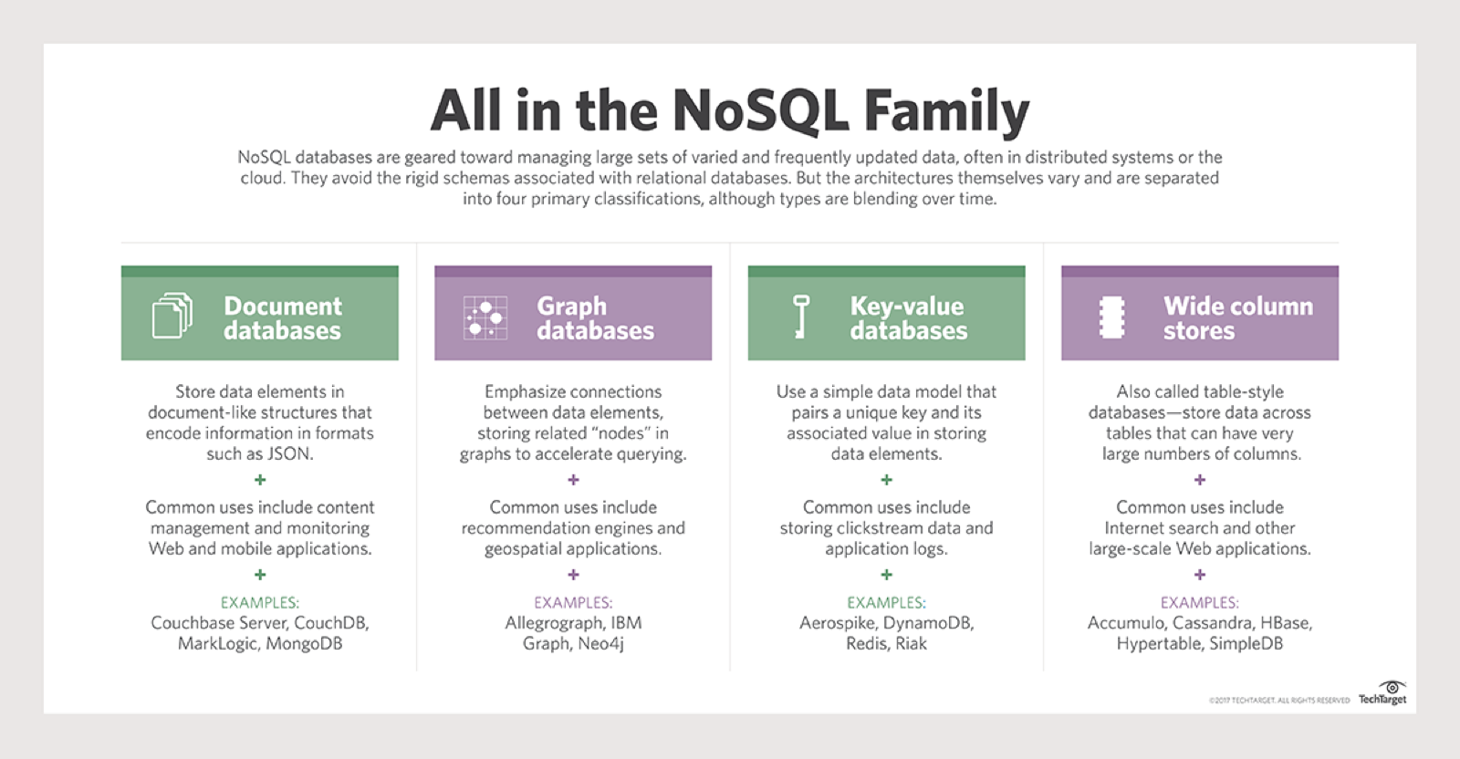
What is NoSQL?
Notes:
Read the Summery Text...
OrientDB attempts to do all of these in one product!
I think these will eventually merge into one product.
Document can simulate Key-Value and Wide Column

Slide 8
Why NoSQL?
Supports polymorphic data types:
Structured, Semi-Structured, Unstructured
Fits well with Agile development
Data Structures may change on-the-fly
Scalability (Big Data Compatible)
Distributed & Parallel Processing
High Performance & Availability
May take advantage of Cloud Computing
Notes:
The slide covers the reasons for using NoSQL! Any other use cases?
https://www.mongodb.com/nosql-explained
Dynamic Schemas
Auto-sharding
Replication
Integrated Caching

Slide 9
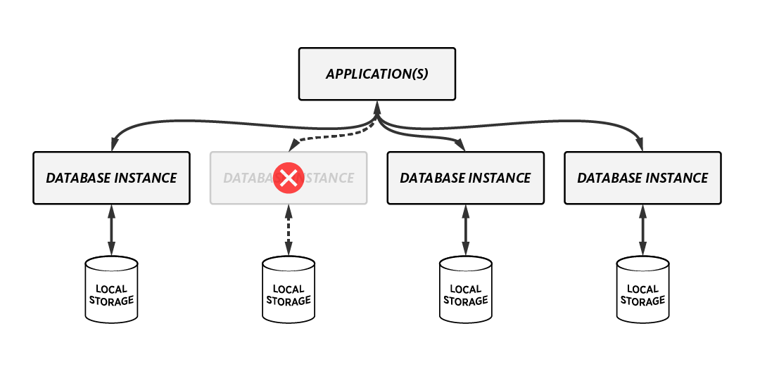
Why NoSQL?
Big Data Features:
High Availability (Auto Fail-Over)
High Performance
Commodity Hardware
May be Local, Remote, or on Cloud
Notes:
NoSQL is designed to work with Big Data Features:
Auto Fail-Over
Auto-Sharding
Replication & High Availability & High Performance Computing
Integrated Caching
Flexible Geographic Locations

Slide 10




NoSQL DB Platforms
Document:
Usually JSON or XML
Popular Technology/Platform:
MongoDB (BSON=Binary Form of JSON)
BaseX (XML)
Graph:
Popular Technology/Platform:
Neo4j (Cypher Query Language)
OrientDB (SQL)
Notes:
OrientDB has a nicer UI than neo4j
https://db-engines.com/en/ranking/document+store
BSON is a binary representation of JSON documents
http://bsonspec.org provides more data types:
https://docs.mongodb.com/manual/reference/bson-types/
https://db-engines.com/en/ranking/graph+dbms

Slide 11

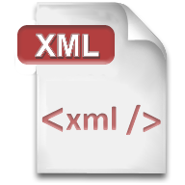
Document Formats
Designed to Store and Transport Data
Human and Machine Readable
JSON:
JavaScript Object Notation
XML:
Extensible Markup Language
Notes:
We will go over each of these in the following slides…

Slide 12
Document Structure
Do you need document structure?
= ?
NoSQL Structural Strategy:
Create a minimal set of common fields
Extend fields at in real-time or as needed
Relational databases provide a relatively static structure, while NoSQL provides a flexible structure.
Document A
Document B
Notes:
If you need to compare one document to another, then you need some structure. Otherwise, you may not need document structure.
I believe more often than not, you would want some kind of document structure.
OrientDB offers "Classes"
MongoDB offers "Schema Validation Rules"

Slide 13
JSON
Data Format in key-value pairs
{"key" : "value"}
The key is always in double quotes
The value quotes depend on data type
Data Types:
String
E.g. { "stringKey" : "string value in Double quotes" }
Number
Integer or floating point, no quotes
E.g. { "age" : 30.123 }
Boolean
true or false, no quotes
E.g. { "flagField" : true }
Null
E.g. { "dummyField" : null }
Notes:
Let's talk about JSON Structure
Only String Data Type Value requires Double Quotes
Date or Time Data Types are NOT supported
Everything is Case Sensitive! True <> true

Slide 14
JSON
How is JSON Data Organized?
Data Structures:
Object { }
An object is an unordered set of key-value pairs
Array [ ]
An array is an ordered collection of values (List)
Data Nesting:
A Value may be an Object or an Array
You can embed Objects inside of Array and vice versa
Notes:
Data Nesting is Supported, and get highly complex.

Slide 15
JSON Example
Simple
{
"name" : "John",
"age" : 31,
"Birth Place" : "New York"
"alive" : true
"married" : null
}
Notes:
Simple Person Object Example
Watch the Quotes and Case Sensitivity! true <> True

Slide 16
JSON Example
Nested
{
"company" : [ "University of Utah", "IHC" ],
"employees" : [ { "firstName":"John", "lastName":"Doe" }, { "firstName":"Anna", "lastName":"Smith" }, { "firstName":"Peter", "lastName":"Jones" } ]
}
Notes:
Array of Strings & Array of Objects

Slide 17
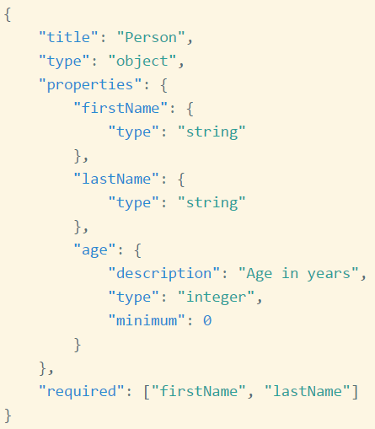
JSON Schema
Validates Structure of JSON (json-schema.org)
Notes:
http://json-schema.org/examples.html
A Developing Standard, not widely used yet.
JSON Fields start within the "properties" key:

Slide 18
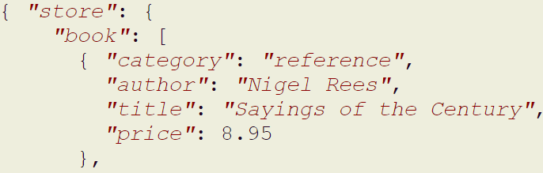
JSON Data Extraction
Extract Data from JSON
Example Books Catalog (Partial Data Shown)
JsonPath to Get Authors of All books
$.store.book[*].author
Notes:
xPath for JSON is called JsonPath
http://goessner.net/articles/JsonPath
-- online examples:
http://jsonpath.com
A Developing Standard, not widely used yet.
Returns "Nigel Rees" here

Slide 19
JSON Query Language
JSONiq
http://jsoniq.org
JSONiq for JSON is the equivalent to:
XQuery for XML
SQL for Relational Databases
JSONiq also a developing standard (work in progress), not yet widely used.
Notes:
JSONiq leverages JsonPath
http://goessner.net/articles/JsonPath
A Developing Standard, not widely used yet.

Slide 20
Data Comments
JSON does NOT support Comments
Use the data itself to comment things
XML
<!-- XML Comments are like this.
Same as HTML Comments. -->
Notes:
XML also supports XML Attributes <node xmlAttribute="comment">Some Data</node>
XML is overall more mature than JSON

Slide 21
XML
eXtensible Markup Language
Uses Start and End Tags similar to <html/>
Data Format:
<nodeName>Some Data</nodeName>
Data Types:
Since Element Data does not require quotes, you may treat everything as text.
if using XML Attributes, always use quotes
<nodeName date="2017-07-24">Some Data</nodeName>
Notes:
https://www.w3schools.com/xml/
Attribute Data is best used as Metadata about the Element Data

Slide 22
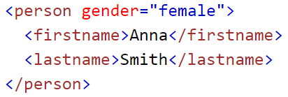
XML Example
Single Person Object
Notes:
Single Entity <person> Example
https://www.w3schools.com/xml/
Attribute Data is best used as Metadata about the Element Data
In this case, I would have used gender as another node, rather than an Attribute.

Slide 23
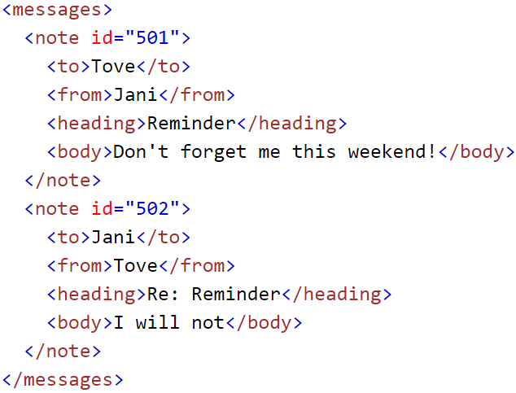
XML Example
Multiple
note
Objects
Notes:
Multiple Entity <note> Example
https://www.w3schools.com/xml/
Attribute Data is best used as Metadata about the Element Data

Slide 24
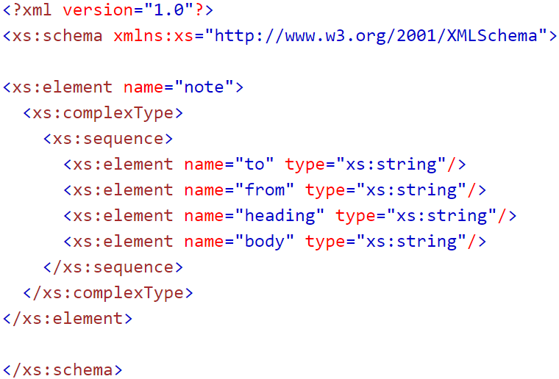
XML Schema
XML Schema Definition (XSD)
Notes:
Defines Valid Structure of the XML Document
https://www.w3schools.com/xml/schema_intro.asp
You can use Java or online tools to validate xml with xml schema.

Slide 25
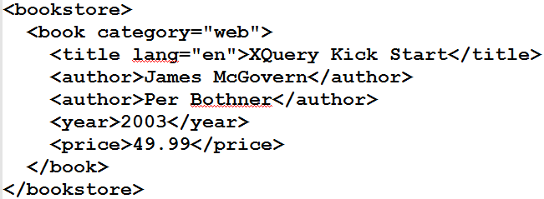
XML Data Extraction
XPath
selects all titles with a price higher than 35
/bookstore/book[price>35]/title
Returns <title lang="en">XQuery Kick Start</title>
Notes:
https://www.w3schools.com/xml/xpath_intro.asp
Returns <title lang="en">XQuery Kick Start</title>
[price>35] is referred to as the Predicate.

Slide 26
XML Query Language
XQuery is a W3C Recommendation
https://www.w3.org/XML/Query
XQuery leverages XPath to Query XML Data
Uses the FLWOR Syntax:
For - selects a sequence of nodes
Let - binds a sequence to a variable
Where - filters the nodes
Order by - sorts the nodes
Return - what to return
Notes:
https://www.w3.org/XML/Query/
https://www.w3schools.com/xml/xquery_intro.asp

Slide 27
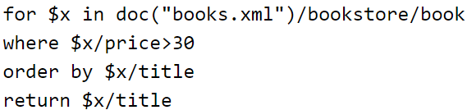
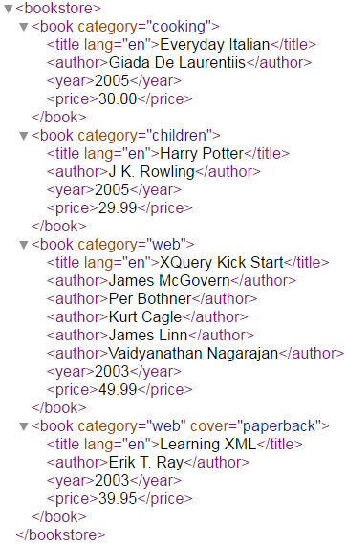
XML Query Language
XQuery Example
Return Book Titles where Price > $30
Results:
Notes:
You can execute XQuery Code in BaseX

Slide 28

Thank You!
Discussion? Questions?

