Slide 1

OrientDB Introduction
Peter Mo
Summer 2017

Slide 2
Objectives
Provide an introduction and conceptual understanding of Graph technology using OrientDB
Provide Hand-On Exercise using OrientDB Graph Database
Notes:
Hands-On Graph Exercise would be fun

Slide 3
Outline
Introduction
Using OrientDB as a Graph DB
OrientDB Architecture
DB Structure
Data Types
Default Users
User Interface
Working with Data
Vertex CRUD Examples
Edge CRUD Examples
Traversing Graphs (Queries)
Notes:
We can do a simple Group Exercise at the End (if time allows)
http://workbench.ccts.utah.edu:2480/studio/index.html
CRUD = Create Read Update Delete

Slide 4
Introduction
What is OrientDB?
OrientDB is a multi-model database, which means you can use it as a Graph DB, Object DB, or Document DB.
However, fundamentally everything is simply a JSON document
Scope of this presentation:
The focus of this presentation is solely on using OrientDB as a Graph Database.
Other use cases (models) are not covered here.
Notes:
Technically, OrientDB is a JSON Document Store!
OrientDB is NOT a Relational DB
I think if you're not using OrientDB as a Graph, then you'd be better off using MongoDB as a Document Store.

Slide 5
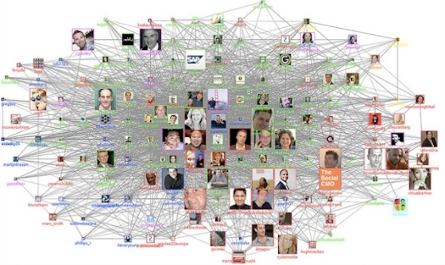
Graph DB
Vertexes (aka Nodes) connected to other Vertexes through Edges (aka Relationships)
Notes:
Social Network is good use case, such as Facebook.
"Nodes" are easier for me, since Vertex Plural can be "Vertexes" or "Vertices"

Slide 6
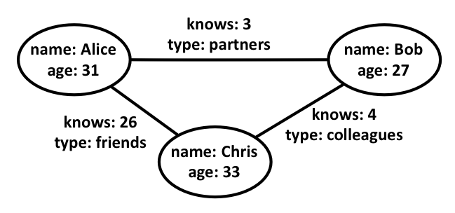
Graph DB
When should you use a Graph DB?
When your Data is Graphical in Nature!
You want to visualize & measure complex relationships.
Example:
Notes:
A Graph DB is all about capturing (storing), measuring (counts & aggregations), traversing (Query), and visualizing Relationships!

Slide 7
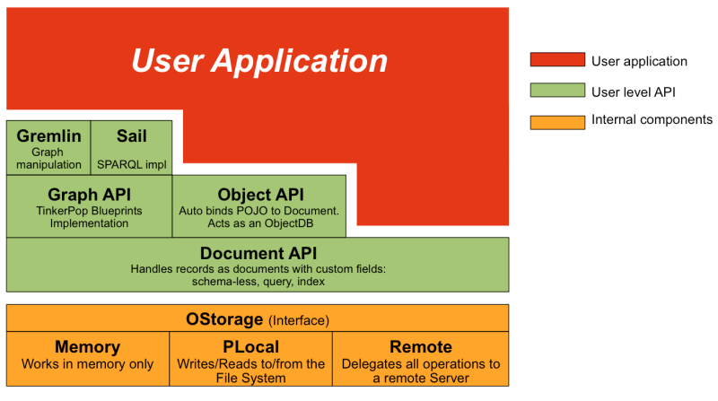
OrientDB Architecture
Everything is a JSON Document
Vertexes and Edges are JSON Documents
Notes:
Sail is the SQL Implementation for OrientDB
Gremlin is a Graph Traversal Language for Graphs
http://orientdb.com/docs/2.2.x/Console-Command-Gremlin.html
http://orientdb.com/docs/2.2.x/Gremlin.html

Slide 8
Vertex & Edge
Graph Data stored in Properties (Fields)
Vertexes may have Properties
Edges may have Properties
Edges always have a single Direction
Vertex & Edge a.k.a. "Records" in OrientDB
Vertex_1
Edge_1
Vertex_2
Property=Value
Property=Value
…
Property=Value
Property=Value
…
Property=Value
Property=Value
…
Notes:
This is also referred to as the Property Graph
Vertex & Edge can be generalized to a Record = JSON Document
Vertex is a JSON with the Property Values
Edge is a JSON with the Property Values
Does Property Key "Fname" == "FirstName" == "fname"? NO!

Slide 9
Database Structure?
While most Non-Relational DBs (such as Neo4j) do not enforce any data structure, OrientDB optionally use Classes to define data structure:
Schema-hybrid Enables classes with some fields, but allows records to define custom fields. This is Default
Schema-full Enables strict-mode at a class-level and sets all fields as static & mandatory.
All Vertexes & Edges belong to a Class (Schema)
Default "V" & "E" Super Classes have no properties, but may be altered for custom properties (Fields)
Child Classes will inherit super class properties, but will NOT inherit strictMode
Notes:
Classes are synonymous to Java Classes (Refer to GMS UML Diagram)
OrientDB supports SQL. That's why I used Non-Relational, rather than NoSQL.
You must inherit all Vertexes from V Class, and all Edges from E Class in order to use the Graph API.
Schema strictMode is defined per Class or at Class Level, not the entire DB.
StrictMode does NOT get inherited to SubClasses!
strictMode also means you cannot adjust the Fields, you cannot add any more custom Fields to the Class; Static structure like a Table.

Slide 10
Record ID (Primary Key)
All OrientDB Records are Uniquely Identified by an Automatic Record ID Property "@rid"
Format of @rid
# Cluster Number : Position in Cluster
E.g. #12:9
A Cluster is a Location Bucket for a group of Records belonging to the same Class
A Class may be assigned to many Clusters
Class
Cluster
1
M
Notes:
In the above example, Cluster 12, Position 9
We can Reference any document, vertex, or edge, using the RecordID @rid
A Cluster is a Logical as well as Physical Storage Location
I believe each cluster may be physically stored on separate Servers for Distributed Processing. (Big Data)
You never really need another primary Key Field.
We will discuss Class in the following slides…

Slide 11
Record Metadata
All Records have automatically assigned Metadata Attributes/Properties:
@rid (Info on Previous Slide)
@class
Name of Class that the Record belongs to
Default Vertex = V Class
Default Edge = E Class
@version
This property keeps track of how many times the record has been updated, starts at 1.
Notes:
http://orientdb.com/docs/2.2.x/Tutorial-Record-ID.html
@version 1 = Never been updated.
These are the 3 most basic Metadata Attributes. There may be a couple more…

Slide 12
Property Data Types
http://orientdb.com/docs/2.2.x/Types.html
Boolean | Datetime | EmbeddedMap | Transient
Integer | String | Link | Date
Short | Binary | LinkList | Custom
Long | Embedded | LinkSet | Decimal
Float | EmbeddedList | LinkMap | LinkBag
Double | EmbeddedSet | Byte | Any
Notes:
http://orientdb.com/docs/2.2.x/Types.html
Class Property Data Types
I think Neo4j does NOT support Binary & EmbeddedMap, which may be important for our use case.
String in java is 2,147,483,647 max characters.

Slide 13
DB Users
The OrientDB Instance has a default "root" user
Inside of Each OrientDB Database, there are 3 default users/passwords:
"admin"/admin (Administration)
"reader"/reader (Read Only)
"writer"/writer (Read and Write)
User have Roles
Roles have Permissions
Notes:
You should always reset the 3 DB User Passwords after you create a Database, if deploying in Public or Production Environments.
We will be using admin for our Exercise Today.
http://orientdb.com/docs/2.2.x/Database-Security.html

Slide 14
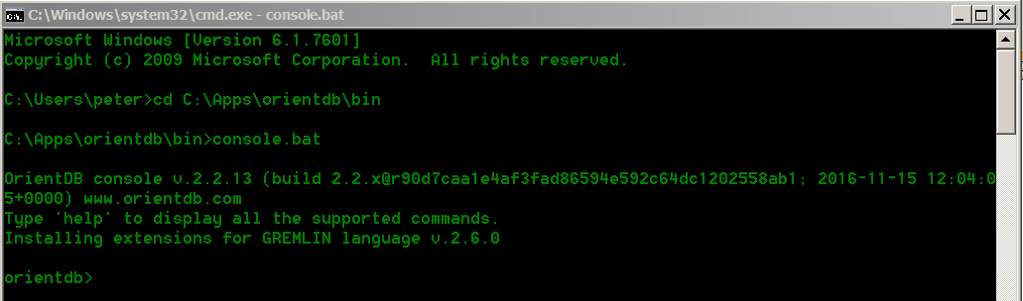
End User Interface
Command Line Console:
Web Studio UI
http://localhost:2480/studio/index.html
Notes:
http://workbench.ccts.utah.edu:2480/studio/index.html

Slide 15
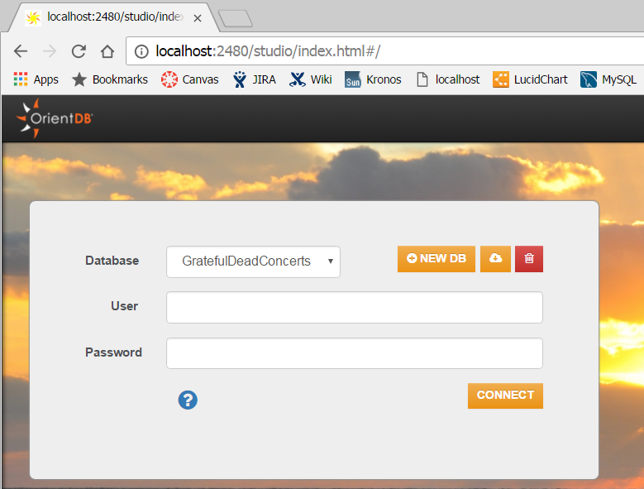
Web Studio Login
Notes:
You can Create or Delete Entire Databases here!
You can also import publicly available databases, but not your own custom databases.
It did not work when I tried to import here…

Slide 16



Web Studio
Graphical User Interface (GUI)
The GUI allows highly interactive management of Classes, Vertexes, Edges (Create, Update, Delete)
However, you can still issue SQL commands on the GUI, so you can simply copy & paste from your SQL scripts.
We will focus on SQL here, since the GUI components are fairly self-explanatory.
Notes:
You can use Web UI Buttons or SQL Statements on the Web Studio
Editing Nodes and Edges does NOT seem to work at time of this writing.

Slide 17
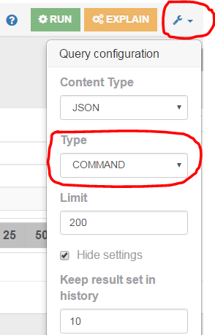
Web Studio
SQL Modes
Command Mode (Default)
Allows for multi-line SQL with carriage returns
Single Command only
Batch Mode
Many SQL Statements, each ending with semicolon ;
Do NOT allow carriage returns within each SQL Statement
Notes:
Web UI allows for SQL Single Command Mode or Batch SQL Mode

Slide 18
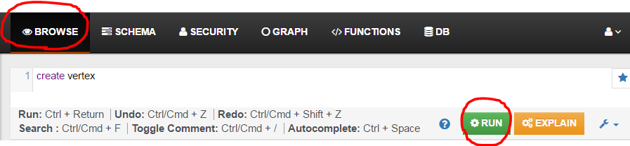
Working with Vertexes
Create the simplest Vertex
"create vertex"
No Class Specified means Uses V Super Class by Default
Notes:
The semicolon is needed if running SQL in Batch Mode (versus Default Single Command Mode) through the Settings Icon.

Slide 19
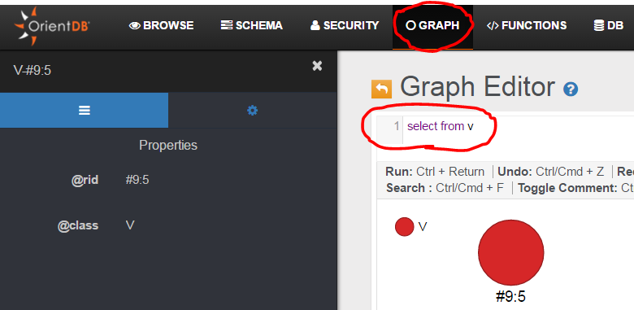
Working with Vertexes
Show Visual Graph (Click the GRAPH Tab)
Select from V;
Notes:
Note the Default Properties of @id and @class
@version is hidden from this screen, but will show under the Browse Tab/Screen
You can change Visual Settings such as what property is displayed and Color for the Node

Slide 20
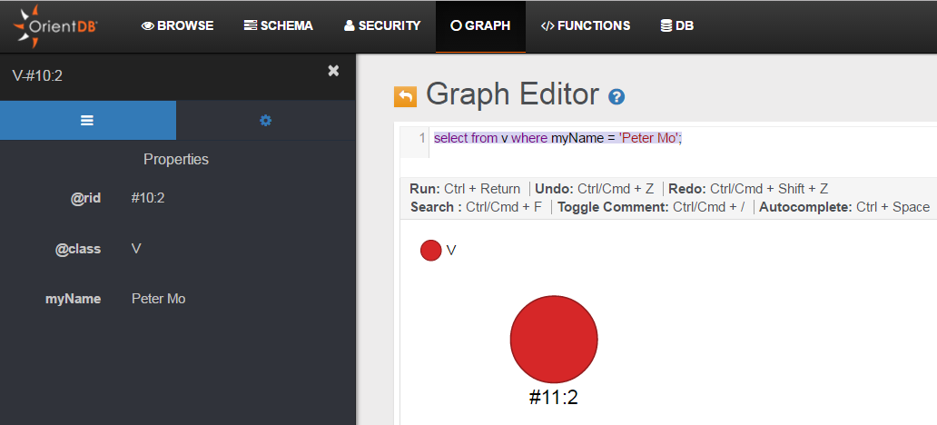
Working with Vertexes
Create Vertex with New Field
CREATE VERTEX SET myName = 'Peter Mo';
select from v where myName = 'Peter Mo';
Notes:
myName Property is Case Sensitive, and is NOT defined in the V Class
"Create Vertex" command only works when we are using either V or a Sub-Class of V.
This is why all Vertex Classes must inherit from V.

Slide 21
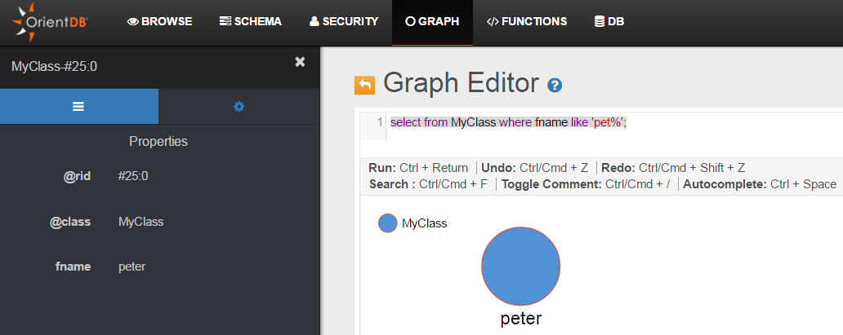
Working with Vertexes
Create Vertex with Custom Class
CREATE CLASS MyClass EXTENDS V;
CREATE PROPERTY MyClass.fname STRING;
insert into MyClass (fname) values ('peter');
select from MyClass where fname like 'pet%';
Notes:
"Insert" is similar to "create vertex", but "insert" command only works if the property already exists in the Class!
It cannot be used to create New Properties on-the-fly like "Create Vertex" can!
Therefore, we can use "Insert" command to restrict to Class Structure if desired.

Slide 22
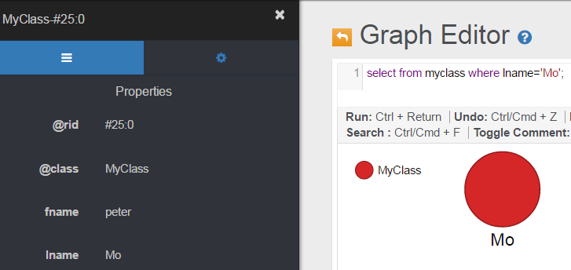
Working with Vertexes
Update Vertex
UPDATE MyClass SET lname = 'Mo' WHERE fname = 'peter';
Creates new property lname in Vertex, which was NOT defined in MyClass Class
select from myclass where lname='Mo';
Notes:
"Update" command can also create New Properties on-the-fly like "Create Vertex" can!
Note this is the SAME Vertex from previous slide @rid = "#25:0"
In real life, if updating only one record, using the @rid is best, since there may be multiple records with fname='peter'
This is only an example here.
To Add Fields to the Class, We use "Create Property" to add Fields to a Class, just like in the previous slide.

Slide 23
Working with Vertexes
Delete ALL Vertexes (Includes all Sub-Classed Vertexes!)
delete vertex v;
Delete ALL Vertexes within "MyClass"
delete vertex MyClass;
Delete Single Vertex (Examples Only)
delete vertex #25:0
delete vertex MyClass where lname='Mo'
Notes:
#25:0 is just an example @rid of One Record

Slide 24
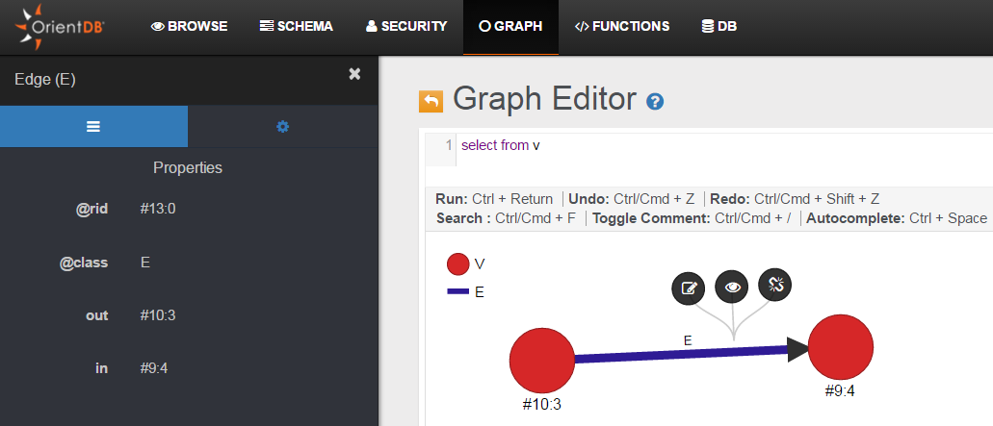
Working with Edges
Create Most Basic Edge
create vertex (1st Vertex)
create vertex (2nd Vertex)
select from v (Get @rid)
create edge from #10:3 to #9:4 (Creates Edge)
Notes:
Out = From
In = To

Slide 25
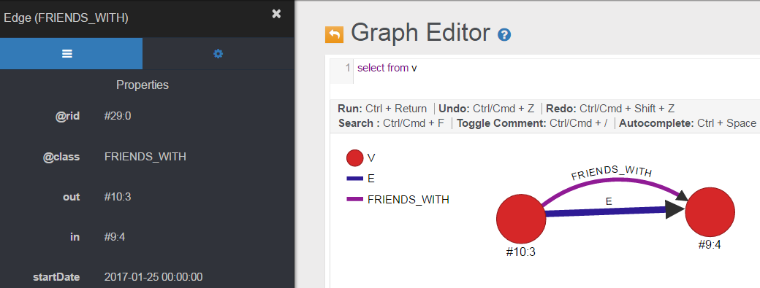
Working with Edges
Edge "E" is not very meaningful Relationship
Create your own Edge Classes!
CREATE CLASS FRIENDS_WITH EXTENDS E;
CREATE PROPERTY FRIENDS_WITH.startDate Date;
CREATE EDGE FRIENDS_WITH FROM #10:3 TO #9:4 set startDate=sysdate();
Notes:
Edges can store data!

Slide 26
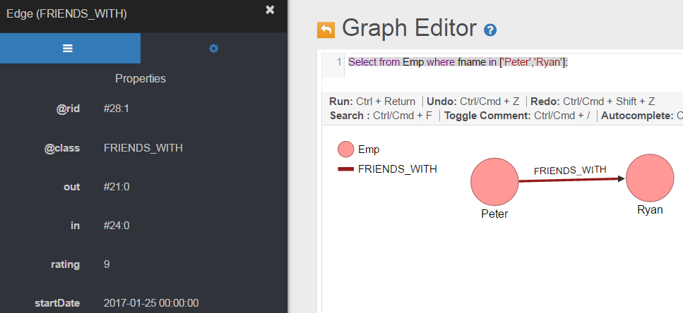
Working with Edges
Update Edge Data
UPDATE FRIENDS_WITH SET rating = 9 WHERE out.fname='Peter' and in.fname='Ryan';
Verify Update
Select from Emp where fname in ['Peter','Ryan'];
Notes:
Notice the "rating" property is added to Edge Instance
Notice the use of Square Brackets in the IN Clause!
I created a "Emp" Employee Vertex Class for this example.

Slide 27
Working with Edges
Delete ALL Edges
Delete edge E
Delete ALL Edges in One Class
Delete edge FRIENDS_WITH
Delete One Edge by @rid
Delete edge #29:0
Delete Edge using Edge Property
Delete edge FRIENDS_WITH where startDate < "2000-01-01"

Slide 28
Working with Edges
When working with Edges, we can Reference the Properties of the associated Vertexes using the "out" and "in" reference key words.
Delete ALL relationships From Peter
Delete edge FRIENDS_WITH where out.fname='Peter';
FROM Vertex -- Edge --> TO Vertex
FROM Vertex = OUT Vertex
TO Vertex = IN Vertex
"From"
Vertex
"Out"
"To"
Vertex
"In"
Edge
Notes:
This example Deletes all of Peter's Friendships, FROM Peter's Perspective Only!
Someone Else can still claim that they are Friends with Peter.
Because Edges/Relationships are always One Directional.

Slide 29
Queries
Various ways to Sail Query:
Select
Returns specific nodes
Useful when a specific graph depth is known
Traverse
Returns entire path of nodes
Especially useful when graph depth is Unknown
Match
Returns specific nodes
Useful when a specific graph depth and Pattern is known
Query using Graph Pattern Matching
Notes:
You can usually mix & combine these 3 methods
There are other API's such as Gremlin, Java, etc.
This slide covers only Sail SQL
The Match method Does NOT currently seem to show up Visually in the Graph Tab in Web Studio
So I do not prefer to use it. I prefer combining Select with Traverse in my Queries.
Online Document Match Reference: http://orientdb.com/docs/2.2.x/SQL-Match.html

Slide 30
Queries
Graph Traversal Functions
out()
Get the adjacent outgoing @rid starting from the current Vertex.
Select out('E1') from V1
V1
out
in
V2
E1
Returns V2's @rid
Notes:
This will return ALL outgoing Node's Record IDs.
This is a simplified example of only one Node V2, but there could be hundreds of outgoing Nodes.

Slide 31
Queries
Graph Traversal Functions
out()
Get the adjacent outgoing @rid starting from the current Vertex.
Select out('E1').out('E1') from V1
V1
out
in
V2
out
in
V3
E1
E1
Returns V3's @rid
Notes:
You can chain the level of depth, to find Friend's Friends, in this example
Starting from V1, gets to V2, then to V3

Slide 32
Queries
Graph Traversal Functions
in()
Get the adjacent incoming vertices starting from the current Vertex.
Select in('E1') from V2
V1
out
in
V2
E1
Returns V1's @rid
Notes:
This will return ALL outgoing Node's Record IDs.
This is a simplified example of only one Node V2, but there could be hundreds of outgoing Nodes.

Slide 33
Queries
Graph Traversal Functions
both()
Get the adjacent outgoing and incoming vertices starting from the current Vertex.
Select both('E1') from V2
out
in
V2
out
in
V1
E1
E1
V3
Returns both V1 & V3's @rid
Notes:
Returns ALL immediate E1s from a starting Node.
In(), out(), and both() only returns the @rid
Use the additional expand() function (following slide) to get actual data.

Slide 34
Queries
Graph Traversal Functions
expand()
Returns Node's Data pointed by @rid
Apply expand() to the out(),in(),both() functions
Examples:
Select expand(out('FRIENDS')) from V1
Select expand(in('FRIENDS')) from V1
Select expand(both('FRIENDS')) from V1
Remember to frequently use expand() with Select clause to Return Data
Notes:
select expand(out('FRIENDS').out('FRIENDS')) from (SELECT FROM Member where fname='Lisa');
Out(),in(), and both() are just some basic functions, there are more online:
http://orientdb.com/docs/2.2.x/SQL-Functions.html

Slide 35
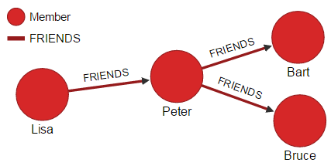
Queries
Traverse
Find Lisa's Friends Infinite Depth
traverse out('FRIENDS') from (SELECT FROM Member where fname='Lisa');
Notes:
traverse out('FRIENDS') from (SELECT FROM Member where fname='Lisa');
Returns ALL Nodes in the Path, expand is not needed
You can also set a Max Depth
traverse out('FRIENDS') from (SELECT FROM Member where fname='Lisa') MAXDEPTH 2;

Slide 36
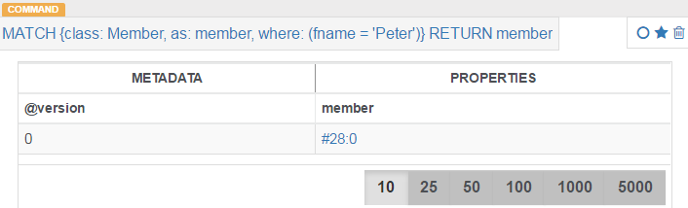
Queries
Match
Return Peter's @rid
MATCH {class: Member, as: member,
where: (fname = 'Peter')}
RETURN member
Notes:
Match only works in the "Browse" Tab, no visual Vertices will show in the "Graph" Tab on Web Studio.
I was not able to do an expand() on this, but I might be doing something wrong.
MATCH {class: Member, as: member, where: (fname = 'Peter')} RETURN member
Online Document Match Reference: http://orientdb.com/docs/2.2.x/SQL-Match.html

Slide 37
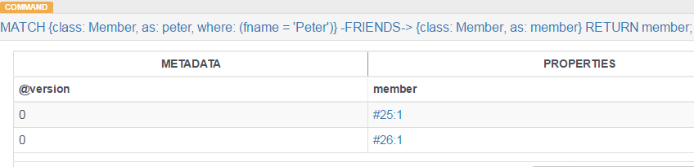
Queries
Match
Get All Peter's Immediate Friends' @rid
MATCH {class: Member, as: peter, where: (fname = 'Peter')}
-FRIENDS->
{class: Member, as: member}
RETURN member;
Notes:
MATCH {class: Member, as: peter, where: (fname = 'Peter')}
-FRIENDS->
{class: Member, as: member}
RETURN member;
Online Document Match Reference: http://orientdb.com/docs/2.2.x/SQL-Match.html

Slide 38
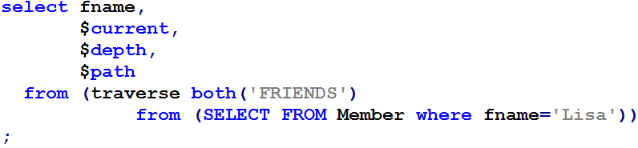
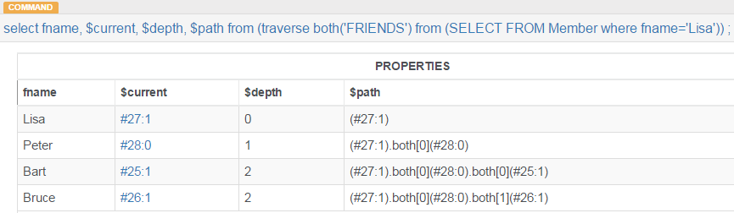
Combined Query
Get ALL of Lisa's Friends' First Names and Paths
Notes:
The $variables are called "Context Variables"
https://orientdb.com/docs/2.2/SQL-Where.html#variables
This has to be run in the "Browse" Tab, and not in the "Graph" Tab in web studio.
This is using a Sub-Query, Select & Traverse, and Reserved Words:
select fname,
$current,
$depth,
$path
from (traverse both('FRIENDS')
from (SELECT FROM Member where fname='Lisa'));
Projection is Relational Algebra equivalence of SQL Select Clause.
Selection is Relational Algebra equivalence of SQL Where Clause.

Slide 39
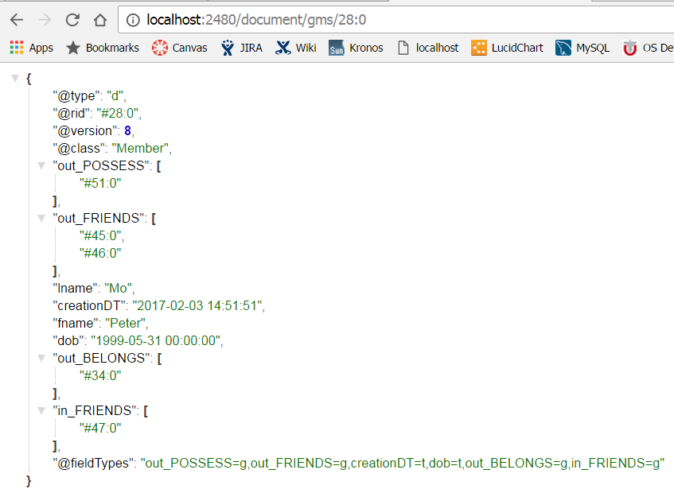
REST Query
Get One JSON Document using @rid
http://localhost:2480/
document/
gms/
17:0
Notes:
REST is enabled by Default!
Online Doc Reference: http://orientdb.com/docs/2.2/OrientDB-REST.html
REST will prompt for username/password (admin/gms)
gms here is our example database name
http://localhost:2480/document/gms/28:0
http://workbench.ccts.utah.edu:2480/document/gms/17:0

Slide 40
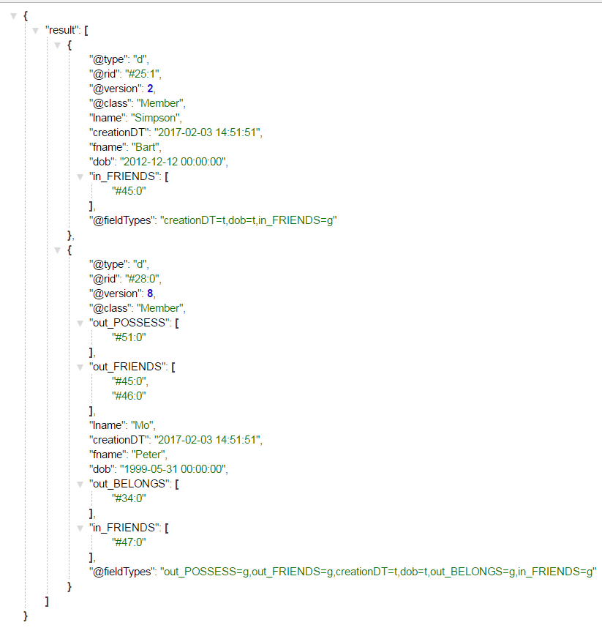
REST Query
Get Two Specific People using SQL
http://localhost:2480/
query/
gms/
sql/
select from Member
where
fname in ['Peter','Bart']
Notes:
Online Doc Reference: http://orientdb.com/docs/2.1/OrientDB-REST.html
REST will prompt for username/password (admin/gms)
gms here is our example database name
-- Copy & Paste onto your Web Browser either one of these should work:
http://localhost:2480/query/gms/sql/select from Member where fname in ['Peter','Bart']
http://workbench.ccts.utah.edu:2480/query/gms/sql/select from Member where fname in ['Peter','Bart']
http://workbench.ccts.utah.edu:2480/query/gms/sql/select%20from%20Member%20where%20fname%20in%20['Peter','Bart']

Slide 41
API Types
http://orientdb.com/docs/2.2.x/Programming-Language-Bindings.html
OrientDB supports 3 kinds of drivers:
Native binary remote
talks directly against the TCP/IP socket using the binary protocol
HTTP REST/JSON
talks directly against the TCP/IP socket using the HTTP protocol
Java wrapped
a layer that links in some way the native Java driver
Runs in JVM, such as Scala, Groovy and JRuby
Notes:
API Categories
Built-in / Internal (Shown earlier in the Architecture Diagram)
REST
Java / External

Slide 42

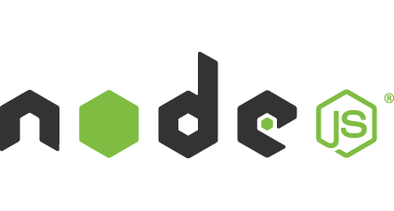



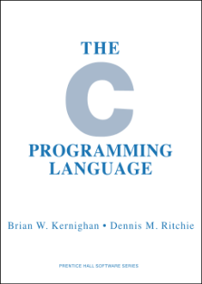








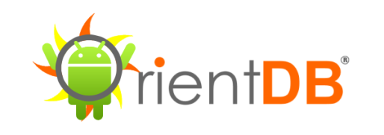

API Languages
Notes:
http://orientdb.com/docs/2.2.x/Programming-Language-Bindings.html
OrientDB was written in Java

Slide 43
Online Resources
Online OrientDB Documentation
http://orientdb.com/docs
Free OrientDB Online Course
https://www.udemy.com/orientdb-getting-started
Notes:
/* Some people's negative experiences with OrientDB: */
http://orientdbleaks.blogspot.com/2015/06/the-orientdb-issues-that-made-us-give-up.html
/* Found Bugs:
The Web Studio's Edit features does not seem to work with Property Constraints & Default Values */

Slide 44
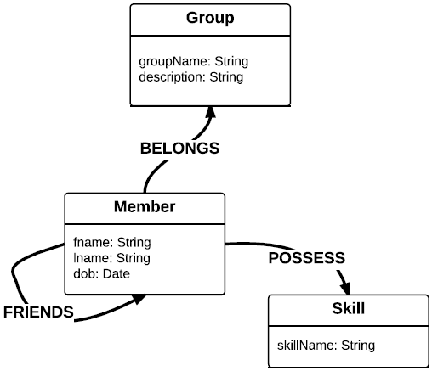
Thank You!
Do we have time for an Exercise?
Group Member Skills (GMS) Graph Database
Notes:
Very Important to understand the Data Model First!

Slide 45
Exercise (if time allows)
http://workbench.ccts.utah.edu:2480
Login to "gms" DB with admin/gms
Review GMS Graph Data Model Document
Follow Exercise Instructions Document to Complete the Exercise
We will Visually Review Our Results in the OrientDB Web Studio together!
Notes:
We will visually verify the Graph on the Web Studio UI:
Select from V;
Or start with one node and then double click through it.

Slide 46
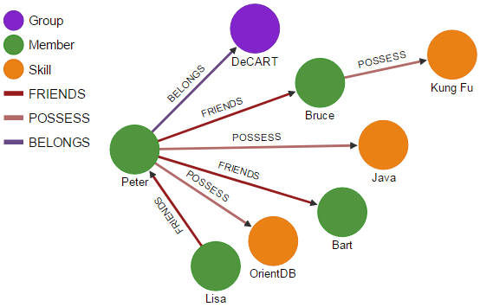
Initial Seed Data in GMS
Notes:
Select from V;

Slide 47
Queries
What are the Unique Skills in our Group?
Get all Members and their Skills within our SIG
Which Members possess Java Skills?
Which Member's Friend Posses Kung Fu Skills?
Top 3 Members with Most Friends?
Top 3 Members with Most Skills?
Top 3 Skills are most Commonly Possessed by Members?
Notes:
select from Skill where in('POSSESS').out('BELONGS').groupName='DeCART'
traverse both('POSSESS','BELONGS') FROM (select from group where groupName='DeCART')
SELECT expand(in('POSSESS')) FROM Skill where skillName.toUpperCase()='JAVA';
traverse both() from (select from skill where skillName='Kung Fu') maxdepth 2;
-- Run in Browse Tab:
select fname.append(lname) as FullName, both('FRIENDS').size() as Count from Member order by Count desc LIMIT 3;
select fname.append(' ').append(lname) as FullName, both('POSSESS').size() as Count from Member order by Count desc LIMIT 3;
select skillName, in('POSSESS').size() as count from Skill where in('POSSESS').size() > 0 group by skillName order by count desc limit 3

