Slide 1
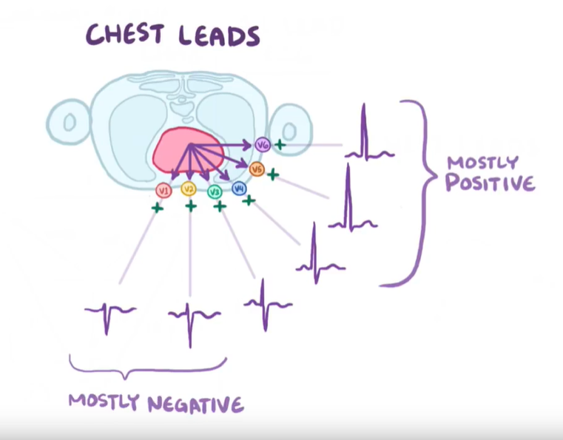
Disease classification from lead-limited ECGs
Supervisor: David Wong
Student: Yue Zhang

Slide 2
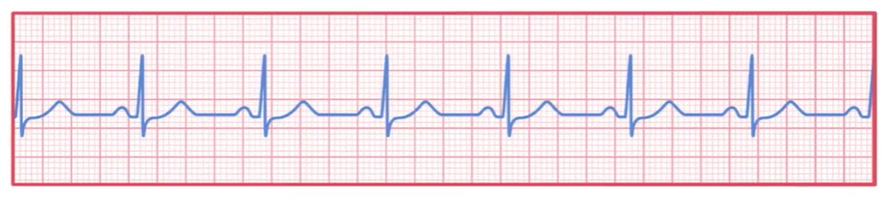

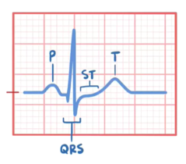
Disease classification from lead-limited ECGs
electrocardiogram
Different classification

Slide 3
Disease classification from lead-limited ECGs
To design and implement a working, open-source algorithm that, based only on the provided twelve-lead ECG recordings and routine demographic data, can automatically identify any cardiac abnormalities present in the recording
Aims and objectives
To identify usefulness algorithm from existing literature
To propose an algorithm(Deep Learning) approach to make classification
To measure the score of the model with code on 2-leads ECGs, and modify the algorithm model

Slide 4
Disease classification from lead-limited ECGs
Feb: Learn about neural networks and convolutional neural networks, and have a general understanding of ECG
Mar - Apr: Use Tensorflow / PyTorch to build a simple model and submit this basic model
May - Jul: Modify the model and try to get better performance and do some writing work
Aug: Write-up
Sep: Check and submit my dissertation

