Slide 1
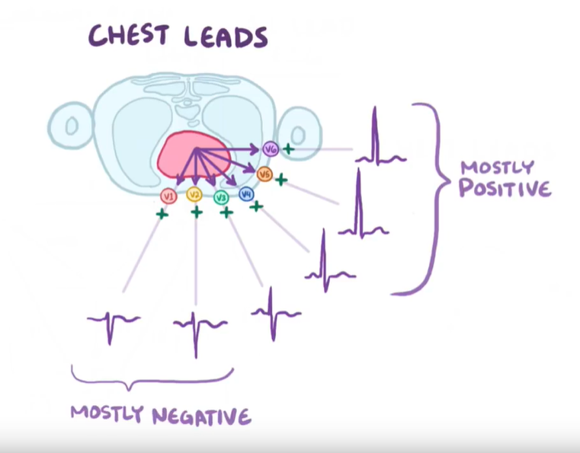
Disease classification from lead-limited ECGs
Supervisor: David Wong
Student: Yue Zhang

Slide 2
Overview of datasets
name | Mean Duration(seconds) | frequency | patient
WFDB_CPSC2018 | 15.948086 | 500 | 6877
WFDB_CPSC2018_2 | 15.908974 | 500 | 3453
WFDB_Ga | 9.974865 | 500 | 10344
WFDB_PTB | 110.76927 | 1000 | 516
WFDB_PTBXL | 10.0 | 500 | 21837
WFDB_StPetersburg | 1800.0 | 274 | 74

Slide 3
Age
age | median | mode | mean | ptp | max | min | var | std | Coefficient of Variation | nan
WFDB_CPSC2018 | 64 | 65 | 60.16807 | 105 | 104 | -1 | 363.49777 | 19.065617 | 3.1558418 | 5
WFDB_CPSC2018_2 | 65 | 65 | 63.74015 | 97 | 96 | -1 | 240.47101 | 15.507128 | 4.110378 | 1
WFDB_Ga | 62 | 66 | 60.4868 | 75 | 89 | 14 | 238.20113 | 15.433765 | 3.9191215 | 77
WFDB_PTB | 57 | 52 | 56.293884 | 70 | 87 | 17 | 195.04776 | 13.96595 | 4.030795 | 9
WFDB_PTBXL | 62 | 67 | 59.836308 | 93 | 95 | 2 | 287.39523 | 16.952736 | 3.5295959 | 89
WFDB_StPetersburg | 59 | 58 | 55.98649 | 62 | 80 | 18 | 190.17549 | 13.790413 | 4.0598125 | 0
Error value: CPSC

Slide 4
Sex
sex | male | female | ratio(male/all) | nan
WFDB_CPSC2018 | 3699 | 3178 | 53.78% | 0
WFDB_CPSC2018_2 | 1843 | 1610 | 53.37% | 0
WFDB_Ga | 5551 | 7166 | 53.66% | 0
WFDB_PTB | 377 | 138 | 73.06% | 1
WFDB_PTBXL | 11379 | 10458 | 52.11% | 0
WFDB_StPetersburg | 40 | 34 | 54.05% | 0
Imbalance dataset: PTB

Slide 5




Classes
heatmap
Bar plots & wave figures
Different distribution dataset
sympthoms
Example wave:
The first person of WFDB_CPSC2018_2
Wavs in one second

