Slide 1
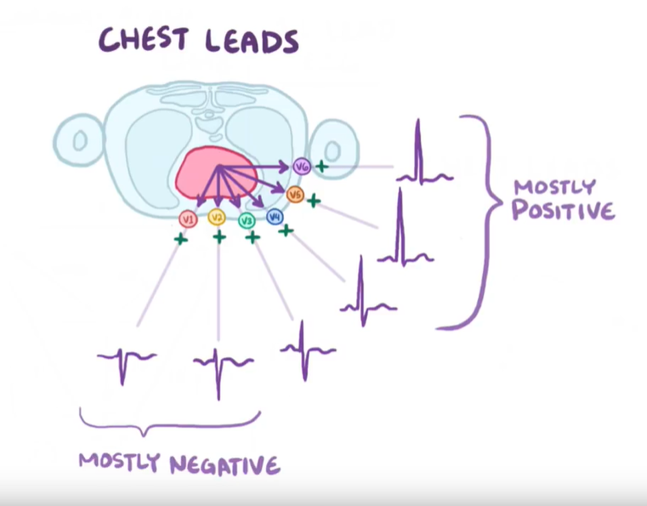
Ethical approval
Disease classification from lead-limited ECGs
Supervisor: David Wong
Student: Yue Zhang

Slide 2
Ethical approval
Research Topic:
Disease classification from lead-limited ECGs
Questions:
What is the legal way to use data?
Authorized data on website
Follow the license description
Not to disclose data
Open-source license

