Slide 1
Literature Review
Disease classification from lead-limited ECGs

Slide 2
Start set of project
Minchole, A., Camps, J., Lyon, A., & Rodriguez, B. (2019). Machine learning in the electrocardiogram. J Electrocardiol, 57S, S61-S64. Retrieved from https://www.ncbi.nlm.nih.gov/pubmed/31521378. doi:10.1016/j.jelectrocard.2019.08.008
Zhao, Z., Fang, H., Relton, S. D., Yan, R., Liu, Y., Li, Z., . . . Wong, D. C. (2020). Adaptive lead weighted ResNet trained with different duration signals for classifying 12-lead ECGs. Paper presented at the 2020 Computing in Cardiology.

Slide 3
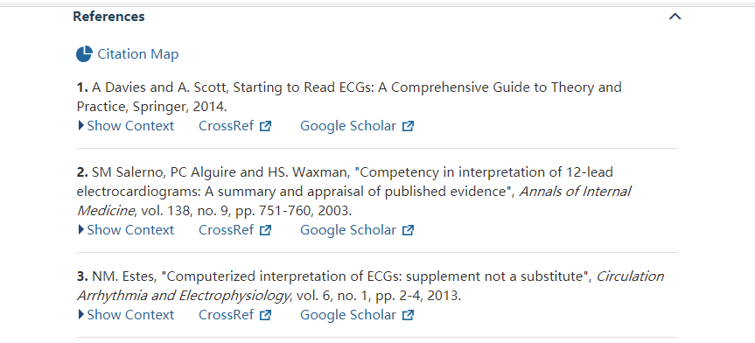
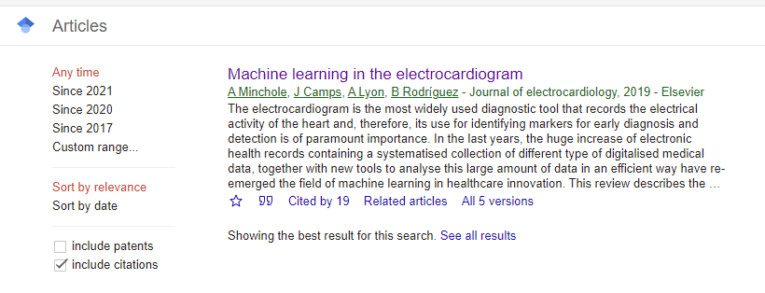
Snowballing Method
High cited
Public within 3 years
backward
Or very classic
Related to my topic/ method
forward

Slide 4
Backward Snowballing
Gee, A. H., Garcia-Olano, D., Ghosh, J., & Paydarfar, D. (2019). Explaining deep classification of time-series data with learned prototypes. arXiv preprint arXiv:1904.08935.
Kang, B., Xie, S., Rohrbach, M., Yan, Z., Gordo, A., Feng, J., & Kalantidis, Y. (2019). Decoupling representation and classifier for long-tailed recognition. arXiv preprint arXiv:1910.09217.
Ribeiro, A. H., Ribeiro, M. H., Paixão, G. M., Oliveira, D. M., Gomes, P. R., Canazart, J. A., . . . Meira Jr, W. (2020). Automatic diagnosis of the 12-lead ECG using a deep neural network. Nature communications, 11(1), 1-9.
Yao, Q., Wang, R., Fan, X., Liu, J., & Li, Y. (2020). Multi-class Arrhythmia detection from 12-lead varied-length ECG using Attention-based Time-Incremental Convolutional Neural Network. Information Fusion, 53, 174-182.

Slide 5
Forward Snowballing
Kumar, U., & Yadav, S. (2021). Application of Machine Learning to Analyse Biomedical Signals for Medical Diagnosis. In Handbook of Research on Disease Prediction Through Data Analytics and Machine Learning (pp. 205-236): IGI Global.
Pandey, S. K., & Janghel, R. R. (2021). Classification of electrocardiogram signal using an ensemble of deep learning models. Data Technologies and Applications.
Rueda, C., Larriba, Y., & Lamela, A. (2021). The hidden waves in the ECG uncovered revealing a sound automated interpretation method. Scientific reports, 11(1), 1-11.

Slide 6
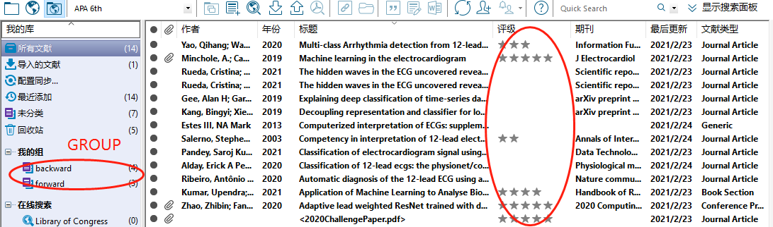
Reference Stored

