Slide 1
(P)

Slide 2

(Presentasia)

Slide 4
Loading……

Slide 5
(P)

Slide 6






Shut Down
Admin has set no new people can be created.
Guest
Admin
+ New
Presentasia OS
Version: 1.0.1
Login

Slide 7
Admin
Shut Down
Back
Password:
Presentasia OS
Version: 1.0.1
Login

Slide 8
Welcome!
Admin

Slide 9


Shut Down
A
W
L
(Files)
Log off
No Time Set
No Date Set
(Internet Atlas)
(Writasia)
A
(Store)
You’re Here
(Apps)
O
(Office)
(Disc)
(Games)

Slide 10
Shut Down
A
W
L
(Files)
Log off
Log Off?
No Time Set
No Date Set
(Internet Atlas)
(Writasia)
Yes
A
(Store)
You’re Here
(Apps)
O
(Disc)
(Games)

Slide 11


Tab 1
Tab 2
Tab 3
(Internet Atlas)
Internet Atlas
v. 1.0
Tab Count:
3

Slide 12
Tab 1
Tab 2
Tab 3

Slide 13
Tab 1
Tab 2
Tab 3

Slide 14
Tab 1
Tab 2
Tab 3

Slide 15

Note 1
Note 2
Note 3
Note 4
Note 5
(Writasia)
Writasia
v. 1.0
Note Count:
5

Slide 16
Note 1
Note 2
Note 3
Note 4
Note 5

Slide 17
Note 1
Note 2
Note 3
Note 4
Note 5

Slide 18
Note 1
Note 2
Note 3
Note 4
Note 5

Slide 19
Note 1
Note 2
Note 3
Note 4
Note 5

Slide 20
Note 1
Note 2
Note 3
Note 4
Note 5

Slide 21
( )
(Connecting to the store…)
Click Here to enter the store

Slide 22

(Store)
Popular
Games
Apps
Music
$ 0.00
>
f
t
t·
YouTube
Facebook App
Twitter App
Tumblr App
YouTube App
YouTube
The Media Center of the World.
Watch 48 hours of video uploaded every minute on the FREE Youtube app.
Broadcast Yourself
Ads by Presentasia Ad Center

Slide 23




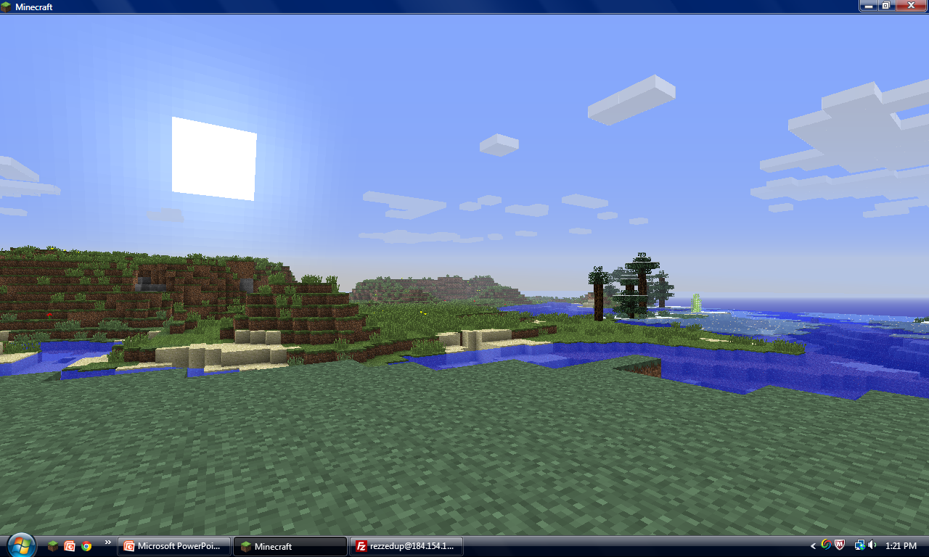


(Store)
Popular
Games
Apps
Music
$ 0.00
>
Minecraft
Plants vs. Zombies
Angry Birds Space
Steam App
Ads by Presentasia Ad Center

Slide 24
(Store)
Popular
Games
Apps
Music
$ 0.00
>
f
t
t·
YouTube
Facebook App
Twitter App
Tumblr App
YouTube App
facebook
Social.
Join your friends and be social with the free facebook app.
Ads by Presentasia Ad Center

Slide 25
(Store)
Popular
Games
Apps
Music
$ 0.00
>
P
Dance
Electronic
Pop
Genres:
Alternative
Jazz
Rock
Classic
New Age
Pandora App
Music
Find the music you want to listen to!
Purchase Your Music Here
Ads by Presentasia Ad Center

Slide 26






(Files)
File Browser
1.0
File Browser

Slide 27
Admin
-User Info-
Administrator Operations Enabled: True
Password locked: True
System Control: True
Name: Admin
-OS Info-
Version: Presentasia OS 1.0.1
Edit

Slide 28
(Apps)
f
Presentasia OS:
Apps
Apps

Slide 29


Slide 30

(Office)
W
(Writasia)
Presentasia OS:
Office
Office

Slide 31
Presentasia Spread Sheet v 1.0
Spread Sheet

Slide 32

(Games)
No games were found on your computer.
Game Selection Menu
Games

Slide 33

Searching for disc…
No Discs Recognized

Slide 34
Back
Are You Sure?
Shut Down
Yes
Presentasia OS
Version: 1.0.1
Shut Down

Slide 35

Shut Down
A
W
L
(Files)
Log off
No Time Set
No Date Set
(Internet Atlas)
(Writasia)
A
(Store)
You’re Here
(Apps)
O
(Office)
(Disc)
(Games)

Slide 36
Shut Down
A
W
L
(Files)
Log off
Log Off?
No Time Set
No Date Set
(Internet Atlas)
(Writasia)
Yes
A
(Store)
You’re Here
(Apps)
O
(Disc)
(Games)

Slide 37
Tab 1
Tab 2
Tab 3
(Internet Atlas)
Internet Atlas
v. 1.0
Tab Count:
3

Slide 38
Tab 1
Tab 2
Tab 3

Slide 39
Tab 1
Tab 2
Tab 3

Slide 40
Tab 1
Tab 2
Tab 3

Slide 41
Note 1
Note 2
Note 3
Note 4
Note 5
(Writasia)
Writasia
v. 1.0
Note Count:
5

Slide 42
Note 1
Note 2
Note 3
Note 4
Note 5

Slide 43
Note 1
Note 2
Note 3
Note 4
Note 5

Slide 44
Note 1
Note 2
Note 3
Note 4
Note 5

Slide 45
Note 1
Note 2
Note 3
Note 4
Note 5

Slide 46
Note 1
Note 2
Note 3
Note 4
Note 5

Slide 47
Guests cannot purchase items from the store.

Slide 48
(Files)
File Browser
1.0
File Browser

Slide 49

Guest
-User Info-
Administrator Operations Enabled: False
Password locked: False
System Control: False
Name: Guest
-OS Info-
Version: Presentasia OS 1.0.1

Slide 50
(Apps)
f
Presentasia OS:
Apps
Apps

Slide 52
(Office)
W
(Writasia)
Presentasia OS:
Office
Office

Slide 53
Presentasia Spread Sheet v 1.0
Spread Sheet

Slide 54
(Games)
No games were found on your computer.
Game Selection Menu
Games

Slide 55
Searching for disc…
No Discs Recognized

