Slide 2
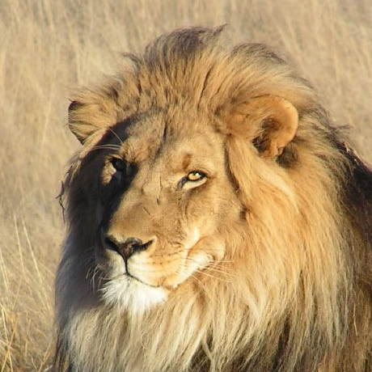

WindOS Version 5.0 codename “Lion”, Copyright Windsoft Team 2021

Slide 4

Setup
×
Thanks for use WindOS 6 Lion
Next

Slide 5
Setup
×
Choose your language
English
中文
Next

Slide 6
Setup
×
Enter your username
Enter your password
Next

Slide 7
Setup
×
Checking update…

Slide 8
Setup
×
Installing update…

Slide 9
Setup
×
All is done, let’s restart system

Slide 16

4:13 PM

Slide 17
username
Login

Slide 18

Welcome

Slide 19







4:13 PM
username
Join my Discord
Shut down
10-Sep-21
Restart
File Manager
Setting
Browser
Calculator
Store
Log out
KindOS 7 is coming
sWrite
4:13 PM

Slide 20

File Manager
×
Download

Slide 21




Settings
×
PC Setting
Enter your username

Slide 22

Settings
×
System Info
Build 6.0.210906.65
WindOS 6 Lion
Windsoft Team made by 2021

Slide 23
Settings
×
Update and Support
Update

Slide 24

Browser
×

Slide 25
Calculator
×
0
C
÷
7
8
9
×
4
5
6
－
1
2
3
＋
.
0
=

Slide 26

Store
×
sWrite
Calculator
Discord

Slide 27
sWrite - New
×

Slide 28
Discord
×

Slide 33
6
WindOS

Slide 34
6
WindOS
Released

Slide 35



