Slide 1
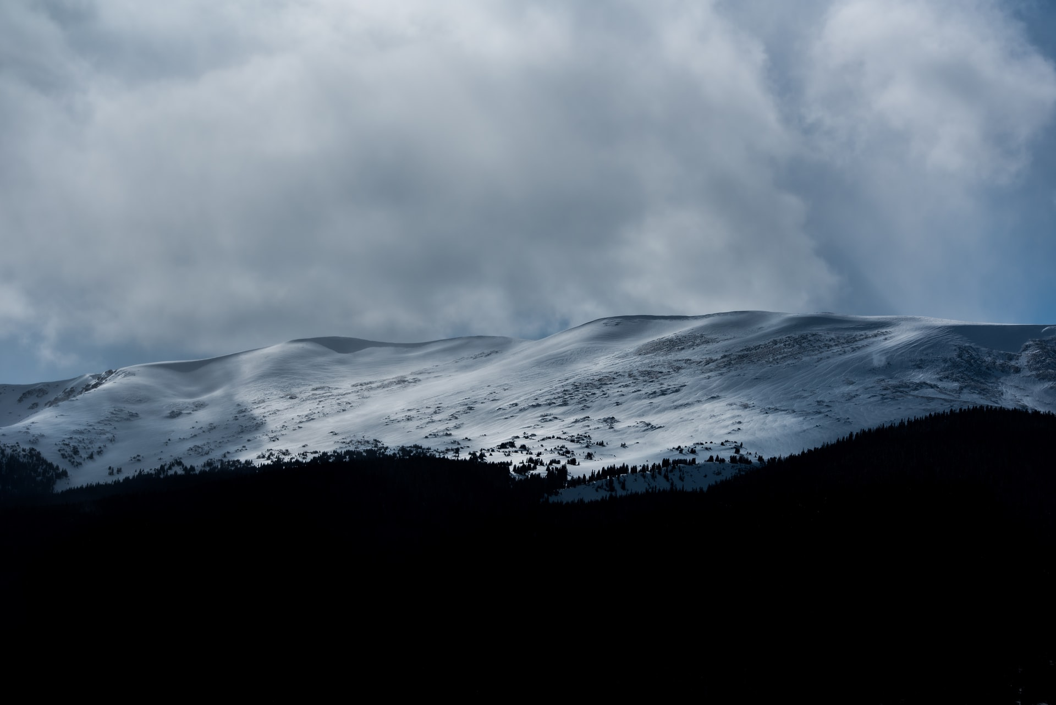


























1 March 2021
clear sky
123---123https://cdn.discordapp.com/attachments/794873905092362242/799689604822990908/ugur-peker-xfOGFBrI5to-unsplash.jpg,Light,
74133.73
Hey there, Zulo! 🥳
How may I help you?
I’m Bubbly, your assistant
Welcome
I can help you with:
Thanks for downloading zeqOS! Before you continue the setup, please make sure you have a PC with at least:
Scheduling events
Telling the weather
Opening applications
- 8GB DDR3 RAM+
- AMD Ryzen 1000 Series or higher / Intel 7th Gen or higher
- Windows 10
- Office 2016+
Changing settings
False
Normal
And even more! To start, just click the Bubbly
icon.
Not having these recommended specifications won’t bring the best experience when using zeqOS Pro. We recommend the Lite version for better performance.
0
1365
Welcome, Zulo!
Today is 28 February 2021.
8:10 PM
False
False
Main Window
Calendar
45%
Battery
zeqOS
Chabazite Pro
This PC
Next
Photos
Shortcut
Do not view, copy, or share the code.
Administrators of zeqOS can view your actions
and block your access from any further testing
of zeqOS. Unauthorized access of Confidential
zeqOS versions will notify the administrators.
Build 90_B02 – Beta Channel.
False
zeqOS Update
Shortcut
Light
This PC
start
zeqOS Studio
Message Box
Message Box
Message Box
Message Box
Message Box
Message Box
Message Box
7°
{;
90
https://cdn.discordapp.com/attachments/481838311439073290/813512411691745350/daniel-sessler-3odiQvgDl4s-unsplash.jpg

