Slide 2


Resetting System

Slide 7
你好
Ola
Bonjour
Hello
Next

Slide 9
Who is using this device
Enter your username
Enter your password
Next

Slide 10
Install or update system
Yes

Slide 11
starting
Copying system file
Installing system file
Checking system update
Installing system update

Slide 12
All is good ,now restart?
Yes

Slide 19


Slide 21
User
Login

Slide 22
Welcome

Slide 23







User

Slide 24


File Manager
Downloads
To protect the system
you cant open this folder
Error

Slide 25



Settings
User Settings
Change your username

Slide 26

Settings
PC Settings
Choose your device wallpaper

Slide 27
Settings
System Settings
Bulid 5.0.210824.U3
WindOS Tiger
Reset
English
中文

Slide 28

Store
Home
Office

Slide 29
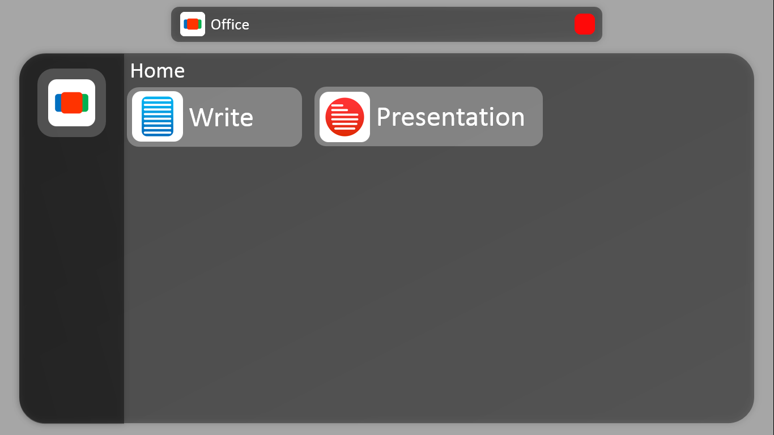
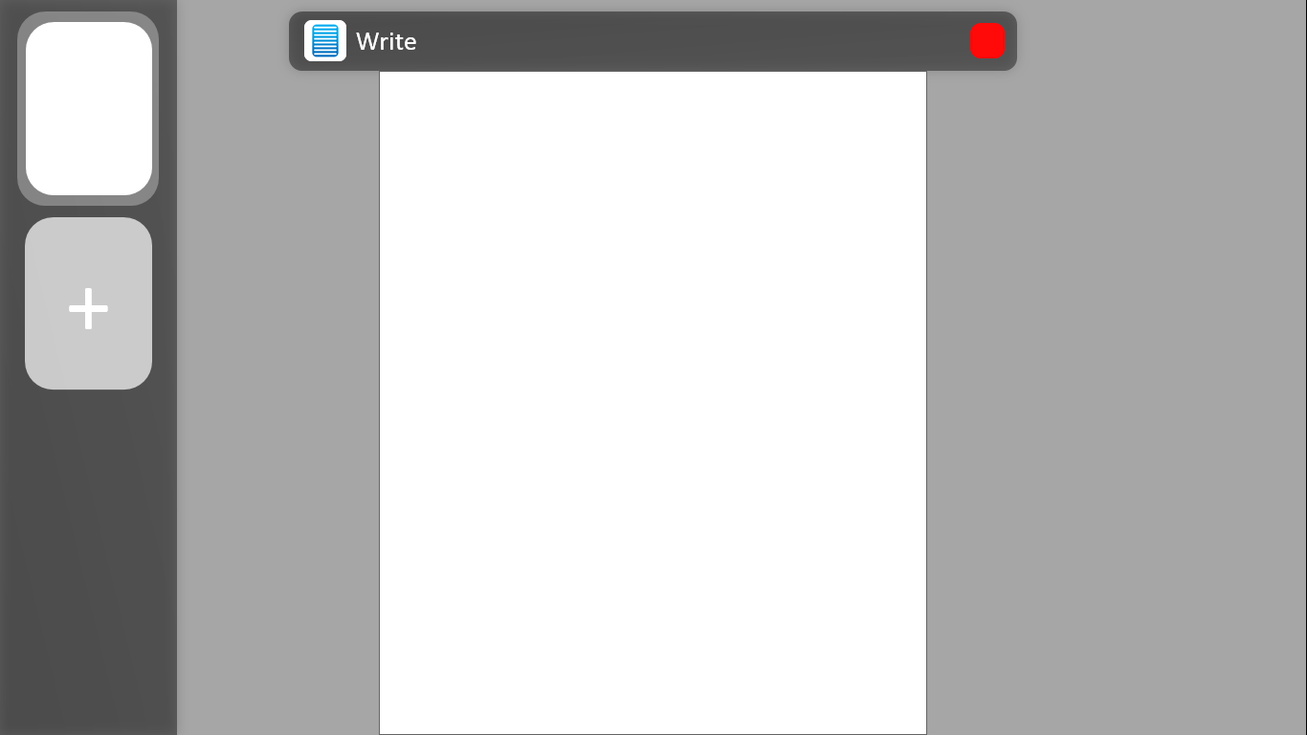
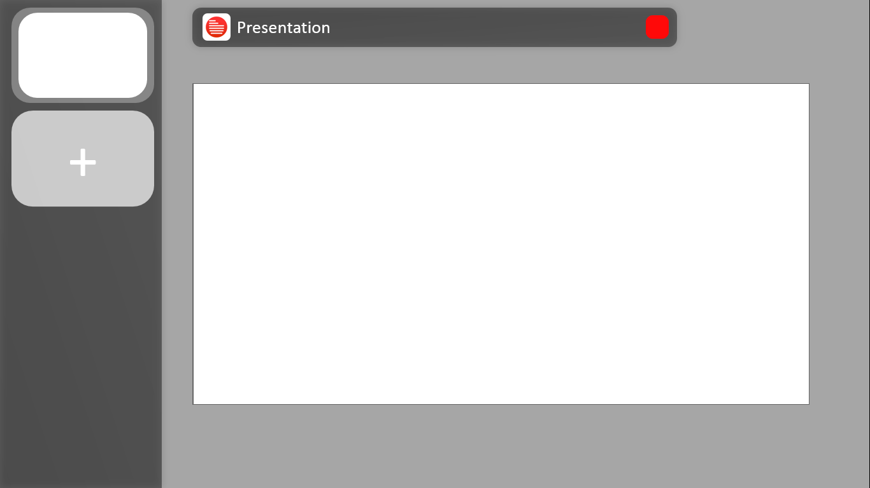
Store
Application
Office
New start and New design
Start
Screenshot

Slide 30

Office 5.0
Windsoft Technology

Slide 31


Office
Home
Write
Presentation

Slide 32
Office
Home
Write
Presentation
Office 5.0
Write
Windsoft Technology

Slide 33
Write
Bold
+
Italic
Calibri
Arial

Slide 34
Office
Home
Write
Presentation
Office 5.0
Presentation
Windsoft Technology

Slide 35
Presentation
+

Slide 36
Clock
下午 11:17:40

Slide 41


WindX 5G
WindOS Tiger
August 26 coming soon

Slide 42





Slide 45
WindOS insider

Slide 46
WindOS insider

Slide 47

Store
Application
App
Example
Screenshot

Slide 48
Reset System
Reset this system, all your data will disappear! Are you sure?
No
Sure

Slide 49
WPC2021-August

