Slide 1

☹
Oops!
You drive is crashed
Pls restart your drive or exit this presentation os
Restart
Exit

Slide 3
Windsoft Technology© 2021

Slide 5

Setup
KindOS Marble
Install
Windsoft Technology© 2021

Slide 6
Setup
Installing…
Windsoft Technology© 2021

Slide 7


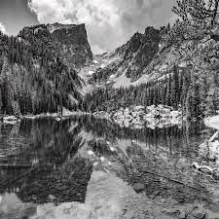

Setup
Enter your username
Enter your password
Next
Windsoft Technology© 2021

Slide 8
Setup
Restart now
Windsoft Technology© 2021

Slide 10
Restarting
Windsoft Technology© 2021

Slide 13
Windsoft Technology© 2021

Slide 15


2:29 PM

Slide 16
Windsoft
Login

Slide 17
Welcome

Slide 18






2:29 PM
Shut down
Restart
File Manager
Settings
Clock
Browser
Notepad
Get Started

Slide 19

File Manager
⨉
Download
Download

Slide 20



Settings
⨉
User Setting
User Setting
Enter your username
Desktop Setting
System

Slide 21
Settings
⨉
User Setting
Desktop Setting
Choose your background
Desktop Setting
System

Slide 22
Settings
⨉
User Setting
System
Build 6.210819.U1
Desktop Setting
KindOS MarbleS
System

Slide 23

Clock
⨉
Clock
Clock
2:29 PM

Slide 24
Browser
⨉
Search
i

Slide 25
Notepad
⨉
Bold
Italic
Calibri
Arial

Slide 26


Get Started
⨉
Get Started on now!

Slide 28
Shut down
Windsoft Technology© 2021

Slide 33


Slide 34
2:29 PM

Slide 35


