Slide 1
Notes:
Update Tips~~~
-------------------
1.Add VB system
2.New logo
3.New UI
4.New wallpaper
---Big Update---
Add lily(beta)
--------done------

Slide 2


Made In Wipo

Slide 4


setup
Welcome
KindOS
Next

Slide 5
setup
Sign in you Wipoaccounts
Name
Next

Slide 6
setup
Install system file

Slide 7
setup
all done! Restart now

Slide 8
Notes:
Update Tips~~~
-------------------
1.Add VB system
2.New logo
3.New UI
4.New wallpaper
--------done------

Slide 9
Made In Wipo

Slide 11
Notes:
Update Tips~~~
-------------------
1.Add VB system
2.New logo
3.New UI
4.New wallpaper
--------done------

Slide 12
Made In Wipo

Slide 14


Slide 15
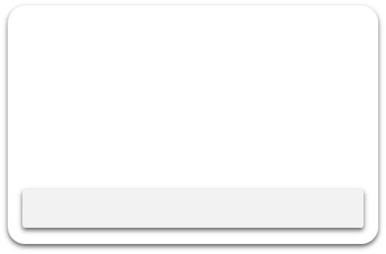











Slide 16



Close

Slide 17

File Center
Close

Slide 18
Kind Browser
Close

Slide 19
Wordpad
Close
a

Slide 20
Office Text
Close

Slide 21
Office Demo
Close

Slide 22
Office Table
Close

Slide 23
wMail
Close
Login
Username
Password
Login

Slide 24

Setting
Close
i

Slide 25
Notes:
Update Tips~~~
-------------------
1.Add VB system
2.New logo
3.New UI
4.New wallpaper
--------done------

Slide 26
Made In Wipo

Slide 28
The Presentation has end
Click ESC out the PPTOS

Slide 29
Setting
Close
User Setting
Name

Slide 30

Setting
Close
i
Info
KindOS2.0
Update
Made In Wipo_2021

