Slide 2

Wind OS 1.0

Slide 4

Welcome
Next

Slide 6

Who’s going to use this device?
Enter your username
Next

Slide 8


Set your personalization.
Next

Slide 10
Click “Install” Start install this system
Install

Slide 11
Copy system files to this device.
Start install system in this device.
Check update.
Install update.
Complete!

Slide 12

Restart in three seconds.

Slide 14
Wind OS 1.0

Slide 16

User
Login

Slide 17









File Manager
Help
Command Manager
Wind OS 1.0
Wipo made by 2021
Wind Store
Wind Office
Setting

Slide 18

Shutdown
Wind OS 1.0
Wipo made by 2021
Restart

Slide 19


File Manager
Download
System
Error

Slide 20
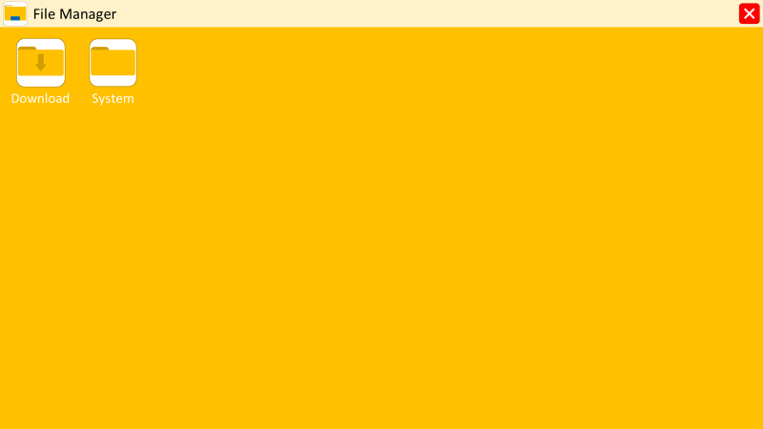
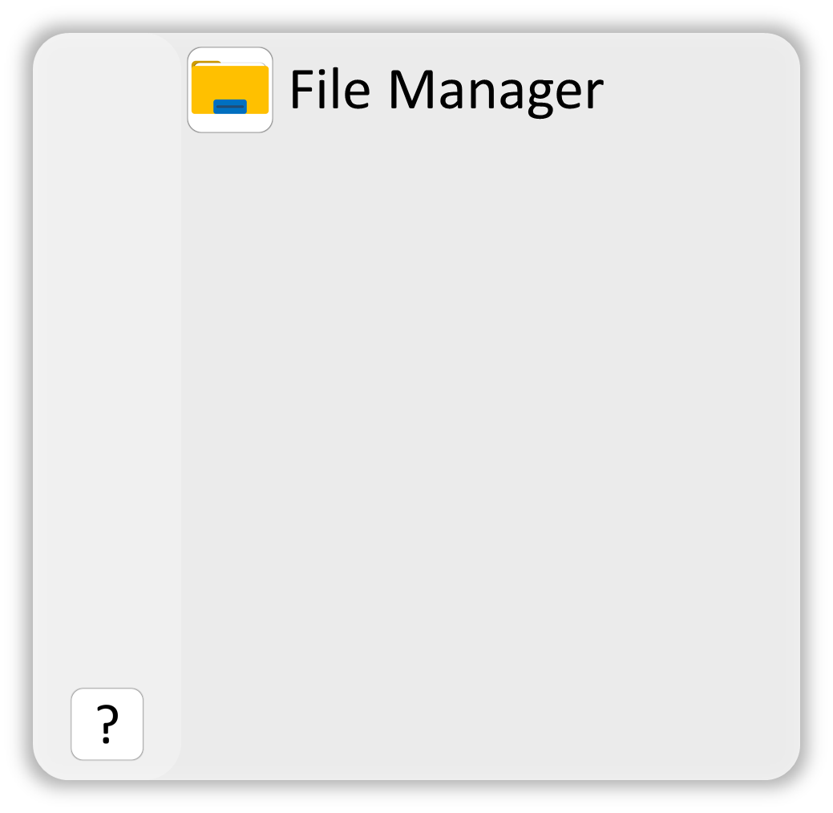


Help
Help
Start learning how to use Wind OS.
The End
Produce made by Wipo
Open Start
Click the start button to open the start menu.
Open File Manager
Click the icon to open the file manager

Slide 21
Command Manager
Run
Clear

Slide 22
Wind Store
Office

Slide 23



Wind Office

Slide 24
Wind Office

Slide 25
Wind Office

Slide 26
Wind Office

Slide 27
Setting

Slide 29
Wind OS 1.0

Slide 31

?

Slide 32



Slide 33

Make a PowerPoint OS

Slide 36
See The Next OS

Slide 37
File Manager

