Slide 2



Slide 4

Welcome
Next

Slide 5

Welcome
Who is using this device
Enter your username
Next

Slide 6


Welcome
Set your wallpaper.
Next

Slide 7
Welcome
Start install this system
Next

Slide 8
Welcome
Install…

Slide 9
Welcome
Restart now!

Slide 13


Slide 14
hhh
Login

Slide 15








File Manager
4:57 PM
Friday, 30 July, 2021

Slide 16




Power
File Manager

Slide 17


File Manager
This Device
This Device
Desktop
WindOS (C:)
Desktop
WindOS(C:)

Slide 18
File Manager
This Device
Desktop
Desktop
WindOS (C:)
File Manager

Slide 19


Setting Center
User Setting
User Setting
Change your username
OS Info &….

Slide 20

Setting Center
User Setting
OS Info & Update
Duo U1
OS Info &….
WindOS 2.1
2.210730.U1
Check Update

Slide 21
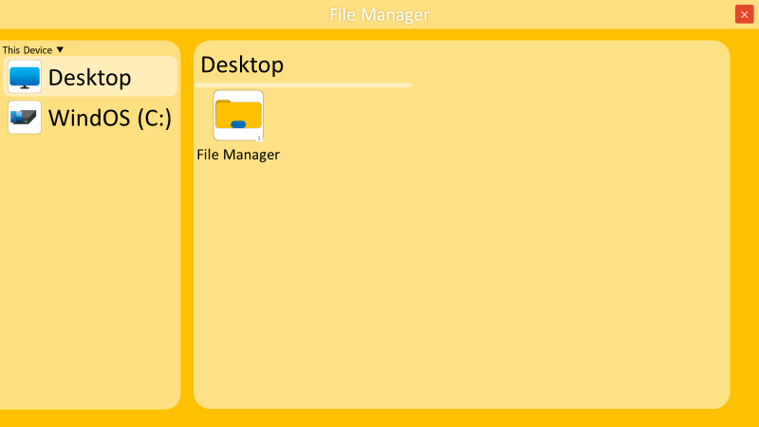
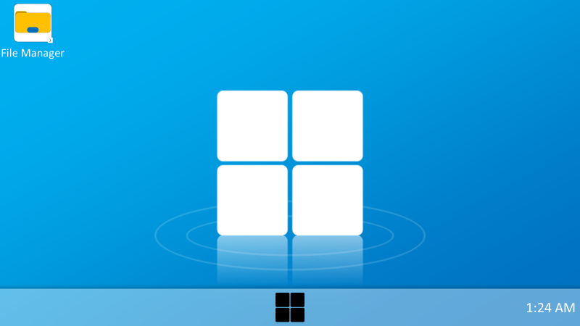
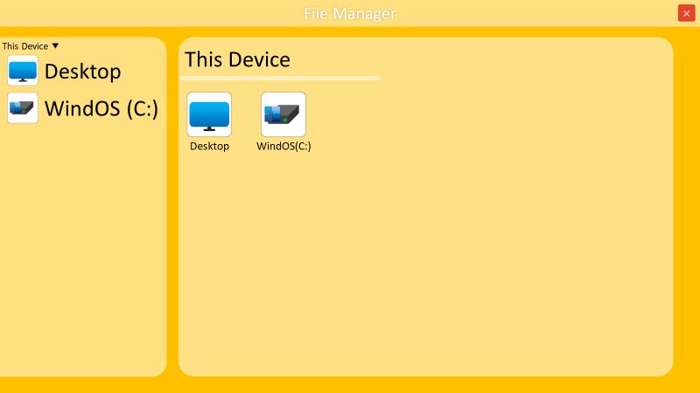

Get Started

Slide 22
Wind Store

Slide 23


Office

Slide 24


Presentation
Local Files

Slide 25

Presentation

Slide 26
Write
Local Files

Slide 27
Text

Slide 28
Clock & Time
Friday, 30 July, 2021

Slide 36
App

Slide 38

Wind UI 2.0
Rounded Rectangle
Shadow

Slide 40



