Slide 2

Welcome!
Thank you for Downloading Sio OS Nitro: Lite, We Welcome you
Now lets Set-Up Your OS 😊
Back
Next

Slide 3

Account
Hello There!, Look’s like you are new here Lets give you an account shall we?
Account Name
Full Name:
Display Name:
Password
Your Account required a Password
Password Example: Rotertree11()
The Password must be a Strong password with a minimum length of 8 characters
Back
Next

Slide 4


Personalization
Let’s Change your OS Look’s
Lockscreen Wallpaper
Desktop Wallpaper
Back
Next

Slide 5
Completed
Thank you for Downloading Sio Nitro: Lite

Slide 6
DO NOT HIDE

Slide 7



Touch Anywhere
Mini Task Bar
6.57 PM
Power
Shutdown
Sleep
Restart
Monday, 23 August 2021

Slide 8


Mini Task Bar
Power
Shutdown
Sleep
Restart
Log-In

Slide 10
This OS Is still in Beta. Do not leak this OS Build
Sio OS Nitro: Lite
Faster
Delete
faster714
Created: 23/08/21
Info:
Faster
faster714
Settings
Account Manager
Shutdown
Sleep
Restart
Start
S App Launcher
Power
File Library

Slide 11
This OS Is still in Beta. Do not leak this OS Build
Sio OS Nitro: Lite
Recents
Downloads
Saved
MP3/MP4 File
Faster
faster714
Settings
Account Manager
Shutdown
Sleep
Restart
Start
S App Launcher
Power
File Library

Slide 12
This OS Is still in Beta. Do not leak this OS Build
Sio OS Nitro: Lite
Settings
Operating System
About
About
Wi-Fi
Sio OS
Nitro: Lite
Battery
Error Loading About
[Error: 010]
Faster
Layout
faster714
Settings
Account Manager
Shutdown
Sleep
Restart
Start
S App Launcher
Power
File Library

Slide 13
This OS Is still in Beta. Do not leak this OS Build
Sio OS Nitro: Lite
Settings
Operating System
Wi-Fi
About
Wi-Fi Name: Rotterdam1
Wi-Fi Type: Multi-Router
Connection: Mild
Wi-Fi
Battery
Connect
Faster
[No Wi-Fi Around your Location]
Layout
faster714
Settings
Account Manager
Shutdown
Sleep
Restart
Start
S App Launcher
Power
File Explorer

Slide 14




S App Launcher
Build-In’s
NetMov
Store & Purchased App’s
SeeStore
Donwloaded App’s

Slide 15





<
>
Home.com
b
A
Download’s
No Download’s
Youtube
Google
R BLOX

Slide 16
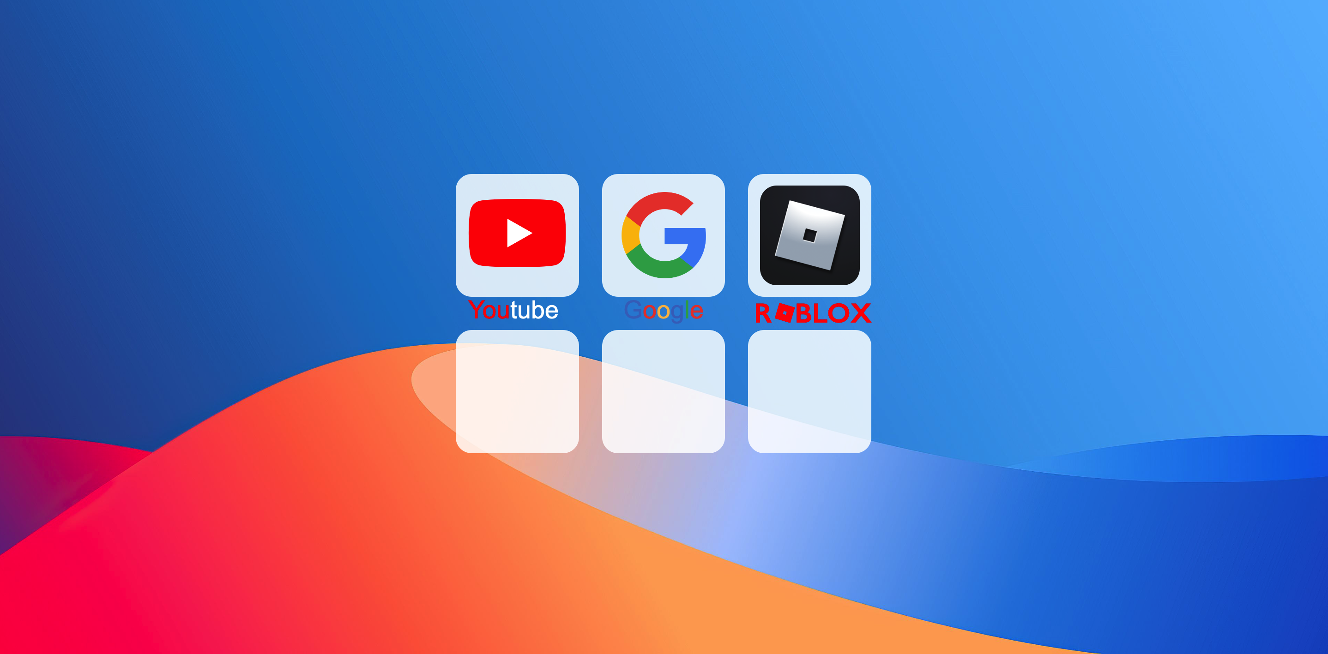
<
>
b
A
Home

Slide 17



NetMovies
Thrills
Family Friendly
Fast and Furious
“It”
Spongebob the Movie:
Sponge on the Run
Madagascar 3:
Europe’s Most Wanted

