Slide 1





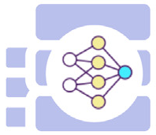



Environment
Propose
Task
Learn
Observations
Configuration
Collect
Robot
Skill Library
Skill Options
Notes:
{
"paper_title": "Agentic skill discovery",
"paper_url": "https://www2.informatik.uni-hamburg.de/wtm/publications/2026/ZWW26/1-s2.0-S0921889025003458-main.pdf",
"figure": "Figure 2",
"page": 4,
"license": "CC BY4.0; https://creativecommons.org/licenses/by/4.0/",
"status": "figure_recreation",
"source_sha256": "6374fb6056098cd13ec89ff351188529d9af2eabb518707fa6a6428149c6233f",
"source_crop_pdf_points": [
108.978,
55.445,
486.541,
158.237
],
"notes": "Faithful structural recreation of publisher Figure2. Original icon artwork retained in nine discrete raster crops; text, context panel and three arrow routes rebuilt as native editable objects. All labels typeable. Font metrics, corner radius, brace and dash cadence approximate the original. Raster icon interiors are not editable; no complete background raster included. Original colors intentionally pale."
}

