Slide 1
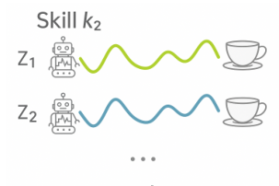





Discrete Skill Policy
Environment State
Continuous Parameter Policy
Low-level Action Policy
Compressed
One-dimensional State
Notes:
{
"paper_title": "Learning Parameterized Skills from Demonstrations (DEPS)",
"paper_url": "https://arxiv.org/pdf/2510.24095v1",
"figure": "Figure 1",
"license": "License not verified; private authorized source reference",
"notes": "Native editable three-level skill hierarchy, major labels and connectors. Six original illustration inserts retain miniature skill-manifold curves, robot/cup icons, action icon and compressed-state icon; annotations baked into those source inserts remain raster.",
"page": 2,
"status": "figure_recreation",
"source_sha256": "75a8a81107ea891a654e5d5a646205f25598bc8eba8a8740e97f0eb42d61d8b0",
"source_crop_pdf_points": [
296,
74,
505,
185
],
"extraction_review": "pending; native geometry extraction is not visual fidelity approval",
"font_substitutions": "Arial or Courier New; source fonts recorded per text object",
"dash_fidelity": "PPTX uses the closest supported native preset, not exact PDF dash lengths. Draw.io retains interval lengths; PDF phase/caps are not preserved; zero intervals become 0.001 scene units.",
"extraction_warnings": [
"16 source clipping groups intersect crop; extracted paths require explicit clipping review",
"path crosses crop boundary: 0"
],
"text_repairs": "Original main policy labels remain live serif text; environment/compressed state labels remain live Arial. Fitted font sizes preserve source line bounds."
}

