Slide 1
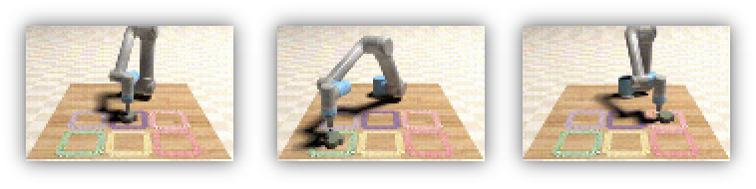
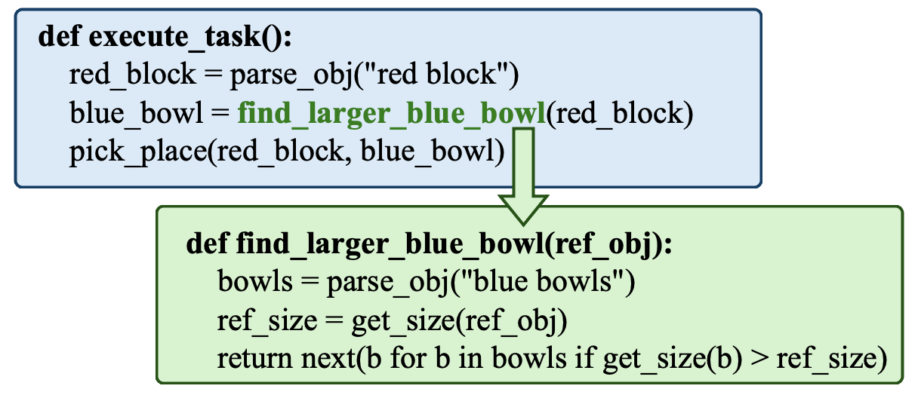

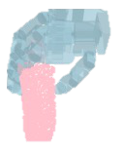
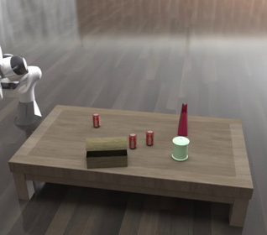
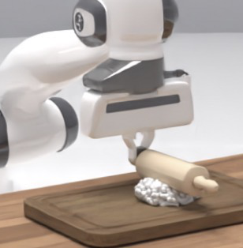
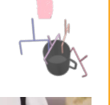

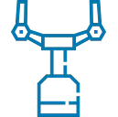

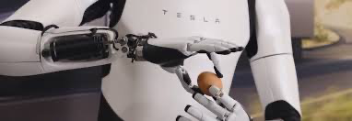
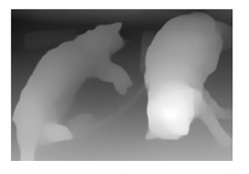
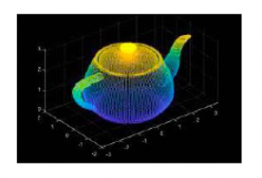
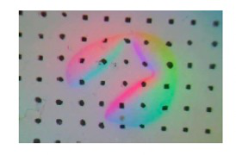
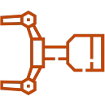
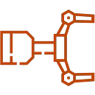
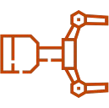






Data
Generation
Image Generation
Code Generation
Grasp
Generation
Visual
-
text Pairs
t
t+1
t+2
Sort the 3 cans
Roll out the dough
into a row
Additional Modalities
Depth
Point clouds
Tactile
Reward
Generation
Trajectory
Generation
Supervision Signal
Labeling
State Generation
Language Generation
Policy Score
update
Step 1: Move gripper to the
drawer.
✕
Assessing
Step 2: Open the drawer.
Step 3:…
✓
Action
✓
Foundation Layer
Intermediate Layer
Policy Layer
Notes:
{
"paper_title": "Generative Artificial Intelligence in Robotic Manipulation: A Survey",
"paper_url": "https://arxiv.org/abs/2503.03464v2",
"figure": "Figure 1",
"license": "No reuse license found in inspected source landing page; retain attribution and review reuse terms",
"notes": "Original vector geometry and editable text; source photo/plot/formula assets preserved separately with their transparency. Internal pixels of raster subassets are not editable. Freeform arrows lack semantic endpoint attachment. Independent cross-format QA pending.",
"page": 2,
"status": "figure_recreation",
"source_sha256": "d0c553eb4834303a8ec30327f724cc2359e32ce6b69b4d8b8f3cf6cd893df8d8",
"source_crop_pdf_points": [
48,
52,
564,
329
],
"extraction_review": "pending; native geometry extraction is not visual fidelity approval",
"font_substitutions": "Arial or Courier New; source fonts recorded per text object",
"outlined_font_families": [
"CMM",
"CMSY",
"CMEX",
"CMR",
"CambriaMath"
],
"outlined_math_limit": "Selected source mathematical fonts preserved as editable glyph outlines, not live equation/text objects.",
"extraction_warnings": [
"58 source clipping groups intersect crop; extracted paths require explicit clipping review",
"path partially intersects raster inset: 134",
"path partially intersects raster inset: 135",
"path partially intersects raster inset: 143",
"path partially intersects raster inset: 159",
"path partially intersects raster inset: 320",
"path partially intersects raster inset: 321",
"path partially intersects raster inset: 322",
"path partially intersects raster inset: 323",
"unhandled image/shading at seq 2: [248.56784057617188, 125.39183807373047, 373.6596984863281, 250.59548950195312]; requires reviewed raster region",
"unhandled image/shading at seq 4: [298.48028564453125, 139.1290283203125, 375.5709228515625, 182.4147186279297]; requires reviewed raster region",
"unhandled image/shading at seq 6: [271.1067810058594, 188.68582153320312, 372.05615234375, 243.84564208984375]; requires reviewed raster region",
"unhandled image/shading at seq 8: [307.5924072265625, 212.25184631347656, 362.72491455078125, 224.88400268554688]; requires reviewed raster region",
"unhandled image/shading at seq 14: [229.14590454101562, 154.33282470703125, 354.854248046875, 275.15185546875]; requires reviewed raster region",
"unhandled image/shading at seq 178: [495.1754455566406, 54.172203063964844, 541.1943969726562, 98.7998275756836]; requires reviewed raster region",
"unhandled image/shading at seq 179: [526.4072875976562, 70.47954559326172, 572.4262084960938, 115.10717010498047]; requires reviewed raster region",
"unhandled image/shading at seq 180: [557.63916015625, 86.78690338134766, 603.6580810546875, 131.41452026367188]; requires reviewed raster region",
"unhandled image/shading at seq 181: [480.3883361816406, 82.49248504638672, 526.4072875976562, 127.12010955810547]; requires reviewed raster region",
"unhandled image/shading at seq 182: [511.6202392578125, 98.79981231689453, 557.63916015625, 143.42742919921875]; requires reviewed raster region",
"unhandled image/shading at seq 183: [542.85205078125, 115.10717010498047, 588.8709716796875, 159.73480224609375]; requires reviewed raster region",
"unhandled image/shading at seq 184: [465.6012268066406, 110.81275177001953, 511.62017822265625, 155.44036865234375]; requires reviewed raster region",
"unhandled image/shading at seq 185: [496.8330993652344, 127.12007904052734, 542.85205078125, 171.74771118164062]; requires reviewed raster region",
"unhandled image/shading at seq 186: [528.06494140625, 143.427490234375, 574.0838623046875, 188.05511474609375]; requires reviewed raster region"
]
}

