Slide 1
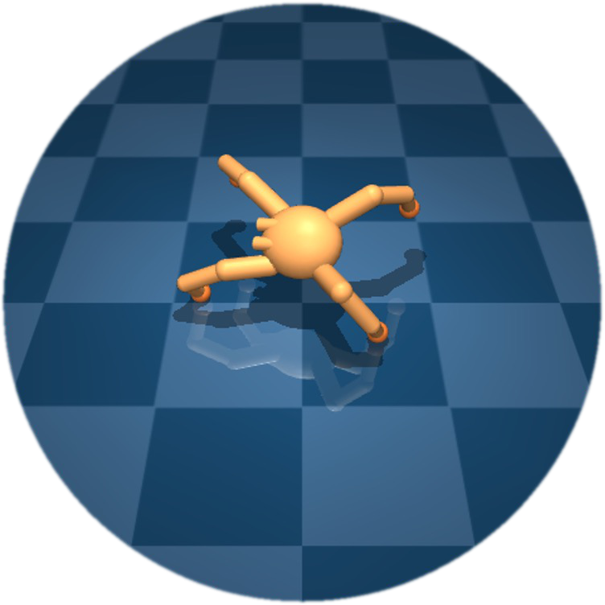
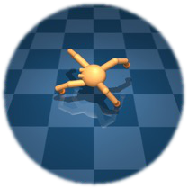
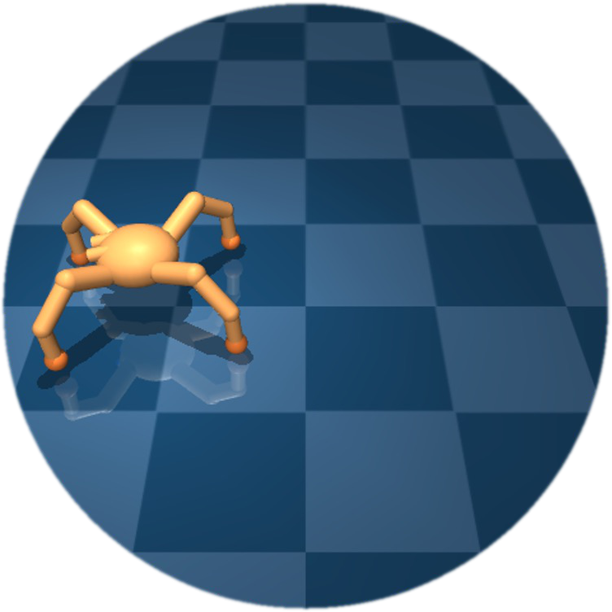
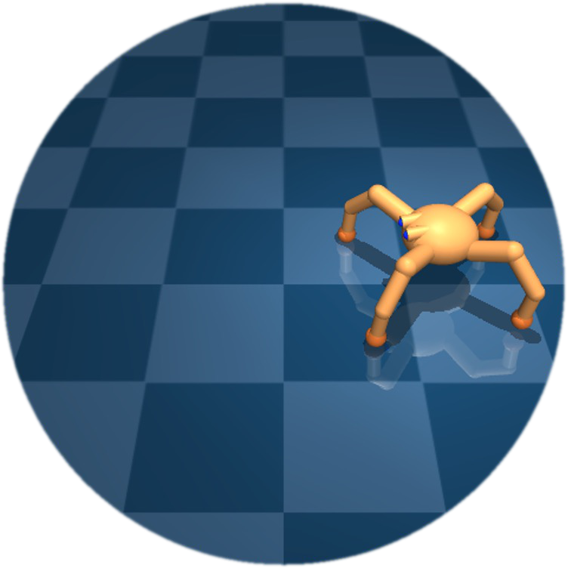




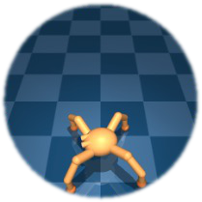
Temporally close
Temporally distant
METRA covers the most
“
temporally spread-out
” manifold
Notes:
{
"paper_title": "METRA: Scalable Unsupervised RL with Metric-Aware Abstraction",
"paper_url": "https://arxiv.org/abs/2310.08887v2",
"figure": "Figure 1",
"license": "No reuse license found in inspected source landing page; retain attribution and review reuse terms",
"notes": "Original manifold/sphere geometry, arrows and source math glyph outlines preserved. Near/far labels and explanatory callout are typeable text, with a Times New Roman substitute for embedded CMU Serif. Nine ant-state thumbnails remain independent transparent raster images; no whole-figure raster is embedded.",
"page": 2,
"status": "figure_recreation",
"source_sha256": "66833b9b67c78b4f247e795e6c73bbf634ca2983907adf28a8a625eca8c17e5f",
"source_crop_pdf_points": [
119,
49,
508,
209
],
"extraction_review": "pending; native geometry extraction is not visual fidelity approval",
"font_substitutions": "CMU Serif and Nimbus Roman ordinary labels use Times New Roman or the editor Times-compatible fallback. Original geometry and math outlines retained.",
"outlined_font_families": [
"CMSY",
"CMR",
"CMBX",
"MSBM"
],
"outlined_math_limit": "Selected source mathematical fonts preserved as editable glyph outlines, not live equation/text objects.",
"dash_fidelity": "PPTX uses the closest supported native preset, not exact PDF dash lengths. Draw.io retains interval lengths; PDF phase/caps are not preserved; zero intervals become 0.001 scene units.",
"extraction_warnings": [
"4 source clipping groups intersect crop; extracted paths require explicit clipping review",
"path crosses crop boundary: 2"
],
"reviewed_arrow_repair": "Straight thumbnail arrows use explicit union outlines; curved thumbnail arrow uses separate source subpaths, avoiding editor even-odd cancellation at the shaft/head join.",
"text_editability": "Ordinary diagram labels and panel/callout prose are native typeable text. Mathematical glyph outlines, where present, remain editable point paths, not live equations."
}

