Slide 1

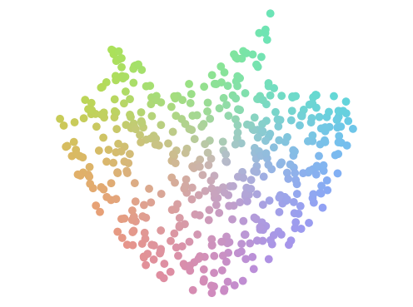
Repertoire
of diverse skills
yes
Commit to repertoire
are features
yes
is state
hand-de
ﬁ
ned?
safe?
no
no
No addition to repertoire
VAE
Notes:
{
"paper_title": "From Tabula Rasa to Emergent Abilities: Discovering Robot Skills via Real-World Unsupervised Quality-Diversity",
"paper_url": "https://arxiv.org/abs/2508.19172v3",
"figure": "Figure 2",
"license": "http://creativecommons.org/licenses/by/4.0/",
"notes": "Original vector geometry and editable text; source photo/plot/formula assets preserved separately with their transparency. Internal pixels of raster subassets are not editable. Freeform arrows lack semantic endpoint attachment. Independent cross-format QA pending. Ordinary text width-fitted to original source boxes; source math gradient glyphs remain tiny raster assets.",
"page": 3,
"status": "figure_recreation",
"source_sha256": "92a73fad024334ad3c8a932f84cac54f8a8d9ade9131ff99c84c23c3689c3096",
"source_crop_pdf_points": [
134,
67,
475,
191
],
"extraction_review": "pending; native geometry extraction is not visual fidelity approval",
"font_substitutions": "Arial or Courier New; source fonts recorded per text object",
"outlined_font_families": [
"CMM",
"CMSY",
"CMEX",
"CMR",
"CambriaMath"
],
"outlined_math_limit": "Selected source mathematical fonts preserved as editable glyph outlines, not live equation/text objects.",
"dash_fidelity": "PPTX uses the closest supported native preset, not exact PDF dash lengths. Draw.io retains interval lengths; PDF phase/caps are not preserved; zero intervals become 0.001 scene units.",
"extraction_warnings": [
"10 source clipping groups intersect crop; extracted paths require explicit clipping review",
"path partially intersects raster inset: 17",
"path partially intersects raster inset: 59",
"path partially intersects raster inset: 68"
]
}

