Slide 1
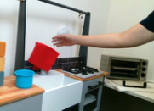
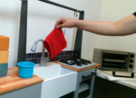
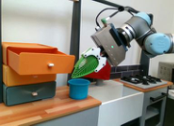
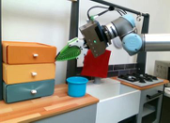
Human & Robot Videos
v
1
z
1
…
Softmax
temporal
Augmentation
Predicted probability
Learnable Skill
Sample
Temporal Skill Encoder
…
Cross
v
Prototypes
(Transformer)
prototype
Entropy
(Linear Layer)
Augmentation
Sinkhorn
2
2
Clustering
…
v
z
…
temporal
Target
Notes:
{
"paper_title": "XSkill: Cross Embodiment Skill Discovery",
"paper_url": "https://proceedings.mlr.press/v229/xu23a/xu23a.pdf",
"figure": "Figure 2",
"license": "License not independently verified; official PMLR proceedings source",
"notes": "Source architecture including temporal encoders, skill prototypes and distribution bar charts retained as native geometry and live text. Four original human/robot demonstration frames remain separately cropped raster images.",
"page": 3,
"status": "figure_recreation",
"source_sha256": "c99c21d537d98e14430b650ed0b02eee012a932b349f53ba08a977e1ab30f5ca",
"source_crop_pdf_points": [
110,
71,
508,
162
],
"extraction_review": "pending; native geometry extraction is not visual fidelity approval",
"font_substitutions": "Arial or Courier New; source fonts recorded per text object",
"outlined_font_families": [
"TimesNewRomanPS-BoldItal"
],
"outlined_math_limit": "Selected source mathematical fonts preserved as editable glyph outlines, not live equation/text objects.",
"extraction_warnings": [
"6 source clipping groups intersect crop; extracted paths require explicit clipping review",
"path crosses crop boundary: 0",
"path partially intersects raster inset: 13",
"path partially intersects raster inset: 17",
"path partially intersects raster inset: 19",
"path partially intersects raster inset: 23",
"path crosses crop boundary: 25",
"path crosses crop boundary: 63",
"path crosses crop boundary: 69",
"path partially intersects raster inset: 86",
"path crosses crop boundary: 98",
"unhandled image/shading at seq 14: [150.9268341064453, 85.4818115234375, 209.1416473388672, 117.98323059082031]; requires reviewed raster region",
"unhandled image/shading at seq 18: [102.7559814453125, 85.4818115234375, 160.97079467773438, 117.98451232910156]; requires reviewed raster region",
"unhandled image/shading at seq 20: [162.69662475585938, 119.81675720214844, 220.91143798828125, 152.3194580078125]; requires reviewed raster region",
"unhandled image/shading at seq 24: [115.99642944335938, 119.81675720214844, 174.21124267578125, 152.3194580078125]; requires reviewed raster region"
],
"text_repairs": "Ordinary labels remain live Times/Arial text; the three stylized function glyphs retain source outlines. Bottom distribution ellipsis baseline adjusted by one PDF point for substituted font metrics."
}

