Slide 1
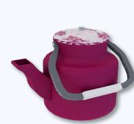
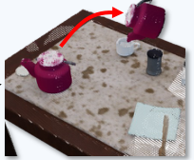
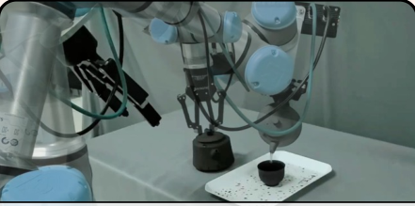

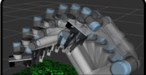
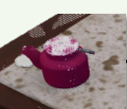
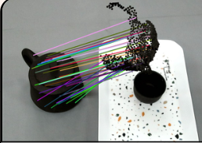
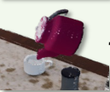

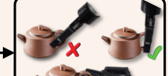
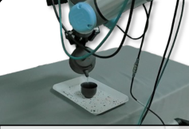
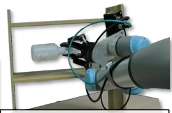
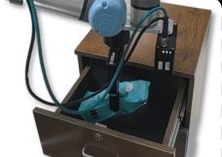
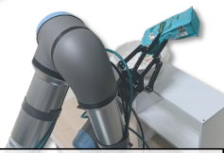
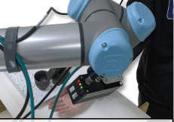
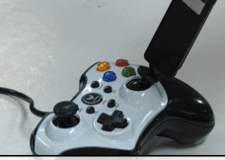
ForeGen
:
Infinite Simulation Data Generation
Application in real
-
world environments
“lift kettle and pour
water into cup”
“Remove the lid”
…
Objects
Tasks
Scenes
& goal states
Train
lift kettle and pour water into cup
ForeFormer
:
3D Goal
-
State Prediction
Target
3D Goal
Diffusion
Noise
Object
State
segmentation
Motion planning
Noised
Err
3D Init
Goal State
Min
State
TransFormer
Task
“lift kettle and
Predicted
Point Cloud
Grasp detection
pour water
Noise
Goal point cloud
into cup”
Inference
lift kettle and pour
move atomizer to
put teabag in drawer
Pour the tea bag into
Place the cup in the
Press the joystick on
water into cup
shelf
the tray
person’s hand
the gamepad
…
…
Zero
-
shot Sim
-
to
-
Real
Object & Task Generalization
Notes:
{
"paper_title": "ForeRobo: Unlocking Infinite Simulation Data for 3D Goal-driven Robotic Manipulation",
"paper_url": "https://arxiv.org/pdf/2511.04381v1",
"figure": "Figure 1",
"license": "http://arxiv.org/licenses/nonexclusive-distrib/1.0/",
"notes": "Native extracted geometry and ordinary live text; source raster photos/icons are separately preserved. Source clipping and cross-format QA pending. Reviewed source EMU-like stroke-width anomaly corrected by factor25400 against original pixels. Georgia labels substituted with width-fitted native Times. Source broad bitmap shadows omitted; discrete photo crop boundaries restored.",
"page": 3,
"status": "figure_recreation",
"source_sha256": "3bdb1dd33b86dd992851ef2d2c84c77d2e6a10c39c3134cc5ede3d36005cb193",
"source_crop_pdf_points": [
50,
57,
559,
408
],
"extraction_review": "pending; native geometry extraction is not visual fidelity approval",
"font_substitutions": "Arial or Courier New; source fonts recorded per text object",
"outlined_font_families": [
"CMM",
"CMSY",
"CMEX",
"CambriaMath"
],
"outlined_math_limit": "Selected source mathematical fonts preserved as editable glyph outlines, not live equation/text objects.",
"dash_fidelity": "PPTX uses the closest supported native preset, not exact PDF dash lengths. Draw.io retains interval lengths; PDF phase/caps are not preserved; zero intervals become 0.001 scene units.",
"extraction_warnings": [
"101 source clipping groups intersect crop; extracted paths require explicit clipping review",
"path crosses crop boundary: 1",
"path crosses crop boundary: 2",
"suspicious source stroke width at seq 4: verify PDF/SVG transform units before rendering",
"path partially intersects raster inset: 7",
"suspicious source stroke width at seq 16: verify PDF/SVG transform units before rendering",
"suspicious source stroke width at seq 31: verify PDF/SVG transform units before rendering",
"suspicious source stroke width at seq 40: verify PDF/SVG transform units before rendering",
"suspicious source stroke width at seq 46: verify PDF/SVG transform units before rendering",
"suspicious source stroke width at seq 58: verify PDF/SVG transform units before rendering",
"path partially intersects raster inset: 61",
"suspicious source stroke width at seq 64: verify PDF/SVG transform units before rendering",
"path partially intersects raster inset: 65",
"suspicious source stroke width at seq 70: verify PDF/SVG transform units before rendering",
"suspicious source stroke width at seq 74: verify PDF/SVG transform units before rendering",
"suspicious source stroke width at seq 86: verify PDF/SVG transform units before rendering",
"path partially intersects raster inset: 98",
"suspicious source stroke width at seq 103: verify PDF/SVG transform units before rendering",
"suspicious source stroke width at seq 104: verify PDF/SVG transform units before rendering",
"path partially intersects raster inset: 104",
"suspicious source stroke width at seq 105: verify PDF/SVG transform units before rendering",
"path partially intersects raster inset: 105",
"suspicious source stroke width at seq 107: verify PDF/SVG transform units before rendering",
"suspicious source stroke width at seq 108: verify PDF/SVG transform units before rendering",
"path partially intersects raster inset: 108",
"suspicious source stroke width at seq 109: verify PDF/SVG transform units before rendering",
"path partially intersects raster inset: 109",
"suspicious source stroke width at seq 111: verify PDF/SVG transform units before rendering",
"suspicious source stroke width at seq 119: verify PDF/SVG transform units before rendering",
"path partially intersects raster inset: 121",
"suspicious source stroke width at seq 122: verify PDF/SVG transform units before rendering",
"path partially intersects raster inset: 122",
"suspicious source stroke width at seq 126: verify PDF/SVG transform units before rendering",
"path partially intersects raster inset: 128",
"suspicious source stroke width at seq 129: verify PDF/SVG transform units before rendering",
"path partially intersects raster inset: 129",
"path partially intersects raster inset: 140",
"suspicious source stroke width at seq 141: verify PDF/SVG transform units before rendering",
"path partially intersects raster inset: 141",
"path partially intersects raster inset: 144",
"suspicious source stroke width at seq 145: verify PDF/SVG transform units before rendering",
"path partially intersects raster inset: 145",
"path partially intersects raster inset: 148",
"suspicious source stroke width at seq 149: verify PDF/SVG transform units before rendering",
"path partially intersects raster inset: 149",
"path partially intersects raster inset: 152",
"suspicious source stroke width at seq 153: verify PDF/SVG transform units before rendering",
"path partially intersects raster inset: 153",
"suspicious source stroke width at seq 162: verify PDF/SVG transform units before rendering",
"path partially intersects raster inset: 164",
"path partially intersects raster inset: 166",
"suspicious source stroke width at seq 167: verify PDF/SVG transform units before rendering",
"path partially intersects raster inset: 167",
"path partially intersects raster inset: 184",
"suspicious source stroke width at seq 186: verify PDF/SVG transform units before rendering",
"path partially intersects raster inset: 193",
"rotated text needs manual reconstruction: …",
"rotated text needs manual reconstruction: …",
"rotated text needs manual reconstruction: …",
"unhandled image/shading at seq 6: [356.4757080078125, 76.9009780883789, 504.83050537109375, 162.5130615234375]; requires reviewed raster region",
"unhandled image/shading at seq 8: [486.6575012207031, 167.01930236816406, 553.5474853515625, 216.91415405273438]; requires reviewed raster region",
"unhandled image/shading at seq 9: [217.91799926757812, 305.5999755859375, 303.11798095703125, 385.03997802734375]; requires reviewed raster region",
"unhandled image/shading at seq 10: [210.35958862304688, 288.640625, 333.12847900390625, 366.34783935546875]; requires reviewed raster region",
"unhandled image/shading at seq 11: [135.83799743652344, 305.5999755859375, 221.2779998779297, 385.03997802734375]; requires reviewed raster region",
"unhandled image/shading at seq 12: [79.3927001953125, 281.9853515625, 238.38279724121094, 383.57745361328125]; requires reviewed raster region",
"unhandled image/shading at seq 13: [53.75799560546875, 305.5999755859375, 138.95799255371094, 385.03997802734375]; requires reviewed raster region",
"unhandled image/shading at seq 14: [28.604705810546875, 299.9039001464844, 162.94261169433594, 377.36456298828125]; requires reviewed raster region",
"unhandled image/shading at seq 18: [224.63800048828125, 71.11994934082031, 292.3179931640625, 135.91995239257812]; requires reviewed raster region",
"unhandled image/shading at seq 19: [127.80450439453125, 43.35527038574219, 411.089111328125, 194.79327392578125]; requires reviewed raster region",
"unhandled image/shading at seq 32: [285.5979919433594, 287.1199645996094, 327.8379821777344, 313.51995849609375]; requires reviewed raster region",
"unhandled image/shading at seq 33: [286.5580139160156, 288.0799865722656, 324.47802734375, 310.15997314453125]; requires reviewed raster region",
"unhandled image/shading at seq 35: [60.238006591796875, 83.5999755859375, 121.43800354003906, 132.31997680664062]; requires reviewed raster region",
"unhandled image/shading at seq 36: [3.9664993286132812, 57.40765380859375, 166.75460815429688, 148.96646118164062]; requires reviewed raster region",
"unhandled image/shading at seq 37: [139.91799926757812, 79.99996948242188, 208.79800415039062, 103.27996826171875]; requires reviewed raster region",
"unhandled image/shading at seq 38: [140.39801025390625, 79.51997375488281, 209.7580108642578, 106.15997314453125]; requires reviewed raster region",
"unhandled image/shading at seq 43: [139.91799926757812, 102.0799560546875, 208.79800415039062, 120.79995727539062]; requires reviewed raster region",
"unhandled image/shading at seq 44: [144.23800659179688, 103.27998352050781, 204.47801208496094, 121.75997924804688]; requires reviewed raster region",
"unhandled image/shading at seq 56: [154.3179931640625, 244.87997436523438, 232.5579833984375, 277.03997802734375]; requires reviewed raster region",
"unhandled image/shading at seq 62: [154.3179931640625, 189.91995239257812, 232.3179931640625, 222.0799560546875]; requires reviewed raster region",
"unhandled image/shading at seq 80: [91.91799926757812, 187.7599639892578, 138.71800231933594, 224.23995971679688]; requires reviewed raster region",
"unhandled image/shading at seq 81: [-33.22840881347656, 134.7138671875, 332.3167724609375, 312.9140625]; requires reviewed raster region",
"unhandled image/shading at seq 82: [92.15800476074219, 219.91998291015625, 138.9580078125, 260.47998046875]; requires reviewed raster region",
"unhandled image/shading at seq 83: [-83.69668579101562, 183.95904541015625, 301.6338195800781, 371.7928466796875]; requires reviewed raster region",
"unhandled image/shading at seq 84: [91.43800354003906, 261.91998291015625, 139.43800354003906, 292.15997314453125]; requires reviewed raster region",
"unhandled image/shading at seq 134: [473.9980163574219, 305.5999755859375, 559.43798828125, 385.03997802734375]; requires reviewed raster region",
"unhandled image/shading at seq 135: [471.7779846191406, 295.743896484375, 574.8463745117188, 372.43646240234375]; requires reviewed raster region",
"unhandled image/shading at seq 136: [390.7179870605469, 305.5999755859375, 475.91796875, 385.03997802734375]; requires reviewed raster region",
"unhandled image/shading at seq 137: [358.98089599609375, 299.9351806640625, 476.07647705078125, 374.88067626953125]; requires reviewed raster region",
"unhandled image/shading at seq 138: [308.87799072265625, 305.5999755859375, 394.0780029296875, 385.03997802734375]; requires reviewed raster region",
"unhandled image/shading at seq 139: [311.2471923828125, 298.27325439453125, 428.3699951171875, 370.7852783203125]; requires reviewed raster region",
"unhandled image/shading at seq 155: [287.2489013671875, 124.72036743164062, 419.5198059082031, 235.44866943359375]; requires reviewed raster region",
"unhandled image/shading at seq 158: [312.63238525390625, 232.8441619873047, 346.5923156738281, 259.3328552246094]; requires reviewed raster region",
"unhandled image/shading at seq 159: [347.456787109375, 235.13351440429688, 374.9539489746094, 260.49395751953125]; requires reviewed raster region",
"unhandled image/shading at seq 165: [387.0628967285156, 211.5324249267578, 475.5185546875, 286.69744873046875]; requires reviewed raster region",
"unhandled image/shading at seq 170: [523.677978515625, 225.43995666503906, 560.8779907226562, 258.7999572753906]; requires reviewed raster region",
"unhandled image/shading at seq 172: [492.9708251953125, 182.7262420654297, 630.8182983398438, 304.35467529296875]; requires reviewed raster region",
"unhandled image/shading at seq 173: [485.9980163574219, 224.9599609375, 531.3580322265625, 257.8399658203125]; requires reviewed raster region",
"unhandled image/shading at seq 176: [461.3938293457031, 186.56106567382812, 581.1556396484375, 317.8016662597656]; requires reviewed raster region",
"unhandled image/shading at seq 177: [493.9179992675781, 249.199951171875, 545.9979858398438, 279.9199523925781]; requires reviewed raster region",
"unhandled image/shading at seq 178: [492.8522033691406, 250.15020751953125, 524.3723754882812, 281.6146545410156]; requires reviewed raster region",
"unhandled image/shading at seq 179: [455.08612060546875, 198.69921875, 578.9359130859375, 338.48858642578125]; requires reviewed raster region",
"unhandled image/shading at seq 181: [544.6856689453125, 244.95220947265625, 561.0379638671875, 258.1981506347656]; requires reviewed raster region",
"unhandled image/shading at seq 182: [537.33837890625, 264.8983154296875, 553.690673828125, 278.1442565917969]; requires reviewed raster region"
],
"ignored_invisible_text_spans": 0
}

