Slide 1


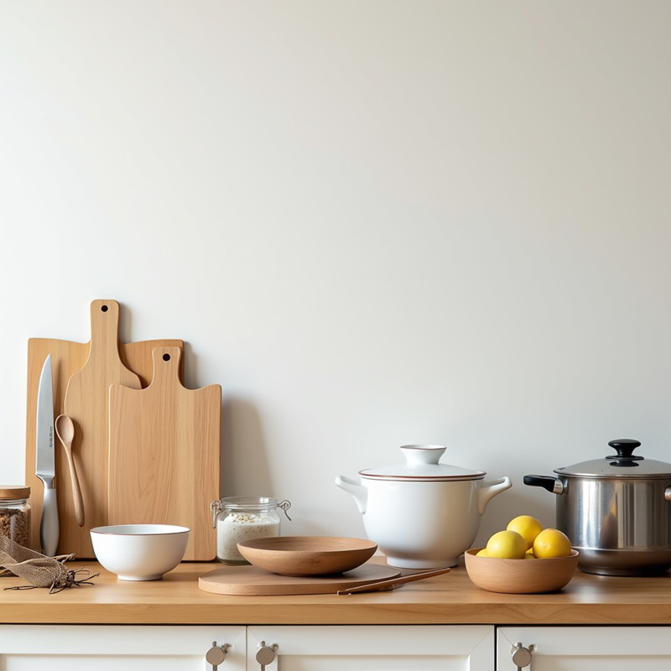
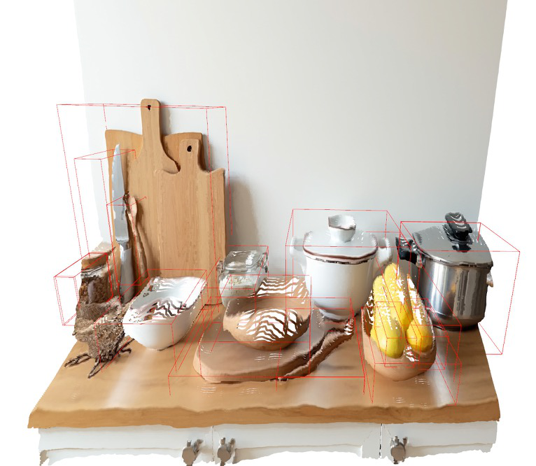

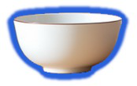


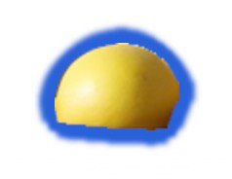

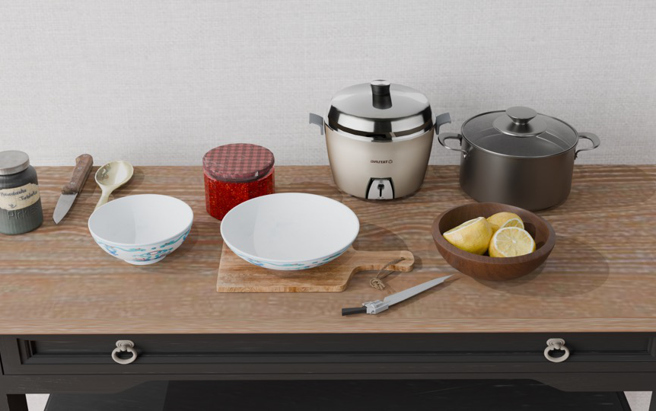



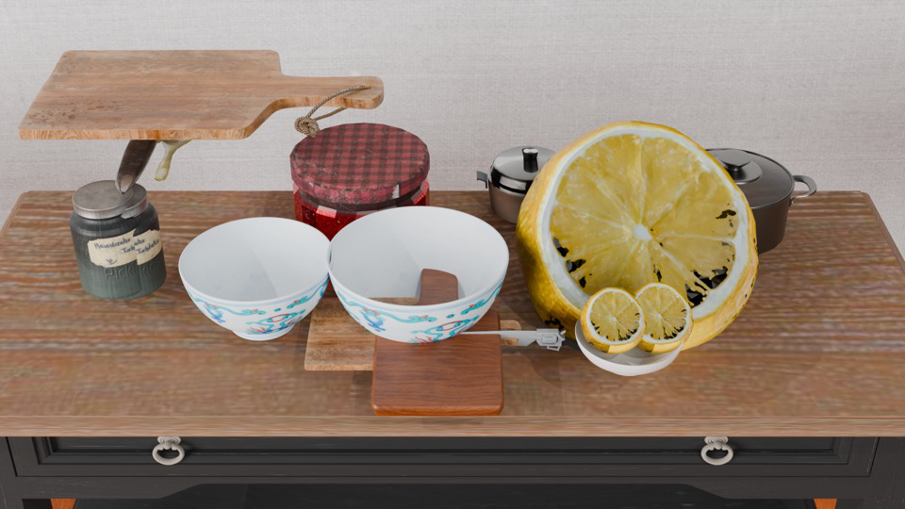



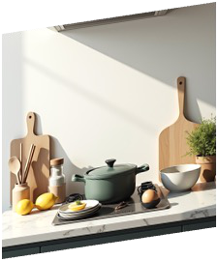
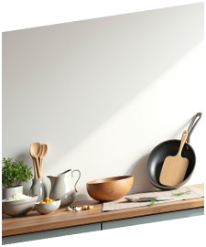
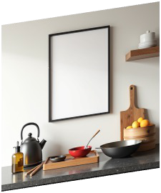
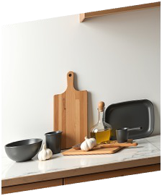
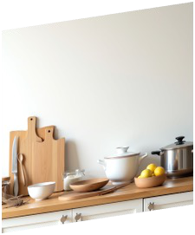


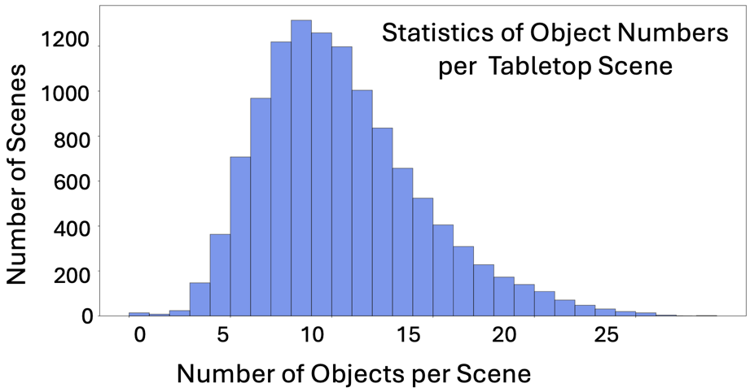
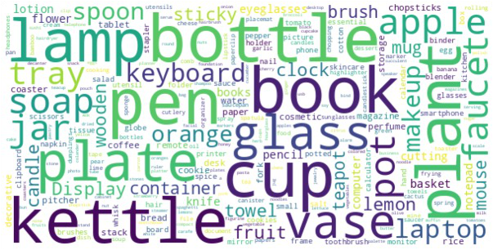
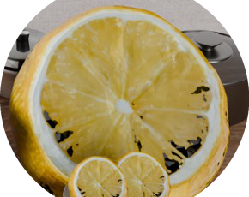
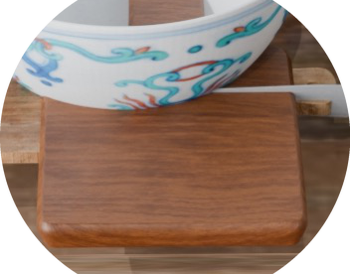
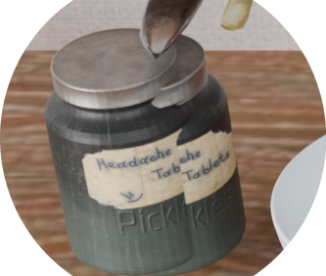





Reference Image
Depth
Point Cloud
3D Asset Library
“Generate
some diverse
Anything V2
{
Kitchen Counter
}
descriptions.
“a white
Grounded
bowl”
SAM
1.
Infer
common
object
2.
Imagine spatial relation
Vision
Language
Object retrieval
“a half
Model
lemon”
Generate
Object
relation:
…
Infer
Object
List
：
Cutting
boards,
knife,
and
spoon
Lemon
are
on
the
left
.
Nearby
is
a
white
Knife
bowl
and
a
glass
jar
.
In
the
middle
,
Isometric
Placement
Bowl
there’s
a
wooden
plate
with
Final Scene
Spoon
chopsticks
.
On
the
right
,
there
are
Cooking
pot
a
white
pot,
a
bowl
of
yellow
Cutting board
lemons
.
Physical Simulation
Description = “{Infer
Object
List}
,
{Object
relation}
”
Manual Craft
2000+
Hours
Wrong Size
Collision
Text
-
to
-
Image
Model
Generated
Redundant
Objects
Images
Notes:
{
"paper_title": "MesaTask: Towards Task-Driven Tabletop Scene Generation via 3D Spatial Reasoning",
"paper_url": "https://arxiv.org/pdf/2509.22281v1",
"figure": "Figure 2",
"license": "http://arxiv.org/licenses/nonexclusive-distrib/1.0/",
"notes": "Native extracted geometry and ordinary live text; source raster photos/icons are separately preserved. Source clipping and cross-format QA pending. Source circular error photos retain reviewed elliptical clipping. Two physical simulation object illustrations cropped back to their source-visible regions. Paragraph word spacing and font metrics approximate source Aptos.",
"page": 5,
"status": "figure_recreation",
"source_sha256": "45ed869dd42c02f733b74aab7dda7f58c295b12485be0d8f07139a71db585258",
"source_crop_pdf_points": [
62,
89,
530,
319
],
"extraction_review": "pending; native geometry extraction is not visual fidelity approval",
"font_substitutions": "Arial or Courier New; source fonts recorded per text object",
"outlined_font_families": [
"CMM",
"CMSY",
"CMEX",
"CambriaMath"
],
"outlined_math_limit": "Selected source mathematical fonts preserved as editable glyph outlines, not live equation/text objects.",
"dash_fidelity": "PPTX uses the closest supported native preset, not exact PDF dash lengths. Draw.io retains interval lengths; PDF phase/caps are not preserved; zero intervals become 0.001 scene units.",
"extraction_warnings": [
"39 source clipping groups intersect crop; extracted paths require explicit clipping review",
"path crosses crop boundary: 0",
"path crosses crop boundary: 1",
"path partially intersects raster inset: 5",
"path partially intersects raster inset: 6",
"path partially intersects raster inset: 7",
"path partially intersects raster inset: 8",
"rotated text needs manual reconstruction: …",
"unhandled image/shading at seq 78: [373.91094970703125, 172.2910919189453, 447.8917236328125, 213.90524291992188]; requires reviewed raster region",
"unhandled image/shading at seq 79: [280.3338623046875, 171.18959045410156, 354.31463623046875, 212.80374145507812]; requires reviewed raster region",
"unhandled image/shading at seq 204: [68.78559875488281, 271.53228759765625, 111.93180084228516, 287.7010803222656]; requires reviewed raster region"
],
"ignored_invisible_text_spans": 0
}

