Slide 1


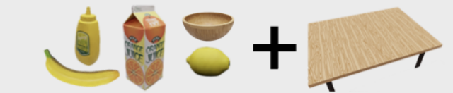
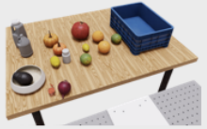
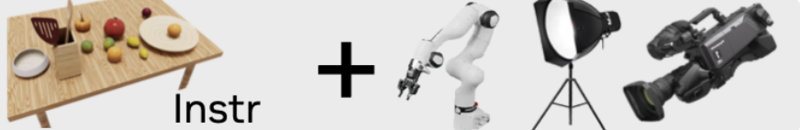
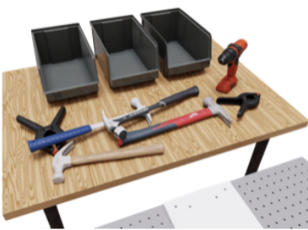
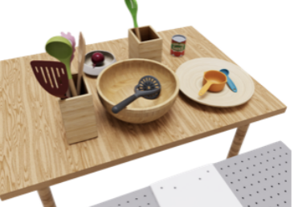
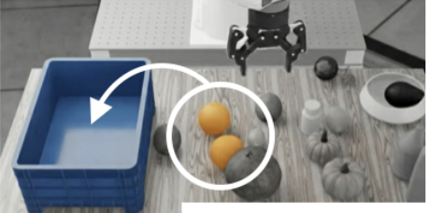
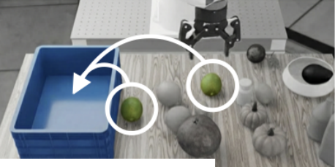
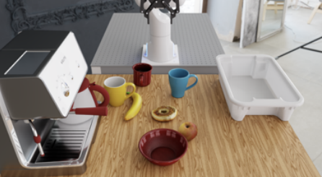
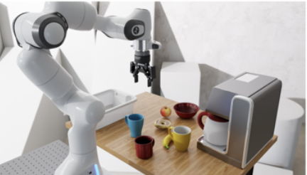
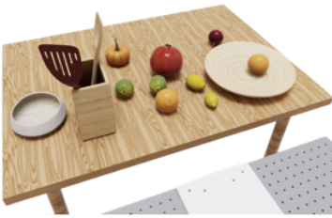
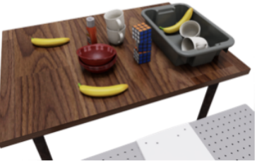
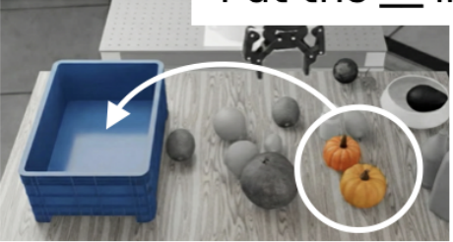
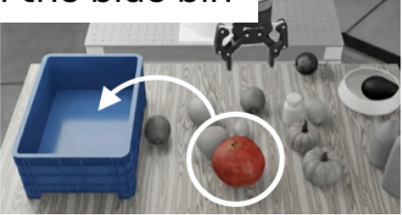
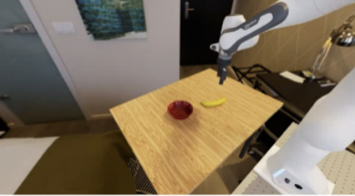
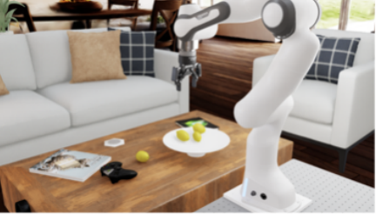

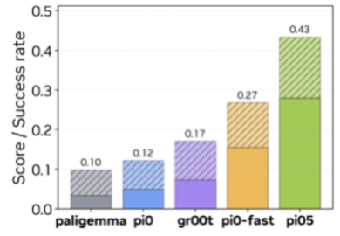
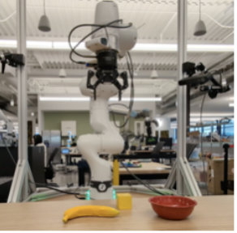
RoboLab Benchmarking Framework
Policy
Scene Generation
Task Generation
Environment Generation
π₁
+
Language
instruction
π₂
⋮
π
N
“Put the __ in the blue bin”
user
LLM
Policy Performance Analysis
Multiple Eval Axes
Metrics
Sensitivity
Analysis
Real world correlation
Competency Categories
×
Wrong obj grabbed
Task Difficulty
×
Gripper collision
Benchmark
Correlation
✓
Language complexity
×
Target obj dropped
p(θ | succ)
Task horizon
×
✓
Target obj grabbed
Spearman ρ=1
Scene Complexity
Continuous
Discrete
Performance
Pearson r=0.68
θ
Notes:
{
"paper_title": "RoboLab: A High-Fidelity Simulation Benchmark for Analysis of Task Generalist Policies",
"paper_url": "https://arxiv.org/abs/2604.09860v4",
"figure": "Figure 1",
"page": 1,
"license": "unverified",
"status": "figure_recreation",
"source_sha256": "49da5e317e36c4320eb3896cfca4ea1600908f8ed591a1e643ff65c405fba73e",
"source_crop_pdf_points": [
50,
178,
561,
425
],
"notes": "Manually reconstructed after inspecting actual source pixels. Original source is a flattened raster. Layout, native panels, labels and connecting geometry are recreated; no whole-figure raster backdrop. Font metrics and curve/arrow geometry approximated. Small original mathematical/photo details retained only where explicitly noted. Independent target-application QA pending. Native framework panels, ordinary labels, metric descriptions, continuous curves, sensitivity chart and policy list. Eighteen bounded example photo/icon assets plus legend icons and original small performance plot remain raster; no whole-figure backdrop."
}

