Slide 1
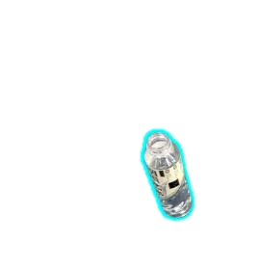
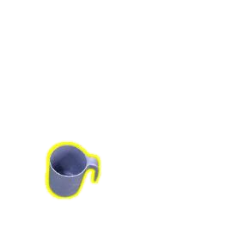
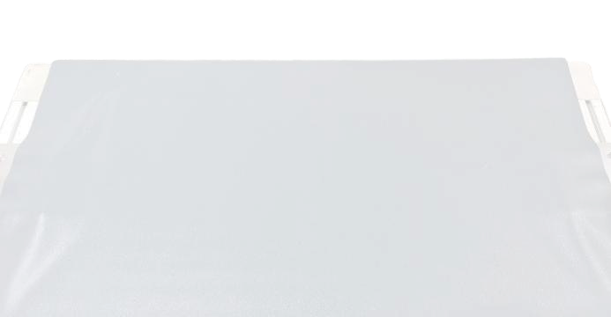
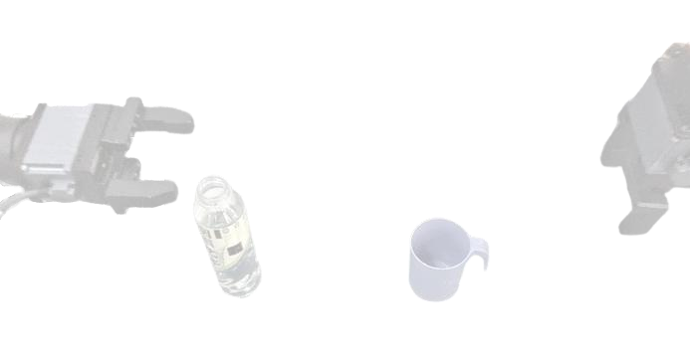
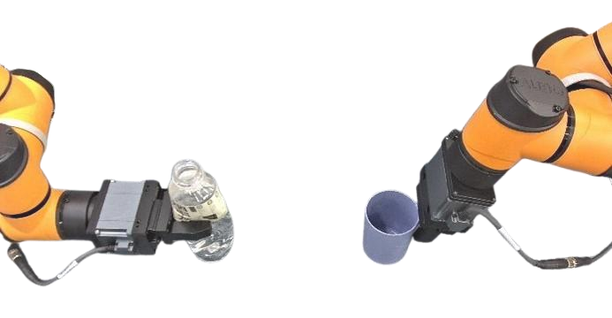

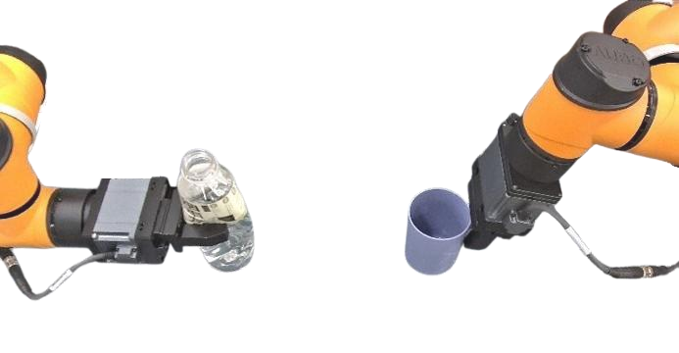
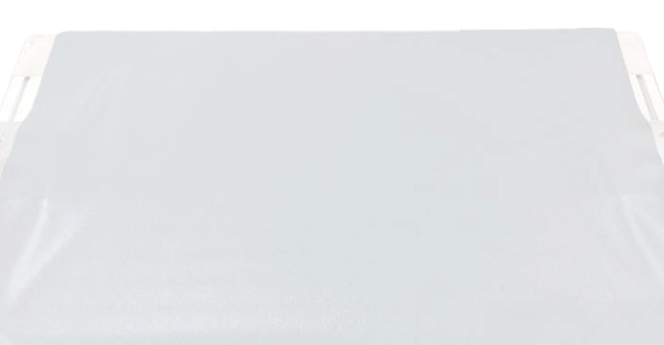
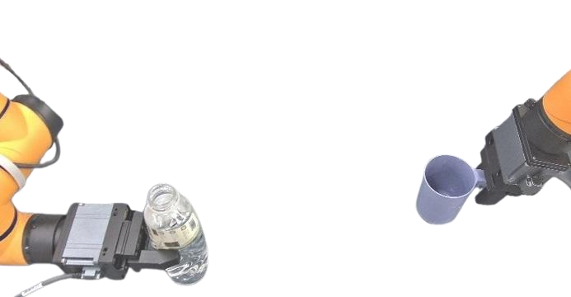

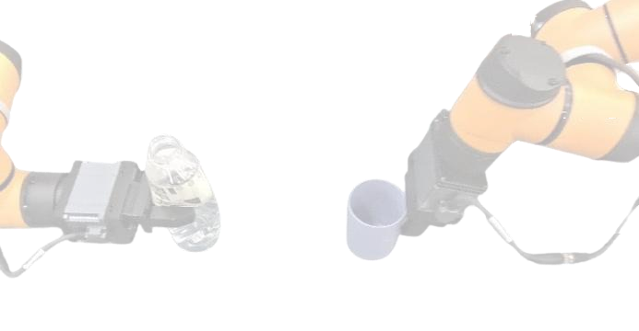
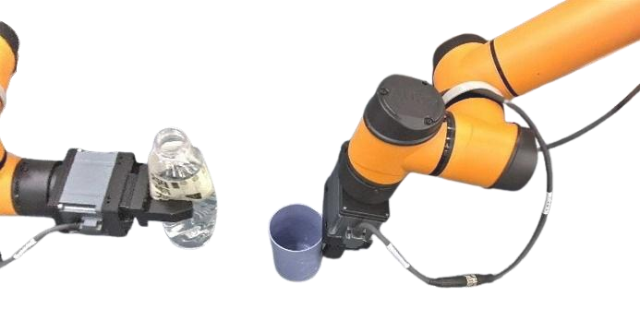
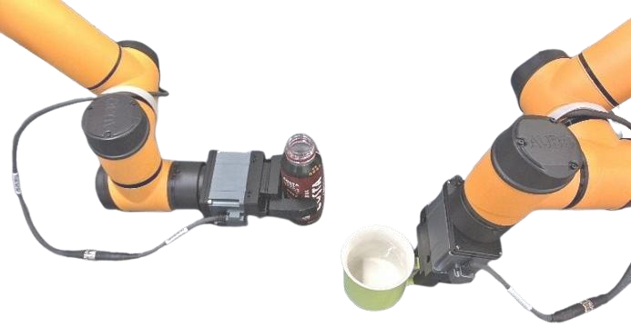



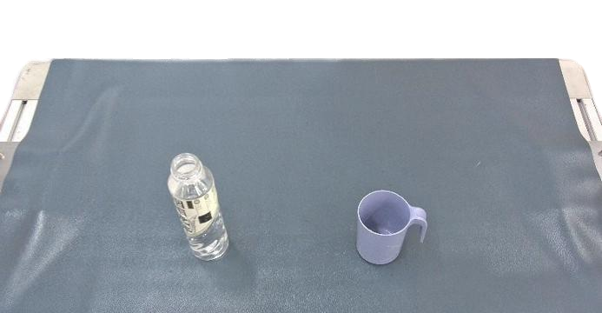
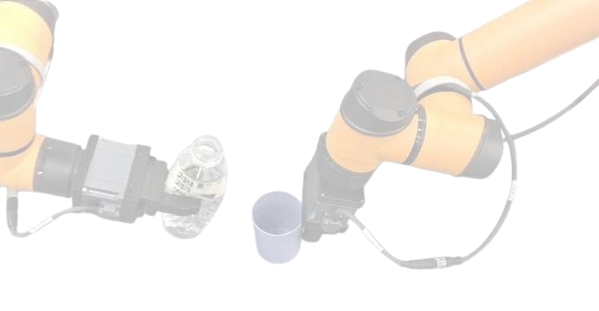
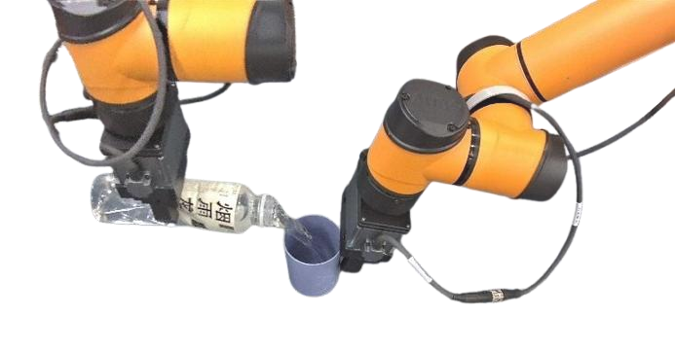
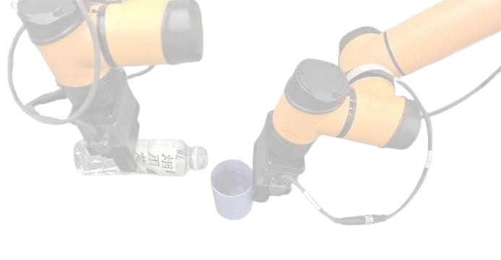
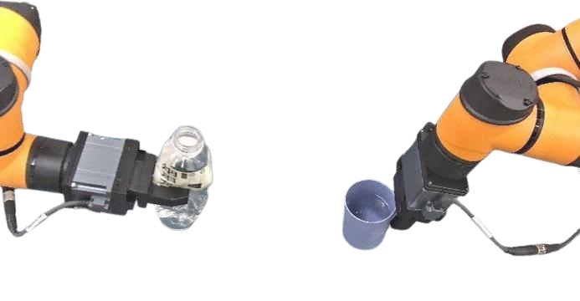

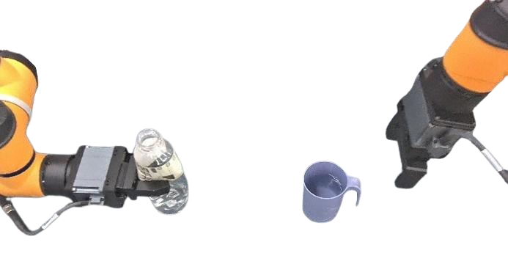
1. Task-Aware Demonstration Decomposition
2. VLM-based Adaptation
3. Trajectory Composition
grasp
lift up
※ For changed spatial location
Adapted
Reused
rel.
※ For changed spatial location
Just
adjust
grasp
actions
of
two
arms!
initial masks of traget objects
※ For new instances / geometries
carry
※ For new instances / geometries
in the given demonstration
rel.
First
adjust
grasp
/
place
actions,
then
Vision-
align
dual-arm
coordination
to
pour.
Language
Pour water from
Model
bottle
into
cup.
pour
place
place
align
L
R
Binocular Observation (showing left RGB)
Notes:
{
"paper_title": "VLBiMan: Vision-Language Anchored One-Shot Demonstration Enables Generalizable Bimanual Robotic Manipulation",
"paper_url": "https://arxiv.org/abs/2509.21723v4",
"figure": "Figure 2",
"license": "http://arxiv.org/licenses/nonexclusive-distrib/1.0/; private user-requested adaptation only.",
"notes": "Faithful native extraction from independently inspected original source figure. Ordinary labels remain live editable text; source photo details are separate raster assets. Source Arial Narrow is approximated with source-width-fitted native Arial to avoid application font substitution overflow; all text remains live. Original raster assets isolated with their exact original alpha, clipping and affine transforms; no full-figure raster backdrop.",
"page": 4,
"status": "figure_recreation",
"source_sha256": "6ecb5efd8c040508243e477990fdad996ca6315102ce18e0f884418f69e4561e",
"source_crop_pdf_points": [
108,
83,
505,
260
],
"extraction_review": "pending; native geometry extraction is not visual fidelity approval",
"font_substitutions": "Arial or Courier New; source fonts recorded per text object",
"extraction_warnings": [
"2 source clipping groups intersect crop; extracted paths require explicit clipping review",
"path crosses crop boundary: 2",
"path crosses crop boundary: 5",
"path partially intersects raster inset: 102",
"path partially intersects raster inset: 103"
],
"ignored_invisible_text_spans": 0,
"original_extraction_warnings": [
"2 source clipping groups intersect crop; extracted paths require explicit clipping review",
"path crosses crop boundary: 2",
"path crosses crop boundary: 5",
"path partially intersects raster inset: 102",
"path partially intersects raster inset: 103",
"unhandled image/shading at seq 7: [111.68695831298828, 100.2965087890625, 206.57388305664062, 149.6182403564453]; requires reviewed raster region",
"unhandled image/shading at seq 8: [111.68695831298828, 100.2965087890625, 206.57388305664062, 149.6182403564453]; requires reviewed raster region",
"unhandled image/shading at seq 9: [111.68695831298828, 100.2965087890625, 206.57388305664062, 149.6182403564453]; requires reviewed raster region",
"unhandled image/shading at seq 12: [209.70431518554688, 100.2965087890625, 304.59124755859375, 149.6182403564453]; requires reviewed raster region",
"unhandled image/shading at seq 13: [209.70431518554688, 100.2965087890625, 304.59124755859375, 149.6182403564453]; requires reviewed raster region",
"unhandled image/shading at seq 14: [209.70431518554688, 100.2965087890625, 304.59124755859375, 149.6182403564453]; requires reviewed raster region",
"unhandled image/shading at seq 17: [209.70431518554688, 153.37477111816406, 304.59124755859375, 202.69650268554688]; requires reviewed raster region",
"unhandled image/shading at seq 18: [209.70431518554688, 153.37477111816406, 304.59124755859375, 202.69650268554688]; requires reviewed raster region",
"unhandled image/shading at seq 19: [209.70431518554688, 153.37477111816406, 304.59124755859375, 202.69650268554688]; requires reviewed raster region",
"unhandled image/shading at seq 22: [307.86083984375, 206.38345336914062, 402.7477722167969, 255.70518493652344]; requires reviewed raster region",
"unhandled image/shading at seq 23: [307.86083984375, 206.38345336914062, 402.7477722167969, 255.70518493652344]; requires reviewed raster region",
"unhandled image/shading at seq 24: [307.86083984375, 206.38345336914062, 402.7477722167969, 255.70518493652344]; requires reviewed raster region",
"unhandled image/shading at seq 27: [111.68695831298828, 206.38345336914062, 206.57388305664062, 255.70518493652344]; requires reviewed raster region",
"unhandled image/shading at seq 40: [193.9825897216797, 186.55735778808594, 205.46084594726562, 198.03561401367188]; requires reviewed raster region",
"unhandled image/shading at seq 44: [140.97216796875, 87.09536743164062, 153.216796875, 94.78927612304688]; requires reviewed raster region",
"unhandled image/shading at seq 45: [151.34896850585938, 87.12434387207031, 275.5356140136719, 96.26753234863281]; requires reviewed raster region",
"unhandled image/shading at seq 52: [405.94775390625, 206.38345336914062, 500.8346862792969, 255.70518493652344]; requires reviewed raster region",
"unhandled image/shading at seq 53: [405.94775390625, 206.38345336914062, 500.8346862792969, 255.70518493652344]; requires reviewed raster region",
"unhandled image/shading at seq 54: [405.94775390625, 206.38345336914062, 500.8346862792969, 255.70518493652344]; requires reviewed raster region",
"unhandled image/shading at seq 67: [117.94202423095703, 141.68780517578125, 169.04345703125, 194.70228576660156]; requires reviewed raster region",
"unhandled image/shading at seq 68: [168.23187255859375, 141.68780517578125, 219.44924926757812, 194.70228576660156]; requires reviewed raster region",
"unhandled image/shading at seq 71: [209.70431518554688, 206.38345336914062, 304.59124755859375, 255.70518493652344]; requires reviewed raster region",
"unhandled image/shading at seq 72: [209.70431518554688, 206.38345336914062, 304.59124755859375, 255.70518493652344]; requires reviewed raster region",
"unhandled image/shading at seq 73: [209.70431518554688, 206.38345336914062, 304.59124755859375, 255.70518493652344]; requires reviewed raster region",
"unhandled image/shading at seq 81: [307.86083984375, 100.2965087890625, 402.7477722167969, 149.6182403564453]; requires reviewed raster region",
"unhandled image/shading at seq 82: [305.970947265625, 94.26753234863281, 357.0723876953125, 147.28201293945312]; requires reviewed raster region",
"unhandled image/shading at seq 83: [353.36224365234375, 94.26753234863281, 404.5796203613281, 147.28201293945312]; requires reviewed raster region",
"unhandled image/shading at seq 84: [307.86083984375, 100.2965087890625, 402.7477722167969, 149.6182403564453]; requires reviewed raster region",
"unhandled image/shading at seq 85: [307.86083984375, 153.37477111816406, 402.7477722167969, 202.69650268554688]; requires reviewed raster region",
"unhandled image/shading at seq 86: [305.970947265625, 147.3689727783203, 357.0723876953125, 200.38345336914062]; requires reviewed raster region",
"unhandled image/shading at seq 87: [353.36224365234375, 147.3689727783203, 404.5796203613281, 200.38345336914062]; requires reviewed raster region",
"unhandled image/shading at seq 88: [307.86083984375, 153.37477111816406, 402.7477722167969, 202.69650268554688]; requires reviewed raster region",
"unhandled image/shading at seq 89: [318.015625, 87.58811950683594, 341.9124450683594, 95.28202819824219]; requires reviewed raster region",
"unhandled image/shading at seq 90: [340.2764892578125, 87.61709594726562, 393.33270263671875, 96.76028442382812]; requires reviewed raster region",
"unhandled image/shading at seq 119: [415.11700439453125, 87.50115966796875, 492.6080017089844, 96.8182601928711]; requires reviewed raster region",
"unhandled image/shading at seq 232: [114.2608642578125, 178.83563232421875, 125.73912048339844, 190.3138885498047]; requires reviewed raster region"
],
"raster_boundaries": [
{
"id": "alpha-photo-30",
"bounds_canvas": [
736.0867309570312,
193.10691833496094,
153.65213012695312,
159.04344177246094
],
"detail": "Original isolated masked bottle/cup photo; original PDF image and its own alpha recombined"
},
{
"id": "alpha-photo-29",
"bounds_canvas": [
593.912841796875,
193.10691833496094,
153.3043212890625,
159.04344177246094
],
"detail": "Original isolated masked bottle/cup photo; original PDF image and its own alpha recombined"
},
{
"id": "alpha-photo-26",
"bounds_canvas": [
736.0867309570312,
33.80259704589844,
153.65213012695312,
159.04344177246094
],
"detail": "Original isolated masked bottle/cup photo; original PDF image and its own alpha recombined"
},
{
"id": "alpha-photo-25",
"bounds_canvas": [
593.912841796875,
33.80259704589844,
153.3043212890625,
159.04344177246094
],
"detail": "Original isolated masked bottle/cup photo; original PDF image and its own alpha recombined"
},
{
"id": "source-raster-0",
"bounds_canvas": [
11,
78,
285,
122
],
"detail": "Isolated original photo/rendering/icon/shading asset; original source transparency and clip retained; internal pixels remain raster"
},
{
"id": "source-raster-1",
"bounds_canvas": [
11,
69,
285,
108
],
"detail": "Isolated original photo/rendering/icon/shading asset; original source transparency and clip retained; internal pixels remain raster"
},
{
"id": "source-raster-2",
"bounds_canvas": [
11,
61,
285,
125
],
"detail": "Isolated original photo/rendering/icon/shading asset; original source transparency and clip retained; internal pixels remain raster"
},
{
"id": "source-raster-4",
"bounds_canvas": [
305,
61,
285,
125
],
"detail": "Isolated original photo/rendering/icon/shading asset; original source transparency and clip retained; internal pixels remain raster"
},
{
"id": "source-raster-5",
"bounds_canvas": [
305,
51,
285,
128
],
"detail": "Isolated original photo/rendering/icon/shading asset; original source transparency and clip retained; internal pixels remain raster"
},
{
"id": "source-raster-7",
"bounds_canvas": [
305,
211,
285,
125
],
"detail": "Isolated original photo/rendering/icon/shading asset; original source transparency and clip retained; internal pixels remain raster"
},
{
"id": "source-raster-8",
"bounds_canvas": [
305,
211,
285,
129
],
"detail": "Isolated original photo/rendering/icon/shading asset; original source transparency and clip retained; internal pixels remain raster"
},
{
"id": "source-raster-10",
"bounds_canvas": [
603,
370,
282,
129
],
"detail": "Isolated original photo/rendering/icon/shading asset; original source transparency and clip retained; internal pixels remain raster"
},
{
"id": "source-raster-11",
"bounds_canvas": [
599,
370,
286,
127
],
"detail": "Isolated original photo/rendering/icon/shading asset; original source transparency and clip retained; internal pixels remain raster"
},
{
"id": "source-raster-12",
"bounds_canvas": [
11,
397,
285,
122
],
"detail": "Isolated original photo/rendering/icon/shading asset; original source transparency and clip retained; internal pixels remain raster"
},
{
"id": "source-raster-13",
"bounds_canvas": [
258,
312,
35,
32
],
"detail": "Isolated original photo/rendering/icon/shading asset; original source transparency and clip retained; internal pixels remain raster"
},
{
"id": "source-raster-17",
"bounds_canvas": [
893,
370,
286,
127
],
"detail": "Isolated original photo/rendering/icon/shading asset; original source transparency and clip retained; internal pixels remain raster"
},
{
"id": "source-raster-18",
"bounds_canvas": [
893,
370,
286,
133
],
"detail": "Isolated original photo/rendering/icon/shading asset; original source transparency and clip retained; internal pixels remain raster"
},
{
"id": "source-raster-19",
"bounds_canvas": [
111,
251,
36,
57
],
"detail": "Isolated original photo/rendering/icon/shading asset; original source transparency and clip retained; internal pixels remain raster"
},
{
"id": "source-raster-20",
"bounds_canvas": [
209,
269,
40,
40
],
"detail": "Isolated original photo/rendering/icon/shading asset; original source transparency and clip retained; internal pixels remain raster"
},
{
"id": "source-raster-22",
"bounds_canvas": [
305,
370,
285,
129
],
"detail": "Isolated original photo/rendering/icon/shading asset; original source transparency and clip retained; internal pixels remain raster"
},
{
"id": "source-raster-23",
"bounds_canvas": [
321,
370,
269,
129
],
"detail": "Isolated original photo/rendering/icon/shading asset; original source transparency and clip retained; internal pixels remain raster"
},
{
"id": "source-raster-24",
"bounds_canvas": [
599,
63,
286,
137
],
"detail": "Isolated original photo/rendering/icon/shading asset; original source transparency and clip retained; internal pixels remain raster"
},
{
"id": "source-raster-27",
"bounds_canvas": [
599,
80,
286,
120
],
"detail": "Isolated original photo/rendering/icon/shading asset; original source transparency and clip retained; internal pixels remain raster"
},
{
"id": "source-raster-31",
"bounds_canvas": [
599,
211,
286,
147
],
"detail": "Isolated original photo/rendering/icon/shading asset; original source transparency and clip retained; internal pixels remain raster"
},
{
"id": "source-raster-35",
"bounds_canvas": [
20,
289,
32,
31
],
"detail": "Isolated original photo/rendering/icon/shading asset; original source transparency and clip retained; internal pixels remain raster"
},
{
"id": "pdf-raster-0",
"bounds_canvas": [
716.0999999999999,
84,
81.90000000000003,
33
],
"detail": "Discrete source relative-motion mathematical expression; PDF contains invalid Unicode surrogate mappings so original math pixels retained"
},
{
"id": "pdf-raster-1",
"bounds_canvas": [
716.0999999999999,
226.5,
114.90000000000003,
33
],
"detail": "Discrete source relative-motion mathematical expression; source equation glyphs retained exactly"
}
],
"final_photo_background_repair": "All31 non-header original photo/icon paint instances use original PDF image pixels and own alpha masks in source paint order, reversing source JPEG soft-mask Matte premultiplication to restore pale-gray table surface color/texture omitted by SVG isolated-raster fallback. The long panel2 instances/geometries label is width-fitted at16.5px; all ordinary labels and source arrows remain native."
}

