Slide 1




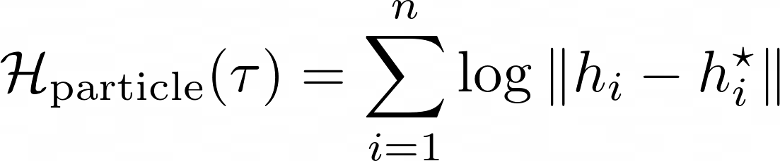

Replay Buffer
Intrinsic Reward
Representation Learning
Replay Buffer
Entr
opy
Conditional Entr
opy
query
k-NN
Noise Contrastive Loss
key
Notes:
{
"paper_title": "CIC: Contrastive Intrinsic Control for Unsupervised Skill Discovery",
"paper_url": "https://arxiv.org/abs/2202.00161v3",
"figure": "Figure 3",
"license": "http://creativecommons.org/licenses/by/4.0/",
"notes": "Original vector geometry and editable text; source photo/plot/formula assets preserved separately with their transparency. Internal pixels of raster subassets are not editable. Freeform arrows lack semantic endpoint attachment. Independent cross-format QA pending. Source header image fragments1/2 are hidden/clipped in PDF; omit these invisible duplicates. Formula assets remain separate raster images.",
"page": 3,
"status": "figure_recreation",
"source_sha256": "01c118cb18c18693dc033735eae3152cf27d515263c2429b009f5532937fd236",
"source_crop_pdf_points": [
104,
68,
493,
199
],
"extraction_review": "pending; native geometry extraction is not visual fidelity approval",
"font_substitutions": "Arial or Courier New; source fonts recorded per text object",
"outlined_font_families": [
"CMM",
"CMSY",
"CMEX",
"CMR",
"CambriaMath"
],
"outlined_math_limit": "Selected source mathematical fonts preserved as editable glyph outlines, not live equation/text objects.",
"extraction_warnings": [
"9 source clipping groups intersect crop; extracted paths require explicit clipping review",
"path crosses crop boundary: 2",
"path crosses crop boundary: 3",
"unhandled image/shading at seq 59: [243.35211181640625, 69.59344482421875, 267.0877990722656, 81.04873657226562]; requires reviewed raster region",
"unhandled image/shading at seq 60: [417.413818359375, 69.44088745117188, 456.9732666015625, 80.50057983398438]; requires reviewed raster region"
]
}

