Slide 1
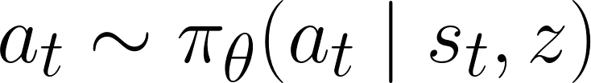



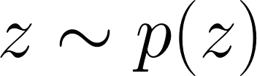
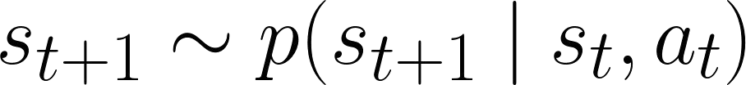
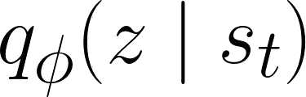
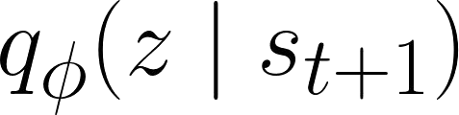
Algorithm 1:
DIAYN
Learned
SKILL
while
not converged
do
Sample one skill per
Fixed
Sample skill
and initial state
episode from
fixed
skill distribution.
for
to
_
_
do
Sample action
from skill.
ENVIRONMENT
Step environment:
.
Compute
with discriminator.
Set skill reward
Discriminator estimates skill
DISCRIMINATOR
from state. Update discriminator
Update skill to maximize
Update policy (
) to maximize
with SAC.
to maximize discriminability.
discriminability.
Update discriminator (
) with SGD.
Notes:
{
"paper_title": "Diversity Is All You Need: Learning Skills without a Reward Function",
"paper_url": "https://arxiv.org/abs/1802.06070v6",
"figure": "Figure 1",
"license": "No reuse license found in inspected source landing page; retain attribution and review reuse terms",
"notes": "Original vector geometry and editable text; source photo/plot/formula assets preserved separately with their transparency. Internal pixels of raster subassets are not editable. Freeform arrows lack semantic endpoint attachment. Independent cross-format QA pending.",
"page": 3,
"status": "figure_recreation",
"source_sha256": "af9965836b917def393670da0258d76c31787076c19ad7cbf46a7a7eda510624",
"source_crop_pdf_points": [
108,
83,
504,
195
],
"extraction_review": "pending; native geometry extraction is not visual fidelity approval",
"font_substitutions": "Arial or Courier New; source fonts recorded per text object",
"outlined_font_families": [
"CMM",
"CMSY",
"CMEX",
"CMR",
"CambriaMath"
],
"outlined_math_limit": "Selected source mathematical fonts preserved as editable glyph outlines, not live equation/text objects.",
"extraction_warnings": [
"12 source clipping groups intersect crop; extracted paths require explicit clipping review",
"path crosses crop boundary: 1",
"path crosses crop boundary: 59"
]
}

