Slide 1
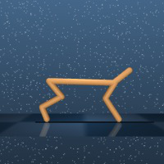
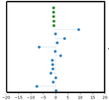
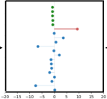
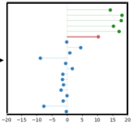
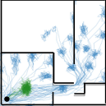
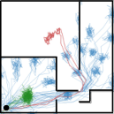
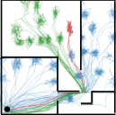
existing skills
guide skill
apprentice skills
<start>
Select
guide skill
with
Select
guide skill
with
Skill trajectories
Skill trajectories
Skill trajectories
Skill trajectories
random walk process
random walk process
(a) bottleneck maze
(b) cheetah
Notes:
{
"paper_title": "Learning to Discover Skills through Guidance (DISCO-DANCE)",
"paper_url": "https://arxiv.org/abs/2310.20178v2",
"figure": "Figure 3",
"license": "No reuse license found in inspected source landing page; retain attribution and review reuse terms",
"notes": "Original vector geometry and editable text; source photo/plot/formula assets preserved separately with their transparency. Internal pixels of raster subassets are not editable. Freeform arrows lack semantic endpoint attachment. Independent cross-format QA pending.",
"page": 5,
"status": "figure_recreation",
"source_sha256": "5c2d09affab42d3ca4b46642312fd4835bfd5f4fd22a1f4791c4a30eacf5e8c6",
"source_crop_pdf_points": [
108,
209,
505,
295
],
"extraction_review": "pending; native geometry extraction is not visual fidelity approval",
"font_substitutions": "Arial or Courier New; source fonts recorded per text object",
"outlined_font_families": [
"CMM",
"CMSY",
"CMEX",
"CMR",
"CambriaMath"
],
"outlined_math_limit": "Selected source mathematical fonts preserved as editable glyph outlines, not live equation/text objects.",
"extraction_warnings": [
"15 source clipping groups intersect crop; extracted paths require explicit clipping review",
"path partially intersects raster inset: 27",
"path partially intersects raster inset: 32",
"path partially intersects raster inset: 39",
"path partially intersects raster inset: 40",
"path partially intersects raster inset: 65",
"path partially intersects raster inset: 74",
"path partially intersects raster inset: 78",
"path partially intersects raster inset: 82",
"unhandled image/shading at seq 11: [251.5520782470703, 217.9405059814453, 311.9998779296875, 278.7388000488281]; requires reviewed raster region",
"unhandled image/shading at seq 12: [201.57586669921875, 217.79322814941406, 261.7919921875, 278.47454833984375]; requires reviewed raster region",
"unhandled image/shading at seq 13: [150.31399536132812, 218.2350311279297, 210.5292510986328, 278.7989501953125]; requires reviewed raster region"
]
}

