Slide 1







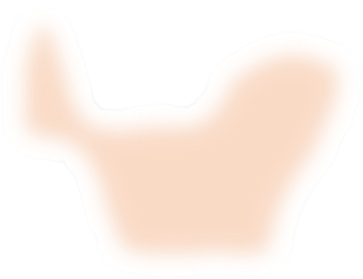






Initialized
Update Skill 1
Update Skill 2
Update Skill 3
Update
Skill
1
Converged
…
Trajectory
of
skill 1
Trajectory
of
skill 2
Trajectory
of
skill 3
Estimated state visitation
Estimated state visitation
Estimated state visitation
distribution of skill 1
distribution of skill 2
distribution of skill 3
Notes:
{
"paper_title": "Unsupervised Skill Discovery via Recurrent Skill Training",
"paper_url": "https://proceedings.neurips.cc/paper_files/paper/2022/file/ff6b031d5bdc552b795175a0f3b35a50-Paper-Conference.pdf",
"figure": "Figure 3",
"license": "No reuse license found in inspected source landing page; retain attribution and review reuse terms",
"notes": "Original vector geometry and editable text; source photo/plot/formula assets preserved separately with their transparency. Internal pixels of raster subassets are not editable. Freeform arrows lack semantic endpoint attachment. Independent cross-format QA pending.",
"page": 3,
"status": "figure_recreation",
"source_sha256": "41a5560ebdf0f65e6f161b5ae47cfd26786ddb6606eaebc5570e97f723fa7ab3",
"source_crop_pdf_points": [
146,
548,
465,
642
],
"extraction_review": "pending; native geometry extraction is not visual fidelity approval",
"font_substitutions": "Arial or Courier New; source fonts recorded per text object",
"outlined_font_families": [
"CMM",
"CMSY",
"CMEX",
"CMR",
"CambriaMath"
],
"outlined_math_limit": "Selected source mathematical fonts preserved as editable glyph outlines, not live equation/text objects.",
"extraction_warnings": [
"7 source clipping groups intersect crop; extracted paths require explicit clipping review",
"path crosses crop boundary: 229",
"path crosses crop boundary: 230"
]
}

