Slide 1
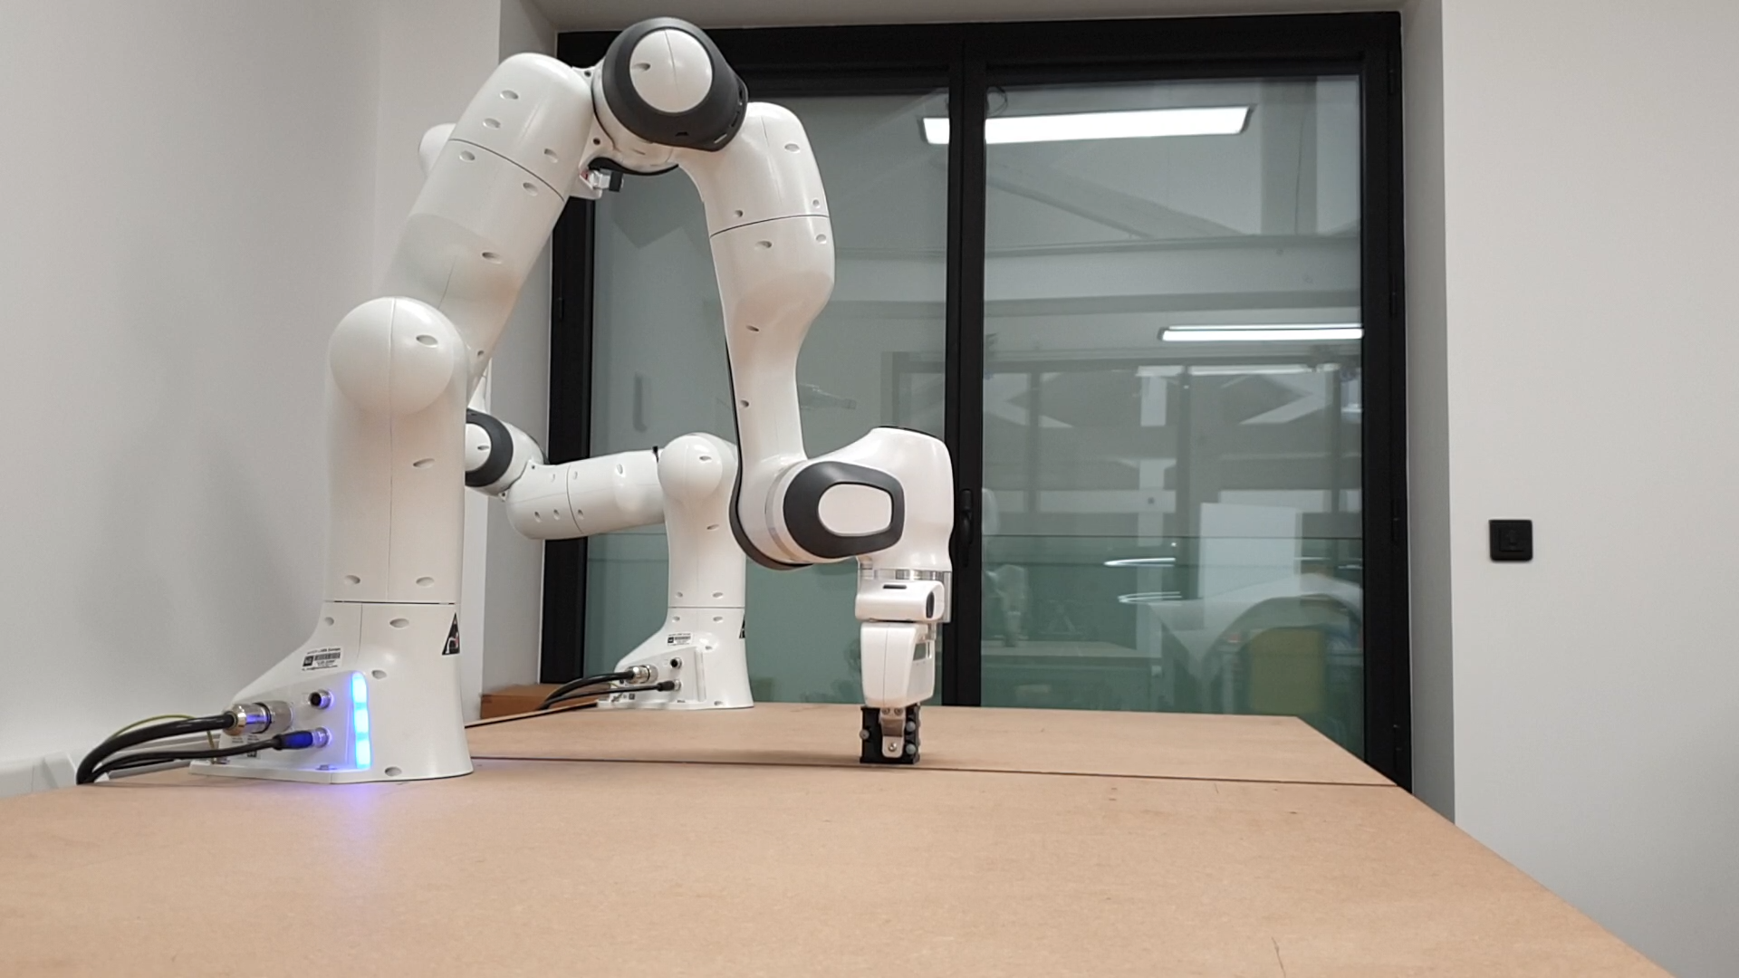
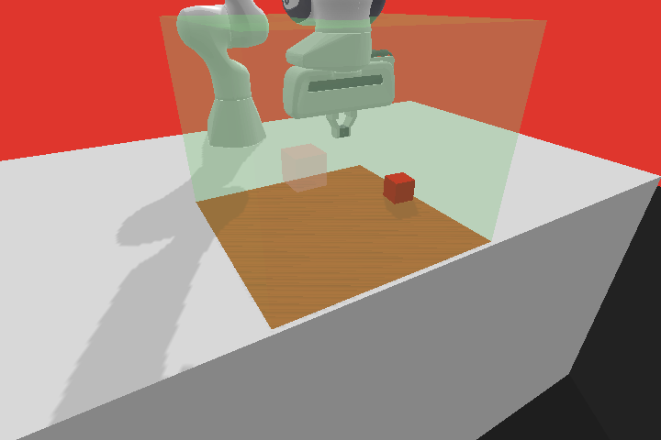
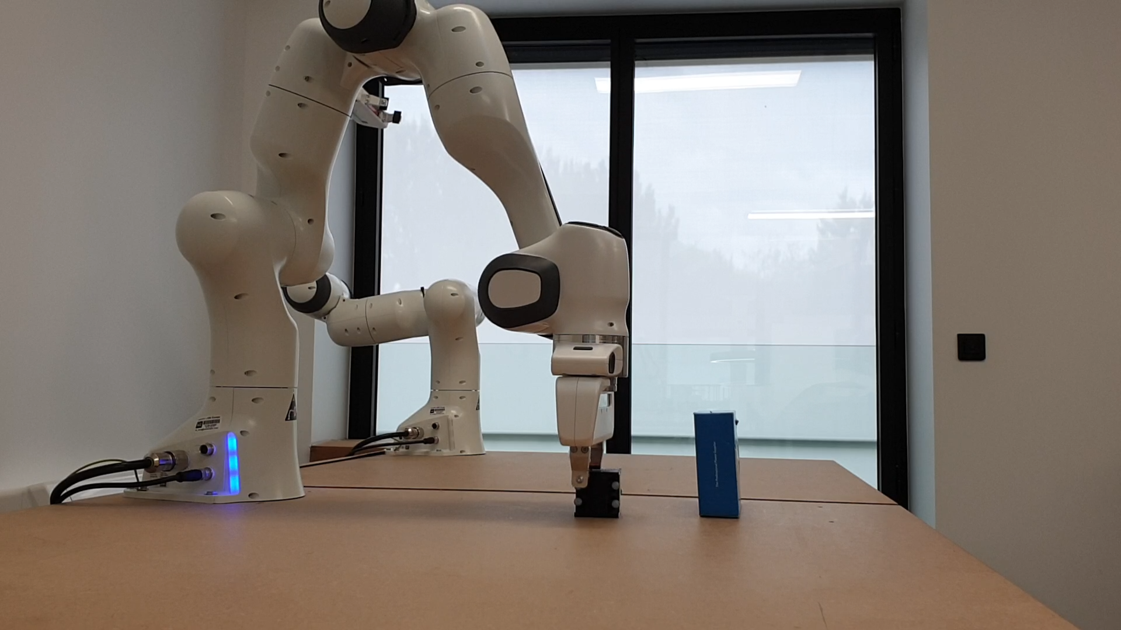
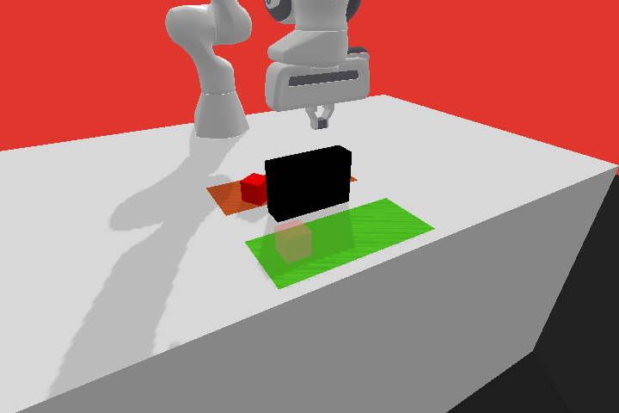
Step 2: Downstream Training
Step 3: Transfer to Real World
Step 1: Pre-Training
Downstream Solver A
Downstream Solver A
Pre-Training Task
Orchestrator
Primitives
Orchestrator
Primitives
Generator
w
π
...
π
w
π
...
π
A
1
K
A
1
K
Pre-Training Solver
Downstream Solver B
Downstream Solver B
Orchestrator
Primitives
Orchestrator
Primitives
Orchestrator
Primitives
w
π
...
π
w
π
...
π
w
π
...
π
1
K
B
1
K
B
1
K
Trainable
Frozen
Notes:
{
"paper_title": "Unsupervised Skill Discovery for Robotic Manipulation through Automatic Task Generation",
"paper_url": "https://arxiv.org/pdf/2410.04855v1",
"figure": "Figure 1",
"license": "http://arxiv.org/licenses/nonexclusive-distrib/1.0/",
"notes": "Original three-stage pre-training/downstream training/real-world transfer layout. Seven separate original robot observation images remain raster; all surrounding boxes, arrows and ordinary labels are native. Freeform paths are not semantic connectors; font and dash rendering may vary.",
"page": 1,
"status": "figure_recreation",
"source_sha256": "109e77792932b2cf422f58afad2fe95bb7c6bea37ef6388174a68db039aca5e5",
"source_crop_pdf_points": [
89,
151,
515,
280
],
"extraction_review": "pending; native geometry extraction is not visual fidelity approval",
"font_substitutions": "Arial or Courier New; source fonts recorded per text object",
"extraction_warnings": [
"28 source clipping groups intersect crop; extracted paths require explicit clipping review"
],
"ignored_invisible_text_spans": 0
}

