Slide 1



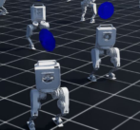
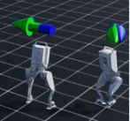
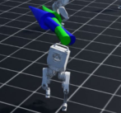
Design a curriculum for
Sequential Training throughout Curriculum
humanoid locomotion
(Step 2)
Fine-tuning Policy
Prompts: Environment Description, Robot
Task Code Sampling
Description, Target Task Description, …
def compute_rewards(self):
# balance reward
(Step 3)
…
Optimal Policy Selection
# velocity reward
(Step 1)
Policy 1:
Curriculum Design
Policy from
base_lin_vel:
[-0.202 -0.114 0.017]
Preceding Subtask
base_ang_vel:
[-0.001 -0.004 0.084]
Basic Stability Learning
Sequentially Trained Policies
Learn to Walk
Increase Speed
Target Task
Notes:
{
"paper_title": "CurricuLLM: Automatic Task Curricula Design for Learning Complex Robot Skills Using Large Language Models",
"paper_url": "https://arxiv.org/pdf/2409.18382v2",
"figure": "Figure 1",
"license": "unverified",
"notes": "Original curriculum design, task code sampling, policy fine-tuning and selection workflow. Panels, connectors, ordinary labels and example code are native; three small source icons and three robot policy observations remain separate raster images.",
"page": 1,
"status": "figure_recreation",
"source_sha256": "4a8066640ce00705b2677e548ff5196bd4a1221ecf099e357fb834033a10a142",
"source_crop_pdf_points": [
312,
157,
559,
279
],
"extraction_review": "pending; native geometry extraction is not visual fidelity approval",
"font_substitutions": "Arial or Courier New; source fonts recorded per text object",
"extraction_warnings": [
"8 source clipping groups intersect crop; extracted paths require explicit clipping review",
"path crosses crop boundary: 21",
"path partially intersects raster inset: 36"
],
"ignored_invisible_text_spans": 0,
"text_repairs": "SourceCodePro code excerpt remains live monospaced Courier New text; ordinary source labels remain live Arial."
}

