Slide 1
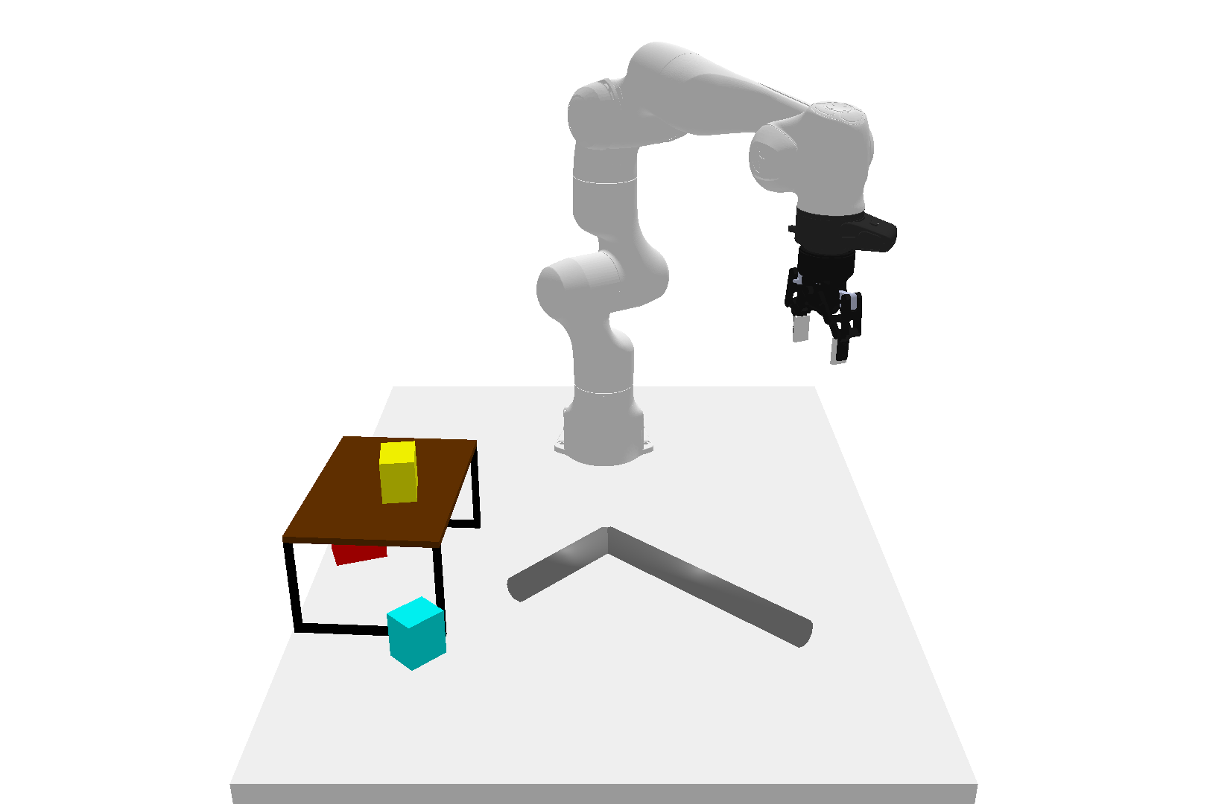
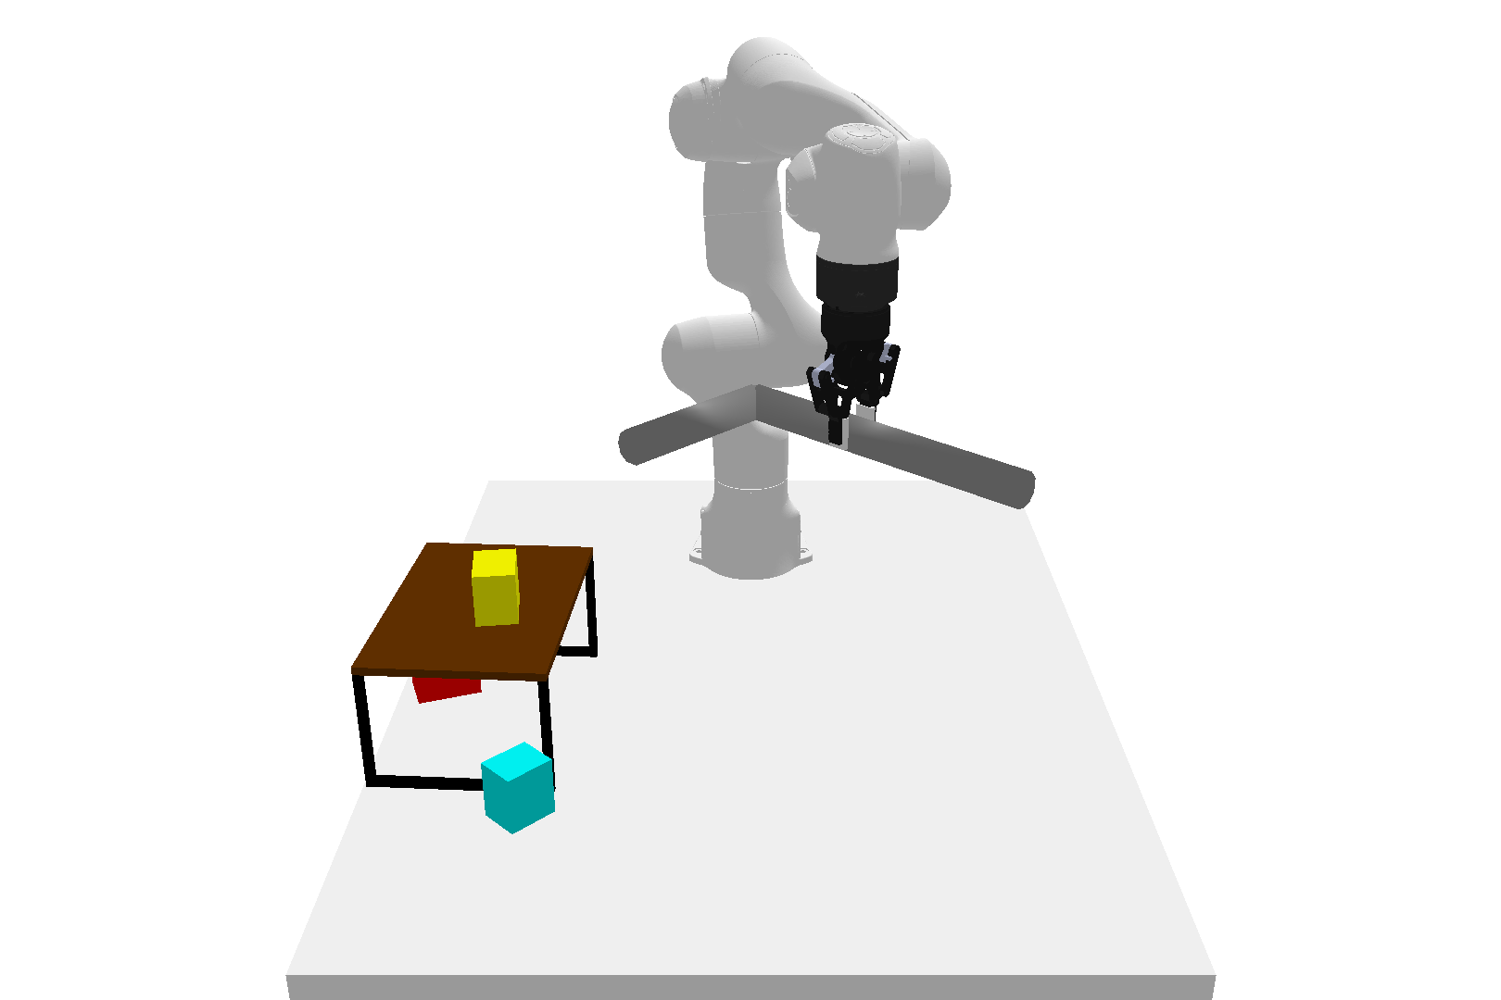
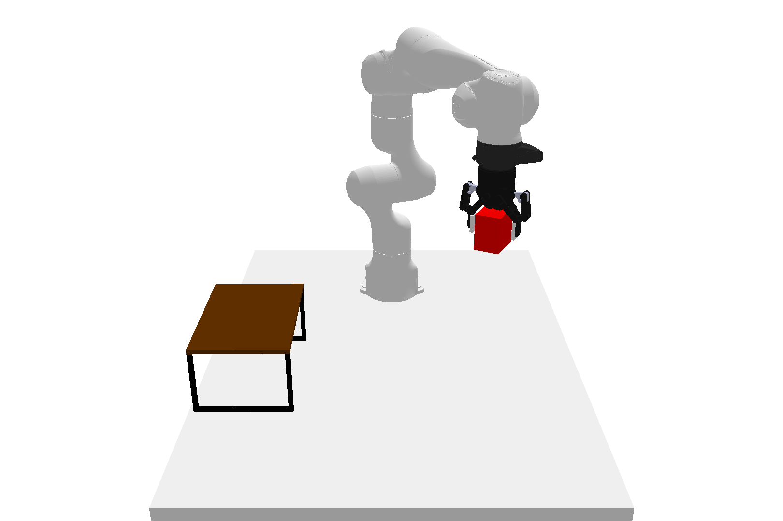
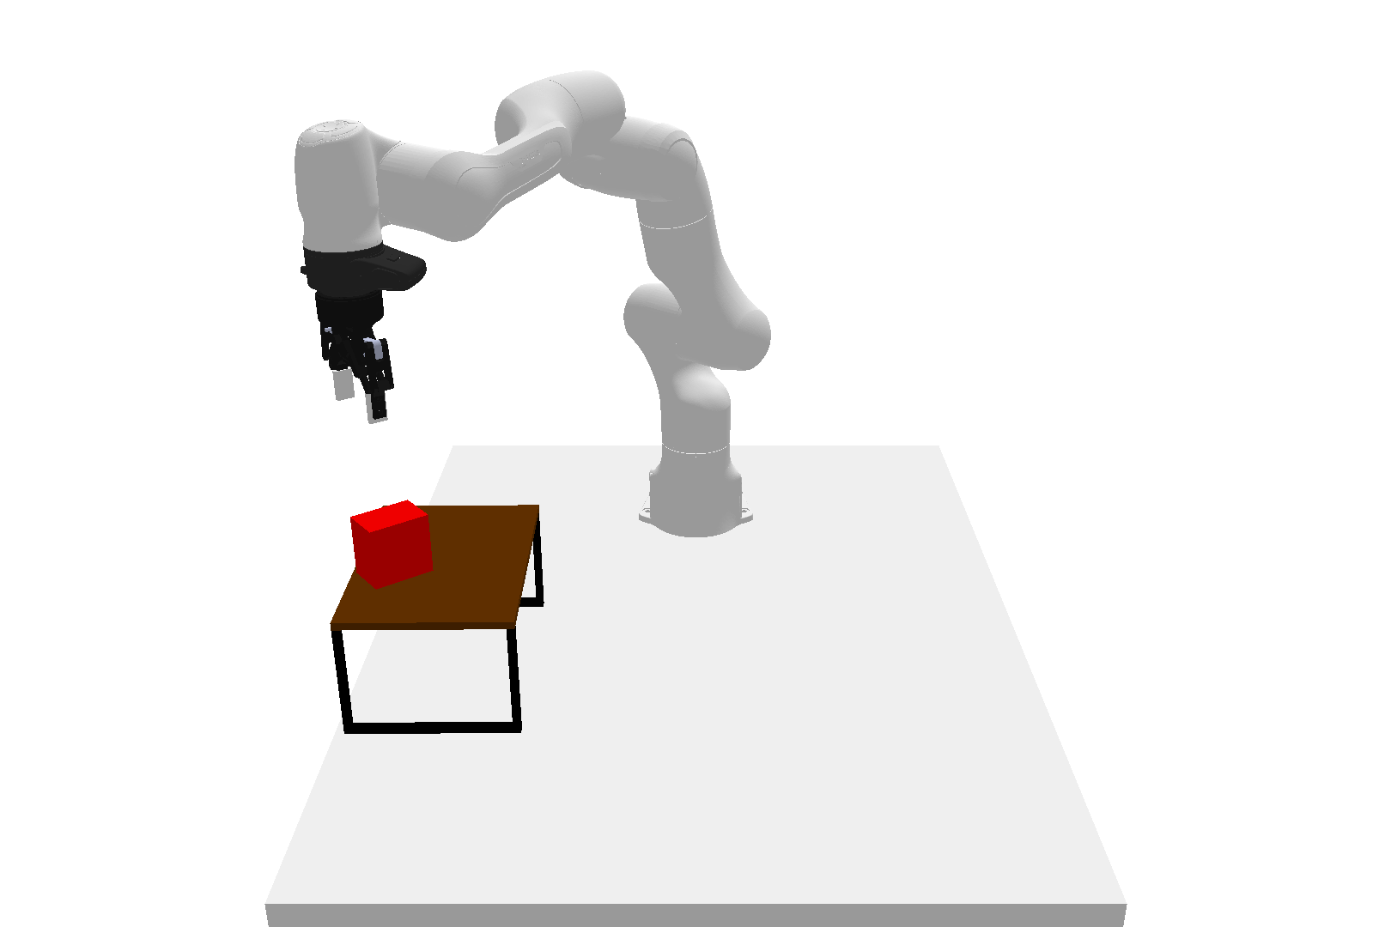
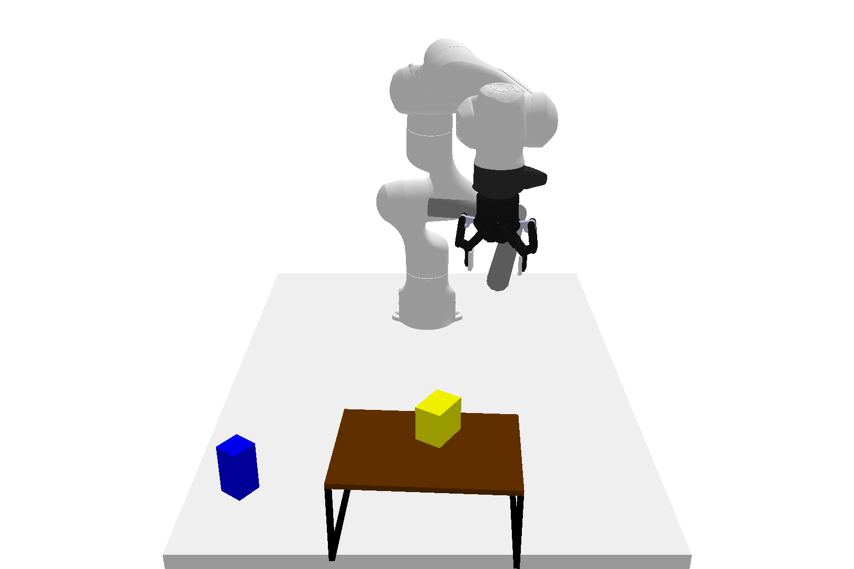
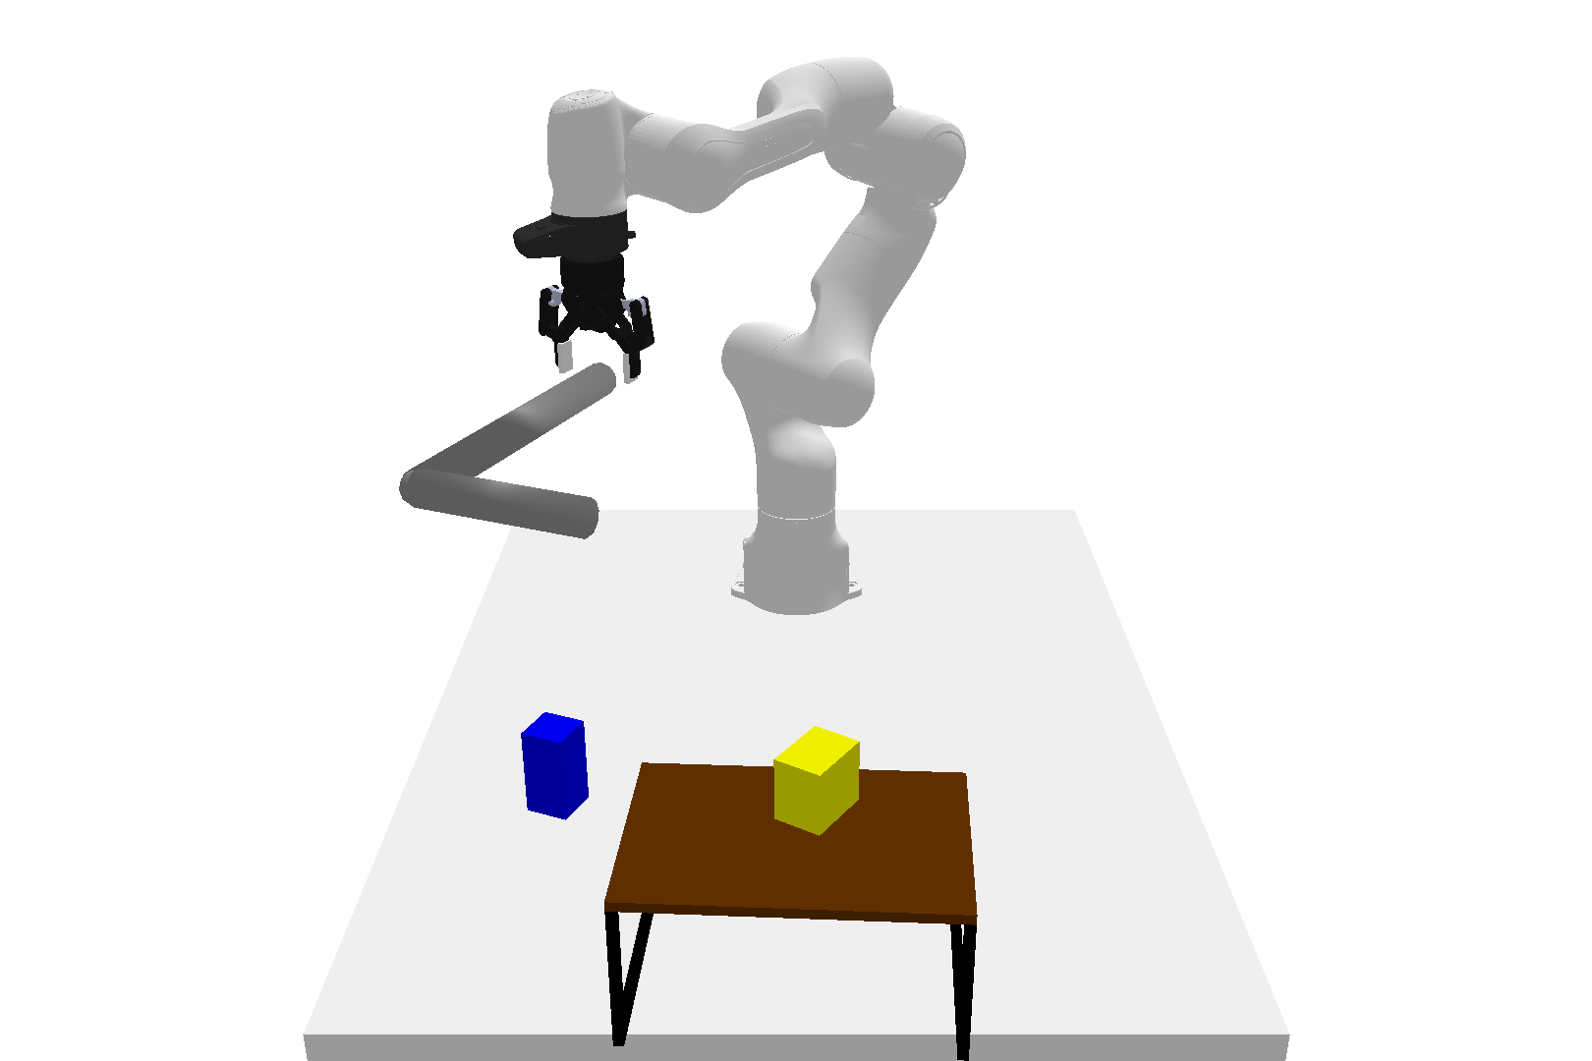
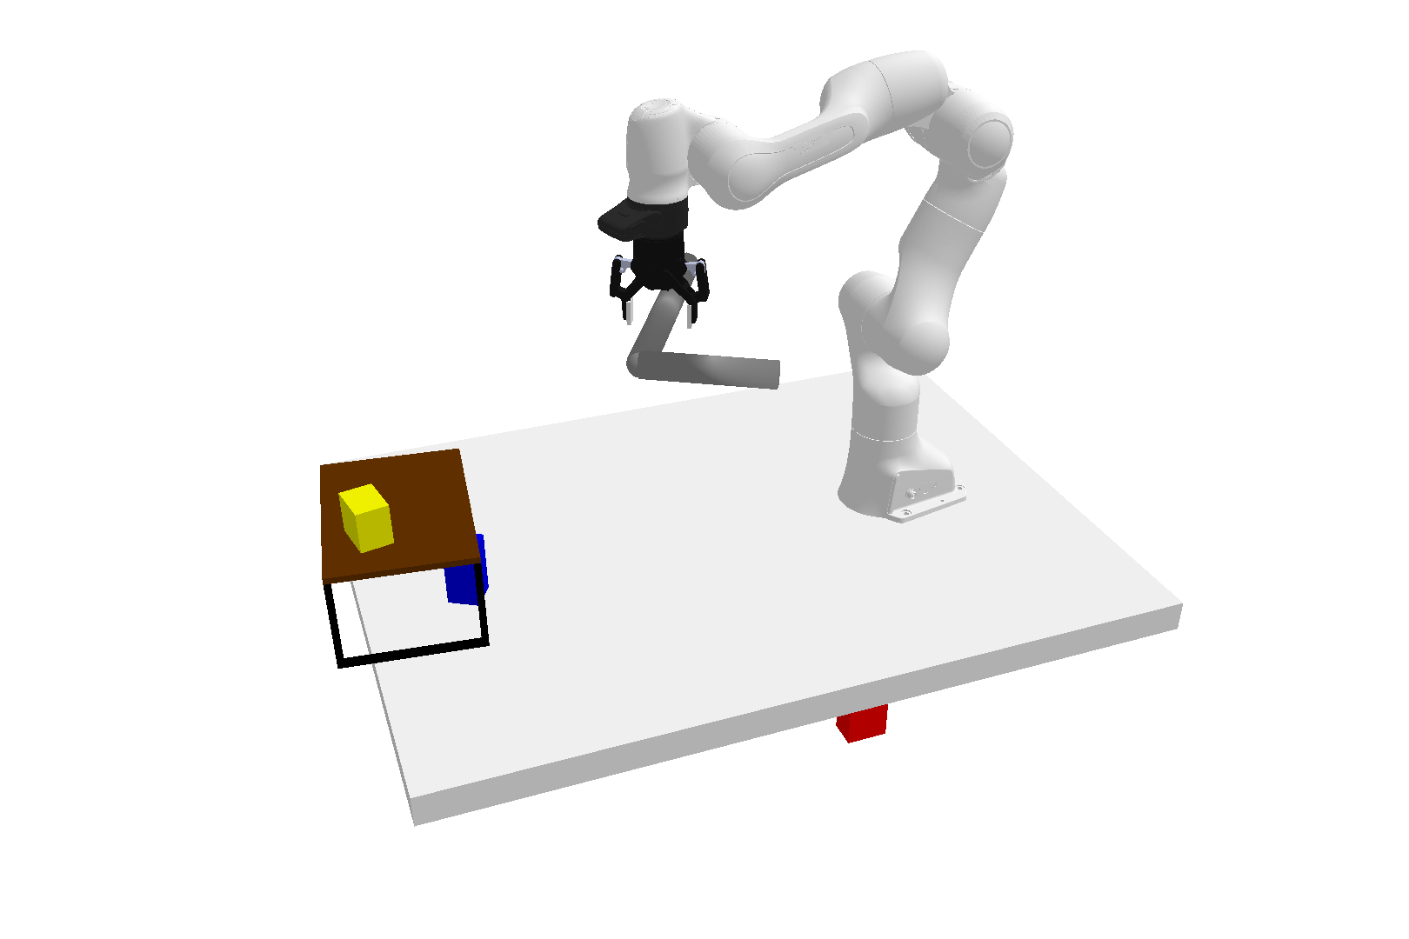
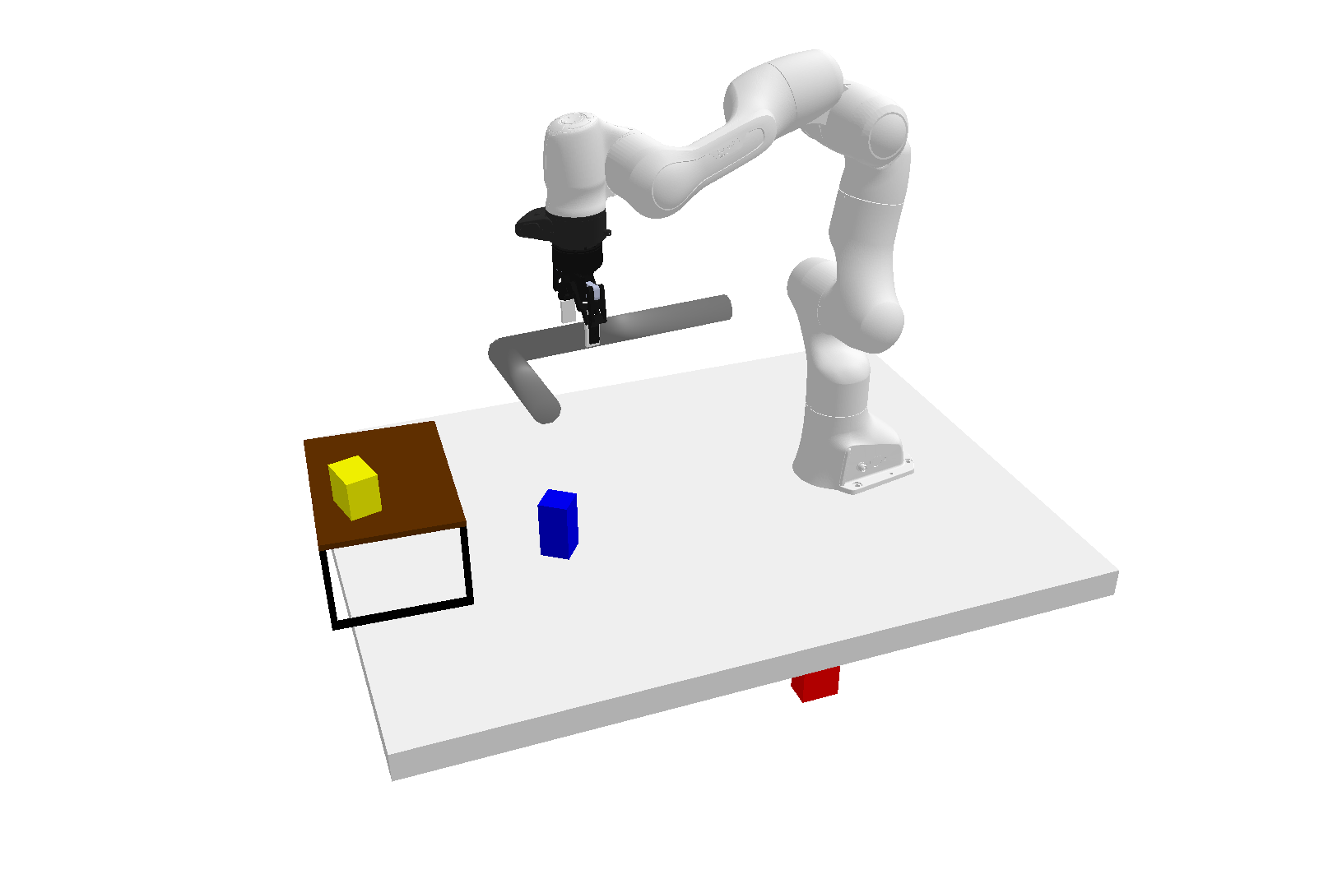
Pick
(Hook, Table)
Place
Unconditional Skill Score Function
(Red Box, Rack)
Pull
(Hook, Blue Box)
Push
Time
Positional
Skill Object
(Hook, Blue Box,
Rack)
Embedding
Embedding
Order
Notes:
{
"paper_title": "Generative Skill Chaining: Long-Horizon Skill Planning with Diffusion Models",
"paper_url": "https://arxiv.org/pdf/2401.03360v1",
"figure": "Figure 3",
"license": "License not verified; private authorized source reference",
"notes": "Original primitive-skill examples and transformer diffusion score network. Architecture, embeddings, arrows and mathematical glyph geometry are native. Eight original robot demonstration renderings remain separate source raster images, with live external captions.",
"page": 5,
"status": "figure_recreation",
"source_sha256": "d97f87dd437392ee3efe1b67b90c298723f93770652a7c430af9f79280fb90b2",
"source_crop_pdf_points": [
108,
70,
505,
250
],
"extraction_review": "pending; native geometry extraction is not visual fidelity approval",
"font_substitutions": "Arial or Courier New; source fonts recorded per text object",
"extraction_warnings": [
"3 source clipping groups intersect crop; extracted paths require explicit clipping review",
"unhandled image/shading at seq 132: [108.23829650878906, 71.99940490722656, 167.68499755859375, 111.62887573242188]; requires reviewed raster region",
"unhandled image/shading at seq 133: [190.96986389160156, 71.99940490722656, 250.41656494140625, 111.62887573242188]; requires reviewed raster region",
"unhandled image/shading at seq 134: [108.23829650878906, 117.07875061035156, 167.68499755859375, 156.70822143554688]; requires reviewed raster region",
"unhandled image/shading at seq 135: [190.96986389160156, 117.07875061035156, 250.41656494140625, 156.70822143554688]; requires reviewed raster region",
"unhandled image/shading at seq 136: [108.23829650878906, 162.16305541992188, 167.68499755859375, 201.79254150390625]; requires reviewed raster region",
"unhandled image/shading at seq 137: [190.96986389160156, 162.16305541992188, 250.41656494140625, 201.79254150390625]; requires reviewed raster region",
"unhandled image/shading at seq 138: [190.96986389160156, 207.7391815185547, 250.41656494140625, 247.36865234375]; requires reviewed raster region",
"unhandled image/shading at seq 139: [108.23829650878906, 207.7391815185547, 167.68499755859375, 247.36865234375]; requires reviewed raster region"
],
"ignored_invisible_text_spans": 0,
"image_repairs": "Eight source raster objects extracted directly by PDF xref without surrounding captions. Original full image bounds retained and all external captions remain live text; this avoids duplicating captions in rendered crops."
}

