Slide 1
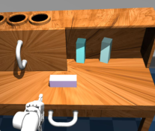
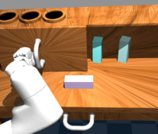
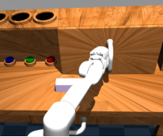
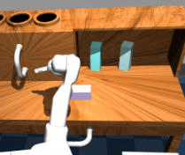
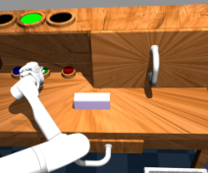
action likelihood
single general policy
action α
ᵗ
closed
action
action
KL divergence
loop
action
decoder
minimization
@ 30Hz
decoder
current
goal
latent plan
current
goal
(sampled)
@ 30Hz
latent plan
sampling
latent plan
distribution space
plan distribution
plan
plan
plan
proposal
recognition
proposal
current
goal
entire sequence
current
goal
@ 1Hz
?
action α
ᵗ
α
ᵗ
⁺
ᵏ
α
ⁿ
play data
(a)
Play-LMP
training.
(b)
Task-agnostic policy inference
Notes:
{
"paper_title": "Learning Latent Plans from Play",
"paper_url": "https://arxiv.org/pdf/1903.01973v2",
"figure": "Figure 1",
"license": "http://arxiv.org/licenses/nonexclusive-distrib/1.0/",
"notes": "Original training and task-agnostic inference architecture. Native plan distributions, proposal/recognition networks, action decoders, colored flow paths and live ordinary labels. Five source demonstration images remain separate clipped raster inserts.",
"page": 2,
"status": "figure_recreation",
"source_sha256": "4a617a68cc9ed89ebbdff8fdda000f0bb744128bd5e91dca1b2c5594631835b0",
"source_crop_pdf_points": [
107,
71,
509,
355
],
"extraction_review": "pending; native geometry extraction is not visual fidelity approval",
"font_substitutions": "Arial or Courier New; source fonts recorded per text object",
"dash_fidelity": "PPTX uses the closest supported native preset, not exact PDF dash lengths. Draw.io retains interval lengths; PDF phase/caps are not preserved; zero intervals become 0.001 scene units.",
"extraction_warnings": [
"9 source clipping groups intersect crop; extracted paths require explicit clipping review",
"path partially intersects raster inset: 1",
"path partially intersects raster inset: 2",
"path partially intersects raster inset: 5",
"path partially intersects raster inset: 6",
"path partially intersects raster inset: 13",
"path partially intersects raster inset: 14",
"path partially intersects raster inset: 104",
"path partially intersects raster inset: 107",
"path partially intersects raster inset: 112",
"path partially intersects raster inset: 143",
"path partially intersects raster inset: 145",
"path partially intersects raster inset: 147",
"path partially intersects raster inset: 216",
"path partially intersects raster inset: 226",
"path partially intersects raster inset: 227",
"path partially intersects raster inset: 230",
"path partially intersects raster inset: 231",
"path partially intersects raster inset: 234",
"path partially intersects raster inset: 236",
"unhandled image/shading at seq 144: [253.67098999023438, 242.66319274902344, 333.8918151855469, 300.67230224609375]; requires reviewed raster region",
"unhandled image/shading at seq 146: [182.45065307617188, 242.64688110351562, 267.6352844238281, 300.65594482421875]; requires reviewed raster region",
"unhandled image/shading at seq 148: [111.0602035522461, 242.78797912597656, 187.2462158203125, 300.79705810546875]; requires reviewed raster region",
"unhandled image/shading at seq 235: [348.1583251953125, 243.67303466796875, 421.103271484375, 302.29833984375]; requires reviewed raster region",
"unhandled image/shading at seq 237: [437.57000732421875, 243.68466186523438, 514.0901489257812, 302.30987548828125]; requires reviewed raster region"
],
"ignored_invisible_text_spans": 0
}

