Slide 1
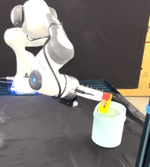
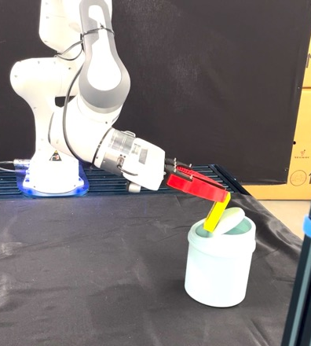


Human Demonstration
SkillGen
: Automatic Data Generation
Policy Deployment
…
Adapt
…
Adapt
MP
MP
Teleoperation
Initiation
MP
BC
SkillGen
Demo
Data
100x Data Amplification
Hybrid Skill Policy (HSP)
Notes:
{
"paper_title": "SkillMimicGen: Automated Demonstration Generation for Efficient Skill Learning and Deployment",
"paper_url": "https://arxiv.org/pdf/2410.18907v1",
"figure": "Figure 1",
"license": "http://arxiv.org/licenses/nonexclusive-distrib/1.0/",
"notes": "Original SkillGen workflow from human demonstrations through automatic generation to hybrid skill-policy deployment. Workflow geometry, icons and source labels remain native. Four original clipped robot photos remain separate raster assets.",
"page": 2,
"status": "figure_recreation",
"source_sha256": "2bdf9e56f6b7f59832f116710bd8c18369d51c3f16cccc16651180fa0c3e2c7a",
"source_crop_pdf_points": [
108,
72,
504,
174
],
"extraction_review": "pending; native geometry extraction is not visual fidelity approval",
"font_substitutions": "Arial or Courier New; source fonts recorded per text object",
"extraction_warnings": [
"13 source clipping groups intersect crop; extracted paths require explicit clipping review",
"path crosses crop boundary: 0",
"unhandled image/shading at seq 80: [115.68846130371094, 92.90364074707031, 249.7777862548828, 168.47039794921875]; requires reviewed raster region",
"unhandled image/shading at seq 85: [230.97561645507812, 97.57838439941406, 315.496337890625, 145.13558959960938]; requires reviewed raster region",
"unhandled image/shading at seq 90: [298.36590576171875, 97.57838439941406, 382.8866271972656, 145.13558959960938]; requires reviewed raster region",
"unhandled image/shading at seq 95: [380.2590637207031, 89.21610260009766, 515.9095458984375, 165.3076171875]; requires reviewed raster region"
],
"ignored_invisible_text_spans": 0,
"stroke_repair": "PDF extraction reported an impossible 152400-scene-pixel red initiation stroke; restored source visually measured 4px line width.",
"image_repairs": "Raw source PDF image objects cropped to original PDF clipping bounds; original Initiation/Demo/Adapt/MP/BC labels and drawn motion paths remain independently editable above the photos."
}

