Slide 1

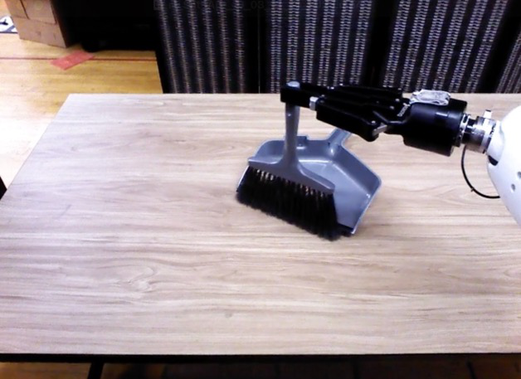

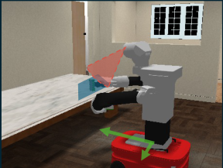
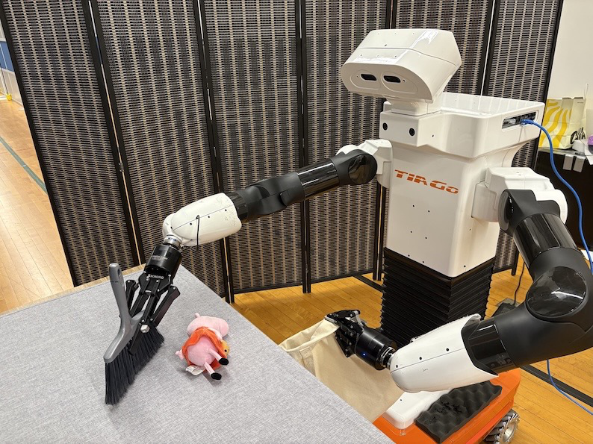
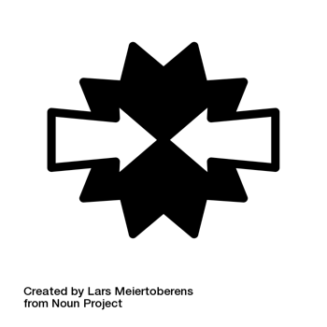
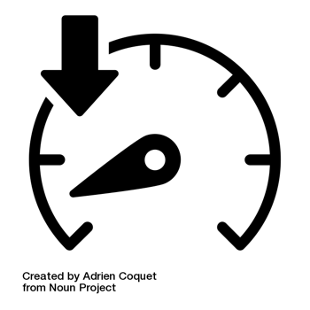
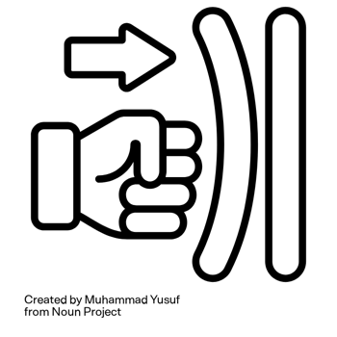






2. Real
2. Real
-
-
world Downstream
1. Unsupervised Latent
world Downstream
1. Unsupervised Latent
Disentangled
Onboard Obs.
Reinforcement Learning
Action Space Learning
States Features
Reinforcement Learning
Action Space Learning
Task
Policy
…
…
latent actions
Camera
Proprio.
Empowerment
latent actions
Reward
…
…
…
…
Universal Safety
Latent Action
Filter
Latent Action
Reward
Task
Decoder
Decoder
Latent Action
Reward
Latent Action
…
Decoder
Decoder
Factorized Qs
…
…
Low Fidelity Simulation
Real
-
world Tasks
Temporally Extended Whole
-
body Motions
Temporally Extended Whole
-
body Motions
Notes:
{
"paper_title": "SLAC: Safe and Efficient Real-Robot Reinforcement Learning via Unsupervised Simulation Pre-Training",
"paper_url": "https://arxiv.org/abs/2506.04147v5",
"figure": "Figure 2",
"license": "http://creativecommons.org/licenses/by/4.0/",
"notes": "Original vector geometry and editable text; source photo/plot/formula assets preserved separately with their transparency. Internal pixels of raster subassets are not editable. Freeform arrows lack semantic endpoint attachment. Independent cross-format QA pending. Broad transparent panel-shadow raster overlays omitted; native panel geometry retained with simplified shadow. Clipped robot frames individually preserved. Task, Policy and Filter are live90degree text; only the slanted mathematical ellipsis is a glyph outline. Other ordinary text remains typeable. Broad shadow images omitted, panel shadows simplified.",
"page": 4,
"status": "figure_recreation",
"source_sha256": "4b5d88741b8729fa81e1042f47874bada21853f811f0f2b9e4cc501f5ce8ee32",
"source_crop_pdf_points": [
61,
52,
537,
213
],
"extraction_review": "pending; native geometry extraction is not visual fidelity approval",
"font_substitutions": "Arial or Courier New; source fonts recorded per text object",
"outlined_font_families": [
"CMM",
"CMSY",
"CMEX",
"CMR",
"CambriaMath"
],
"outlined_math_limit": "Selected source mathematical fonts preserved as editable glyph outlines, not live equation/text objects.",
"dash_fidelity": "PPTX uses the closest supported native preset, not exact PDF dash lengths. Draw.io retains interval lengths; PDF phase/caps are not preserved; zero intervals become 0.001 scene units.",
"extraction_warnings": [
"34 source clipping groups intersect crop; extracted paths require explicit clipping review",
"path crosses crop boundary: 2",
"path crosses crop boundary: 3",
"path partially intersects raster inset: 10",
"path partially intersects raster inset: 17",
"path partially intersects raster inset: 71",
"path partially intersects raster inset: 177",
"rotated text needs manual reconstruction: …",
"rotated text needs manual reconstruction: …",
"rotated text needs manual reconstruction: T",
"rotated text needs manual reconstruction: a",
"rotated text needs manual reconstruction: s",
"rotated text needs manual reconstruction: k",
"rotated text needs manual reconstruction: T",
"rotated text needs manual reconstruction: a",
"rotated text needs manual reconstruction: s",
"rotated text needs manual reconstruction: k",
"rotated text needs manual reconstruction: P",
"rotated text needs manual reconstruction: o",
"rotated text needs manual reconstruction: l",
"rotated text needs manual reconstruction: i",
"rotated text needs manual reconstruction: c",
"rotated text needs manual reconstruction: y",
"rotated text needs manual reconstruction: P",
"rotated text needs manual reconstruction: o",
"rotated text needs manual reconstruction: l",
"rotated text needs manual reconstruction: i",
"rotated text needs manual reconstruction: c",
"rotated text needs manual reconstruction: y",
"rotated text needs manual reconstruction: F",
"rotated text needs manual reconstruction: i",
"rotated text needs manual reconstruction: l",
"rotated text needs manual reconstruction: t",
"rotated text needs manual reconstruction: e",
"rotated text needs manual reconstruction: r",
"unhandled image/shading at seq 9: [68.62913513183594, 88.75396728515625, 164.3251953125, 174.00668334960938]; requires reviewed raster region",
"unhandled image/shading at seq 134: [168.18643188476562, 151.8346405029297, 224.993896484375, 194.4397430419922]; requires reviewed raster region",
"unhandled image/shading at seq 136: [204.13540649414062, 151.98947143554688, 260.9421081542969, 194.59457397460938]; requires reviewed raster region",
"unhandled image/shading at seq 138: [240.4581756591797, 151.80763244628906, 297.26483154296875, 194.41273498535156]; requires reviewed raster region",
"unhandled image/shading at seq 197: [394.89068603515625, 163.0272216796875, 451.409912109375, 194.85267639160156]; requires reviewed raster region",
"unhandled image/shading at seq 198: [436.73760986328125, 163.16802978515625, 493.2568359375, 194.9934844970703]; requires reviewed raster region",
"unhandled image/shading at seq 199: [478.584716796875, 162.95289611816406, 535.1039428710938, 194.77835083007812]; requires reviewed raster region",
"unhandled image/shading at seq 215: [513.2056884765625, 80.99032592773438, 526.4443359375, 94.22906494140625]; requires reviewed raster region",
"unhandled image/shading at seq 258: [62.44482421875, 55.25862121582031, 289.34197998046875, 210.75131225585938]; requires reviewed raster region",
"unhandled image/shading at seq 260: [291.27978515625, 54.20164489746094, 532.7984619140625, 209.6943359375]; requires reviewed raster region"
],
"rotated_text_source_seqnos": [
92,
152,
153,
154,
155,
205
]
}

