Slide 1
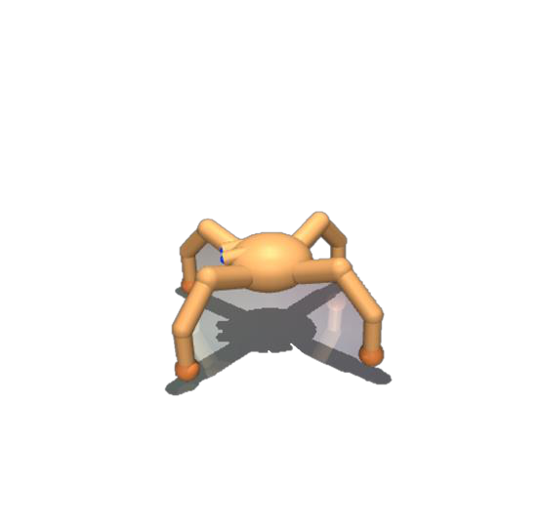

Latent Fourier skill space
orbit of a skill z
State space
Rotated
Skill generalizes
t
rajectory
along its group orbit
T
rajectory
Notes:
{
"paper_title": "Group-Invariant Unsupervised Skill Discovery: Symmetry-aware Skill Representations for Generalizable Behavior",
"paper_url": "https://arxiv.org/abs/2601.14000v1",
"figure": "Figure 1",
"license": "No reuse license found in inspected source landing page; retain attribution and review reuse terms",
"notes": "Source vector geometry and separate native text extracted from the inspected original figure. Two source raster components (gradient state-space illustration and robot) remain raster. Fonts are substituted; curves are editable freeforms without semantic attachments. Original math glyph placement may vary by editor.",
"page": 3,
"status": "figure_recreation",
"source_sha256": "f6a7684b7949c7856c05577ce2293fe25fe48bd6a0179499624f063745b7d298",
"source_crop_pdf_points": [
310,
51,
564,
191
],
"extraction_review": "pending; native geometry extraction is not visual fidelity approval",
"font_substitutions": "Arial or Courier New; source fonts recorded per text object",
"outlined_font_families": [
"CambriaMath"
],
"outlined_math_limit": "Selected source mathematical fonts preserved as editable glyph outlines, not live equation/text objects.",
"extraction_warnings": [
"58 source clipping groups intersect crop; extracted paths require explicit clipping review",
"path crosses crop boundary: 2",
"path crosses crop boundary: 16",
"path crosses crop boundary: 23"
]
}

