Slide 1

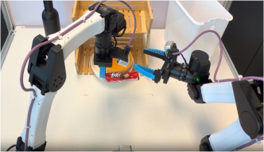




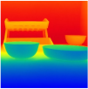
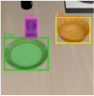
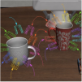

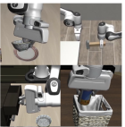
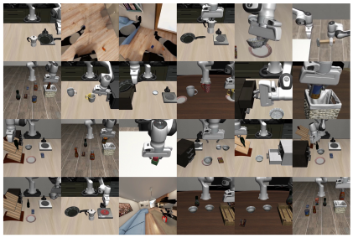
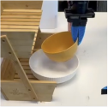
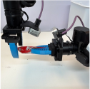
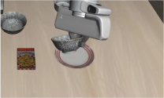
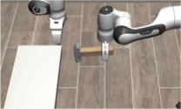
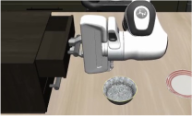
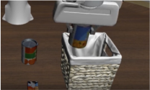
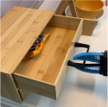
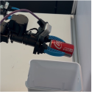
Robot Execution Engine
Agentic Coding
Physical Engine
Programs
1
open_gripper()
2
-
move_to_joints(lift_pos)
3
move_to_joints(grasp_pos)
4
+
close_gripper()
ASPIRE
Coordinator
Iterative Debugging
iter N
Actor Agent
π₀
π₁
…
πₖ
iter N + 1
. . .
Multimodal Traces
π₀′
π₁′
…
πₖ′
Depth
SAM3
Grasp
Motion Plan
/
skills
Multimodal Traces
Evolutionary
Search
Skill Library
Diverse Skills Learned across
150+ Sim Tasks
Sim Skills Transfer to Real
1
2
1
2
bowl_on_plate()
handover()
Sim
-
to
-
Real
3
4
3
4
. . .
open_drawer()
can_in_trash()
Lu et al., ASPIRE (2026), Fig. 1, p. 2 · Original vector paths + editable text; source photos/snippets remain separate raster assets
Notes:
{
"paper_title": "ASPIRE: Agentic /Skills Discovery for Robotics",
"paper_url": "https://arxiv.org/abs/2607.00272v1",
"pdf_url": "https://arxiv.org/pdf/2607.00272v1",
"figure": "Figure 1",
"page": 2,
"license": "arXiv page links CC BY 4.0; PDF also contains NVIDIA copyright notice. Figure-specific third-party assets not independently cleared for public redistribution. Private conversion only.",
"status": "figure_recreation",
"notes": "Original PDF vector geometry, colors and placement extracted, with individually clipped source raster assets. Original curves and zoom inset retained. Native labels use Arial/Courier New substitutions for source fonts. Freeform arrow paths remain editable points but are not semantic attached connectors. Code and evolutionary-search panels manually reconstructed as native text/shapes/connections from original pixels; typography and small routing differences remain. No full-figure raster backdrop. Code syntax colors simplified to a single function-line color to remain readable with substituted fonts.",
"source_sha256": "9df00979a6d52c7fcfbcc9d17275fc5196e6431d872a0624fea642a63f9beefc",
"source_crop_pdf_points": [
61,
84,
534,
368
],
"font_substitutions": {
"NVIDIASans": "Arial",
"ArialMT": "Arial",
"ArialRoundedMTBold": "Arial Bold",
"Consolas": "Courier New",
"CourierNewPSMT": "Courier New"
},
"source_image_limit": "Only individual photos, diagnostic image pixels and decorative logo assets remain raster; the code/search mini-panels are native reconstructions.",
"native_snippet_reconstruction": "Source code/search images replaced by native editable labels, boxes and arrows; original information and relative arrangement retained with small geometric/font approximation."
}

