Slide 1
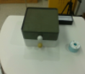
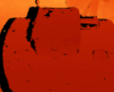
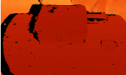
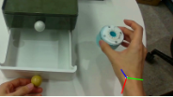













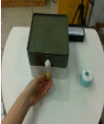
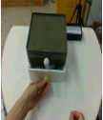
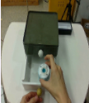
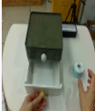

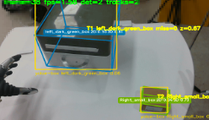
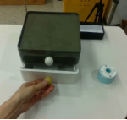
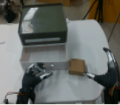
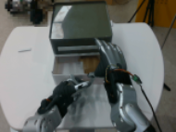
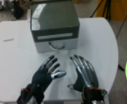

Inputs
2
Recover & Build
Object-Centric Keyframe Policy
3
In-Context Optimization Solver
(Sequential Refinement)
Success
Fail
RGB-D Observation
Language Instruction
Recover from Selected Video
Π⁰
Metric Depth
Wrist Motion
Rollout Rⁿ from Πₙ
Rollout Memory Mⁿ⁺¹
Open the drawer,
place the blue
cylinder inside,
then close it.
…
…
RGB (ego / third-person)
Π¹
Object + EE pose
RGB
Hand Action
…
Hand Motion
Object Poses
Gripper + proprioception
…
…
Offset
Mⁿ⁺¹ = Mⁿ ∪ {Rⁿ}
1
Generate &
Select Ego-centric Video
EE Pose
Object Pose
Π²
Frozen VLM Editor ΔΠⁿ
Keypoint Selection and Encoding
Offset
Insert
Diagnose
Edit
Ego-centric Video Candidates
…
…
• Success
…
• Alignment
• Infeasible
• Keep
• Align
• Offset
• Insert
• Delete
1
2
3
Approach
…
VLM Scorer
(frozen)
……
Insert
Π³
Contact
Completion
Delete
…
…
Object-Centric Representation
⋮
Selected video
Validator + Projection ProjF
Π*
⋮
Object-Centric Re-ground
Bound / IK
…
…
…
Approach Clearance
…
Object-based alignment
Estimate Object Poses in New Scene
Re-ground Aligned Keyframes
Whole-Body Controller Tracking
Task Completion
4
Execution
(Frozen Policy)
Source-layout reconstruction of He et al., RoboReact (2026), Figure 2, p. 3 · Native labels, panels and graph elements; photos, icons and equation strip remain raster · Private user-requested adaptation
Notes:
{
"paper_title": "RoboReact: Agentic Skill Distillation from Generated Egocentric Videos for Generalizable Whole-Body Manipulation",
"paper_url": "https://arxiv.org/abs/2608.03387v2",
"pdf_url": "https://arxiv.org/pdf/2608.03387v2",
"figure": "Figure 2",
"page": 3,
"license": "arXiv non-exclusive distribution license; no open reuse license verified. Private user-requested adaptation, not permission for public redistribution. https://arxiv.org/licenses/nonexclusive-distrib/1.0/",
"status": "figure_recreation",
"notes": "Reconstructed from actual original figure pixels. Original panel arrangement, labels, colors, graph progression and photo panels retained closely. Panels, ordinary labels, graph nodes and connections are native editable objects; photos, decorative icons, compact formula strips and diagnostic overlays remain raster crops. Font and curve geometry approximated. Original figure is a single 2256×1000 raster in the PDF, not extractable vector artwork.",
"caption": "Overview of RoboReact.",
"source_bbox_pdf_points": [
54,
54.003,
557.9904,
277.403
],
"visual_inspection": "Source PDF page 3 and extracted original 2256×1000 figure inspected 2026-10-09",
"omitted_details": [
"No omitted method stages or photographs",
"Some tiny diagnostic overlay text remains embedded in raster panels",
"Curve curvature, exact fonts and individual dash lengths approximated"
],
"raster_details": [
"17 photographic/depth/pose source panels retained as individual crops; their pixel contents and diagnostic overlays are not editable",
"12 decorative source icon/mark crops remain raster",
"1 mathematical editor-update equation strip remains raster; its symbols are not editable",
"All four blue iteration arrows and the large orange execution arrow are native freeform paths",
"Policy graph nodes/edges use native shapes/connectors; small curves and dash spacing approximate the source"
]
}

