Slide 1



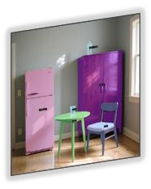
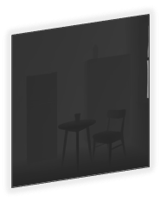


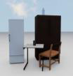
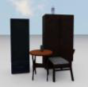
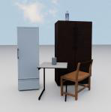









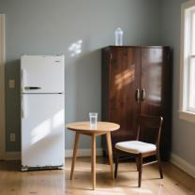




































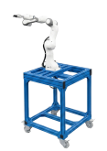





A. Simulated Scene Generation
[Dai et al. 2024]
Output
Input
Multi
-
view execution videos
Image sequences
GSAM
-
v2
BEHAVIOR
-
1K
Many
simulated scenes
DepAny
-
v2
Offline embodied dataset
CLIP, DINOv2, …
from RGB image
(HDF5: point clouds, robot actions…)
Simple subtasks
and description
BDDL configs, adjusted objects size
B. Graph
-
Based Task
Generation
Initial action flow, evolved action flow…
Single real
-
world RGB
image
◆
Module 3
Primitive Action
Policy Learning
◆
Module 2
Library
(
Behavior Cloning)
Task Decomposition
BDDL Config Generation
Approach
PointNet
Encoder
I want the robot to
◆
Module 4
Grasp
pick up the glass
.
For each subtask…
Move EEF …
High SR
Object Size Adjustment
Open
90%+
Move Base …
…
Causal Transformer
User query
◆
Module 1
◆
Module 5
Training Policy
Action MLP
Task Understanding
Action Flow Planning
IK controller
Evaluation
C. Self
-
Evolution via Agentic Feedback
D. Expert Demos Generation
Parameter Adjustment
Point Cloud
Domain
Sequence Modification
Randomization
Robot Actions
Self
-
Evolution
◆
Module 6
◆
Module 7
(
7
-
DoF
+
3
-
DoF
)
arm/gripper
mobile base
Robotic Safety Inspector
New sequence
Reasons
Robotic Task Supervisor
Notes:
{
"paper_title": "Affordance-Graphed Task Worlds: Self-Evolving Task Generation for Scalable Embodied Learning",
"paper_url": "https://arxiv.org/pdf/2602.12065v2",
"figure": "Figure 1",
"license": "unverified",
"notes": "Native extracted geometry and ordinary live text; source raster photos/icons are separately preserved. Source clipping and cross-format QA pending.",
"page": 2,
"status": "figure_recreation",
"source_sha256": "b674fcff9f5ac42c4f950ed94e2f37077468b383b4f77878a59060d4c212475d",
"source_crop_pdf_points": [
69,
64,
539,
305
],
"extraction_review": "pending; native geometry extraction is not visual fidelity approval",
"font_substitutions": "Arial or Courier New; source fonts recorded per text object",
"outlined_font_families": [
"CMM",
"CMSY",
"CMEX",
"CambriaMath"
],
"outlined_math_limit": "Selected source mathematical fonts preserved as editable glyph outlines, not live equation/text objects.",
"dash_fidelity": "PPTX uses the closest supported native preset, not exact PDF dash lengths. Draw.io retains interval lengths; PDF phase/caps are not preserved; zero intervals become 0.001 scene units.",
"extraction_warnings": [
"364 source clipping groups intersect crop; extracted paths require explicit clipping review",
"path crosses crop boundary: 0",
"path partially intersects raster inset: 1",
"path partially intersects raster inset: 19",
"path partially intersects raster inset: 67",
"path partially intersects raster inset: 73",
"path partially intersects raster inset: 140",
"path partially intersects raster inset: 254"
],
"ignored_invisible_text_spans": 0
}

